Slide 1
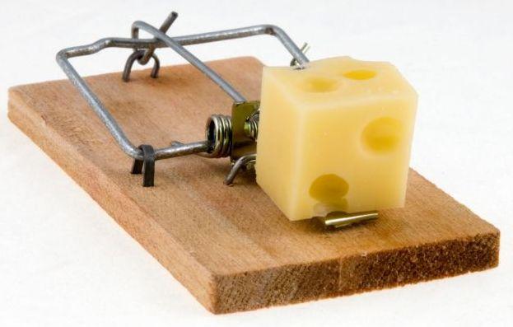
If Sinners Entice You
Proverbs 1:10-15

Slide 2
Proverbs 1:10-15
¹⁰ My son, if sinners entice you, Do not consent. ¹¹ If they say, “Come with us, Let us lie in wait to shed blood; Let us lurk secretly for the innocent without cause; ¹² Let us swallow them alive like Sheol, And whole, like those who go down to the Pit; ¹³ We shall find all kinds of precious possessions, We shall fill our houses with spoil; ¹⁴ Cast in your lot among us, Let us all have one purse”— ¹⁵ My son, do not walk in the way with them, Keep your foot from their path…

Slide 3
Point Made to Israel
Ex. 23:1-3 Not follow a multitude to do evil
Ex. 23:32-33 Applied to Israel & nations
Deut. 12:29-32 Warn against evil influence
Idolatry
Commit abominations
Give children to be burned in fire
2 Kgs. 17:7-17 Warning fulfilled

Slide 4
Principles Applied to All Evil
Psa. 1:1-2 Avoid evil, seek God’s law
Prov. 1:10f Impact of evil enticement
Prov. 4:10f Avoid way of evil ones
Applied to seductress (Prov. 5:7-10)
Applied to adultery (Prov. 6:20-29)
Applied to angry person (Prov. 22:24-25)
Prov. 24:1-2 General principle restated

Slide 5
Principle Applied to Church
Warned of fellowship with sin & error
2 Cor. 6:14f General principle stated
1 Cor. 5:7 Purge out leaven of evil
1 Cor. 5:9f Withdraw from brother in sin
1 Cor. 15:32f Evil companions corrupt
Applied to those denying resurrection
2 John 9-11 Not to accept those in error

Slide 6
Principle Is True Applied To...
Influence of immoral people
Influence of the bitter & wrathful
Influence of corrupt speech
Influence of denominational ideas
Influence of evil in the church
Influence of error among Christians

