Slide 1
LOVE:
Foundational for Family Success

Slide 2
LOVE - Introduced
Love is a defining point of God’s nature
1 Jn. 4:7, 8, 16 Repeat: “God is love”
God’s love is eternal in expression & planning
Love necessary to have fullness of God in us (Eph. 3:14-19)
Pre-eminence of love declared
Mark 12:28-34 Foundational to all service
Colossians 3:14 Bond of perfectness
1 Cor. 13:1-3, 13 Actions wasted without it

Slide 3
LOVE - Foundational in Family
Begins with love of husband towards his wife
Eph. 5:25f As Christ loved church & as self
Col. 3:19 Love & be not bitter against them
Gen. 29:20 Example of Jacob’s love for Rachel
Prov. 5:18f “Be ravished always with her love…”
Song Sol. 8:7 All possessions not equal to value of love
Wives to love in response to husband’s love
Titus 2:4 Wives taught to love own husbands
Parents lead in love & children respond
Mk. 5:21-22 Jairus was ruler, but begged for daughter
Mt. 15:21-27 Canaanite woman endured humiliation
Parental love seen as natural affection in Bible
Children respond with love & honor that sets future path

Slide 4
LOVE - Defined (1 Corinthians 13:4-7)
⁴ Love suffers long and is kind; love does not envy; love does not parade itself, is not puffed up; ⁵ does not behave rudely, does not seek its own, is not provoked, thinks no evil; ⁶ does not rejoice in iniquity, but rejoices in the truth; ⁷ bears all things, believes all things, hopes all things, endures all things.

Slide 5
LOVE - Defined
Longsuffering (Eph. 4:1-2)
Kindness (Rom. 12:10; 2 Pet. 1:5-7)
Not envious (Gal. 5:25 - 6:2)
Selfless, not self-centered (Jn. 15:13; Phil. 2:1f)
Absent rash anger (Col. 3:8-14; Jas. 1:19-20)
Not vengeful (Matt. 5:43-48; Rom. 12:19-21)
Associated with truth, not evil (Rom. 12:9; 13:9)
Keeps commands of God (Jn. 14:15, 23; 1 Jn. 5:3)
Lasting despite trials (Rom. 8:35)

Slide 6
LOVE - Defined
Exemplified in…
Longsuffering
Kindness
Not envious
Selfless, not self-centered
Absent rash anger
Not vengeful
Associated with truth, not evil
Lasting despite trials
Jacob & Rachel
Hannah & Samuel
Ruth & Naomi

Slide 7
LOVE – Its Absence (2 Timothy 3:1-5)
¹But know this, that in the last days grievous times shall come. ²For men shall be lovers of self, lovers of money, boastful, haughty, railers, disobedient to parents, unthankful, unholy, ³without natural affection, implacable, slanderers, without self-control, fierce, no lovers of good, ⁴traitors, headstrong, puffed up, lovers of pleasure rather than lovers of God; ⁵holding a form of godliness, but having denied the power therefore. From these also turn away.

Slide 8
Absence of Bible Love Breeds Evil: Examination of 2 Timothy 3:1-5
Character producing “grievous times”
Love present was opposite of Bible love:
“Lovers of Self” (beginning of problem)
“Lovers of Money”
“No Lovers of Good”
“Lovers of Pleasure” rather than loving God
Absence of love allows pride & hate to rule
Given to violence – expression of inner hatred
Given to hedonism – use of others for selfish lusts
Ignorant of & antagonistic to truth – teacher of love
People of this character are headed to self-destruction
Presence of selfless love in family sets path of life

Slide 9
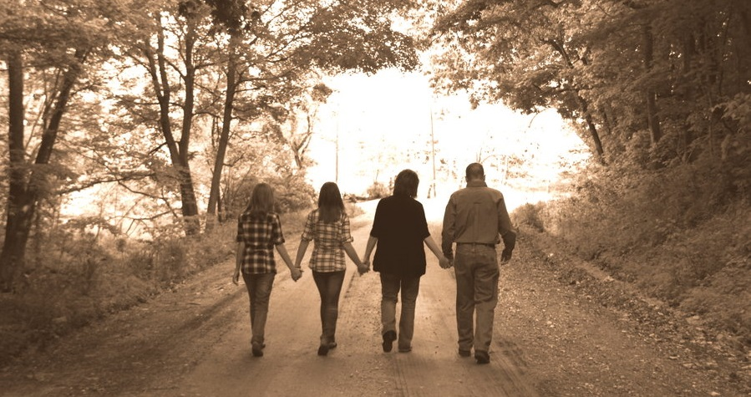
Are Our Families Characterized by Love or a Lack of It?

