Slide 1
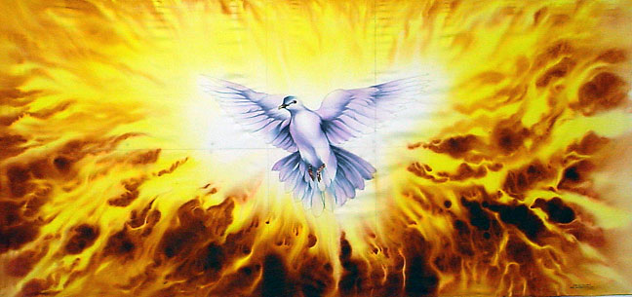
The Person & Work of the Holy Spirit
Holy Spirit in the Old Testament

Slide 2
Holy Spirit’s Work Is:
Instructing & Blessing

Slide 3
Blessings Brought by Spirit
Holy Spirit is said to have brought blessings upon Israel from beginning
  Haggai 2:4-5 Spirit with Israel in exodus
  Isaiah 63:7-14 Spirit blesses in days of old
  Isaiah 32:13-15 Spirit blesses in restoration
  Isaiah 44:1-5 “Spirit” parallel to “blessing”
  Psalm 143:4-10 “My spirit” vs. “Thy Spirit”

Slide 4
Holy Spirit & Instruction to Israel

Slide 5
Spirit: Source of Instruction
Instruction to Israel is attributed to Holy Spirit
  Nehemiah 9:5f God directs Israel in history
  Nehemiah 9:16f Spirit instructed Israel
  Micah 3:7-8 Spirit revealed, not diviners
  Isaiah 63:10 Rebel at word = Spirit grieved
    compare Ephesians 4:30
  Zechariah 7:11-12 Law spurned of Spirit
Charge of Stephen confirms (Acts 7:51-53)
NT says OT revelation of Spirit (2 Pet. 1:21)

Slide 6
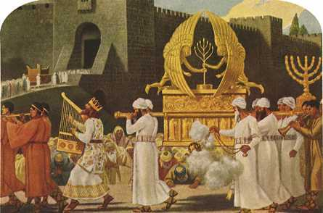
Holy Spirit & The Temple

Slide 7
Dedication of Temple in 1 Kings 8
All had been built according to plan
Cloud filled the house (vs. 10-11)
Solomon prays in dedication (vs. 12-53)
Repeatedly calls it God’s house or dwelling
Yet, not literal dwelling place (vs. 27-30)
What is meant by God “dwelling” in temple?
Place symbolized God’s abiding with Israel through blessings & instruction (vs. 31-53)

Slide 8
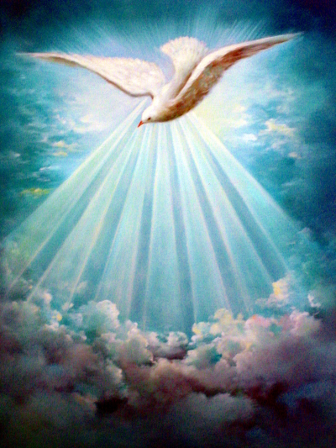
Holy Spirit Works with People

Slide 9

Holy Spirit & Messianic Promise

Slide 10
Spirit “With” & “Upon” Messiah
Isaiah 61:1f Spirit to anoint Messiah
  Fulfillment seen in Luke 4:16-20
Isaiah 11:1-2 Spirit of Jehovah on Him
Isaiah 42:1f Spirit to be upon Messiah
  Fulfillment declared in Matthew 12:15-28
Isaiah 59:20-21 Spirit evidenced by words
Point of prophecy speaks to divine unity in purpose & action in Messiah’s work

Slide 11
Holy Spirit Evidenced by Coming of the New Kingdom
Beginning at the baptism of Jesus, Spirit gave testimony of Jesus as the Christ
Perfect divine unity in purpose and action seen throughout Jesus’ earthly ministry
Zenith reached in resurrection & ascension of Christ to rule on throne in heaven
Pouring forth of Spirit to be evidence for all
  Joel 2:28-32 fulfilled in Acts 2:16f

Slide 12
Pouring Forth of Spirit on Pentecost
How do we know kingdom & salvation promised in OT are present reality?
“THIS (actions recorded on Pentecost)
IS
THAT” (promise given in Joel 2)
If “this is that”
Then “that is this”
So, time for coming of salvation & kingdom of Christ is identified!

Slide 13
Salvation & Kingdom of Christ Now Present Reality
Salvation & Kingdom to Come with Spirit
Spirit Came on Pentecost
Spirit’s Coming Proved Present Reality of
Salvation & Kingdom

