Slide 1
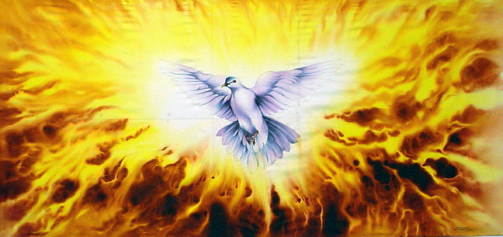
The Person & Work of the Holy Spirit
Holy Spirit’s Work in Revelation

Slide 2
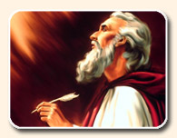
Old Testament Work of Spirit in Revelation

Slide 3
Example of Balaam
Numbers 22 - 24 Note control of message
Balaam seeks hire of wrong (2 Pet. 2:15)
Cannot go beyond word of Jehovah (22:18)
May speak only word God speaks (22:35)
To speak word God puts in mouth (22:38)
God puts 3 blessings in Balaam’s mouth
“I cannot go beyond the word of Jehovah to do either good or bad of my own mind”

Slide 4
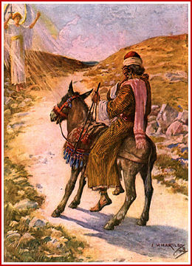
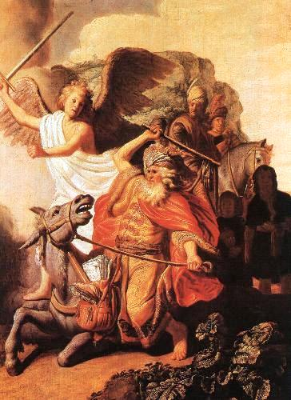
If God had absolute control over the words of a donkey...
...God can & does control the words of His revelation

Slide 5
Exemplified in Call of Prophets
Isaiah 6 Mouth of prophet cleansed by God
Isaiah 51:16 Confirms guidance of words
Ezekiel 2-3 Spirit entered = Speak for God
All words of God spoken regardless of result
Ezekiel 33 Watchman spoke word given
Jeremiah 1:4-10 God readies mouth & words
Jeremiah 36:2-8 All words of God recorded
Words of God = Spirit’s work = Written O.T.

Slide 6
Concerning Prophesy of Salvation in Old Testament
1 Peter 1:10 -12 Explains the Spirit’s work
Prophets did not always understand words
Words were result of the Spirit within them
Message not for present time, but fullness
Ultimately made known through Gospel
Holy Spirit was source of messages of prophesy and fulfillment

Slide 7
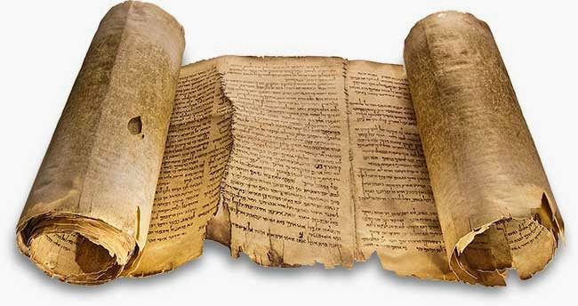
Holy Spirit Inspiration & New Testament

Slide 8
Promise of Comforter: John 14-16
Jesus foretold Spirit’s work before betrayal
Would cause apostles to remember words of Jesus while on earth (14:26)
Would “bear witness” of Christ (15:26)
Would convict the world of sin… (16:8-10)
Would guide apostles to all truth (16:12-13)
Result: Complete revelation of truth given to apostles & confirmed by Holy Spirit

Slide 9
1 Corinthians 2:6-13
God’s hidden wisdom revealed by the Spirit
Spirit was able to know the mind of God
Apostles received Spirit in order to make known the mind of God to others
Revelation not made known through words taught by man’s wisdom
Made known by combining spiritual things with spiritual words
Spirit’s record is inspired: Verbal & Plenary

Slide 10
Ephesians 3:3-7
Gospel was previously a mystery known only to God
Made known by revelation of the Spirit
May be understood by reading the words written & perceiving things same as writer
Message of apostles & prophets was result of their inspiration by the Holy Spirit
Spirit’s inspired message is understandable

Slide 11
Inspired Revelation Is Pattern

Slide 12
All Spoken Constitutes Pattern
1 Chron. 28:11-12 Pattern given for temple
Same as with tabernacle (Exodus 25:9, 40)
Pattern composed of all instructed by Spirit
2 Timothy 1:8-14 Pattern of sound words
Right handling of all Scripture (2:15; 3:16f)
Pattern given OT & NT not to be changed
Deut. 4:2 & 12:32 Not to add or subtract
2 John 9 Not go beyond doctrine of Christ
Revelation 22:18-19 Same instruction

Slide 13
Conclusion
God provided for man to know His will
Holy Spirit revealed will by inspiring man
One who was inspired spoke the message under the control of the Holy Spirit
Words chosen were determined by Spirit
God insured accuracy & content of message
Product is revelation which says exactly what God meant so we can understand

