Slide 1
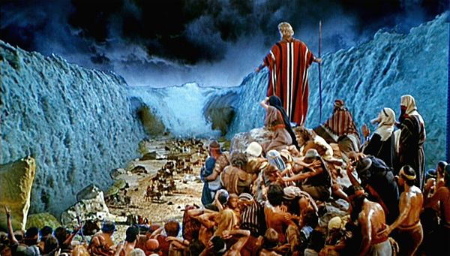
The Person & Work of the Holy Spirit
Miraculous Action in Scripture

Slide 2
The Holy Spirit’s Work Is:
Instructing
Anointing - appoint to a work
Revealing - inspire word taught
Confirming - show divine origin
Blessing

Slide 3
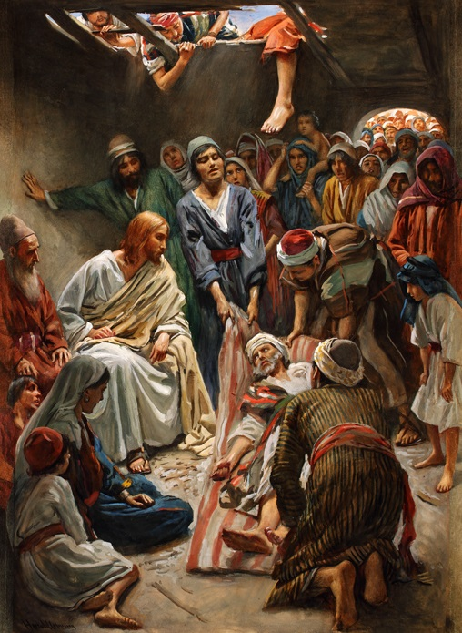
Defining the Terms
Romans 15:18-19
Signs
Wonders
Miracles

Slide 4
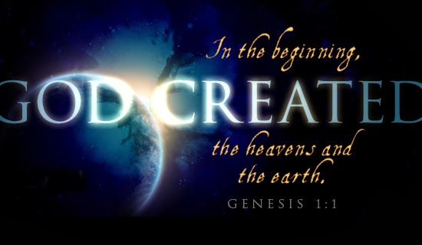
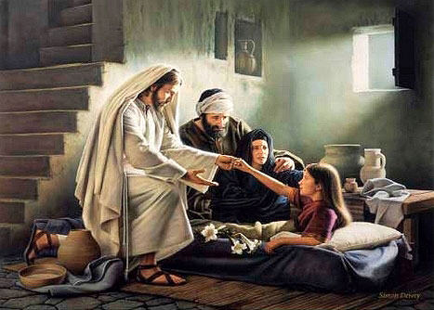
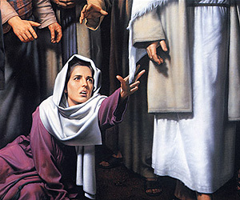
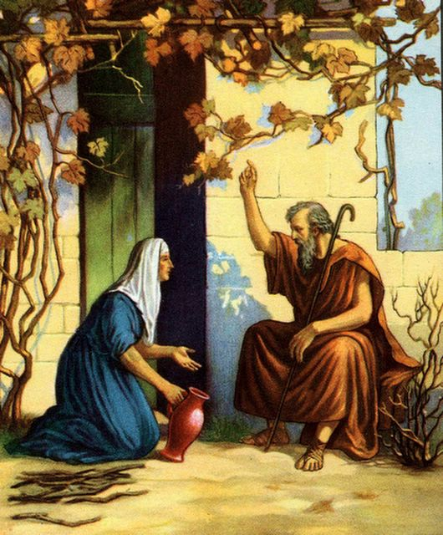
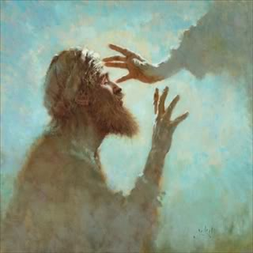
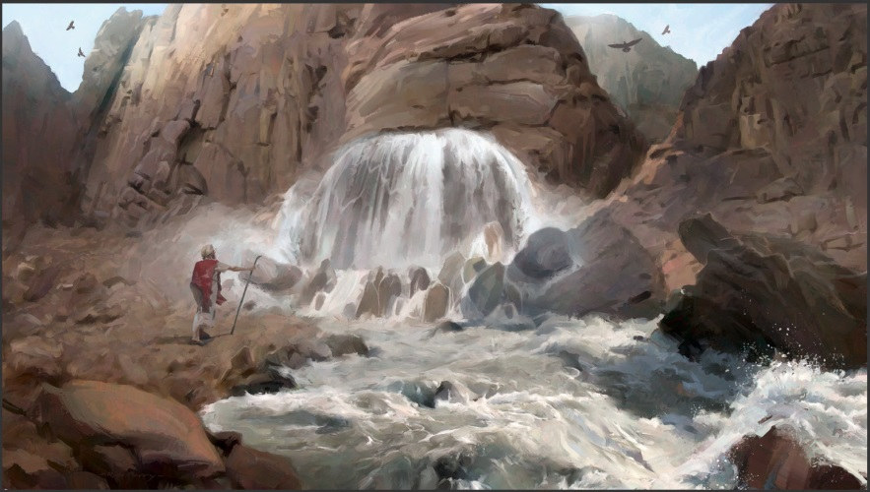
Cases of Miracles in Bible

Slide 5
Creation
Psalm 33:6-9 Spoken into completed being
Hebrews 11:3 Framed by word of God
Repeated statements of Genesis 1 are key:
“And God said… and it was so”
“Let there be _____ and there was _____”
“And God saw that it was good”
“And God saw everything that He had made and, behold, it was very good. And there was evening and there was morning, the sixth day. And the heavens and the earth were finished...”

Slide 6
Exodus, Wandering & Victory
Plagues brought upon Egypt (Exodus 7-12)
Water to blood Frogs Lice Flies
Pestilence on cattle Boils Hail Locusts
Darkness upon Egypt Death of firstborn
Led, fed & sustained people in wilderness
God delivered by dividing the Red Sea (Exod. 14)
God provided manna, quail & water throughout
Victory given to Israel by power of God
Walls of Jericho made to fall (Josh. 6)
Sun stood still as enemies pursued (Josh. 10:12f)

Slide 7
During Time of Prophets
Prophet of Judah (1 Kings 13:1-6)
Miracles worked by Elijah (1 Kings)
Restore widow’s food & resurrect her son (17:8-24)
Calls for fire upon sacrifice at Carmel (18:37f)
Miracles worked by Elisha (2 Kings)
Division of Jordan River to cross (2:7-14)
Man buried with Elisha is raised (13:20f)
Healing & sign given to Hezekiah (2 Kings 20)

Slide 8
In Earthly Ministry of Jesus
Multiplied food (Matt. 14:15f 5k; Matt. 15:32f 4k)
Healed the sick (Matt. 4:23f; 9:35; Luke 4:40)
Made blind to see (John 9: Matt. 9:27f; 20:30f)
Lepers made whole (Mark 1:40f; Luke 17:12f)
Bodies made whole (Mark 3:1f; Luke 22:50f)
Raised the dead (Luke 7:11f; 8:41f; John 11:1f)
Cast out demons (Luke 4:31f; 8:26f; 11:14f)
Over natural world (Matt. 8:23f; John 6:16f)

Slide 9
During Apostolic Time
Miracles of apostles foretold (Mark 16:15-20)
Lame man cured at temple (Acts 3:2-10)
Aeneas healed of palsy (Acts 9:32-35)
Dorcas raised from dead (Acts 9:36-42)
Crippled man healed at Lystra (Acts 14:8-10)
Demon cast out of woman (Acts 16:16-18)
Special miracles by Paul (Acts 19:11-12)
Eutychus raised from dead (Acts 20:9-12)
Unharmed by snake bite & healings (Acts 28:3-9)

Slide 10
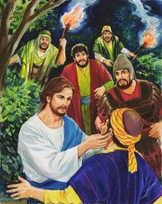
Nature of Bible Miracles

Slide 11
Action of Bible Miracles Was...
INSTANTANEOUS
Did not start & slowly develop over time
Witnesses saw both start & full effect of action
BEYOND NATURAL EXPLANATION
Witnesses repeatedly said different from norm
Action did not conform to physical processes
No beginning by God & continuing by nature
EVIDENCE TO UNBELIEVER
Not done to confirm believers or give 2nd grace

Slide 12
Nature of Bible Cases of Healing
Characteristics of New Testament Miracles of Healing
1. Healed all manner of diseases
2. There were no failures
3. There were no relapses after healing took place
4. Miracle not conditioned on faith of one to be healed
5. Subject was completely and perfectly healed
6. Healing took place immediately
7. Nature of illness healed served as a sign to witness
8. No testimonial given about healing done elsewhere
9. No question about genuineness of miracle performed
--- edited from material by Roy Cogdill and James Bales ---

Slide 13
Among Pentecostal World
Say any improbable action is a “miracle”
Say miracles depend on faith of the subject
Say miracles sometimes occur over long period
Say miracles happen according to natural processes created (providence not miraculous)
Pervert passages of Scripture to bolster their claims (Matthew 17:14f, Mark 8:23f…)

Slide 14
Hill Roberts As posted on Ferrell Jenkins web site
“The parting of the Red Sea was a miracle. It was not instantaneous. It was produced by forces of nature acting in accord with God’s fiat over a span of six hours (Exodus 14:21). How many other examples do you want? How about a flood rain of forty days? How about God giving the ten commandments over forty days, leading Hebrews in the wilderness 38 years just to kill them, marching them around Jericho for seven days, God conquering Canaan over many years under Joshua... Never in the Bible does God argue for His nature on the basis of how fast He created or does anything. The Biblical argument is that God demonstrates His divinity because He created — period” (Response by Hill Roberts to the Open Letter).

Slide 15
Shane Scott (In His Response to Open Letter)
“The next step in the argument is that God’s work in creation must also follow the same pattern of instantaneous action unexplainable by natural law. This extreme position is seriously flawed from a number of biblical perspectives…”
“The definition of miracles as instantaneous… does not apply to many Bible miracles.”
Goes on to deny instantaneous nature of the flood and healing of the blind man in Mark 8.

Slide 16
Colly Caldwell (In His Defense of Shane Scott)
“While it is understandable that without some of this background one would see brother Scott as dogmatic about this topic, he is not. Although he does wrestle with correlating Genesis 1 and some statements in Genesis 2 with the literal day position, he has never questioned instantaneous creation by God of all that God created” (from Truth Magazine, Response to Connie W. Adams).

Slide 17
Who Said the Following?
"The Hebrew word yohm, translated 'day,' can mean different lengths of time. Among the meanings possible, William Wilson's Old Testament Word Studies includes the following: 'A day is frequently put for time in general, or for a long time; a whole period under consideration . . . Day is also put for a particular season or time when any extraordinary event happens.' This last sentence appears to fit the creative days, for certainly they were periods when extraordinary events were described as happening. It also allows for periods much longer than 24 hours.”
“Life-How did it get here? By evolution or by creation?” (Watchtower Bible and Tract Society of Pennsylvania, 1985)
Roman Catholic Church & many more take same position

Slide 18
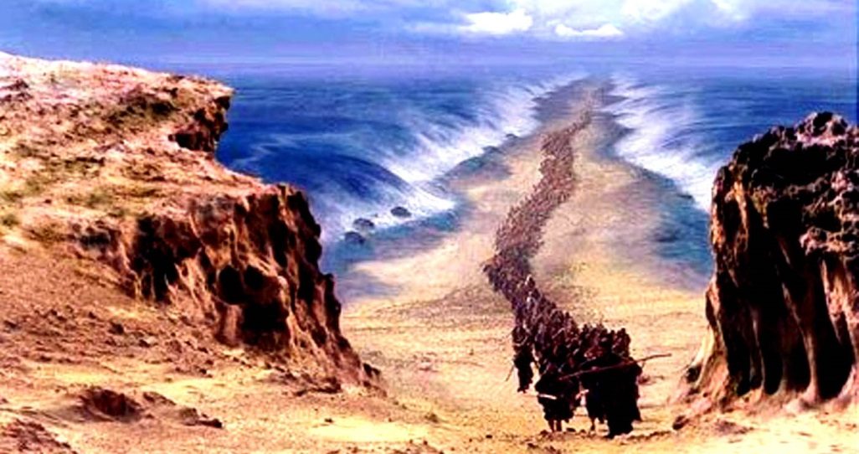
If We Take False View of Confirmation
We Are Led to False View of Revelation

