Slide 1
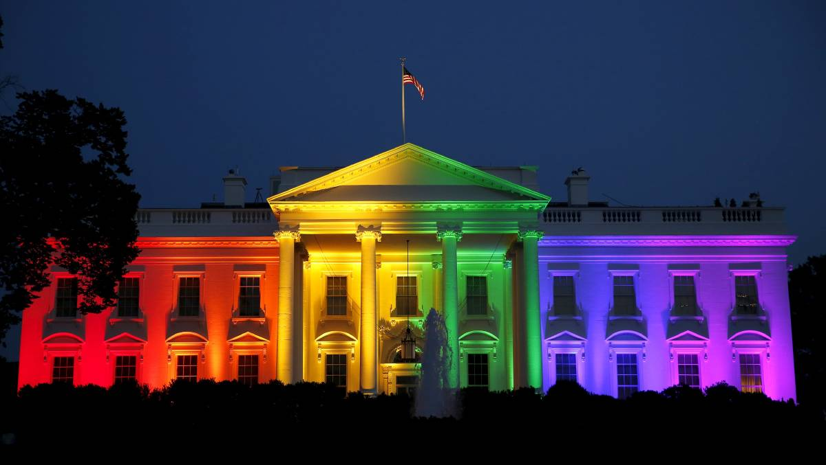
A Growing Tolerance of Immorality
Psalm 50:16-21

Slide 2
Psalm 50:16-21
¹⁶ But to the wicked God says: “What right have you to declare My statutes, or take My covenant in your mouth, ¹⁷ seeing you hate instruction and cast My words behind you? ¹⁸ When you saw a thief, you consented with him, and have been a partaker with adulterers. ¹⁹ You give your mouth to evil, and your tongue frames deceit. ²⁰ You sit and speak against your brother; you slander your own mother’s son. ²¹ These things you have done, and I kept silent; you thought that I was altogether like you; but I will rebuke you, and set them in order before your eyes.

Slide 3
Principle Established
Identified with wicked by tolerating evil
Saw a thief and consented with him
Made a partaker with adulterers
How? By tolerating evil rather than rebuking it
Proverbs speak to the same principle
17:15 Justifying the wicked is abomination
24:24 One covering for wicked will be cursed
28:4 Praising the wicked = Forsaking the law
Such actions aid wicked (Ezek. 13:22)

Slide 4
Greco-Roman World:
The New Testament Age
“There was no strong body of opinion against immorality. To the Greco-Roman world immorality in sexual matters was not immorality; it was established custom and practice” (Barclay, 28)
Sadly, Modern America Is Taking Same Path to Immorality

Slide 5
Regardless of the Realm, “Sin is a Reproach to Any People”

Slide 6
Seen in Israel & Judah
Rule for any nation: Proverbs 14:34
Judah tolerated it at times (1 Kings 14:22-24)
Later put it away (1 Kings 15:11-12; 22:46)
Law tolerated none of such (Deut. 23:17)
Israel destroyed for continual tolerance of it (2 Kings 17:7-18)
Hosea 13:9 Destroyed self, but help was from God
Death sentence to assure “that there be no wickedness among you” (Lev. 20:10-16)

Slide 7
Seen in the Church
Ideal of purity stated: 2 Cor. 11:2-3 ^{ASV}
Cases of immorality tolerated in churches
Rev. 2:20-23 Jezebel tolerated at Thyatira
1 Cor. 5:1-2 Puffed up in receiving evil doer
1 Cor. 15:33 Primary application to church
In every case of evil present in any church, instruction was always to purge it out
When done as God commands, purity brings the best for all involved (1 Cor. 5:3-8)
Fellowship of evil is unequal yoke (2 Cor. 6:14f)

Slide 8
Seen in the Family
Purity Is for Good of Family: 1 Pet. 3:1-7
Tolerance of immorality devastates a family
Matthew 5:32
Matthew 19:9
Influence of immorality brings more if no rebuke
Consider demands of Bible love (Rom. 12:9)
“Abhor that which is evil”
“Cleave to that which is good
No true love present if tolerate immorality

Slide 9
Seen in the Individual
Personal Purity Brings Blessings: Prov. 11:19
God’s law never given for harm, but man’s good
Deut. 6:24 “For our good always”
Prov. 19:23 Fear God = “Will abide in satisfaction”
1 Pet. 3:10-12 He who would love life & see good…
Destructive effects of sin are evident
Psalm 34:21 “Evil shall slay the wicked”
Rom. 1:22-27 Dishonor self, receive recompense due
2 Pet. 2:9, 12-14 Destruction is in time and eternity
Immorality brings one to disgrace & suffering

Slide 10
Must Not Conceal Sin, But Must Expose & Rebuke It
Dealt with severely in O.T. (Deut. 13:6-11)
“you shall not consent to him or listen to him”
“nor shall your eye pity him”
“nor shall you spare him or conceal him”
“your hand shall be first against him”
Same principle seen in N.T.
Romans 1:32
Ephesians 5:7-12

Slide 11
Do We Have a Growing Tolerance of Evil?
What do we do when we know of evil…
In the society around us?
In the local church?
In our family?
In our friends?
Do we:
Consent with sinner or give ear to his complaint?
Does our eye pity him?
Do we spare him or conceal him?
Repent, Cease the tolerance & Stand for Truth!

