Slide 1
Go to Shiloh & See
Jeremiah 7:1-15

Slide 2
Jeremiah 7:1-15
¹ The word that came to Jeremiah from the Lord, saying, ² “Stand in the gate of the Lord’s house, and proclaim there this word, and say, ‘Hear the word of the Lord, all you of Judah who enter in at these gates to worship the Lord!’” ³ Thus says the Lord of hosts, the God of Israel: “Amend your ways and your doings, and I will cause you to dwell in this place. ⁴ Do not trust in these lying words, saying, ‘The temple of the Lord, the temple of the Lord, the temple of the Lord are these.’ ⁵ For if you thoroughly amend your ways and your doings, if you thoroughly execute judgment between a man and his neighbor, ⁶ if you do not oppress the stranger, the fatherless, and the widow, and do not shed innocent blood in this place, or walk after other gods to your hurt, ⁷ then I will cause you to dwell in this place, in the land that I gave to your fathers forever and ever.

Slide 3
⁸ “Behold, you trust in lying words that cannot profit. ⁹ Will you steal, murder, commit adultery, swear falsely, burn incense to Baal, and walk after other gods whom you do not know, ¹⁰ and then come and stand before Me in this house which is called by My name, and say, ‘We are delivered to do all these abominations’? ¹¹ Has this house, which is called by My name, become a den of thieves in your eyes? Behold, I, even I, have seen it,” says the Lord. ¹² “But go now to My place which was in Shiloh, where I set My name at the first, and see what I did to it because of the wickedness of My people Israel.¹³ And now, because you have done all these works,” says the Lord, “and I spoke to you, rising up early and speaking, but you did not hear, and I called you, but you did not answer, ¹⁴ therefore I will do to the house which is called by My name, in which you trust, and to this place which I gave to you and your fathers, as I have done to Shiloh. ¹⁵ And I will cast you out of My sight, as I have cast out all your brethren—the whole posterity of Ephraim.

Slide 4
⁸ “Behold, you trust in lying words that cannot profit. ⁹ Will you steal, murder, commit adultery, swear falsely, burn incense to Baal, and walk after other gods whom you do not know, ¹⁰ and then come and stand before Me in this house which is called by My name, and say, ‘We are delivered to do all these abominations’? ¹¹ Has this house, which is called by My name, become a den of thieves in your eyes? Behold, I, even I, have seen it,” says the Lord. ¹² “But go now to My place which was in Shiloh, where I set My name at the first, and see what I did to it because of the wickedness of My people Israel.¹³ And now, because you have done all these works,” says the Lord, “and I spoke to you, rising up early and speaking, but you did not hear, and I called you, but you did not answer, ¹⁴ therefore I will do to the house which is called by My name, in which you trust, and to this place which I gave to you and your fathers, as I have done to Shiloh. ¹⁵ And I will cast you out of My sight, as I have cast out all your brethren—the whole posterity of Ephraim.

Slide 5
Examining the Context
Lord tells Judah to amend their ways (1-3)
They had false confidence in the Temple (4)
Their existence dependent on “thoroughly” changing their ways (5-7)
They trusted in lying words to no profit (8)
Despite evil, thought temple made safe (9-10)
Temple had become a den of thieves (11)
Told: Go to Shiloh & see what happened (12-15)

Slide 6
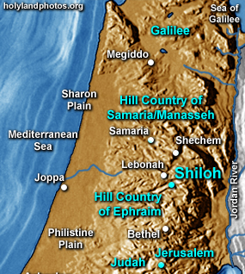
Locating Shiloh

Slide 7
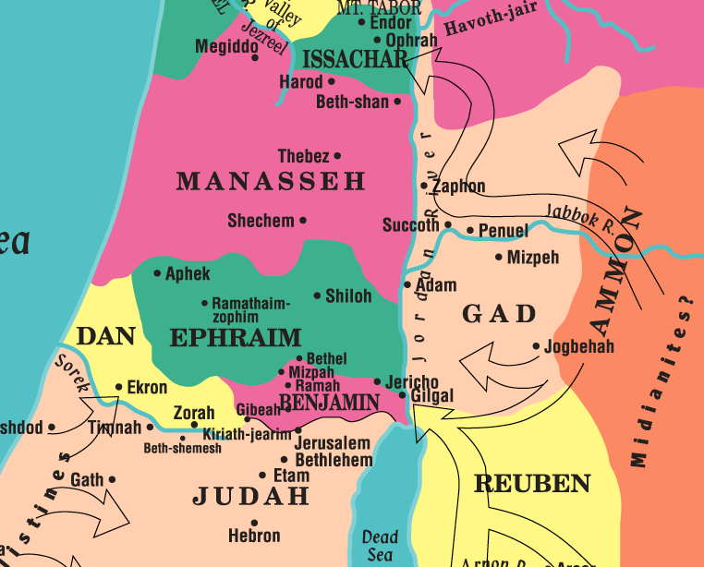

Slide 8
Examining the Context
Lord tells Judah to amend their ways (1-3)
They had false confidence in the Temple (4)
Their existence dependent on “thoroughly” changing their ways (5-7)
They trusted in lying words to no profit (8)
Despite evil, thought temple made safe (9-10)
Temple had become a den of thieves (11)
Told: Go to Shiloh & see what happened (12-15)
What was the history to be remembered?

Slide 9
The History of Shiloh
Shiloh was original place in land of Israel for tabernacle with the ark of covenant (Joshua 18:1)
1 Sam. 1:3 Elkanah & Hannah went for worship yearly
1 Sam. 1:9f Hannah prayed there for son
1 Sam. 1:24 Samuel dedicated to serve the Lord there
1 Sam. 3:1-18 Lord revealed Himself to Samuel there
1 Sam. 3:21 Lord continued to give His word to Samuel
1 Sam. 4:1-11 Ark taken to use in battle & captured
Eli & sons died; Shiloh ceased to be memorial place

Slide 10
Modern Shilohs of False Confidence
Past work in Lord’s service (Matt. 7:21-23)
Belief that one is beyond falling (1 Cor. 10:12)
Riches as security of future (Luke 12:15-21)
Faithful heritage of family (Jn. 8:31-33, 39-44; Ezek. 18:5-13, 20)
Churches with a history for past soundness (Rev. 3:1-3)

