Slide 1
Knitting Hearts in Love
Colossians 2:1-10

Slide 2
Colossians 2:1-10
¹ For I want you to know what a great conflict I have for you and those in Laodicea, and for as many as have not seen my face in the flesh, ² that their hearts may be encouraged, being knit together in love, and attaining to all riches of the full assurance of understanding, to the knowledge of the mystery of God, both of the Father and of Christ, ³ in whom are hidden all the treasures of wisdom and knowledge. ⁴ Now this I say lest anyone should deceive you with persuasive words. ⁵ For though I am absent in the flesh, yet I am with you in spirit, rejoicing to see your good order and the steadfastness of your faith in Christ. ⁶ As you therefore have received Christ Jesus the Lord, so walk in Him, ⁷ rooted and built up in Him and established in the faith, as you have been taught, abounding in it with thanksgiving. ⁸ Beware lest anyone cheat you through philosophy and empty deceit, according to the tradition of men, according to the basic principles of the world, and not according to Christ. ⁹ For in Him dwells all the fullness of the Godhead bodily; ¹⁰ and you are complete in Him, who is the head of all principality and power.

Slide 3
Colossians 2:1-10
¹ For I want you to know what a great conflict I have for you and those in Laodicea, and for as many as have not seen my face in the flesh, ² that their hearts may be encouraged, being knit together in love, and attaining to all riches of the full assurance of understanding, to the knowledge of the mystery of God, both of the Father and of Christ, ³ in whom are hidden all the treasures of wisdom and knowledge. ⁴ Now this I say lest anyone should deceive you with persuasive words. ⁵ For though I am absent in the flesh, yet I am with you in spirit, rejoicing to see your good order and the steadfastness of your faith in Christ. ⁶ As you therefore have received Christ Jesus the Lord, so walk in Him, ⁷ rooted and built up in Him and established in the faith, as you have been taught, abounding in it with thanksgiving. ⁸ Beware lest anyone cheat you through philosophy and empty deceit, according to the tradition of men, according to the basic principles of the world, and not according to Christ. ⁹ For in Him dwells all the fullness of the Godhead bodily; ¹⁰ and you are complete in Him, who is the head of all principality and power.

Slide 4
Knitting Hearts in Love
Uniting Souls in Purpose
Colossians 2:1-10
1 Samuel 17:55 - 18:1

Slide 5
1 Samuel 17:55 - 18:1
⁵⁵ When Saul saw David going out against the Philistine, he said to Abner, the commander of the army, “Abner, whose son is this youth?” And Abner said, “As your soul lives, O king, I do not know.” ⁵⁶ So the king said, “Inquire whose son this young man is.” ⁵⁷ Then, as David returned from the slaughter of the Philistine, Abner took him and brought him before Saul with the head of the Philistine in his hand. ⁵⁸ And Saul said to him, “Whose son are you, young man?” So David answered, “I am the son of your servant Jesse the Bethlehemite.” ^{18:1} Now when he had finished speaking to Saul, the soul of Jonathan was knit to the soul of David, and Jonathan loved him as his own soul.

Slide 6
1 Samuel 17:55 - 18:1
⁵⁵ When Saul saw David going out against the Philistine, he said to Abner, the commander of the army, “Abner, whose son is this youth?” And Abner said, “As your soul lives, O king, I do not know.” ⁵⁶ So the king said, “Inquire whose son this young man is.” ⁵⁷ Then, as David returned from the slaughter of the Philistine, Abner took him and brought him before Saul with the head of the Philistine in his hand. ⁵⁸ And Saul said to him, “Whose son are you, young man?” So David answered, “I am the son of your servant Jesse the Bethlehemite.” ^{18:1} Now when he had finished speaking to Saul, the soul of Jonathan was knit to the soul of David, and Jonathan loved him as his own soul.

Slide 7
Love & Unity Are Built from a Common Cause
Jonathan & David shared the same cause
David had gone forth to battle & defeat Goliath
Jonathan had also battled Philistines (1 Sam. 14)
Saul’s self-interest brought on slander & hostility
Saul angry at both when victories brought praise
But their souls were knit together in love: Why?
Devotion to same cause brings unity of spirit
“…stand fast in one spirit, with one soul striving for the faith of the gospel; and in nothing affrighted by the adversaries…” (Phil. 1:27-28)
Sunathleo = Strive together, as on the same team

Slide 8
Love Born of a Unity of Purpose in Jonathan & David
1 Sam. 18:1 Their souls were “knit” together
1 Sam. 19:1 Jonathan delighted greatly in David
1 Sam. 19:4-5 Backed innocent David over father
1 Sam. 20:4 Servant’s heart → Meet other’s desire
1 Sam. 20:17 Loved him as he loved his own soul
1 Sam. 20:42 God was between them & future seed
1 Sam. 23:16 Strengthened hands “in God”
2 Sam. 1:25-27 David lamented at Jonathan’s death
Elements that knit them together will knit us as well

Slide 9
Applying a Love of Unity in Purpose to Our Own Lives
With Brethren in Christ in Local Church
3 John 1-4, 8 Example of John and Gaius
Philippians 2:19-22 Bond of Paul and Timothy
Philemon 20-21 Paul had confidence in Philemon to act
Ephesians 5:21 “Submitting … in the fear of God”
Within Our Families
1 Peter 3:1-7 “…won by conduct… heirs together…”
Ephesians 5:25 Husbands – “just as Christ also loved”
Colossians 3:18 Wives – “as is fitting in the Lord”
Eph. 6:4 Fathers – “in training & admonition of Lord”
Col. 3:20 Children – “this is well pleasing to Lord”

Slide 10
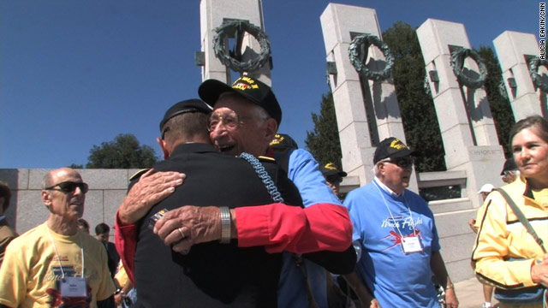
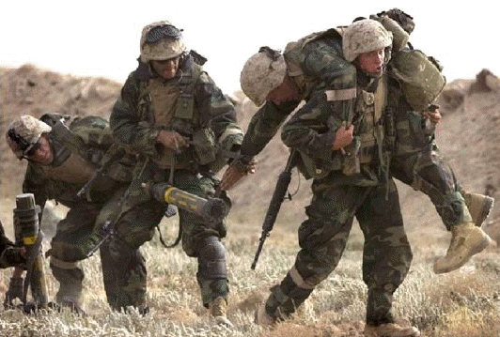
A Lasting Bond Is Built on
Committed Unity of Purpose

