Slide 1
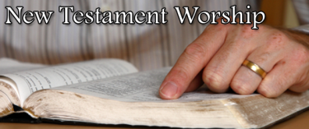
Acceptable Worship in N.T. – Defined
John 4:19-24

Slide 2
John 4:19-24
¹⁹ The woman said to Him, “Sir, I perceive that You are a prophet. ²⁰ Our fathers worshiped on this mountain, and you Jews say that in Jerusalem is the place where one ought to worship.” ²¹ Jesus said to her, “Woman, believe Me, the hour is coming when you will neither on this mountain, nor in Jerusalem, worship the Father. ²² You worship what you do not know; we know what we worship, for salvation is of the Jews.²³ But the hour is coming, and now is, when the true worshipers will worship the Father in spirit and truth; for the Father is seeking such to worship Him.²⁴ God is Spirit, and those who worship Him must worship in spirit and truth.”

Slide 3
John 4:19-24
¹⁹ The woman said to Him, “Sir, I perceive that You are a prophet. ²⁰ Our fathers worshiped on this mountain, and you Jews say that in Jerusalem is the place where one ought to worship.” ²¹ Jesus said to her, “Woman, believe Me, the hour is coming when you will neither on this mountain, nor in Jerusalem, worship the Father. ²² You worship what you do not know; we know what we worship, for salvation is of the Jews.²³ But the hour is coming, and now is, when the true worshipers will worship the Father in spirit and truth; for the Father is seeking such to worship Him.²⁴ God is Spirit, and those who worship Him must worship in spirit and truth.”

Slide 4
John 4:19-24
¹⁹ The woman said to Him, “Sir, I perceive that You are a prophet. ²⁰ Our fathers worshiped on this mountain, and you Jews say that in Jerusalem is the place where one ought to worship.” ²¹ Jesus said to her, “Woman, believe Me, the hour is coming when you will neither on this mountain, nor in Jerusalem, worship the Father. ²² You worship what you do not know; we know what we worship, for salvation is of the Jews.²³ But the hour is coming, and now is, when the true worshipers will worship the Father in spirit and truth; for the Father is seeking such to worship Him.²⁴ God is Spirit, and those who worship Him must worship in spirit and truth.”

Slide 5
Words Used for “Worship” Describe What It Involves

Slide 6
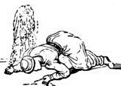
Proskuneo (proskunevw)
Custom of prostrating self before ruler; kissing his feet; do obeisance; reverence
1 Corinthians 14:25 – literal idea is used for point
Show respect for one & humble self
God is the only proper object of worship
Matthew 4:10; Rev. 4:10-11; 19:10; 22:8-9
Jesus, as deity, is worthy of worship
Rev. 5:12-14; Matt. 2:11; 8:2; 9:18; 14:33
Jn. 4:23-24 - involves right thought (spirit, heart) & action (divinely authorized)
Worship is unacceptable if either element is missing
1 Cor. 11:17, 27-29; Matt. 15:7-9 (see also Lev. 10:1-2)

Slide 7
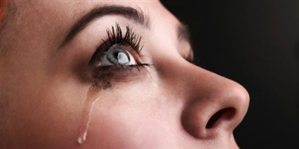
Sebomai (sevbomai)
Worship or revere; stressing the feeling of awe or devotion behind the action
Used in reference to acceptable worship
Acts 16:13-14; 18:7, 12-13 (contrary to “law”)
Used of unacceptable worship
Matt. 15:9; Mk. 7:7
Disrespect seen in replacing God’s will with man’s
Not present unless both heart & action are right
Worship is unacceptable if either element is missing
Rom. 1:25; Acts 19:27; Mk. 7:7 (remember Lev. 10:1-2)

Slide 8
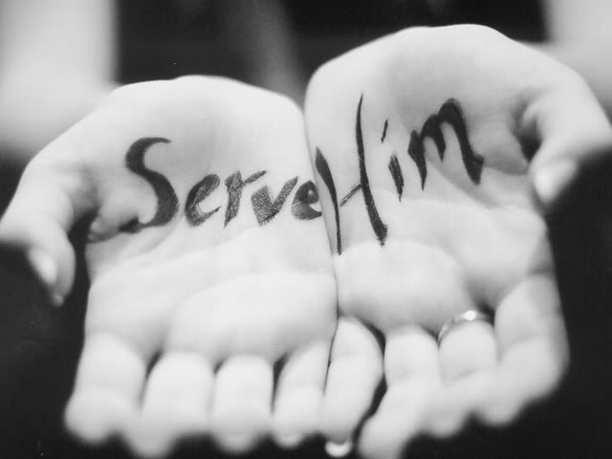
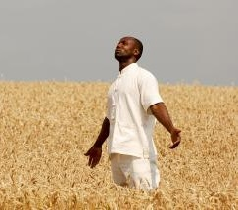
Words Used Less Often
Latreuo (latreuvw)
Render religious service or homage; emphasis of word is on the thing done in service
Translated “served” in Rom. 1:25 to make point
Used in Heb. 8:5; 10:2; 12:28; Phil. 3:3; Acts 24:14
Eusebeo (eujsebevw)
Be reverent, devout or respectful; to show piety
Used only in Acts 17:23 & 1 Tim. 5:4
Worship is unacceptable if missing either proper spirit
(heart, thought) or proper action (God-prescribed)

Slide 9
Reverent Heart Always Required, But Lawful Actions Have Changed
O.T. Worship Has Been Done Away with the Old Law & Replaced with Law of Christ Now Governing Our Worship
Under Mosaic Law
Teaching Law of Moses
Prayer
Animal sacrifice
Grain offering
Burning incense
Feast days & Fast
Going to Jerusalem
Physical temple
Instrumental music
Under the Gospel
Teaching or learning the gospel of Christ
Prayer
Singing
Lord’s Supper in assembly on 1st day of the week
Contribution of assembled saints on 1st day of week
John 4:21-24
2 Cor. 3:14 & Col. 2:14

Slide 10
Over the next few weeks, we will be looking at each of these acts of worship as taught in the N.T. What is acceptable worship under the gospel of Christ?

