Slide 1
Ecclesiastes 7:1-6
¹ A good name is better than precious ointment, and the day of death than the day of one’s birth; ² better to go to the house of mourning than to go to the house of feasting, for that is the end of all men; and the living will take it to heart. ³ Sorrow is better than laughter, for by a sad countenance the heart is made better. ⁴ The heart of the wise is in the house of mourning, but the heart of fools is in the house of mirth. ⁵ It is better to hear the rebuke of the wise than for a man to hear the song of fools. ⁶ For like the crackling of thorns under a pot, so is the laughter of the fool. This also is vanity.

Slide 2
Two Journeys to a Funeral
Ecclesiastes 7:1-6

Slide 3
Two Journeys to a Funeral
Wise Journey – taking lessons of mortality to heart
It is wise to consider our end (Psa. 39:4-5; 90:10, 12)
It is wise to realize life’s brevity (Psa. 89:47; Jas. 4:14)
It is wise to think on the certainty of death (Heb. 9:27)
It is wise to ponder present path & it’s end (Lk. 12:16-21)
It is wise to reflect on the effect of our life on others (Matt. 5:14-16; Heb. 11:4 cf. 1 Kgs. 21:25; Rev. 2:20)
Journey Too Late – going as the one who passed on
This is a journey taken without choice
It can have no impact on our future
It happens though the person’s soul is somewhere else

Slide 4
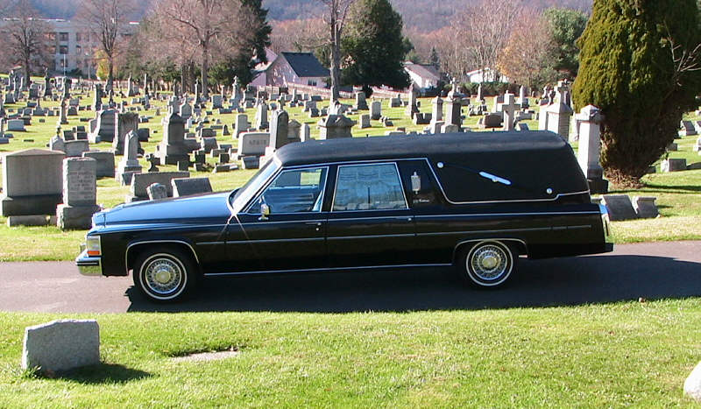
When It Is My Time To Take This Ride…
Where Will I Be?

