Slide 1
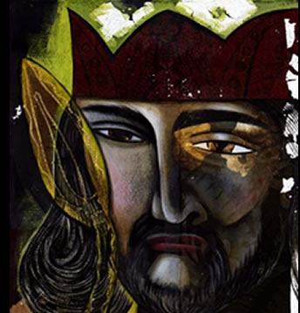
Evil Influences: Turning Israel’s Heart Away from God
1st Kings
11:1-8

Slide 2
1 Kings 11:1-8
¹ But King Solomon loved many foreign women, as well as the daughter of Pharaoh: women of the Moabites, Ammonites, Edomites, Sidonians, and Hittites – ² from the nations of whom the Lord had said to the children of Israel, “You shall not intermarry with them, nor they with you. Surely they will turn away your hearts after their gods.” Solomon clung to these in love. ³ And he had seven hundred wives, princesses, and three hundred concubines; and his wives turned away his heart.⁴ For it was so, when Solomon was old, that his wives turned his heart after other gods; and his heart was not loyal to the Lord his God, as was the heart of his father David. ⁵ For Solomon went after Ashtoreth the goddess of the Sidonians, and after Milcom the abomination of the Ammonites. ⁶ Solomon did evil in the sight of the Lord, and did not fully follow the Lord, as did his father David. ⁷ Then Solomon built a high place for Chemosh the abomination of Moab, on the hill that is east of Jerusalem, and for Molech the abomination of the people of Ammon.⁸ And he did likewise for all his foreign wives, who burned incense and sacrificed to their gods.

Slide 3
How God Viewed Evil of Canaan
In time of Abraham, their wickedness was present, but not yet fully developed
Gen. 15:12-21 Amorites’ iniquity “is not yet complete”
By time of deliverance & Law of Moses, God viewed their practice as “abominations”
Deut. 7:23-25 Images were abominations to be burned
Deut. 18:9-14 Practices of Canaanites were abomination
Heb. tow’ebah – something disgusting; an abhorrence
Same problem present in exiles’ return (Ezra 9:1-15)
Thus, the laws were given for separation with God’s disgust for Canaanite evils as the reason

Slide 4
Instruction Given to Israel
Not to follow the crowd to do evil (Ex. 23:1-3)
Ex. 23:31-33 Applied to Israel & nations
Warned against evil influences (Deut. 12:29-32)
Idolatry
Commit abominations
Give children to be burned in fire
“Do not inquire after their gods, saying…”
“For they even burn their sons and daughters in the fire to their gods”
Where did such practices get the former inhabitants?
Despite the warnings, Israel fell into same practices (1 Kings. 14:21-24; 2 Kings 16:1-4; 21:1-9; 17:7-17)

Slide 5
1 Kings 14:21-24
²¹ And Rehoboam the son of Solomon reigned in Judah. Rehoboam was forty-one years old when he became king. He reigned seventeen years in Jerusalem, the city which the Lord had chosen out of all the tribes of Israel, to put His name there. His mother’s name was Naamah, an Ammonitess. ²² Now Judah did evil in the sight of the Lord, and they provoked Him to jealousy with their sins which they committed, more than all that their fathers had done. ²³ For they also built for themselves high places, sacred pillars, and wooden images on every high hill and under every green tree. ²⁴ And there were also perverted persons [Heb. “sodomites”] in the land. They did according to all the abominations of the nations which the Lord had cast out before the children of Israel.

Slide 6
1 Kings 14:21-24
²¹ And Rehoboam the son of Solomon reigned in Judah. Rehoboam was forty-one years old when he became king. He reigned seventeen years in Jerusalem, the city which the Lord had chosen out of all the tribes of Israel, to put His name there. His mother’s name was Naamah, an Ammonitess. ²² Now Judah did evil in the sight of the Lord, and they provoked Him to jealousy with their sins which they committed, more than all that their fathers had done. ²³ For they also built for themselves high places, sacred pillars, and wooden images on every high hill and under every green tree. ²⁴ And there were also perverted persons [Heb. “sodomites”] in the land. They did according to all the abominations of the nations which the Lord had cast out before the children of Israel.

Slide 7
2 Kings 16:1-4
¹ In the seventeenth year of Pekah the son of Remaliah, Ahaz the son of Jotham, king of Judah, began to reign. ² Ahaz was twenty years old when he became king, and he reigned sixteen years in Jerusalem; and he did not do what was right in the sight of the Lord his God, as his father David had done. ³ But he walked in the way of the kings of Israel; indeed he made his son pass through the fire, according to the abominations of the nations whom the Lord had cast out from before the children of Israel. ⁴ And he sacrificed and burned incense on the high places, on the hills, and under every green tree.

Slide 8
2 Kings 16:1-4
¹ In the seventeenth year of Pekah the son of Remaliah, Ahaz the son of Jotham, king of Judah, began to reign. ² Ahaz was twenty years old when he became king, and he reigned sixteen years in Jerusalem; and he did not do what was right in the sight of the Lord his God, as his father David had done. ³ But he walked in the way of the kings of Israel; indeed he made his son pass through the fire, according to the abominations of the nations whom the Lord had cast out from before the children of Israel. ⁴ And he sacrificed and burned incense on the high places, on the hills, and under every green tree.

Slide 9
2 Kings 21:1-9
Manasseh was twelve years old when he became king, and he reigned fifty-five years in Jerusalem. His mother’s name was Hephzibah.² And he did evil in the sight of the Lord, according to the abominations of the nations whom the Lord had cast out before the children of Israel.³ For he rebuilt the high places which Hezekiah his father had destroyed; he raised up altars for Baal, and made a wooden image, as Ahab king of Israel had done; and he worshiped all the host of heaven and served them. ⁴ He also built altars in the house of the Lord, of which the Lord had said, “In Jerusalem I will put My name.” ⁵ And he built altars for all the host of heaven in the two courts of the house of the Lord. ⁶ Also he made his son pass through the fire, practiced sooth-saying, used witchcraft, and consulted spiritists and mediums. He did much evil in the sight of the Lord, to provoke Him to anger. ⁷ He even set a carved image of Asherah that he had made, in the house of which the Lord had said to David and to Solomon his son, “In this house and in Jerusalem, which I have chosen out of all the tribes of Israel, I will put My name forever;⁸ and I will not make the feet of Israel wander anymore from the land which I gave their fathers – only if they are careful to do according to all that I have commanded them, and according to all the law that My servant Moses commanded them.” ⁹ But they paid no attention, and Manasseh seduced them to do more evil than the nations whom the Lord had destroyed before the children of Israel.

Slide 10
2 Kings 21:1-9
Manasseh was twelve years old when he became king, and he reigned fifty-five years in Jerusalem. His mother’s name was Hephzibah.² And he did evil in the sight of the Lord, according to the abominations of the nations whom the Lord had cast out before the children of Israel.³ For he rebuilt the high places which Hezekiah his father had destroyed; he raised up altars for Baal, and made a wooden image, as Ahab king of Israel had done; and he worshiped all the host of heaven and served them. ⁴ He also built altars in the house of the Lord, of which the Lord had said, “In Jerusalem I will put My name.” ⁵ And he built altars for all the host of heaven in the two courts of the house of the Lord. ⁶ Also he made his son pass through the fire, practiced sooth-saying, used witchcraft, and consulted spiritists and mediums. He did much evil in the sight of the Lord, to provoke Him to anger. ⁷ He even set a carved image of Asherah that he had made, in the house of which the Lord had said to David and to Solomon his son, “In this house and in Jerusalem, which I have chosen out of all the tribes of Israel, I will put My name forever;⁸ and I will not make the feet of Israel wander anymore from the land which I gave their fathers – only if they are careful to do according to all that I have commanded them, and according to all the law that My servant Moses commanded them.” ⁹ But they paid no attention, and Manasseh seduced them to do more evil than the nations whom the Lord had destroyed before the children of Israel.

Slide 11
2 Kings 21:1-9
Manasseh was twelve years old when he became king, and he reigned fifty-five years in Jerusalem. His mother’s name was Hephzibah.² And he did evil in the sight of the Lord, according to the abominations of the nations whom the Lord had cast out before the children of Israel.³ For he rebuilt the high places which Hezekiah his father had destroyed; he raised up altars for Baal, and made a wooden image, as Ahab king of Israel had done; and he worshiped all the host of heaven and served them. ⁴ He also built altars in the house of the Lord, of which the Lord had said, “In Jerusalem I will put My name.” ⁵ And he built altars for all the host of heaven in the two courts of the house of the Lord. ⁶ Also he made his son pass through the fire, practiced sooth-saying, used witchcraft, and consulted spiritists and mediums. He did much evil in the sight of the Lord, to provoke Him to anger. ⁷ He even set a carved image of Asherah that he had made, in the house of which the Lord had said to David and to Solomon his son, “In this house and in Jerusalem, which I have chosen out of all the tribes of Israel, I will put My name forever;⁸ and I will not make the feet of Israel wander anymore from the land which I gave their fathers – only if they are careful to do according to all that I have commanded them, and according to all the law that My servant Moses commanded them.” ⁹ But they paid no attention, and Manasseh seduced them to do more evil than the nations whom the Lord had destroyed before the children of Israel.
→ Jer. 15:3-4

Slide 12
2 Kings 17:7-17
⁷ For so it was that the children of Israel had sinned against the Lord their God, who had brought them up out of the land of Egypt, from under the hand of Pharaoh king of Egypt; and they had feared other gods, ⁸ and had walked in the statutes of the nations whom the Lord had cast out from before the children of Israel, and of the kings of Israel, which they had made. ⁹ Also the children of Israel secretly did against the Lord their God things that were not right, and they built for themselves high places in all their cities, from watchtower to fortified city. ¹⁰ They set up for themselves sacred pillars and wooden images on every high hill and under every green tree. ¹¹ There they burned incense on all the high places, like the nations whom the Lord had carried away before them; and they did wicked things to provoke the Lord to anger, ¹² for they served idols, of which the Lord had said to them, “You shall not do this thing.” ¹³ Yet the Lord testified against Israel and against Judah, by all of His prophets, every seer, saying, “Turn from your evil ways, and keep My commandments and My statutes, according to all the law which I commanded your fathers, and which I sent to you by My servants the prophets.”

Slide 13
2 Kings 17:7-17
⁷ For so it was that the children of Israel had sinned against the Lord their God, who had brought them up out of the land of Egypt, from under the hand of Pharaoh king of Egypt; and they had feared other gods, ⁸ and had walked in the statutes of the nations whom the Lord had cast out from before the children of Israel, and of the kings of Israel, which they had made. ⁹ Also the children of Israel secretly did against the Lord their God things that were not right, and they built for themselves high places in all their cities, from watchtower to fortified city. ¹⁰ They set up for themselves sacred pillars and wooden images on every high hill and under every green tree. ¹¹ There they burned incense on all the high places, like the nations whom the Lord had carried away before them; and they did wicked things to provoke the Lord to anger, ¹² for they served idols, of which the Lord had said to them, “You shall not do this thing.” ¹³ Yet the Lord testified against Israel and against Judah, by all of His prophets, every seer, saying, “Turn from your evil ways, and keep My commandments and My statutes, according to all the law which I commanded your fathers, and which I sent to you by My servants the prophets.”

Slide 14
¹⁴ Nevertheless they would not hear, but stiffened their necks, like the necks of their fathers, who did not believe in the Lord their God. ¹⁵ And they rejected His statutes and His covenant that He had made with their fathers, and His testimonies which He had testified against them; they followed idols, became idolaters, and went after the nations who were all around them, concerning whom the Lord had charged them that they should not do like them. ¹⁶ So they left all the commandments of the Lord their God, made for themselves a molded image and two calves, made a wooden image and worshiped all the host of heaven, and served Baal. ¹⁷ And they caused their sons and daughters to pass through the fire, practiced witchcraft and soothsaying, and sold themselves to do evil in the sight of the Lord, to provoke Him to anger. ¹⁸ Therefore the Lord was very angry with Israel, and removed them from His sight; there was none left but the tribe of Judah alone.

Slide 15
¹⁴ Nevertheless they would not hear, but stiffened their necks, like the necks of their fathers, who did not believe in the Lord their God. ¹⁵ And they rejected His statutes and His covenant that He had made with their fathers, and His testimonies which He had testified against them; they followed idols, became idolaters, and went after the nations who were all around them, concerning whom the Lord had charged them that they should not do like them. ¹⁶ So they left all the commandments of the Lord their God, made for themselves a molded image and two calves, made a wooden image and worshiped all the host of heaven, and served Baal. ¹⁷ And they caused their sons and daughters to pass through the fire, practiced witchcraft and soothsaying, and sold themselves to do evil in the sight of the Lord, to provoke Him to anger. ¹⁸ Therefore the Lord was very angry with Israel, and removed them from His sight; there was none left but the tribe of Judah alone.

Slide 16
Cause of God’s Reaction to Israel’s Sin It Was an Abomination
God’s reaction to their sin came from His contempt for it as being in opposition to His will
Jer. 19:1-7 Condemnation for sin in valley of Hinnom
“…to burn their sons with fire for burnt offerings to Baal, which I did not command or speak, nor did it come into My mind”
Jer. 32:26-35 Actions of Jerusalem were provocation
“…to cause their sons and daughters to pass through the fire to Molech, which I did not command them, nor did it come into My mind”
Prov. 17:15 Abomination: Justify wrong or condemn right
It could have been prevented by right associations

Slide 17
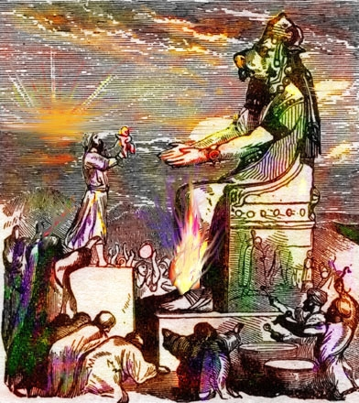
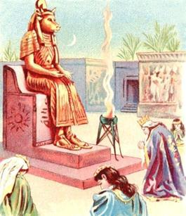
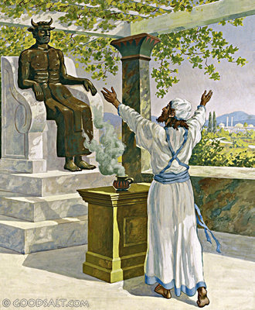
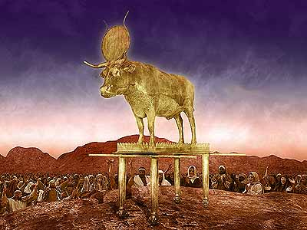
The Path of Abomination

Slide 18
Proverbs Repeatedly Show Result of All Sin Turning One Away from God
Book of Proverbs is book of wisdom applied to life:
Perverse person is abomination to God (Prov. 3:32)
Perverse heart is abomination to God (Prov. 11:20)
“Perverse” – Heb. Iqqesh – distorted, deceitful, false
Their prayer is an abomination to God (Prov. 28:9)
Their sacrifice is abomination to God (Prov. 21:27)
Dishonesty in business is abomination (Prov. 11:1)
Lying is an abomination (Prov. 12:22)
Despite all of the teaching, warnings & examples, Israel failed to see evil as God saw it!

Slide 19
Will We Learn the Lesson?

