Slide 1
Evil Influences: Turning Our Hearts Away from God
2nd Corinthians
6:14 – 7:1

Slide 2
2nd Corinthians 6:14 – 7:1
¹⁴ Do not be unequally yoked together with unbelievers. For what fellowship has righteousness with lawlessness? And what communion has light with darkness? ¹⁵ And what accord has Christ with Belial? Or what part has a believer with an unbeliever? ¹⁶ And what agreement has the temple of God with idols? For you are the temple of the living God. As God has said: “I will dwell in them and walk among them. I will be their God, and they shall be My people.” ¹⁷ Therefore, “Come out from among them and be separate, says the Lord. Do not touch what is unclean, and I will receive you.” ¹⁸ “I will be a Father to you, and you shall be My sons and daughters, says the Lord Almighty.” ^{7:1} Therefore, having these promises, beloved, let us cleanse ourselves from all filthiness of the flesh and spirit, perfecting holiness in the fear of God.

Slide 3
A Short Review of First Lesson

Slide 4
How God Viewed Evil of Canaan
In time of Abraham, their wickedness was present, but not yet fully developed
Gen. 15:12-21 Amorites’ iniquity “is not yet complete”
By time of deliverance & Law of Moses, God viewed their practice as “abominations”
Deut. 7:23-25 Images were abominations to be burned
Deut. 18:9-14 Practices of Canaanites were abomination
Heb. tow’ebah – something disgusting; an abhorrence
Same problem present in exiles’ return (Ezra 9:1-15)
Thus, the laws were given for separation with God’s disgust for Canaanite evils as the reason

Slide 5
Cause of God’s Reaction to Israel’s Sin It Was an Abomination
God’s reaction to their sin came from His contempt for it as being in opposition to His will
Jer. 19:1-7 Condemnation for sin in valley of Hinnom
“…to burn their sons with fire for burnt offerings to Baal, which I did not command or speak, nor did it come into My mind”
Jer. 32:26-35 Actions of Jerusalem were provocation
“…to cause their sons and daughters to pass through the fire to Molech, which I did not command them, nor did it come into My mind”
Prov. 17:15 Abomination: Justify wrong or condemn right
It could have been prevented by right associations

Slide 6
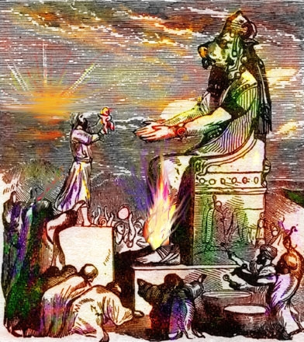
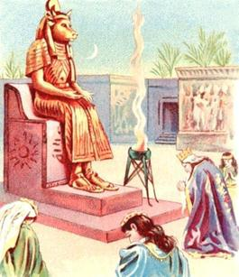
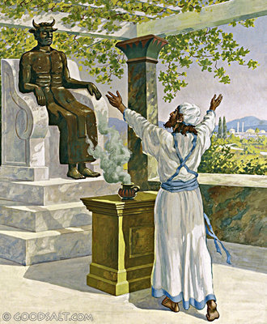
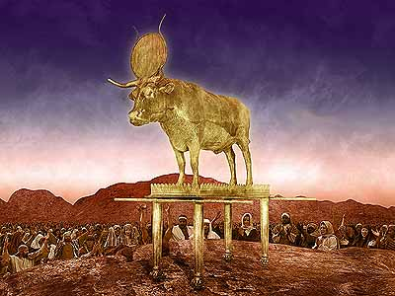
The Path of Abomination

Slide 7
Christians Must Avoid Evil Influence
We have a responsibility to live holy & pure lives
1 Pet. 1:13-16 Must be holy as God is holy
Titus 2:11-14 Must live sober, righteous & godly lives
We must be careful to avoid evil associations
1 Cor. 15:33 Evil companions corrupt good morals
Matt. 7:13-14 Following majority assures wrong path
Wisdom books help teach us about proper associations
Psa. 1:1-2 Avoid evil, seek God’s law
Prov. 1:10f Impact of evil enticement
Prov. 4:10f Avoid way of evil ones
Applied to seductress (Prov. 5:7-10)
Applied to adultery (Prov. 6:20-29)
Applied to angry person (Prov. 22:24-25)
Prov. 24:1-2 General principle we must remember & apply

Slide 8
Principle Applied to Church
Warned of fellowship with sin & error
2 Cor. 6:14f General principle stated – separation from evil
1 Cor. 5:7-11 Purge out leaven – withdraw from evil ones
2 Thess. 3:6 Withdraw from those who walk “disorderly”
2 John 9-11 Not to accept those in error
Rom. 16:17-18 Note those causing division & avoid them
Why is our fellowship important to our souls?
Remember: All sin & error is an abomination to God
Accepting one in immorality or sinful practice threatens all
Allowing teacher of error among us endangers all of us
Getting close as possible to sinful practice, doctrinal error or denominational ways that God hates imperils us!

