Slide 1
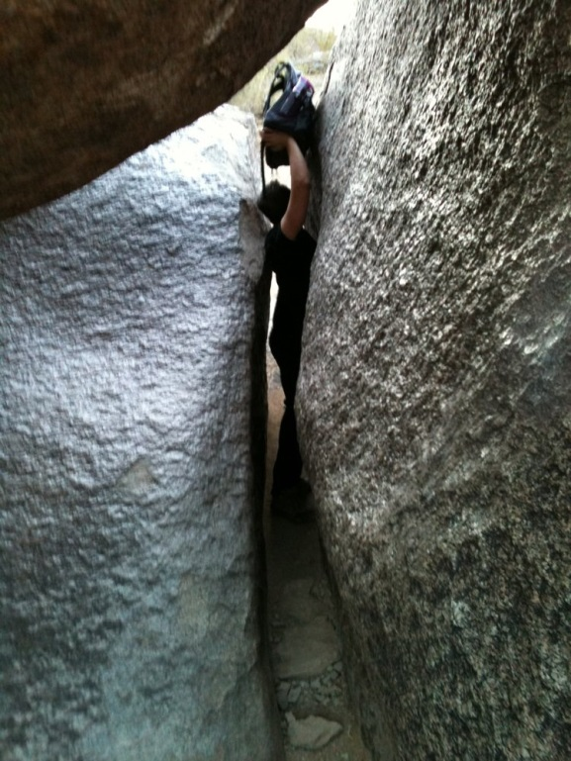
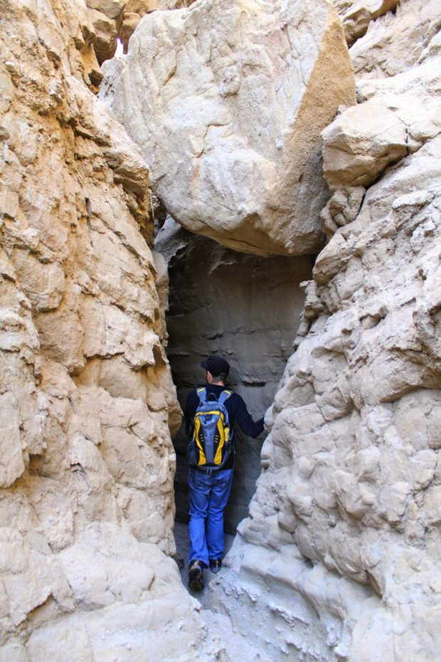
Striving to Enter Or Just Seeking to Enter?
Luke 13:22-28

Slide 2
Luke 13:22-28
²² And He went through the cities and villages, teaching, and journeying toward Jerusalem. ²³ Then one said to Him, “Lord, are there few who are saved?” And He said to them, ²⁴ “Strive to enter through the narrow gate, for many, I say to you, will seek to enter and will not be able. ²⁵ When once the Master of the house has risen up and shut the door, and you begin to stand outside and knock at the door, saying, ‘Lord, Lord, open for us,’ and He will answer and say to you, ‘I do not know you, where you are from,’ ²⁶ then you will begin to say, ‘We ate and drank in Your presence, and You taught in our streets.’ ²⁷ But He will say, ‘I tell you I do not know you, where you are from. Depart from Me, all you workers of iniquity.’ ²⁸ There will be weeping and gnashing of teeth, when you see Abraham and Isaac and Jacob and all the prophets in the kingdom of God, and yourselves thrust out.”

Slide 3
Meaning of Word “Strive”
Word from original language is agōnizomai
To struggle, fight or labor fervently; literally (to compete for a prize), figuratively (to contend with an adversary)
Thayer – to contend with adversary, difficulty or danger; to endeavor with strenuous zeal to obtain something
Parallel to “narrow gate” or way of Matt. 7:13-14
“Difficult is the way…” (NKJV) – “Narrow way” (KJV)
“The way is hard…” (ESV)
Word is thlibō – “to press hard upon, afflict, distress”
Used to denote one squeezing through an obstacle
Conveys a very difficult path requiring struggle

Slide 4
The Difference
Striving
Seeking
Intensity
Struggle
Difficult task
Few undertake
Lack Intensity
Desire
Want easiest
Favored by many

Slide 5
Are We Striving or Seeking When It Comes to…

Slide 6
Contend for Faith vs. Compromise
World: “Be tolerant of all beliefs & practices”
Bible: Must contend, strive & fight for truth
Jude 3 Contend earnestly (epi-agonidzomai)
Phil. 1:27-28 Strive for faith of gospel
1 Tim. 6:12 Fight the good fight of faith
2 Tim. 2:14-18 Involves identifying error & errist
Heb. 12:3-4 Intense striving against sin necessary
This tolerance & compromise affects church
Cannot receive teachers of error (2 Jn. 9-11)
Are we defended narrow truth or broad way?

Slide 7
One Church vs. Denominations
World says, “Attend church of your choice”
Narrow truth gives God’s choice (Eph. 4:1-6)
One body = the church of Christ (Matt. 16:18)
Eph. 4:4 “There is one body”
Eph. 1:22-23 “…the church, which is His body”
Col. 1:18 “He is head of the body, the church”
Characteristics of New Testament church
Its identity (1 Cor. 1:1-2)
Its mission (1 Tim. 3:15)
Its worship (Acts 2:42; Col. 3:16-17)
Its doctrine (Acts 20:27-32; 2 Tim. 4:1-5)

Slide 8
Gospel of Salvation vs. Error of Man
Christ commanded all to teach gospel of salvation
Matthew 28:18-20
Mark 16:15-16
Luke 24:45-49
When we put all facts together, what did Jesus tell them to command others to do for salvation?
Hear gospel
Believe it (including readiness to confess faith)
Repent of sins
Be baptized
Receive salvation or remission of sins
Same gospel was preached on Pentecost -- (Acts 2

