Slide 2
Jesus prayed for unity
John 17:20–21
²⁰ “I do not pray for these alone, but also for those who will believe in Me through their word;
²¹ that they all may be one, as You, Father, are in Me, and I in You; that they also may be one in Us, that the world may believe that You sent Me.
Our goal should be to strive for unity
God hates division (Prov. 6:16-19)
Thus, fellowship is a vitally important question

Slide 3
The Importance of Fellowship
Refuse to fellowship those we should
Extend fellowship to those we should not
(3 John 9-11)
(2 John 9-11)

Slide 4
The Question of Unity & Fellowship
Surfaces With Every Issue
1850 – 1900 Instrumental Music & Missionary Society
1930 – 1940 Premillennialism
1950 – 1960 Institutionalism
1980 – 1990 Divorce and Remarriage
2000 – 2005 Days of Creation

Slide 5
“Fellowship Movement”
Many Unity Efforts
Murch – Witty (1930’s)
James DeForest Murch (Christian Church) & Claude F. Witty (church of Christ)
Series of unity meetings (1938 – ff)
50 “key men”
Lost momentum and died

Slide 6
The Second Meeting (May 1939)
H. Leo Boles – The Way of Unity
“It is not only wrong to bring such things (acts of worship based upon human opinion) into the worship of God; it is wrong to tolerate them in the worship; it is wrong to affiliate with them or countenance those who bring them in. Hence, it is sinful to bring anything not commanded by God into the worship of God; it is unfaithful and disloyal to Christ to tolerate them in worship; It is wrong to encourage and fellowship those who walk by opinion; It is cowardly and rebellious to refuse to oppose them.”

Slide 7
“Fellowship Movement”
Many Unity Efforts
Murch – Witty (1930’s)
Ketcherside (Mission Messenger) (1960’s)
W. Carl Ketcherside (Along with Leroy Garrett)
Gospel – Doctrine distinction
United upon the doctrine about Christ vs the doctrine of Christ (2 Jno. 9)

Slide 8
“Fellowship Movement”
Many Unity Efforts
Murch – Witty (1930’s)
Ketcherside (Mission Messenger) (1960’s)
Restoration Summit (1980s)
Joplin, Mo
Rubel Shelly – same gospel- doctrine distinction (lower & Upper case) (F)(f)ellowship.

Slide 9
“Fellowship Movement”
Many Unity Efforts
Murch – Witty (1930’s)
Ketcherside (Mission Messenger) (1960’s)
Restoration Summit (1980s)
Ed Harrell (Christianity Magazine) (1989-1990)
17 articles
Defending fellowship with Homer Hailey
Appeal to Rom 14 – includes issues of moral and doctrinal import

Slide 10
Imperative That We Understand
What Bible Fellowship Is
Can we fellowship those that teach doctrinal error?
Can we fellowship those that practice sin?
Is food and fun fellowship?
Is fellowship merely a local church matter?

Slide 11
What Is
Biblical Fellowship?

Slide 12
What Is
Biblical Fellowship?
The Meaning of Fellowship

Slide 13
The Meaning of Fellowship
From Grk: Koinonia
1 John 1:7
But if we walk in the light as He is in the light, we have fellowship with one another, and the blood of Jesus Christ His Son cleanses us from all sin.
κοινωνία

Slide 14
Thayer’s Lexicon
“fellowship, association, community, communion, joint participation, intercourse; in the N. T. as in class, Grk.
the share which one has in anything, participation; w. gen. of the thing in which he shares:
2. intercourse, fellowship, intimacy: δεξιὰ κοινωνίας, the right hand as the sign and pledge of fellowship (in fulfilling the apostolic office)
3. a benefaction jointly contributed, a collection, a contribution, as exhibiting an embodiment and proof of fellowship
Thayer, J. H. (1889). A Greek-English lexicon of the New Testament (p. 352)

Slide 15
TDNT
κοινωνός means “fellow,” “participant.” It implies fellowship or sharing with someone or in something.
Kittel, G., Bromiley, G. W., & Friedrich, G. (Eds.). (1964–). Theological dictionary of the New Testament (electronic ed., Vol. 3, p. 797). Grand Rapids, MI: Eerdmans.

Slide 16
Strong’s
κοινωνία kŏinōnia, koy-nohn-ee´-ah; from 2844; partnership, i.e. (lit.) participation, or (social) intercourse, or (pecuniary) benefaction:—(to) communicate (-ation), communion, (contri-) distribution, fellowship
κοινωνός kŏinōnŏs, koy-no-nos´; from 2839; a sharer, i.e. associate:—companion, × fellowship, partaker, partner.
Strong, J. (2009). A Concise Dictionary of the Words in the Greek Testament and The Hebrew Bible (Vol. 1, p. 42). Bellingham,

Slide 17
Dictionary of Biblical Languages
3126 κοινωνία (koinōnia), ας (as), ἡ (hē): n.fem.; ≡ Str 2842; TDNT 3.797—1. LN 34.5 fellowship, close mutual association (1Jn 1:3; 1Co 1:9); 2. LN 57.98 share, participation (2Co 8:4); 3. LN 57.101 willing contribution, gift (Ro 15:26+)
Swanson, J. (1997). Dictionary of Biblical Languages with Semantic Domains: Greek (New Testament) (electronic ed.). Oak Harbor: Logos Research Systems, Inc.

Slide 18
Lexham Theological
Wordbook
κοινωνία (koinōnia). n. fem. fellowship, communion, sharing, participation. A term that conveys a sense of commonality, solidarity, and shared responsibility among households or individuals.
The most general sense of this term refers to a shared conviction that manifests itself as mutual responsibility and status….
Those who choose to willing engage in mutual responsibility are described as having “partnership” (koinōnia) with the body of Christ (1 Cor 10:16), the gospel (Phil 1:5), the Spirit (Phil 2:1), the sufferings of the Messiah (Phil 3:10), or, negatively, unbelievers (2 Cor 6:14).
Davis, D. L. (2014). Assembly, Religious. D. Mangum, D. R. Brown, R. Klippenstein, & R. Hurst (Eds.), Lexham Theological Wordbook. Bellingham, WA: Lexham Press.

Slide 19
W.E. Vine
1. koinonia (κοινωνία, 2842), (a) “communion, fellowship, sharing in common” (from koinos, “common”), is translated “communion” in 1 Cor. 10:16; Philem. 6, rv, “fellowship,” for kjv, “communication”; it is most frequently translated “fellowship”; (b) “that which is the outcome of fellowship, a contribution,” e.g., Rom. 15:26; 2 Cor. 8:4. See communion, contribution, etc.
Note: In Eph. 3:9, some mss. have koinonia, instead of oikonomia, “dispensation,” rv.
3. koinonos (κοινωνός, 2844) denotes “a partaker” or “partner” (akin to No. 1); in 1 Cor. 10:20 it is used with ginomai, “to become,” “that ye should have communion with,” rv (kjv, fellowship with). See companion, partaker, partner.
Vine, W. E., Unger, M. F., & White, W., Jr. (1996). Vine’s Complete Expository Dictionary of Old and New Testament Words (Vol. 2, p. 233

Slide 20
Use in LXX
Lev. 6:2 (KJV)
If a soul sin, and commit a trespass against the Lord, and lie unto his neighbour in that which was delivered him to keep, or in fellowship, or in a thing taken away by violence, or hath deceived his neighbour;
NKJV – “pledge”
Something held in common
NCV – “something he was taking care of for someone else

Slide 21
Use in LXX
Job 34:8
Who goes in company with the workers of iniquity,
And walks with wicked men?
Brenton: “Saying, I have not sinned, nor committed ungodliness, nor had fellowship with workers of iniquity, to go with the ungodly”
Association
Working together
Implied approval – “he goes along with…”

Slide 22
The Meaning of Fellowship
From Grk: Koinonia
How it is translated

Slide 23
Text | NKJV | ESV | KJV | NASB
Acts 2:42 | fellowship | fellowship | fellowship | fellowship
Rom 15:16 | contribution | contribution | contribution | contribution
1 Cor. 1:9 | fellowship | fellowship | fellowship | fellowship
1 Cor. 10:16 | communion communion | participation participation | sharing sharing | communion communion
2 Cor. 6:14 | communion | fellowship | communion | communion
2 Cor. 8:4 | fellowship | part | fellowship | participation
2 Cor. 9:13 | sharing | contribution | distribution | contribution
2 Cor. 13:14 | communion | fellowship | communion | fellowship
Gal. 2:9 | fellowship | fellowship | fellowship | fellowship
Eph. 3:9 | fellowship | plan | fellowship | fellowship
Phil. 1:5 | fellowship | partnership | fellowship | participation
Phil. 2:1 | fellowship | participation | fellowship | fellowship
Phil. 3:10 | fellowship | share | fellowship | fellowship
Philem 6 | sharing | sharing | communication | fellowship
Heb. 13:16 | share | share | communicate | sharing
1 John 1:3 | fellowship fellowship | fellowship fellowship | fellowship fellowship | fellowship fellowship
1 John 1:6 | fellowship | fellowship | fellowship | fellowship
1 Jno. 1:7 | fellowship | fellowship | fellowship | fellowship

Slide 24
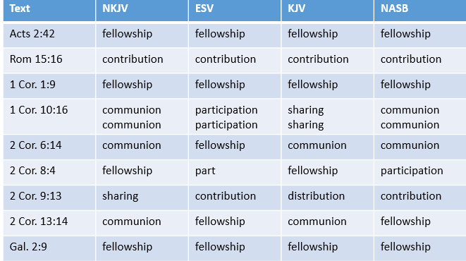

Slide 25
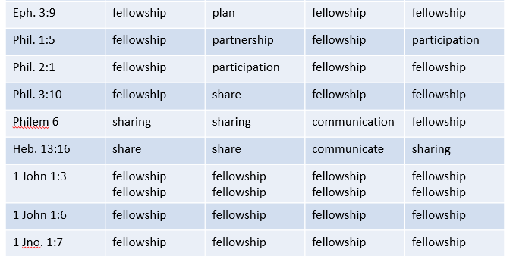

Slide 26
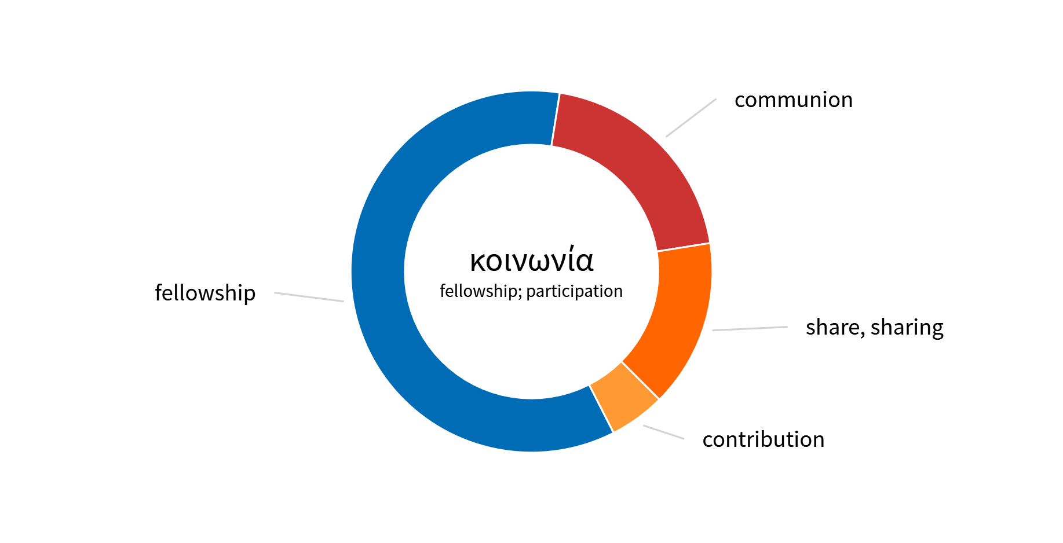
NKJV

Slide 27
Fellowship
Contribution
Communion
Part
Participation
Sharing
Partnership
Distribution
Communicate
KJV
NKJV
ESV
NASB

Slide 28
The Meaning of Fellowship
From Grk: Koinonia
How it is translated
Summary

Slide 29
Fellowship
(Koinonia)
COMMUNION – Lord’s Supper (1 Cor. 10:16)
COMMUNITY - Sharing of goods (Acts 2:42)
CONTRIBUTION – For poor saints (Rom. 15:26)
COOPERATION – Extending right hand of fellowship (Gal. 2:9)

Slide 30
The Meaning of Fellowship
From Grk: Koinonia
How it is translated
Summary
Spiritual association – based on agreement in principle

Slide 31
2 Corinthians 6:14–17
¹⁴ Do not be unequally yoked together with unbelievers. For what fellowship has righteousness with lawlessness? And what communion has light with darkness?
¹⁵ And what accord has Christ with Belial? Or what part has a believer with an unbeliever?
¹⁶ And what agreement has the temple of God with idols? For you are the temple of the living God. As God has said: “I will dwell in them And walk among them. I will be their God, And they shall be My people.”
¹⁷ Therefore “Come out from among them And be separate, says the Lord. Do not touch what is unclean, And I will receive you.”
Common Work
Share in Action
koinonia
Harmony of thought
A part together with
others
A union of purpose
Thus:
Agreement in principle
leading to joint or common action in spiritual work

Slide 32
What Is
Biblical Fellowship?
The Meaning of Fellowship
The Direction of Fellowship

Slide 33
The Direction of Fellowship
Both vertical & horizontal
God
1 John 1:3-6
1 John 1:7
Me
Another

Slide 34
The Direction of Fellowship
Both vertical & horizontal
Vertical first – then horizontal
God
Before we fellowship another – first determine if they are in fellowship with God
Acts 9:26-28
1 Jno. 1:7 (cf. 2 Jno 4; 3 Jno 3)
1 Jno. 2:4 – keeps commands
1
Me
2
Another

Slide 35
The Direction of Fellowship
Both vertical & horizontal
Vertical first – then horizontal
God
Before we fellowship another – first determine if they are in fellowship with God
Any movement / effort to unite without regard to teaching & practice – misses 1 John
Question is not: how can I be united with brethren? – but are we both in fellowship with God?
1
Me
2
Another

Slide 36
What Is
Biblical Fellowship?
The Meaning of Fellowship
The Direction of Fellowship
The Use of Fellowship

Slide 37
The Use of Fellowship
Share in humanity (Heb. 2:14)
Business partners (Luke 5:10)
Likeness to others (Matt. 23:30)
Suffering (Phil. 3:10)
Benevolence (Rom. 15:26; 2 Cor. 8:4)
Support of preaching (Phil. 1:5; 4:14-16)
In Each of These:
Sharing in Principle & Action

Slide 38
What Is
Biblical Fellowship?
The Meaning of Fellowship
The Direction of Fellowship
The Use of Fellowship
The Conclusions about Fellowship

Slide 39
The Conclusions About Fellowship
Fellowship: Agreement in principle leading to joint or common action in spiritual work
Fellowship is conditional (1 John 1:7)
Fellowship cannot be arbitrary (3 John)
Fellowship that is forbidden (Eph. 5:11; 2 John 9-11)
Fellowship is never used of fun and games

Slide 40
What Is
Biblical Fellowship?
The Meaning of Fellowship
The Direction of Fellowship
The Use of Fellowship
The Conclusions about Fellowship

