Slide 2
Love Vs. Hate

Slide 3
No Middle Ground : If you “love not” your brother, you “hate” your brother (I Jn. 4:20 )
Love Vs. Hate

Slide 4
No Middle Ground : If you “love not” your brother, you “hate” your brother (I Jn. 4:20 )
This same antithetical attitude applies to the world (I Jn. 2:15)
Love Vs. Hate

Slide 5
No Middle Ground : If you “love not” your brother, you “hate” your brother (I Jn. 4:20 )
This same antithetical attitude applies to the world (I Jn. 2:15)
Love Vs. Hate
What is “the world” that a Christian is to hate?

Slide 6
No Middle Ground : If you “love not” your brother, you “hate” your brother (I Jn. 4:20 )
This same antithetical attitude applies to the world (I Jn. 2:15)
Love Vs. Hate
What is “the world” that a Christian is to hate?
What are the reasons for obeying the command which demands such a strong attitude?

Slide 7
LOVE VS. HATE
If you love the world, you do not love the Father (I Jn. 2:15)
You cannot love God and the world!

Slide 8
Hate People (Jn. 3:16)???
Love Not The World
Hate the Created World (I Jn. 2:16)???

Slide 9
Worldly thinking – inspired by the evil one, the god of this world (2 Cor. 4:4, Eph. 2:2-3; Jn. 3:19-21)
Hate People (Jn. 3:16)???
Love Not The World
Hate the Created World (I Jn. 2:16)???

Slide 10
Worldly thinking – inspired by the evil one, the god of this world (2 Cor. 4:4, Eph. 2:2-3; Jn. 3:19-21)
Hate People (Jn. 3:16)???
Love Not The World
The World – the way of thinking opposed to God
Hate the Created World (I Jn. 2:16)???

Slide 11
LOVE VS. HATE
If you love all that is in the world, you do not love the Father (I Jn. 2:15)

Slide 12
LOVE VS. HATE
If you love all that is in the world, you do not love the Father (I Jn. 2:15)
“in the world” focus: the “lust of the flesh”, the “lust of the eyes”, and the “pride of life” (I Jn. 3:17, Mk. 12:44)

Slide 13
Worldly thinking – inspired by the evil one, the god of this world (2 Cor. 4:4, Eph. 2:2-3; Jn. 3:19-21)
Hate People (Jn. 3:16)???
Love Not The World
The World – the way of thinking opposed to God
Hate the Created World (I Jn. 2:16)???
All that is in the world – our attitude toward things

Slide 14
Ur
LOVE VS. HATE
Who will be your Master? – You cannot love God and Mammon (Riches) (Matt. 6:24)

Slide 15
LOVE VS. HATE
Who will be your Master? – You cannot love God and Mammon (Riches) (Matt. 6:24)
We must hate coveting riches – will lead you astray from the faith (I Tim. 6:9-10)

Slide 16
o
LOVE VS. HATE
If you love God, you will keep His commandments (I Jn. 5:3)

Slide 17
o
LOVE VS. HATE
If you love God, you will keep His commandments (I Jn. 5:3)
Commandments are “not grievous” because the “begotten of God” overcomes the world (I Jn. 5:4 v.1; v.5, Jn. 16:33)

Slide 18
o
LOVE VS. HATE
If you love God, you will keep His commandments (I Jn. 5:3)
Commandments are “not grievous” because the “begotten of God” overcomes the world (I Jn. 5:4 v.1; v.5, Jn. 16:33)
Loving God means you will do the will of God and will overcome the world (I Jn. 2:17)

Slide 19
o
LOVE VS. HATE
If you love God, you will keep His commandments (I Jn. 5:3)
Commandments are “not grievous” because the “begotten of God” overcomes the world (I Jn. 5:4 v.1; v.5, Jn. 16:33)
Loving God means you will do the will of God and will overcome the world (I Jn. 2:17)
You will abide while the world and its lusts will pass away (2 Pet. 3:10)

Slide 20
LOVE VS. HATE
If you love God and Keep His commandments, you know you love the children of God (I Jn. 5:2)

Slide 21
LOVE VS. HATE
If you love God and Keep His commandments, you know you love the children of God (I Jn. 5:2)
There is no demand of God regarding your brother that is burdensome when you love God.

Slide 22
LOVE VS. HATE
If you love God and Keep His commandments, you know you love the children of God (I Jn. 5:2)
There is no demand of God regarding your brother that is burdensome when you love God
Guards us from “sentimental” love: “Why will you not eat with me?” (I Cor. 5:4-5, 11; 2 Cor. 2:6-8)

Slide 23
Winning Combination
FAITH
Overcome the World (I Jn. 5:1-5)
LOVE

Slide 24
Winning Combination
More than Conquerors (Rom. 8:28, 37-39)
FAITH
Overcome the World (I Jn. 5:1-5)
LOVE

Slide 25
Winning Combination
More than Conquerors (Rom. 8:28, 37-39)
FAITH
Overcome the World (I Jn. 5:1-5)
Heirs of the Kingdom (Jms. 2:5)
LOVE

Slide 26
Four Reasons :
1. The Love Of The Father Is Not In You.
2. The course of the world in covetousness and pride is not of the Father.
Love Not The World
3. The World Will Pass Away Along With Its Lust.
I Jn. 2:15-17
4. He that does the will of God will abide For ever.

Slide 27
Why Should We Hate “The World”… (Psm. 119:104)
And you did he make alive, when ye were dead through your trespasses and sins, ² wherein ye once walked according to the course of this world, according to the prince of the powers of the air, of the spirit that now worketh in the sons of disobedience; ³ among whom we also all once lived in the lusts of our flesh, doing the desires of the flesh and of the mind, and were by nature children of wrath, even as the rest:—
Ephesians 2:1-3

Slide 28
Why Should We Hate “The World”… (Psm. 119:104)
The god of this world blinds souls from their true condition before God
And you did he make alive, when ye were dead through your trespasses and sins, ² wherein ye once walked according to the course of this world, according to the prince of the powers of the air, of the spirit that now worketh in the sons of disobedience; ³ among whom we also all once lived in the lusts of our flesh, doing the desires of the flesh and of the mind, and were by nature children of wrath, even as the rest:—
The Walking Dead
Ephesians 2:1-3

Slide 29
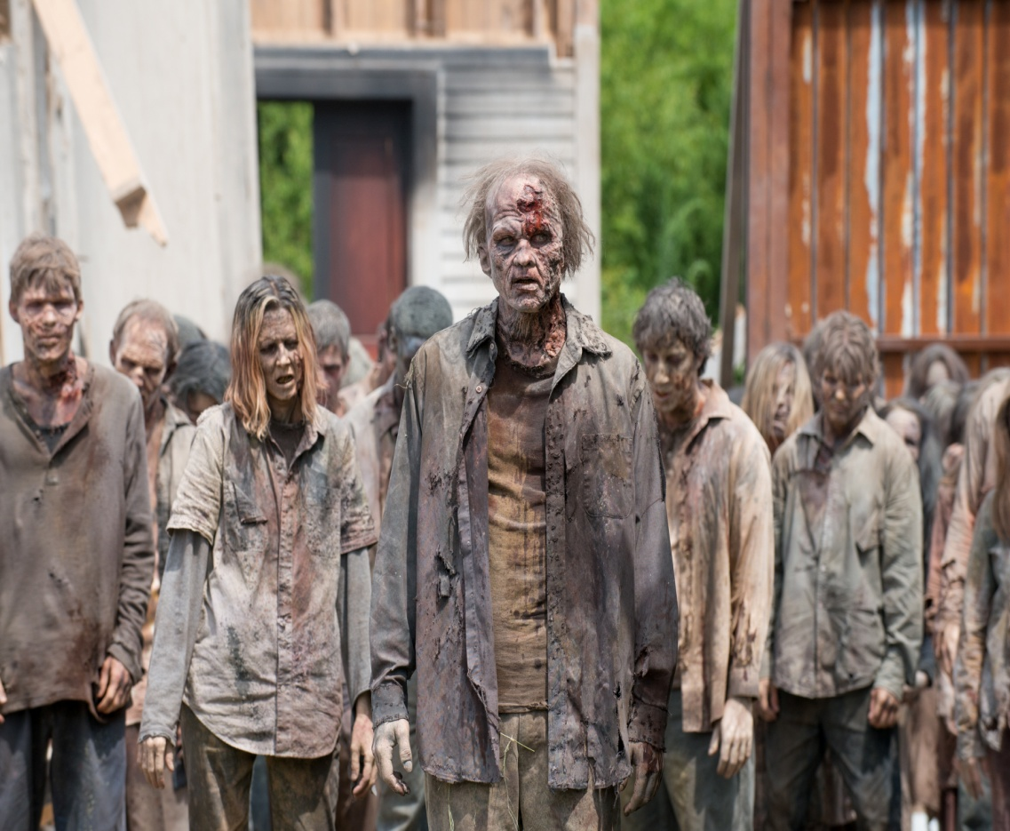
Why Should We Hate “The World”… (Psm. 119:104)
The god of this world blinds souls from their true condition before God
And you did he make alive, when ye were dead through your trespasses and sins, ² wherein ye once walked according to the course of this world, according to the prince of the powers of the air, of the spirit that now worketh in the sons of disobedience; ³ among whom we also all once lived in the lusts of our flesh, doing the desires of the flesh and of the mind, and were by nature children of wrath, even as the rest:—
Ephesians 2:1-3
The Walking Dead

Slide 30
Why Should We Hate “The World”… (Psm. 119:104)
I John 2:17
Passes Away
The World – Lust

Slide 31
Why Should We Hate “The World”… (Psm. 119:104)
I John 2:17
Passes Away
Blinded
The World – Lust

Slide 32
Why Should We Hate “The World”… (Psm. 119:104)
I John 2:17
Passes Away
“He that Doeth The will of God abideth forever”
Blinded
The World – Lust

