Slide 1
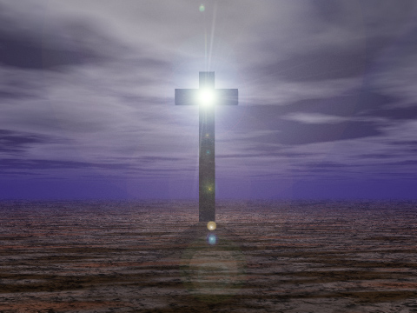
Have You Considered Christ Jesus?
Hebrews 3:1-6

Slide 2
Hebrews 3:1-6
¹ Therefore, holy brethren, partakers of the heavenly calling, consider the Apostle and High Priest of our confession, Christ Jesus, ² who was faithful to Him who appointed Him, as Moses also was faithful in all His house. ³ For this One has been counted worthy of more glory than Moses, inasmuch as He who built the house has more honor than the house. ⁴ For every house is built by someone, but He who built all things is God. ⁵ And Moses indeed was faithful in all His house as a servant, for a testimony of those things which would be spoken afterward, ⁶ but Christ as a Son over His own house, whose house we are if we hold fast the confidence and the rejoicing of the hope firm to the end.

Slide 3
Hebrews 3:1-6
¹ Therefore, holy brethren, partakers of the heavenly calling, consider the Apostle and High Priest of our confession, Christ Jesus, ² who was faithful to Him who appointed Him, as Moses also was faithful in all His house. ³ For this One has been counted worthy of more glory than Moses, inasmuch as He who built the house has more honor than the house. ⁴ For every house is built by someone, but He who built all things is God. ⁵ And Moses indeed was faithful in all His house as a servant, for a testimony of those things which would be spoken afterward, ⁶ but Christ as a Son over His own house, whose house we are if we hold fast the confidence and the rejoicing of the hope firm to the end.

Slide 4
Characteristics of Jesus
Apostle (Messenger) of Our Confession
Jn. 12:48-50 Jesus declared message given of God
Jn. 17:8 Jesus was from Father & gave words of Father
High Priest of Our Confession
Heb. 2:17 Jesus is high priest to offer for us
Heb. 4:14-15 Can sympathize with our weaknesses
Faithful in All Things
Heb. 5:7-9 Made perfect in obedience; totally faithful
Phil. 2:5-8 Humbled Himself, obedient even to cross
Worthy of More Honor & Glory than Moses
2 Cor. 3:12-16 Glory of Moses surpassed by Christ
Phil. 2:9-11
Heb. 1:1-4

Slide 5
Hebrews 3:1-6
¹ Therefore, holy brethren, partakers of the heavenly calling, consider the Apostle and High Priest of our confession, Christ Jesus, ² who was faithful to Him who appointed Him, as Moses also was faithful in all His house. ³ For this One has been counted worthy of more glory than Moses, inasmuch as He who built the house has more honor than the house. ⁴ For every house is built by someone, but He who built all things is God. ⁵ And Moses indeed was faithful in all His house as a servant, for a testimony of those things which would be spoken afterward, ⁶ but Christ as a Son over His own house, whose house we are if we hold fast the confidence and the rejoicing of the hope firm to the end.

Slide 6
Hebrews 3:1-6
¹ Therefore, holy brethren, partakers of the heavenly calling, consider the Apostle and High Priest of our confession, Christ Jesus, ² who was faithful to Him who appointed Him, as Moses also was faithful in all His house. ³ For this One has been counted worthy of more glory than Moses, inasmuch as He who built the house has more honor than the house. ⁴ For every house is built by someone, but He who built all things is God. ⁵ And Moses indeed was faithful in all His house as a servant, for a testimony of those things which would be spoken afterward, ⁶ but Christ as a Son over His own house, whose house we are if we hold fast the confidence and the rejoicing of the hope firm to the end.

Slide 7
Characteristics of House of Jesus
Hold Fast Our Confidence
Rom. 11:22 Goodness on us if continue in God’s way
Heb. 4:14 Confidence comes by seeing greatness of Christ
Heb. 10:19-23 Sacrifice of Christ urges our continuance
Heb. 10:35-39 Demands boldness, patience & persistence
Hold Fast the Rejoicing of Our Hope
Rom. 5:1-2 Rejoice in hope by entry found in Christ
Rom. 5:10-11 Cause: change from enemies to reconciled
Phil. 3:20-21 Joy urged later based on hope in Christ
Firm unto the End
Heb. 3:12-14 Must hold confidence firm to end
Are we showing characteristics of Jesus’ house?

