Slide 1
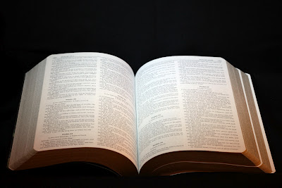
Living for the Will of God
1 Peter 4:1-6

Slide 2
1 Peter 4:1-6
¹ Therefore, since Christ suffered for us in the flesh, arm yourselves also with the same mind, for he who has suffered in the flesh has ceased from sin, ² that he no longer should live the rest of his time in the flesh for the lusts of men, but for the will of God. ³ For we have spent enough of our past lifetime in doing the will of the Gentiles — when we walked in lewdness, lusts, drunkenness, revelries, drinking parties, and abominable idolatries. ⁴ In regard to these, they think it strange that you do not run with them in the same flood of dissipation, speaking evil of you. ⁵ They will give an account to Him who is ready to judge the living and the dead. ⁶ For this reason the gospel was preached also to those who are dead, that they might be judged according to men in the flesh, but live according to God in the spirit.

Slide 3
1 Peter 4:1-6
¹ Therefore, since Christ suffered for us in the flesh, arm yourselves also with the same mind, for he who has suffered in the flesh has ceased from sin, ² that he no longer should live the rest of his time in the flesh for the lusts of men, but for the will of God. ³ For we have spent enough of our past lifetime in doing the will of the Gentiles — when we walked in lewdness, lusts, drunkenness, revelries, drinking parties, and abominable idolatries. ⁴ In regard to these, they think it strange that you do not run with them in the same flood of dissipation, speaking evil of you. ⁵ They will give an account to Him who is ready to judge the living and the dead. ⁶ For this reason the gospel was preached also to those who are dead, that they might be judged according to men in the flesh, but live according to God in the spirit.

Slide 4
Demands Abstaining from Sin
Col. 3:5-9 Putting sin to death must always be aim
1 Thess. 5:21-22 Abstain every form of evil
Eph. 4:17-24 Evil of old man is package – End it!
1 Pet. 4:3 Must cease from sin; No longer live in it
Lewdness (Rom. 13:13) – touch arousing passion
Lust (Eph. 2:1-3) – pornography, immodesty, sexting”
Drunkenness, revelries & drinking parties (Prov. 20:1; 23:31-32) – use of intoxicants from drunkenness to any less
All of these are manifestations of life still in flesh, but are incompatible with mind of Christ

Slide 5
Demands Difference from World
World sees Christians as being so different that they are “strange”
What is the basis for this assessment by world?
Jn. 15:18-19 World hated Jesus first & hates us if same
1 Jn. 2:15-17 Reason is the world’s values
True Christians have exact opposite values as world
Our lives must show way to God (Matt. 5:14-16)
Differences seen should include…
How we talk & act
Where we spend our money & our time
Our priorities in life as seen in effort, choices…

Slide 6
Demands Obedience to Gospel
Acceptability to God depends on obeying gospel
2 Thess. 1:7-9 Lost = Obey not the gospel
1 Pet. 4:15-17 Christian -vs- Those not obeying gospel
What is meant by “not obeying the gospel”?
Opposite of obeying gospel – How do we obey it?
Mark 16:15-16, Jesus said:
“Go into all the world and preach the gospel to every creature.
He who believes and is baptized will be saved.”
Jesus defined what was to be preached (gospel) & how it was obeyed (believe & be baptized)

