Slide 1
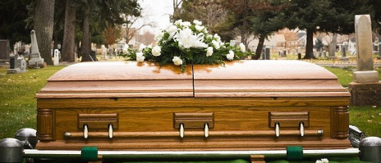
Dead, But How Dead?
Ephesians 2:1-3
“And you He made alive, who were dead in trespasses and sins, in which you once walked according to the course of this world, according to the prince of the power of the air, the spirit who now works in the sons of disobedience, among whom also we all once conducted ourselves in the lusts of our flesh, fulfilling the desires of the flesh and of the mind, and were by nature children of wrath, just as the others….”

Slide 2
All in Sin Are Dead Spiritually
Romans 6:23
For the wages of sin is death, but the gift of God is eternal life in Christ Jesus our Lord.
Genesis 2:16-17
And the Lord God commanded the man, saying, “Of every tree of the garden you may freely eat; but of the tree of the knowledge of good and evil you shall not eat, for in the day that you eat of it you shall surely die.”
Ezekiel 18:20
The soul who sins shall die. The son shall not bear the guilt of the father, nor the father bear the guilt of the son. The righteousness of the righteous shall be upon himself, and the wickedness of the wicked shall be upon himself.
James 1:15
Then, when desire has conceived, it gives birth to sin; and sin, when it is full-grown, brings forth death.

Slide 3
But Bible Recognizes Varying Depths of Those Dead in Sin
1 Timothy 5:24
Some men’s sins are clearly evident, preceding them to judgment, but those of some men follow later.
1 Thessalonians 5:14
Now we exhort you, brethren, warn those who are unruly, comfort the fainthearted, uphold the weak, be patient with all.
Jude 22-23 ^{[ESV]}
And have mercy on those who doubt; save others by snatching them out of the fire; to others show mercy with fear, hating even the garment stained by the flesh.

Slide 4
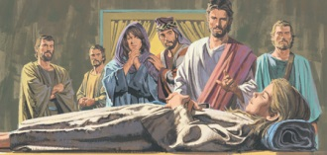
Having Just Died Mark 5:22-42
Galatians 6:1

Slide 5
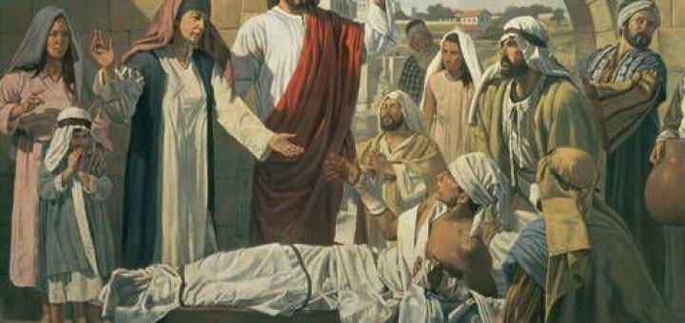
Having Died & Ready for Burial Luke 7:11-16
James. 5:19-20

Slide 6
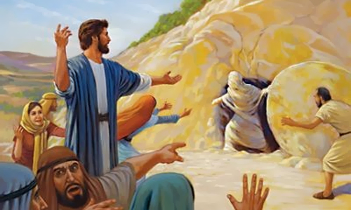
Having Died & In Decay Mark 5:22-42
2 Thess. 3:14-15
Titus 3:10-11

Slide 7
In Every Case of Resurrection,
Jesus Raised Them from Dead
No Matter How Dead They Were
HE CAN DO SAME FOR ALL, No Matter How Dead In Sin

