Slide 1
Life in Darkness -vs- Life in Christ
Ephesians 4:17-24

Slide 2
Ephesians 4:17-19
¹⁷ This I say, therefore, and testify in the Lord, that you should no longer walk as the rest of the Gentiles walk, in the futility of their mind, ¹⁸ having their understanding darkened, being alienated from the life of God, because of the ignorance that is in them, because of the blindness of their heart; ¹⁹ who, being past feeling, have given themselves over to lewdness, to work all uncleanness with greediness.

Slide 3
Life in Darkness
Darkened in Understanding
Psalm 82:5 No knowledge or understanding = darkness
John 1:4-10 Light not comprehended by darkened world
Romans 1:18-21 Darkness causes irrational rejection of God
Darkened by Choice
Romans 10:3 Focus on man’s ways leads to ignoring God’s
John 9:30 Blind man understood what others missed
Matthew 13:10-15 Hidden in open sight due to own prejudice
Darkened in Actions
John 3:19-20 Darkness loved when acts of evil present
Romans 1:26-32 Perversion & ungodliness manifest darkness
Ephesians 5:3-14 Vast difference of darkness & light in life
Darkness Is Avoidable

Slide 4
Ephesians 4:20-24
²⁰ But you have not so learned Christ, ²¹ if indeed you have heard Him and have been taught by Him, as the truth is in Jesus: ²² that you put off, concerning your former conduct, the old man which grows corrupt according to the deceitful lusts,²³ and be renewed in the spirit of your mind, ²⁴ and that you put on the new man which was created according to God, in true righteousness and holiness.

Slide 5
Life in Christ
It Is a Learned Life
Isaiah 2:2-3 Prophecy of teaching in Messianic kingdom
John 6:44-45 God draws us to Him by teaching
Matthew 11:28-30 Must lean to respond to invitation
It Is a Renewed Life
Romans 12:1-2 Transformed by renewing of mind
Titus 3:3-5 Washing of regeneration & renewing of the H.S.
2 Corinthians 4:16 Renewal continues through life
It Is a New Life
Galatians 6:15 One is a new creation in Christ
2 Corinthians 5:17 New creation & old things passed away
Col. 3:8-17 Put off old man & live a new life (Rom. 13:11f)
The new life patterned after God’s holiness of truth

Slide 6
386 - Jesus Is Coming Soon - Title

Slide 7
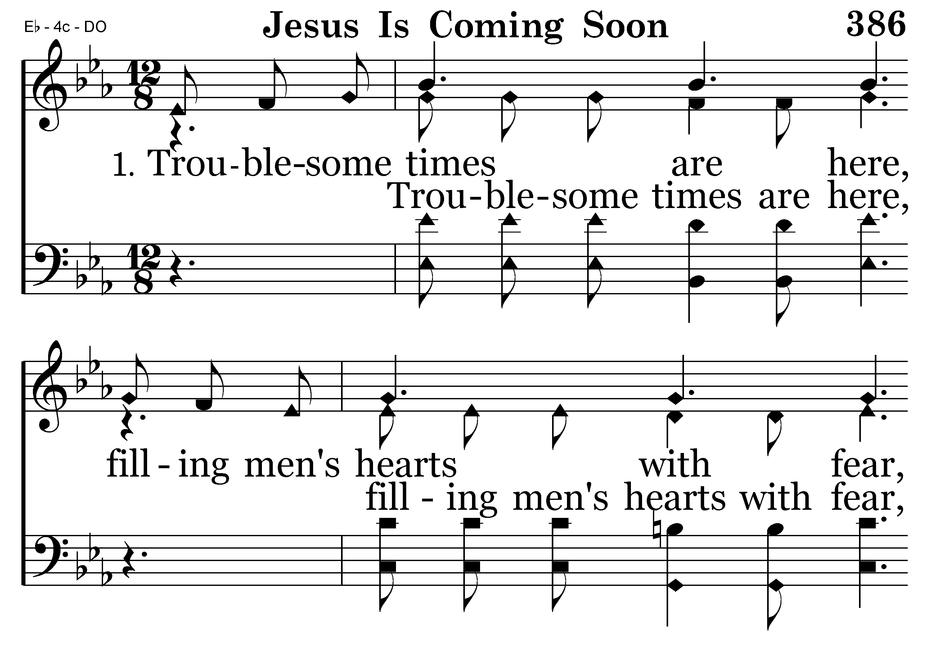
386 - Jesus Is Coming Soon - 1.1

Slide 8
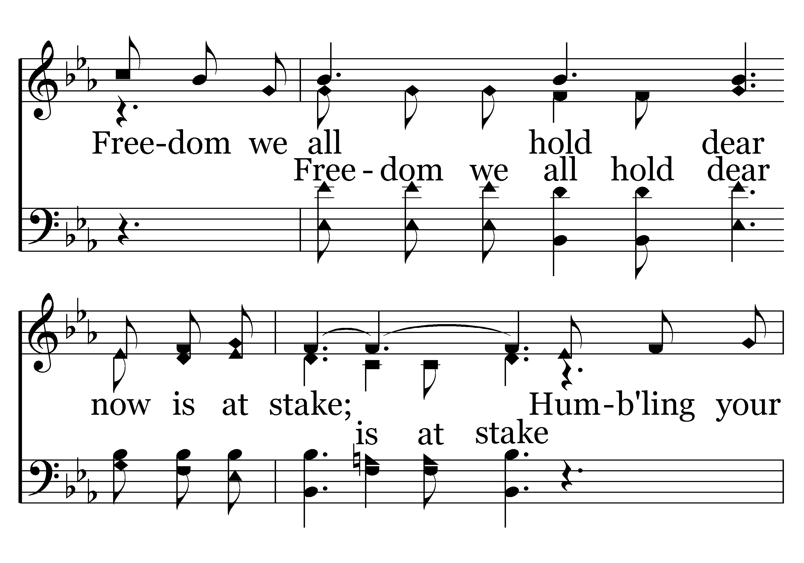
386 - Jesus Is Coming Soon - 1.2

Slide 9
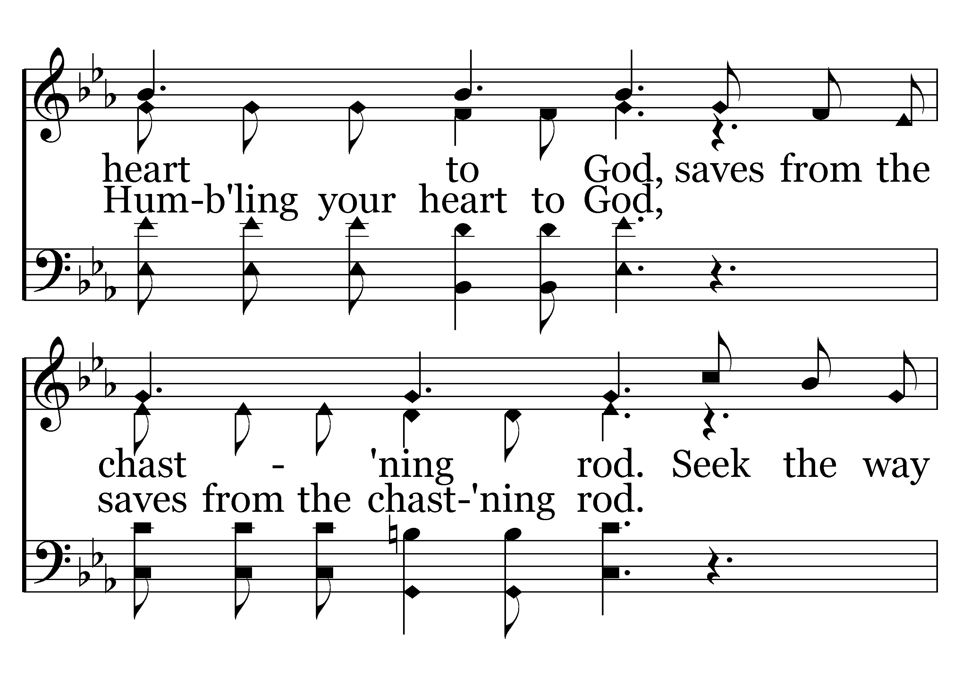
386 - Jesus Is Coming Soon - 1.3

Slide 10
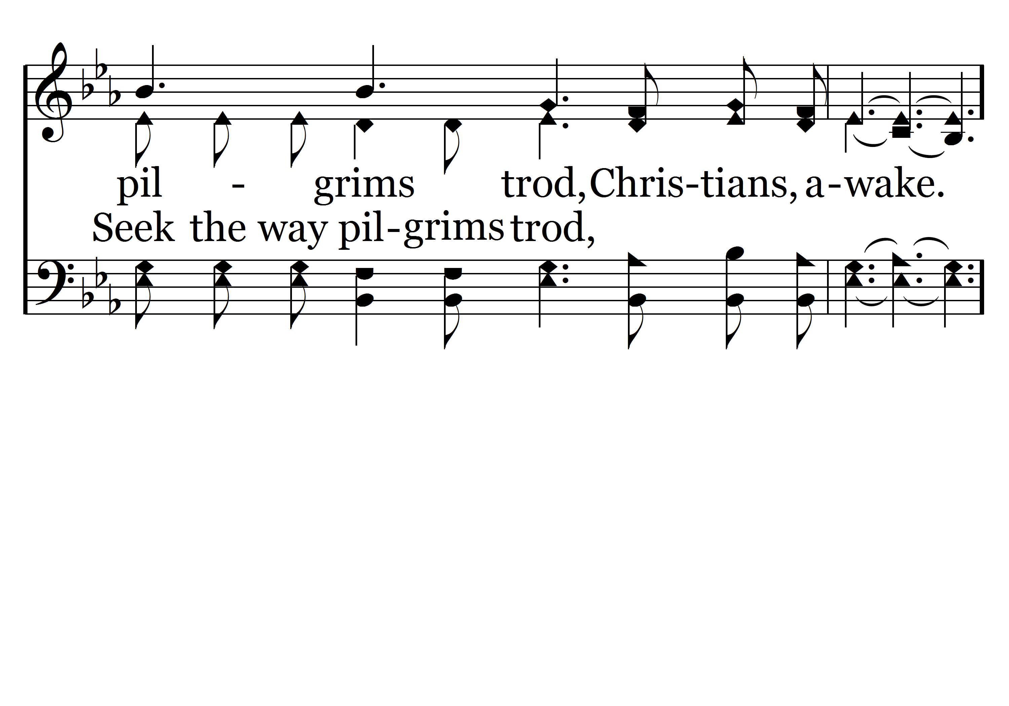
386 - Jesus Is Coming Soon - 1.4

Slide 11
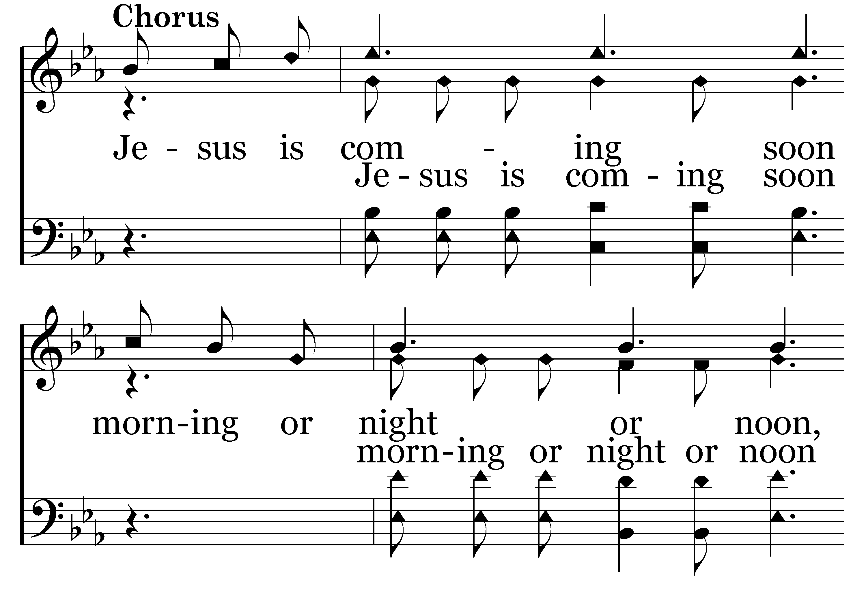
386 - Jesus Is Coming Soon - C.1

Slide 12
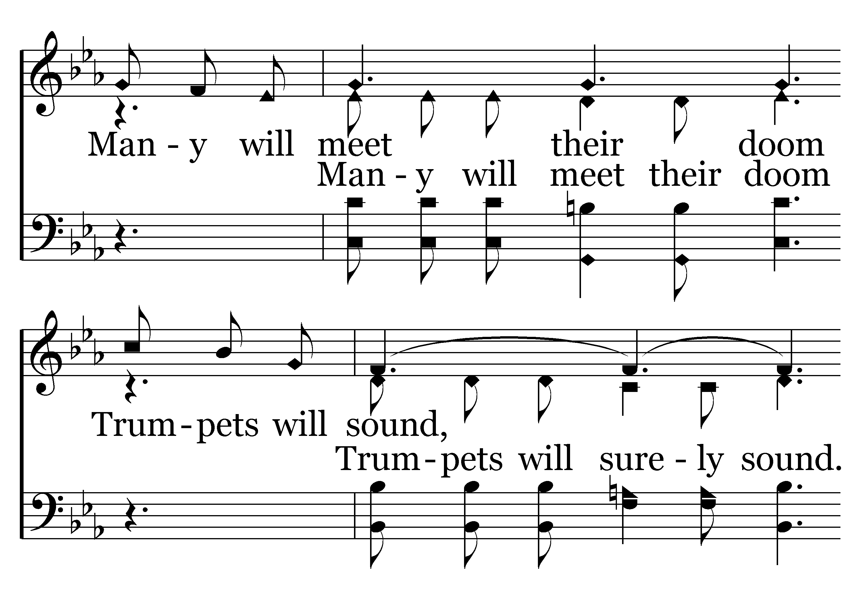
386 - Jesus Is Coming Soon - C.2

Slide 13
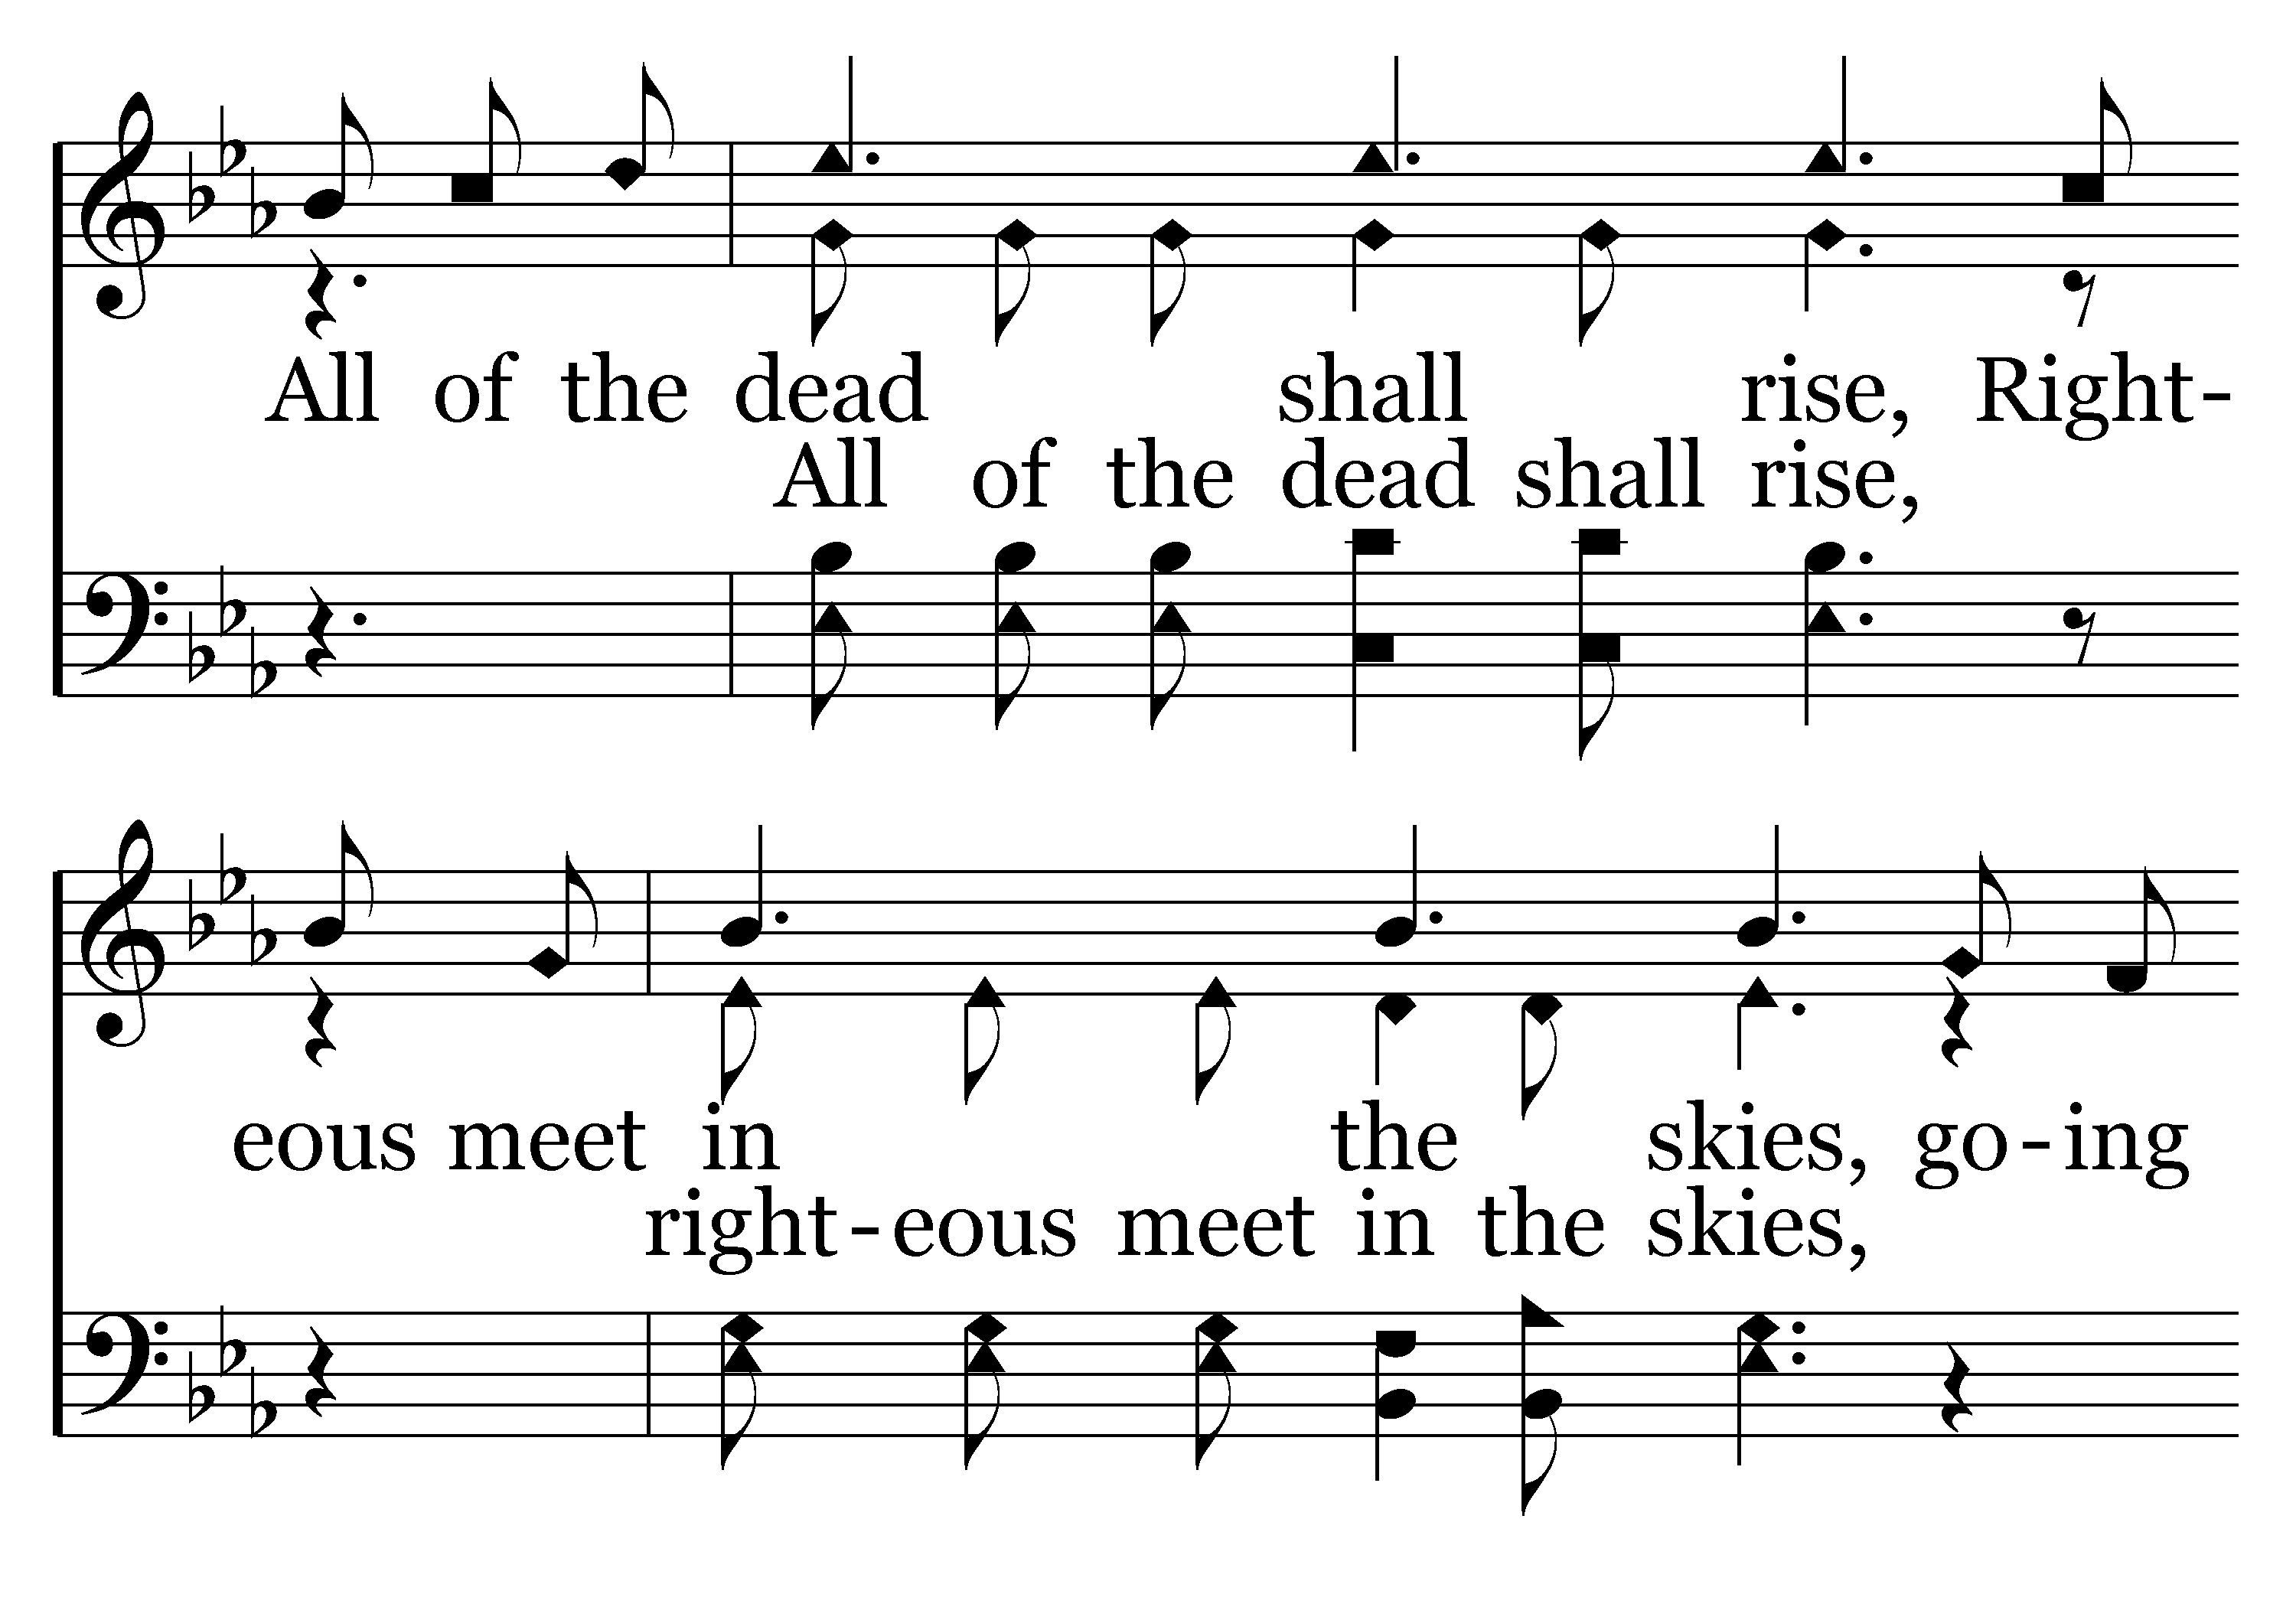
386 - Jesus Is Coming Soon - C.3

Slide 14
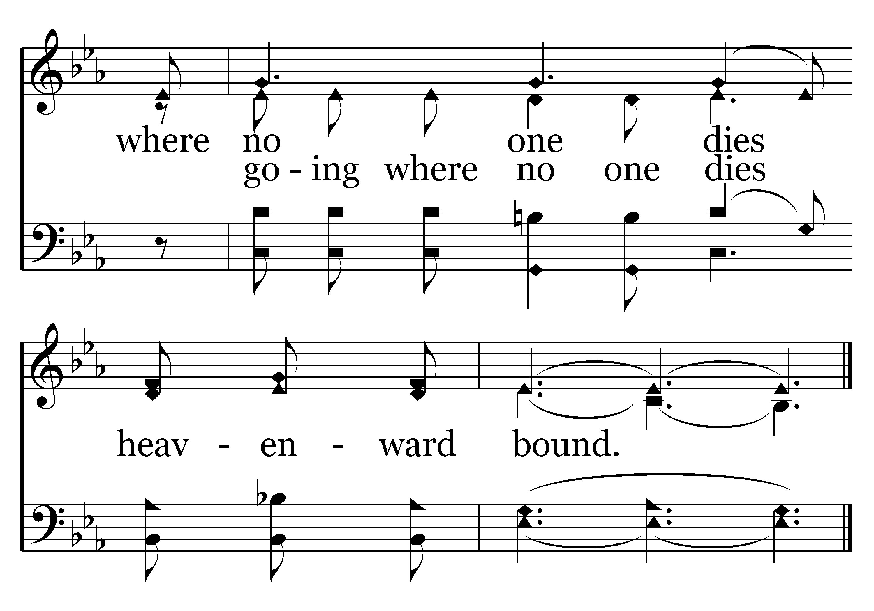
386 - Jesus Is Coming Soon - C.4
End of Verse 1

Slide 15
386 - Jesus Is Coming Soon - 2.1

Slide 16
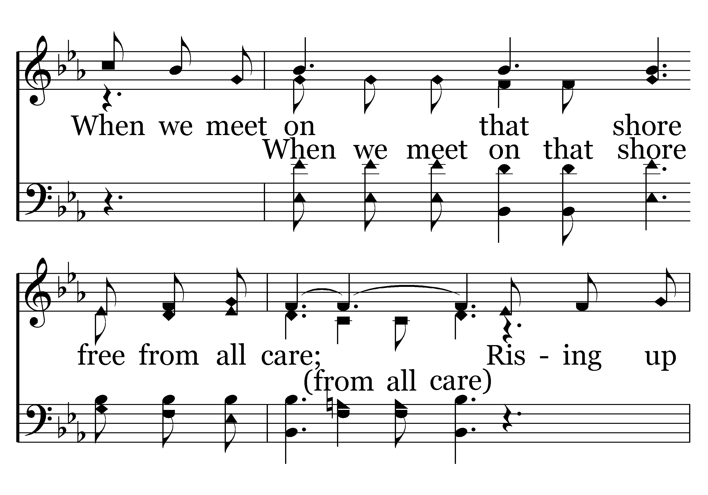
386 - Jesus Is Coming Soon - 2.2

Slide 17
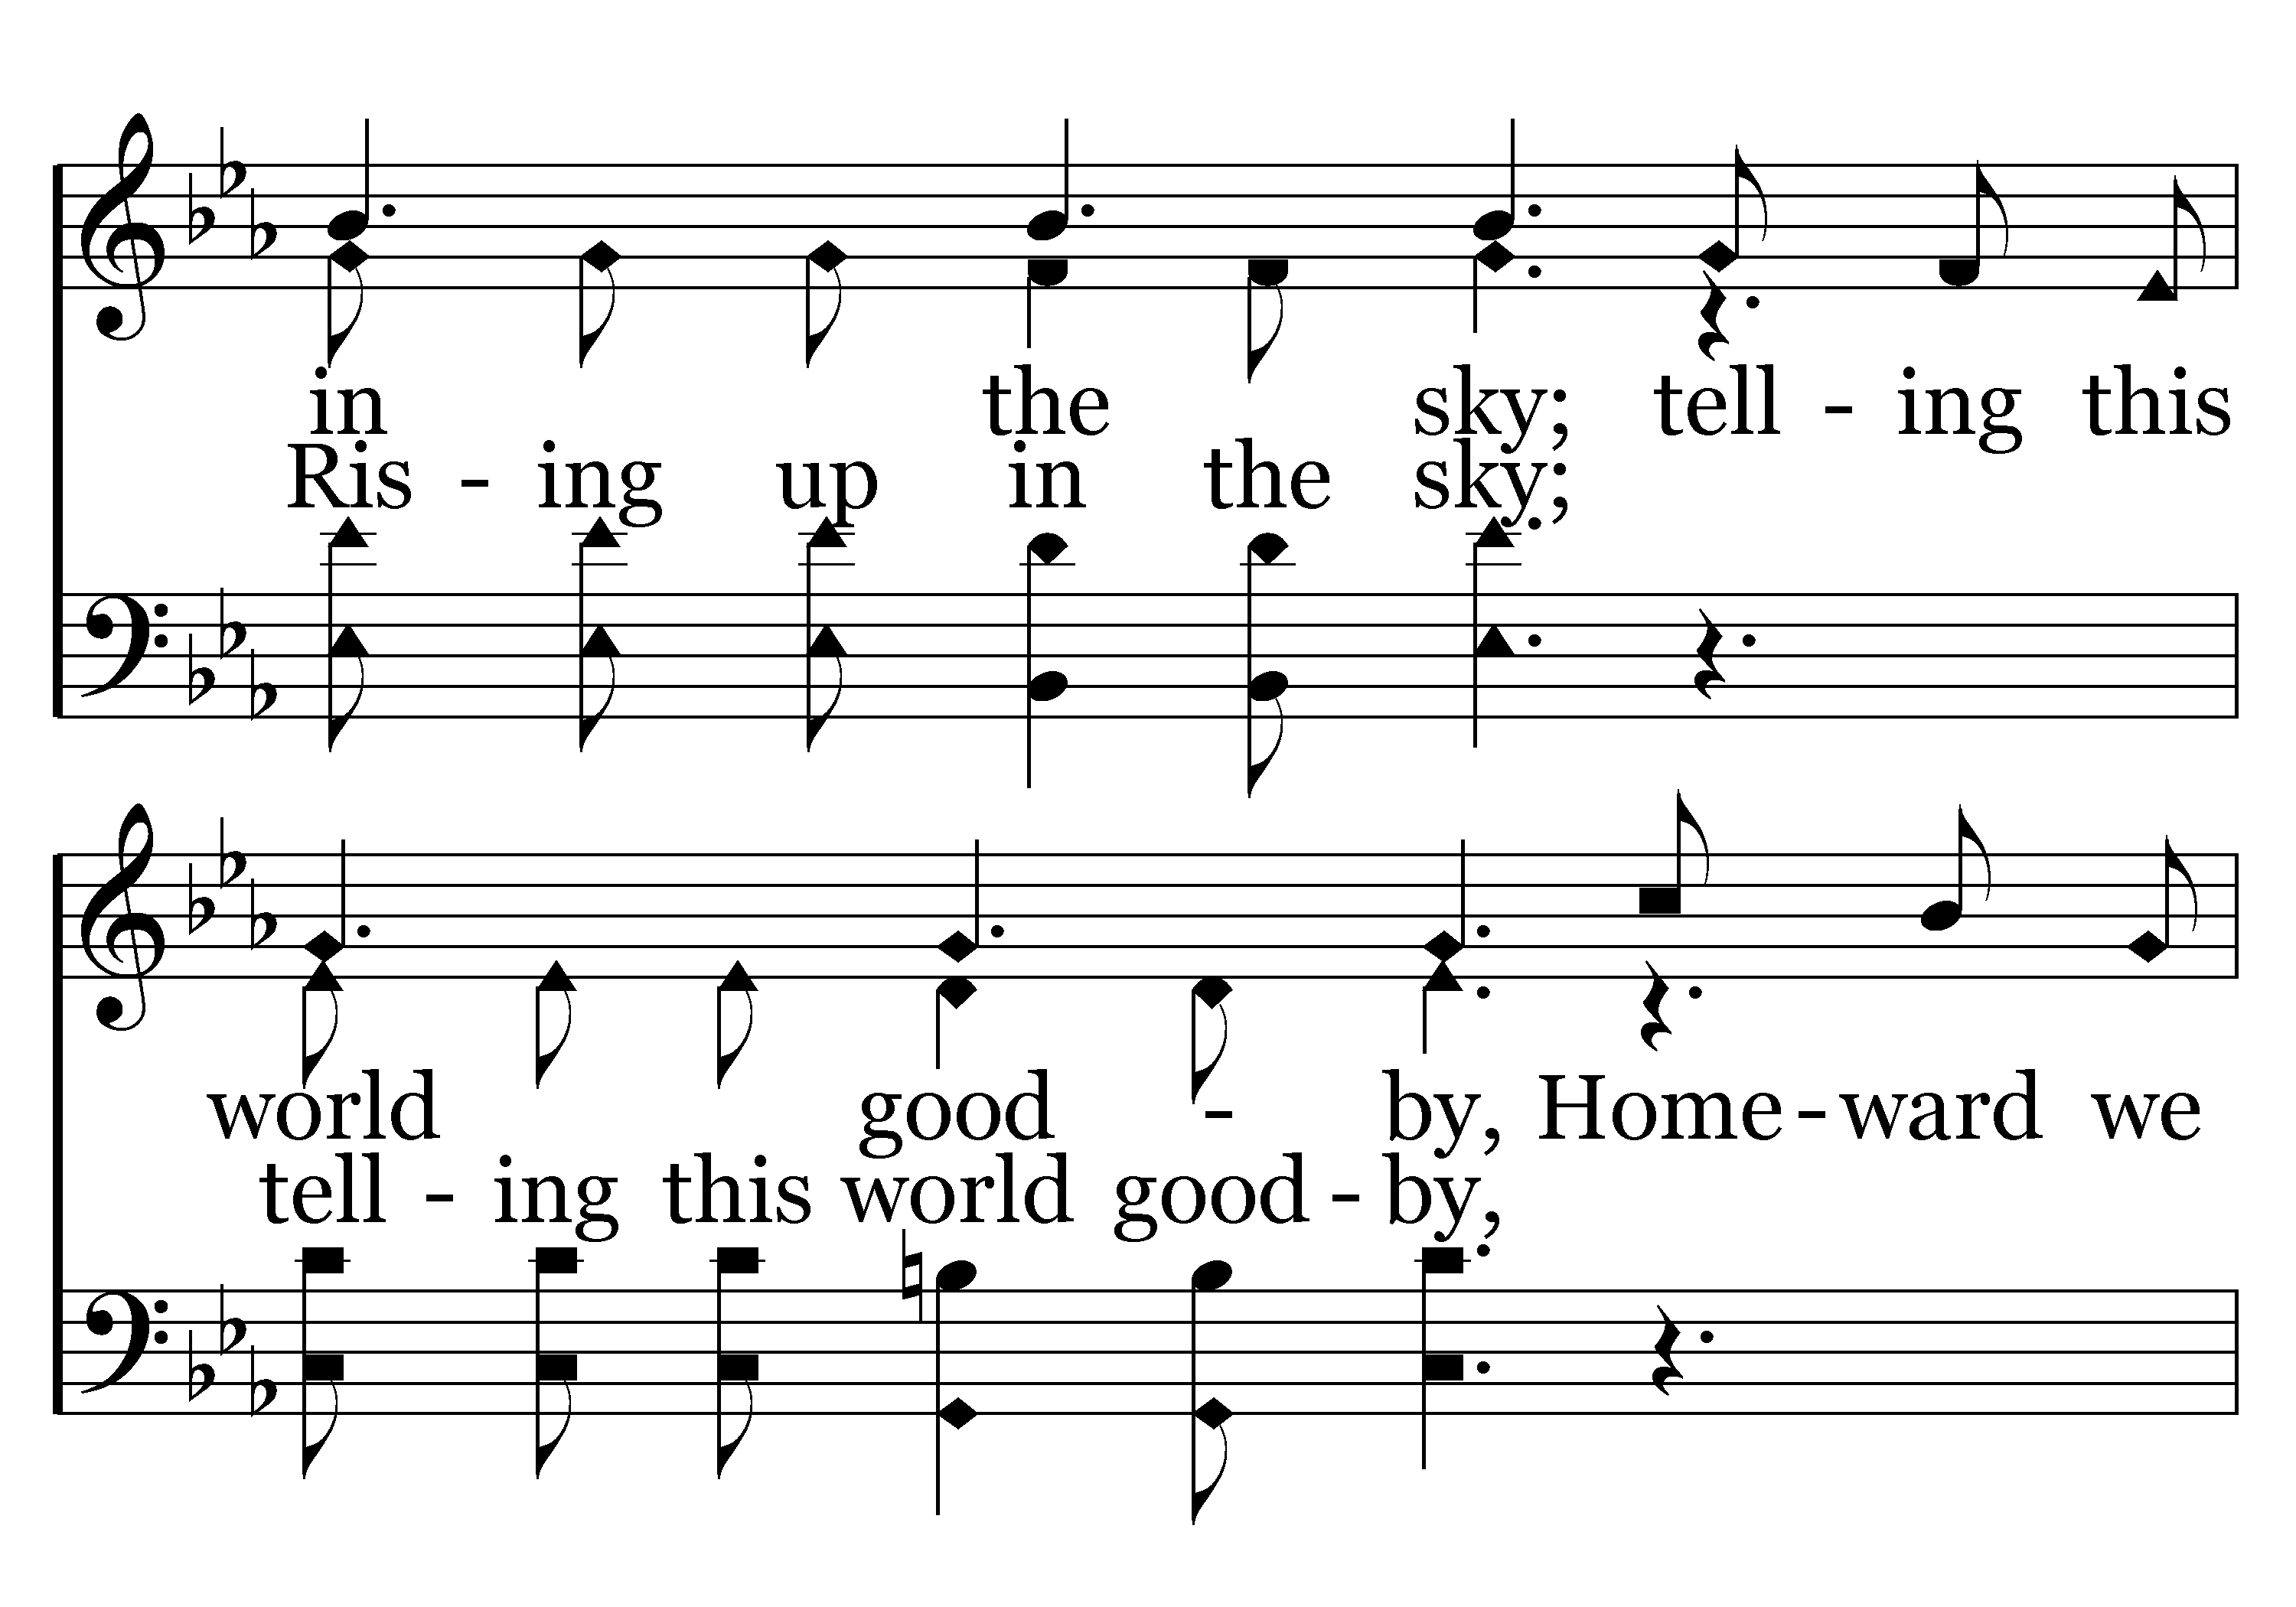
386 - Jesus Is Coming Soon - 2.3

Slide 18
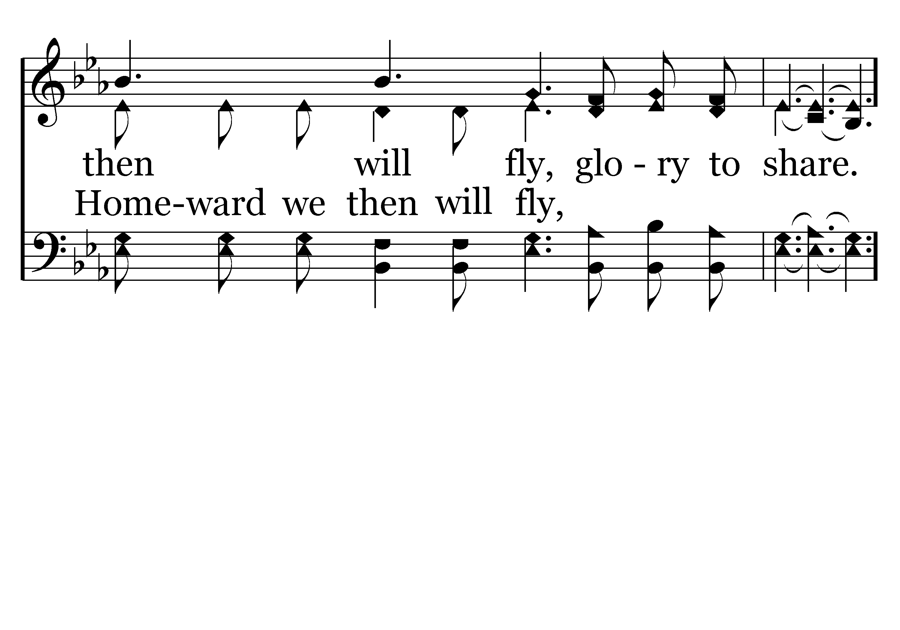
386 - Jesus Is Coming Soon - 2.4

Slide 19
386 - Jesus Is Coming Soon - C.1

Slide 20
386 - Jesus Is Coming Soon - C.2

Slide 21
386 - Jesus Is Coming Soon - C.3

Slide 22
386 - Jesus Is Coming Soon - C.4
End of Song

