Slide 1
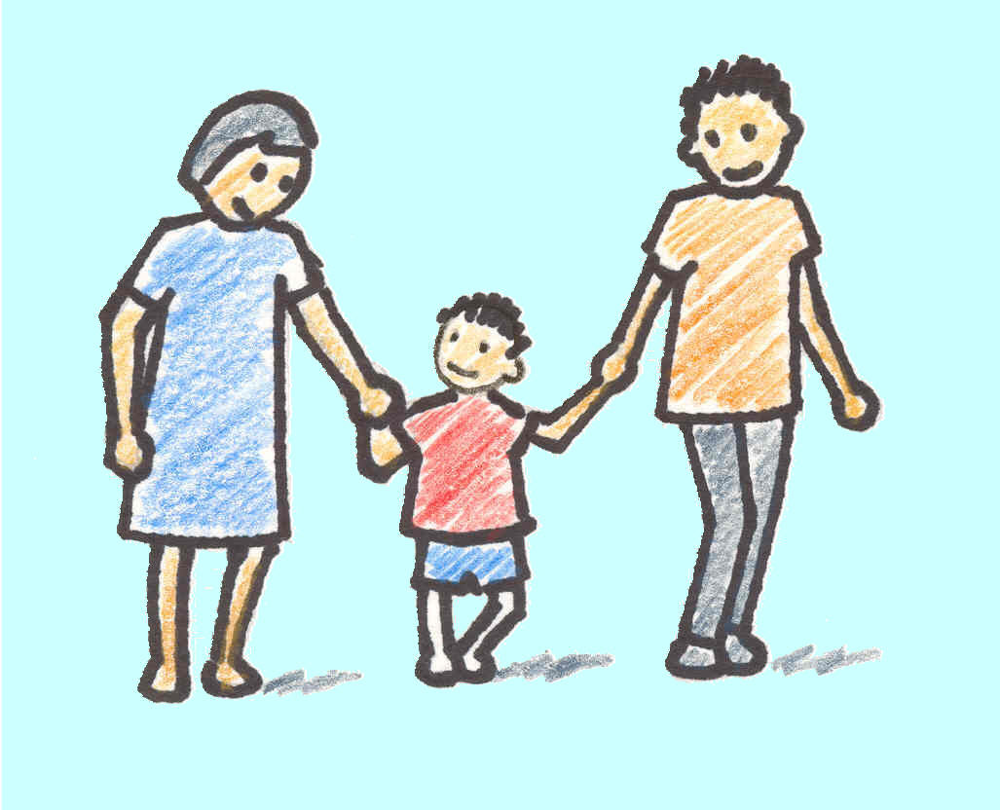
Loving Respect in the Home
Loving Respect in the Home
Proverbs 23:22-26

Slide 2
Proverbs 23:22-26
²² Listen to your father who begot you,
And do not despise your mother when she is old.
²³ Buy the truth, and do not sell it,
Also wisdom and instruction and understanding.
²⁴ The father of the righteous will greatly rejoice,
And he who begets a wise child will delight in him.
²⁵ Let your father and your mother be glad,
And let her who bore you rejoice.
²⁶ My son, give me your heart,
And let your eyes observe my ways.

Slide 3
Proverbs 23:22-26
²² Listen to your father who begot you,
And do not despise your mother when she is old.
²³ Buy the truth, and do not sell it,
Also wisdom and instruction and understanding.
²⁴ The father of the righteous will greatly rejoice,
And he who begets a wise child will delight in him.
²⁵ Let your father and your mother be glad,
And let her who bore you rejoice.
²⁶ My son, give me your heart,
And let your eyes observe my ways.

Slide 4
Proverbs 23:22-26
²² Listen to your father who begot you,
And do not despise your mother when she is old.
²³ Buy the truth, and do not sell it,
Also wisdom and instruction and understanding.
²⁴ The father of the righteous will greatly rejoice,
And he who begets a wise child will delight in him.
²⁵ Let your father and your mother be glad,
And let her who bore you rejoice.
²⁶ My son, give me your heart,
And let your eyes observe my ways.

Slide 5
Proverbs 23:22-26
²² Listen to your father who begot you,
And do not despise your mother when she is old.
²³ Buy the truth, and do not sell it,
Also wisdom and instruction and understanding.
²⁴ The father of the righteous will greatly rejoice,
And he who begets a wise child will delight in him.
²⁵ Let your father and your mother be glad,
And let her who bore you rejoice.
²⁶ My son, give me your heart,
And let your eyes observe my ways.

Slide 6
For Loving Respect To Be Present…
Parents Have Responsibility to Teach It
Psa. 127:1-5 Starts with understanding what children are
Psa. 34:8-11; Prov. 22:6, 15; 19:18 Instill respect of Lord
Gen. 18:16-19 Lord knew Abraham would teach rightly in…
Eph. 6:4 Fathers charged with training & admonition in Lord
Children Have Responsibility to Learn It
Exod. 20:12; Lev. 19:1-3 Required to honor father & mother
Deut. 27:16; Prov. 20:20; 30:17 Lack of honor condemned
Lam. 3:25-29 Patience & hope learned from yoke in youth
Eph. 6:1-3; Col. 3:20 Obedience & honor go together
All Have Responsibility to Display It
Prov. 20:11; 23:22-35 Actions show whether learned or not
Lev. 19:32 Respect of parents shown in respect of other aged
1 Tim 5:4 Loving respect seen in care for parents in need
Mark 7:9-13 Lack of care not excused by other responsibility

Slide 8
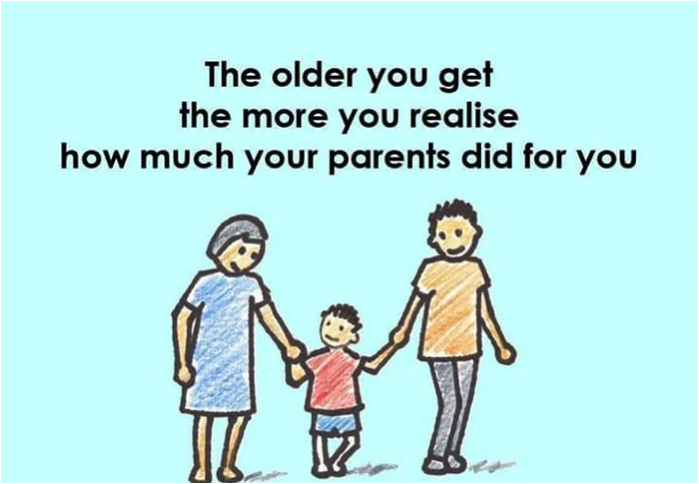
Remember to Thank Them!

Slide 10
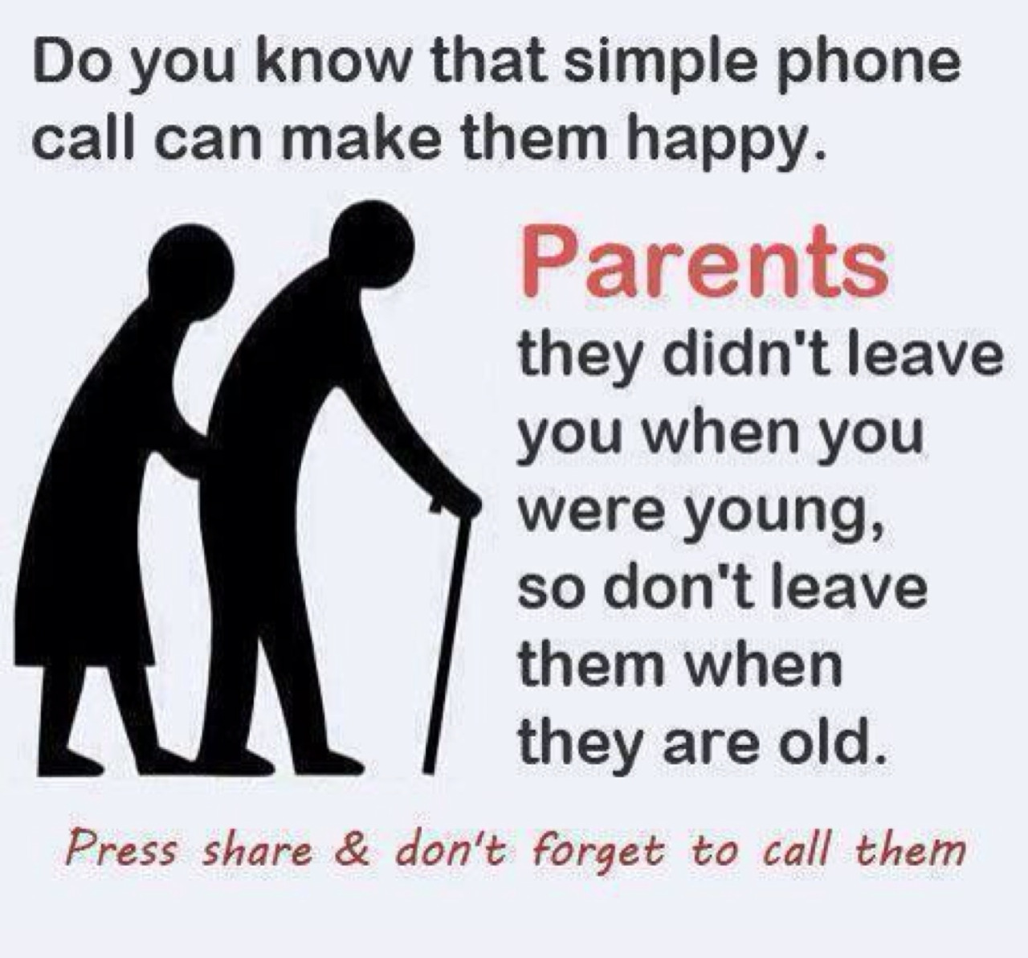

Slide 11
