Slide 2
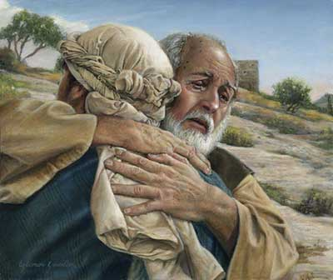
The Journey of a Rebel
He Came to his Father (12)
He Came into a Far Country (13)
He Came to be in “Want” (14)
He Came to Himself (17)
He Came Back Home (20)

