Slide 1
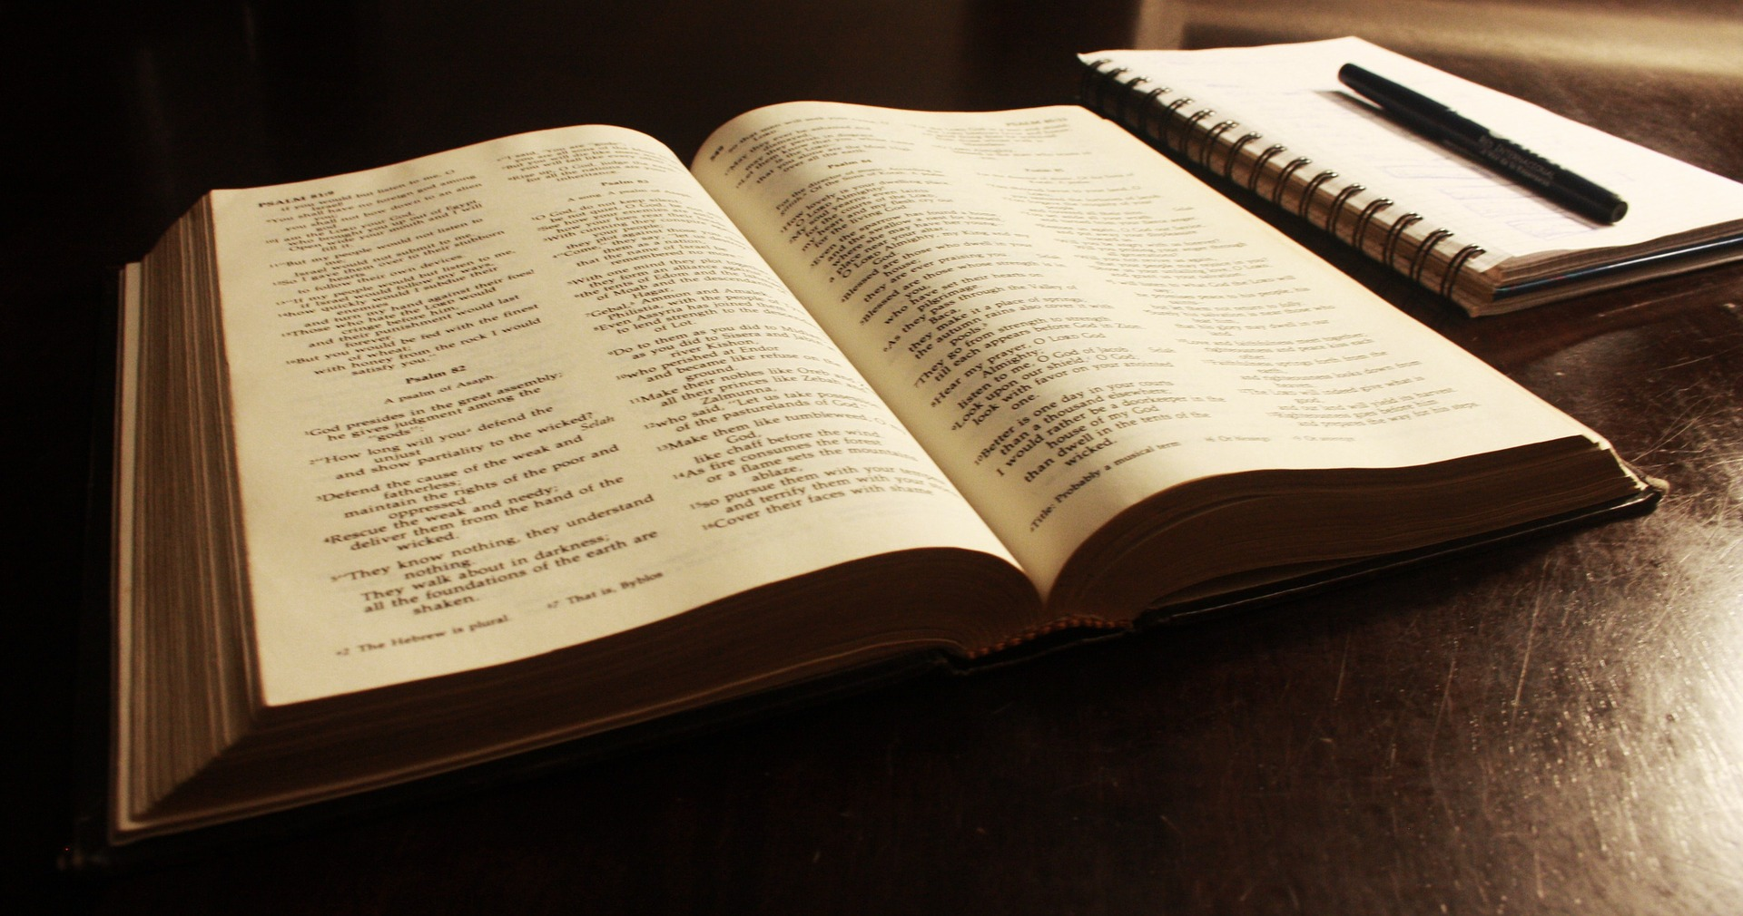
How to Study the Bible Part 1
Rightly Dividing
Part 1

Slide 2
COMMIT yourself to studying the Bible

Slide 3
Psalm 119:124-128
¹²⁴ Deal with Your servant according to Your mercy,
And teach me Your statutes.
¹²⁵ I am Your servant;
Give me understanding,
That I may know Your testimonies.
¹²⁶ It is time for You to act, O Lord,
For they have regarded Your law as void.
¹²⁷ Therefore I love Your commandments
More than gold, yes, than fine gold!
¹²⁸ Therefore all Your precepts concerning all things
I consider to be right;
I hate every false way.

Slide 4
2 Tim. 3:16
¹⁶ All Scripture is given by inspiration of God, and is profitable for doctrine, for reproof, for correction, for instruction in righteousness,
2 Tim. 2:15
¹⁵ Be diligent to present yourself approved to God, a worker who does not need to be ashamed, rightly dividing the word of truth.

Slide 5
1 Tim. 4:12-16
¹² Let no one despise your youth, but be an example to the believers in word, in conduct, in love, in spirit, in faith, in purity. ¹³ Till I come, give attention to reading, to exhortation, to doctrine. ¹⁴ Do not neglect the gift that is in you, which was given to you by prophecy with the laying on of the hands of the eldership. ¹⁵ Meditate on these things; give yourself entirely to them, that your progress may be evident to all. ¹⁶ Take heed to yourself and to the doctrine. Continue in them, for in doing this you will save both yourself and those who hear you.
2 Tim. 2:2
² And the things that you have heard from me among many witnesses, commit these to faithful men who will be able to teach others also.

Slide 6
Acts 17:11-12
¹¹ These were more fair-minded than those in Thessalonica, in that they received the word with all readiness, and searched the Scriptures daily to find out whether these things were so. ¹² Therefore many of them believed, and also not a few of the Greeks, prominent women as well as men.
1 Thess. 2:13
¹³ For this reason we also thank God without ceasing, because when you received the word of God which you heard from us, you welcomed it not as the word of men, but as it is in truth, the word of God, which also effectively works in you who believe.

Slide 7
1 Cor. 13:2
² And though I have the gift of prophecy, and understand all mysteries and all knowledge, and though I have all faith, so that I could remove mountains, but have not love, I am nothing.
Rom. 10:17
¹⁷ So then faith comes by hearing, and hearing by the word of God.
John 7:16-17
¹⁶ Jesus answered them and said, “My doctrine is not Mine, but His who sent Me. ¹⁷ If anyone wills to do His will, he shall know concerning the doctrine, whether it is from God or whether I speak on My own authority.

Slide 8
COMMIT yourself to studying the Bible
DETERMINE what you are going to study

Slide 9
Jas. 1:22-25
²² But be doers of the word, and not hearers only, deceiving yourselves. ²³ For if anyone is a hearer of the word and not a doer, he is like a man observing his natural face in a mirror; ²⁴ for he observes himself, goes away, and immediately forgets what kind of man he was. ²⁵ But he who looks into the perfect law of liberty and continues in it, and is not a forgetful hearer but a doer of the work, this one will be blessed in what he does.

Slide 10
Acts 15:4-6
⁴ And when they had come to Jerusalem, they were received by the church and the apostles and the elders; and they reported all things that God had done with them. ⁵ But some of the sect of the Pharisees who believed rose up, saying, “It is necessary to circumcise them, and to command them to keep the law of Moses.” ⁶ Now the apostles and elders came together to consider this matter.
1 Cor. 15:12
¹² Now if Christ is preached that He has been raised from the dead, how do some among you say that there is no resurrection of the dead?

Slide 11
COMMIT yourself to studying the Bible
DETERMINE what you are going to study
LEARN what the Bible says on your subject

Slide 12
1 Pet. 4:11
¹¹ If anyone speaks, let him speak as the oracles of God. If anyone ministers, let him do it as with the ability which God supplies, that in all things God may be glorified through Jesus Christ, to whom belong the glory and the dominion forever and ever.
Isa. 5:20
²⁰ Woe to those who call evil good, and good evil;
Who put darkness for light, and light for darkness;
Who put bitter for sweet, and sweet for bitter!

Slide 13
1 Cor. 1:13-17
¹³ Is Christ divided? Was Paul crucified for you? Or were you baptized in the name of Paul? ¹⁴ I thank God that I baptized none of you except Crispus and Gaius, ¹⁵ lest anyone should say that I had baptized in my own name. ¹⁶ Yes, I also baptized the household of Stephanas. Besides, I do not know whether I baptized any other. ¹⁷ For Christ did not send me to baptize, but to preach the gospel, not with wisdom of words, lest the cross of Christ should be made of no effect.

Slide 14
1 Cor. 1:13-17
¹³ Is Christ divided? Was Paul crucified for you? Or were you baptized in the name of Paul? ¹⁴ I thank God that I baptized none of you except Crispus and Gaius, ¹⁵ lest anyone should say that I had baptized in my own name. ¹⁶ Yes, I also baptized the household of Stephanas. Besides, I do not know whether I baptized any other. ¹⁷ For Christ did not send me to baptize, but to preach the gospel, not with wisdom of words, lest the cross of Christ should be made of no effect.

Slide 15
1 Cor. 1:13-17
¹³ Is Christ divided? Was Paul crucified for you? Or were you baptized in the name of Paul? ¹⁴ I thank God that I baptized none of you except Crispus and Gaius, ¹⁵ lest anyone should say that I had baptized in my own name. ¹⁶ Yes, I also baptized the household of Stephanas. Besides, I do not know whether I baptized any other. ¹⁷ For Christ did not send me to baptize, but to preach the gospel, not with wisdom of words, lest the cross of Christ should be made of no effect.

Slide 16
Matt. 3:11
¹¹ I indeed baptize you with water unto repentance, but He who is coming after me is mightier than I, whose sandals I am not worthy to carry. He will baptize you with the Holy Spirit and fire.
Acts 19:4-5
⁴ Then Paul said, “John indeed baptized with a baptism of repentance, saying to the people that they should believe on Him who would come after him, that is, on Christ Jesus.” ⁵ When they heard this, they were baptized in the name of the Lord Jesus.

Slide 17
Gen. 3:4
⁴ Then the serpent said to the woman, “You will not surely die.
Job 2:9
⁹ Then his wife said to him, “Do you still hold fast to your integrity? Curse God and die!”

Slide 18
Acts 1:4-5, 8
⁴ And being assembled together with them, He commanded them not to depart from Jerusalem, but to wait for the Promise of the Father, “which,” He said, “you have heard from Me; ⁵ for John truly baptized with water, but you shall be baptized with the Holy Spirit not many days from now.”
Acts 1:1-3
¹ The former account I made, O Theophilus, of all that Jesus began both to do and teach, ² until the day in which He was taken up, after He through the Holy Spirit had given commandments to the apostles whom He had chosen, ³ to whom He also presented Himself alive after His suffering by many infallible proofs, being seen by them during forty days and speaking of the things pertaining to the kingdom of God.

Slide 19
Acts 8:22-23
²² Repent therefore of this your wickedness, and pray God if perhaps the thought of your heart may be forgiven you. ²³ For I see that you are poisoned by bitterness and bound by iniquity.”
Acts 8:12-13
¹² But when they believed Philip as he preached the things concerning the kingdom of God and the name of Jesus Christ, both men and women were baptized. ¹³ Then Simon himself also believed; and when he was baptized he continued with Philip, and was amazed, seeing the miracles and signs which were done.

Slide 20
1 John 1:9
⁹ If we confess our sins, He is faithful and just to forgive us our sins and to cleanse us from all unrighteousness.”
1 John 1:7-8
⁷ But if we walk in the light as He is in the light, we have fellowship with one another, and the blood of Jesus Christ His Son cleanses us from all sin. ⁸ If we say that we have no sin, we deceive ourselves, and the truth is not in us.

Slide 21
Ephesians 2:8
⁸ For by grace you have been saved through faith, and that not of yourselves; it is the gift of God,
Jas. 2:17-20
¹⁷ Thus also faith by itself, if it does not have works, is dead. ¹⁸ But someone will say, “You have faith, and I have works.” Show me your faith without your works, and I will show you my faith by my works. ¹⁹ You believe that there is one God. You do well. Even the demons believe—and tremble! ²⁰ But do you want to know, O foolish man, that faith without works is dead?

Slide 22
2 Tim. 2:7
⁷ Consider what I say, and may the Lord give you understanding in all things.
Hos. 4:6
⁶ My people are destroyed for lack of knowledge.
Because you have rejected knowledge,
I also will reject you from being priest for Me;
Because you have forgotten the law of your God,
I also will forget your children."
John 8:31-32
³¹ Then Jesus said to those Jews who believed Him, “If you abide in My word, you are My disciples indeed. ³² And you shall know the truth, and the truth shall make you free.”

