Slide 1
Noah’s Ark
Noah Pleases God Genesis 6:
9 This is the genealogy of Noah. Noah was a just man, perfect in his generations. Noah walked with God. 10 And Noah begot three sons: Shem, Ham, and Japheth.11 The earth also was corrupt before God, and the earth was filled with violence. 12 So God looked upon the earth, and indeed it was corrupt; for all flesh had corrupted their way on the earth.

Slide 2
The Ark Prepared
13 And God said to Noah, "The end of all flesh has come before Me, for the earth is filled with violence through them; and behold, I will destroy them with the earth. 14 Make yourself an ark of gopherwood; make rooms in the ark, and cover it inside and outside with pitch. 15 And this is how you shall make it: The length of the ark shall be three hundred cubits, its width fifty cubits, and its height thirty cubits. 16 You shall make a window for the ark, and you shall finish it to a cubit from above; and set the door of the ark in its side. You shall make it with lower, second, and third decks.

Slide 3
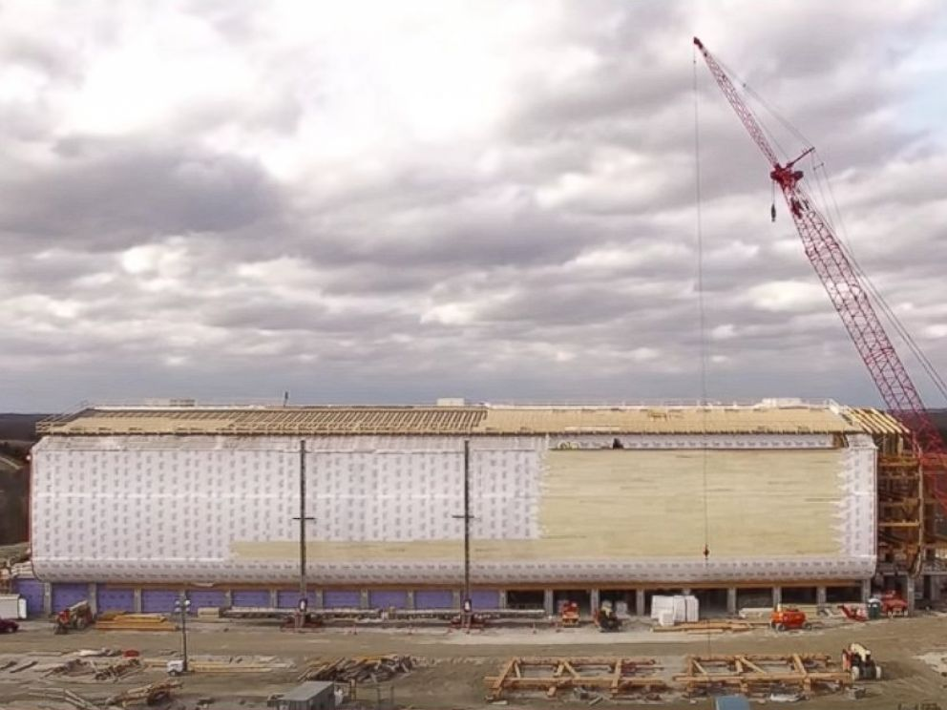

Slide 4
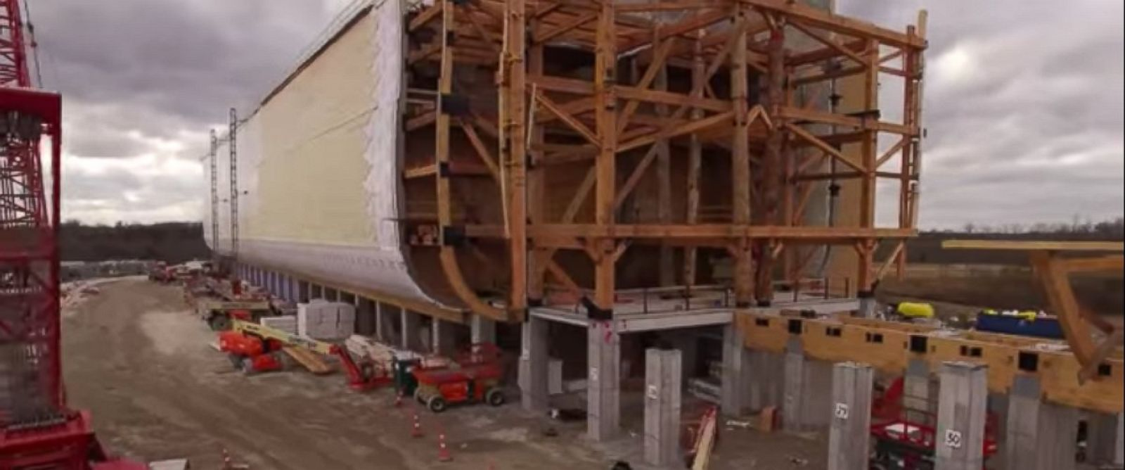

Slide 5
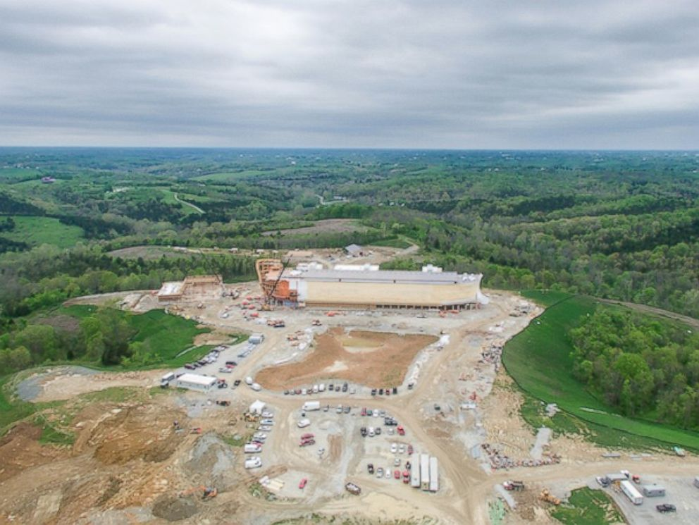

Slide 6
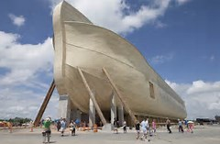

Slide 7
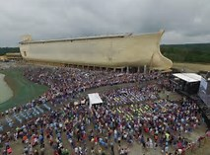

Slide 8
17 And behold, I Myself am bringing floodwaters on the earth, to destroy from under heaven all flesh in which is the breath of life; everything that is on the earth shall die. 18 But I will establish My covenant with you; and you shall go into the ark — you, your sons, your wife, and your sons ' wives with you. 19 And of every living thing of all flesh you shall bring two of every sort into the ark, to keep them alive with you; they shall be male and female. 20 Of the birds after their kind, of animals after their kind, and of every creeping thing of the earth after its kind, two of every kind will come to you to keep them alive. . 21 And you shall take for yourself of all food that is eaten, and you shall gather it to yourself; and it shall be food for you and for them."22 Thus Noah did; according to all that God commanded him, so he did.

Slide 9
The Great Flood 7
1 Then the Lord said to Noah, " Come into the ark, you and all your household, because I have seen that you are righteous before Me in this generation. 2 You shall take with you seven each of every clean animal, a male and his female; two each of animals that are unclean, a male and his female; 3 also seven each of birds of the air, male and female, to keep the species alive on the face of all the earth. 4 For after seven more days I will cause it to rain on the earth forty days and forty nights, and I will destroy from the face of the earth all living things that I have made." 5 And Noah did according to all that the Lord commanded him. 6 Noah was six hundred years old when the floodwaters were on the earth.

Slide 10
7 So Noah, with his sons, his wife, and his sons ' wives, went into the ark because of the waters of the flood. 8 Of clean animals, of animals that are unclean, of birds, and of everything that creeps on the earth, 9 two by two they went into the ark to Noah, male and female, as God had commanded Noah. 10 And it came to pass after seven days that the waters of the flood were on the earth. 11 In the six hundredth year of Noah's life, in the second month, the seventeenth day of the month, on that day all the fountains of the great deep were broken up, and the windows of heaven were opened. 12 And the rain was on the earth forty days and forty nights

Slide 11
13 On the very same day Noah and Noah 's sons, Shem, Ham, and Japheth, and Noah's wife and the three wives of his sons with them, entered the ark — 14 they and every beast after its kind, all cattle after their kind, every creeping thing that creeps on the earth after its kind, and every bird after its kind, every bird of every sort. 15 And they went into the ark to Noah, two by two, of all flesh in which is the breath of life. 16 So those that entered, male and female of all flesh, went in as God had commanded him; and the Lord shut him in.

Slide 12
Noah's Deliverance 8
13 And it came to pass in the six hundred and first year, in the first month, the first day of the month, that the waters were dried up from the earth; and Noah removed the covering of the ark and looked, and indeed the surface of the ground was dry. 14 And in the second month, on the twenty- seventh day of the month, the earth was dried.15 Then God spoke to Noah, saying, 16 " Go out of the ark, you and your wife, and your sons and your sons ' wives with you. 17 Bring out with you every living thing of all flesh that is with you, birds and cattle and every creeping thing that creeps on the earth, so that they may abound on the earth, and be fruitful and multiply on the earth."

Slide 13
Salvation of Noah’s Family
18 So Noah went out, and his sons and his wife and his sons ' wives with him. 19 Every animal, every creeping thing, every bird, and whatever creeps on the earth, according to their families, went out of the ark.

Slide 14
Baptism now saves Us
1Pet 3:20 in the days of Noah, while the ark was being prepared, in which a few, that is, eight souls, were saved through water. 21 There is also an antitype which now saves us — baptism (not the removal of the filth of the flesh, but the answer of a good conscience toward God), through the resurrection of Jesus Christ,

Slide 15
Baptism washes away Sin
Acts 22:16 And now why are you waiting? Arise and be baptized, and wash away your sins, calling on the name of the Lord. '

Slide 16
How are we saved?
Hear Rom 10:14 , 17 Faith comes by hearing
Believe Mark 16:15, 16
Repent Luke 13:3
Confess Rom 10:10
Baptism Acts 2:38

