Slide 1
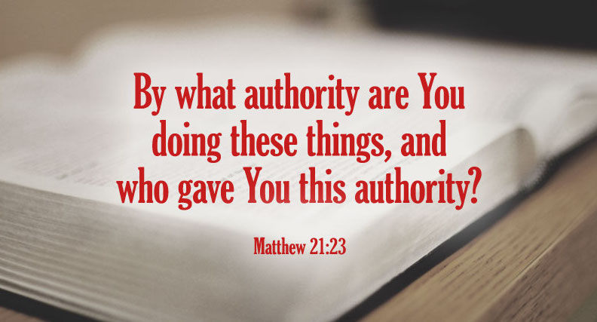
By What Authority…? Jesus on Authority of Scripture
Matthew 4:1-10

Slide 2
Matthew 21:23-25
²³ Now when He came into the temple, the chief priests and the elders of the people confronted Him as He was teaching, and said, “By what authority are You doing these things? And who gave You this authority?” ²⁴ But Jesus answered and said to them, “I also will ask you one thing, which if you tell Me, I likewise will tell you by what authority I do these things: ²⁵ The baptism of John—where was it from? From heaven or from men?”
“By what authority are you doing these things?”
Jesus gave the only options:
“From heaven or from men?”

Slide 3
An Introduction to the Text
Text says, “the chief priests and the elders of the people confronted” Jesus
Who were they? How did they come to their power?
Priests to strictly observe God’s ordinances (Lev. 22:9)
Mandatory for priests to do as God said (Lev. 10:1-3)
By end of OT, they were not doing so (Mal. 2:1-9)
In Maccabean time, changed high priesthood to political office rather than law defining the office & succession
In time of Jesus, Annas was high priest (A.D. 6-15), but Romans removed him an installed Caiaphas (A.D. 18-36)
Accounts for lack of respect given by Paul (Acts 23:1-5)
The law of Moses said nothing about “chief priests” (pl.)
Their assumption of own inherent power was wrong!

Slide 4
What Things Was Jesus Doing?
Matt. 21:1-11 Accepted adoration & praise at entry
Chief priests & elders rejected Jesus as the Messiah
But Jesus was Divine Messiah of promise (Jn. 20:30-31)
He received praise & adoration as prophesied (Zech. 9:9)
Thus, Jesus had authority from heaven for what He did
Matt. 21:12-17 Cleansed temple of merchandisers
Leaders believed they were the authorities for temple
Actually, God was the authority & their actions were in conflict with God’s law (Isa. 56:7; Jer. 7:1-11; etc.)
As Deity, Jesus had authority from heaven to cleanse it
Matt. 21:18-19 Withered the fig tree immediately
Action itself proved His heavenly, divine authority to act

Slide 5
Matthew 4:1-10
¹ Then Jesus was led up by the Spirit into the wilderness to be tempted by the devil. ² And when He had fasted forty days and forty nights, afterward He was hungry. ³ Now when the tempter came to Him, he said, “If You are the Son of God, command that these stones become bread.” ⁴ But He answered and said, “It is written, ‘Man shall not live by bread alone, but by every word that proceeds from the mouth of God.’” ⁵ Then the devil took Him up into the holy city, set Him on the pinnacle of the temple, ⁶ and said to Him, “If You are the Son of God, throw Yourself down. For it is written: ‘He shall give His angels charge over you,’ and, ‘In their hands they shall bear you up, lest you dash your foot against a stone.’” ⁷ Jesus said to him, “It is written again, ‘You shall not tempt the Lord your God.’” ⁸ Again, the devil took Him up on an exceedingly high mountain, and showed Him all the kingdoms of the world and their glory. ⁹ And he said to Him, “All these things I will give You if You will fall down and worship me.” ¹⁰ Then Jesus said to him, “Away with you, Satan! For it is written, ‘You shall worship the Lord your God, and Him only you shall serve.’”

Slide 6
Jesus Spoke of Scripture as...
Authoritative: “It is written”
Inspired: “… every word that proceeds from the mouth of God”
Harmonious: “Again it is written”
It was originally stated
Respecting its context
Understandable
Practical
Having the purpose of glorifying God, not serving to justify selfish desires

Slide 7
Other Passages in Gospels Show How Jesus Used Scripture

Slide 8
Distinguished Divine Law from Human Tradition
Matthew 15:1-14
Mark 7:1-13
Condemned the vain worship of Pharisees
Pharisees added & deleted elements of law
Added vigorous hand washing not commanded in law
Deleted honor of parents that was commanded in law
Pharisees did not strictly adhere to the law
Strict adherence to law is opposite Pharisees path
Jesus required obedience to God’s law unchanged

Slide 9
In Conflict over Resurrection
Matthew 22:23-33
Sadducees tried to use hypothetical case in order to negate truth
Jesus went to real source of problem: “You are wrong, because you know neither the Scriptures nor the power of God.” [ESV]
Used the tense of one word as significant
Demands an acceptance of verbal inspiration of Scripture
Conclusion drawn from a necessary inference

Slide 10
In Answer to Question about the Greatest Commandment
Matthew 22:34-40
If Jesus had little respect for commands of law, this was opportunity to show it
Instead, He affirmed the need to adhere to the law from the foundation
“On these two commandments hang all the Law and the Prophets”
Showed the cohesion and unity of all Scripture in purpose & function

Slide 11
In Conflict over Nature & Identity of the Messiah
Matthew 22:41-46
Jews accepted prophecy of the Messiah as being the “son of David”
Jesus noted another prophecy about the Messiah given by David “in the Spirit” (inspiration affirmed)
Messiah both “son of David” & “Lord”
Appealed to harmony of Scripture
Must accept all Scripture says, not just favored part
Conclusion is again the inescapable deduction from the facts presented (necessary inference)

Slide 12
In Conflict over Obedience Required
Luke 10:25-37
Jesus pointed the man to the proper source to answer: “What is written in the law?”
Jesus recognized his ability to understand the law: “What is your reading of it?”
The man was able to understand the requirements of the law
When asked to apply the principles, the man showed ability to know & apply
Jesus used Scripture as the answer to every question

