Slide 1
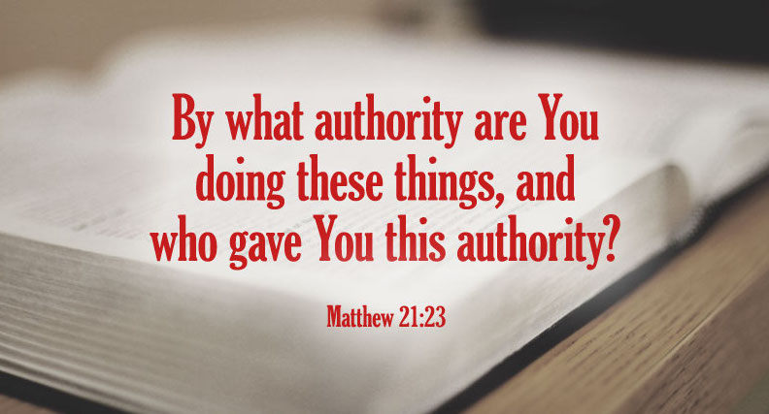
By What Authority…? Application: Individual vs. Collective Action
Matthew 18:15-17

Slide 2
Matthew 21:23-25
²³ Now when He came into the temple, the chief priests and the elders of the people confronted Him as He was teaching, and said, “By what authority are You doing these things? And who gave You this authority?” ²⁴ But Jesus answered and said to them, “I also will ask you one thing, which if you tell Me, I likewise will tell you by what authority I do these things: ²⁵ The baptism of John—where was it from? From heaven or from men?”
“By what authority are you doing these things?”
Jesus gave the only options:
“From heaven or from men?”

Slide 3
Jesus Spoke of Scripture as...
Authoritative: “It is written”
Inspired: “… every word that proceeds from the mouth of God”
Harmonious: “Again it is written”
It was originally stated
Respecting its context
Understandable
Practical
Having the purpose of glorifying God, not serving to justify selfish desires

Slide 4
Matthew 28:18-20
¹⁸ And Jesus came and spoke to them, saying, “All authority has been given to Me in heaven and on earth. ¹⁹ Go therefore and make disciples of all the nations, baptizing them in the name of the Father and of the Son and of the Holy Spirit, ²⁰ teaching them to observe all things that I have commanded you; and lo, I am with you always, even to the end of the age.”

Slide 5
Individual vs. Collective Action
Applying the Principles
Is there a difference between the church and individual Christians?
Can the church do collectively whatever individuals can do separately?

Slide 6
Case For No Distinction Stated

Slide 7
They say it is alright for Christians to support colleges but that it is wrong for a church to do so. Thus, they make a difference between Christian duties and church duties, Christian responsibilities and church responsibilities, Christian work and church work, all of which is absurd on its face” (G. C. Brewer, The Harding College Lectures, p.113, 1947).

Slide 8
“In view of all that has been said above, it is now possible to state principle. Any ‘good work’ which the individual, as a Christian, is obligated to support financially, the church is equally obligated to support financially. There has been a great deal of talk about what the individual can do in supporting good works and what the church cannot do in supporting the same good works. No such distinction is taught in the scriptures. If it is a good work, which the Lord wants done, the obligation falls equally upon individuals and upon the church, for individuals are the church” (Batsell Barrett Baxter, Questions & Issues of the Day, p. 23, 1963)

Slide 9
“There are those who try to distinguish between the work of the church and the work of Christians, indicating one to be divine, the other human. This is fallacious reasoning. The church is composed of Christians; what the church does, Christians do; what Christians do, the church does, generally speaking. We cannot separate the Christian’s work from the work of the church…. Actually, we may say that whatever is the duty of a Christian is the duty of a congregation of Christians” (V. E. Howard, Institutionalism, Orphan Homes and Church Cooperation, pp. 6-7, 1958)

Slide 10
“… this idea of trying to distinguish between Christian activity of the disciples and the church is an absurdity anyway”
(Guy N. Woods, Cooperation in the Field of Benevolence and Evangelism, 1957).

Slide 11
Bible Teaching on Differences between Individual & Church Action
Matthew 18:15-17
¹⁵ “Moreover if your brother sins against you, go and tell him his fault between you and him alone. If he hears you, you have gained your brother. ¹⁶ But if he will not hear, take with you one or two more, that ‘by the mouth of two or three witnesses every word may be established.’ ¹⁷ And if he refuses to hear them, tell it to the church. But if he refuses even to hear the church, let him be to you like a heathen and a tax collector.”

Slide 12
Bible Teaching on Differences between Individual & Church Action
1 Corinthians 12:12-31
v. 12 – “For as the body is one and has many members, but all the members of that one body, being many, are one body, so also is Christ.”
v. 14 – “For in fact the body is not one member but many.”
v.20 – “But now indeed there are many members, yet one body.”
v. 27 – “Now you are the body of Christ, and members individually.”

Slide 13
Bible Teaching on Differences between Individual & Church Action
1 Timothy 5:3-16
- ³ Honor widows who are really widows. ⁴ But if any widow has children or grandchildren, let them first learn to show piety at home and to repay their parents; for this is good and acceptable before God… ⁸ But if anyone does not provide for his own, and especially for those of his household, he has denied the faith and is worse than an unbeliever.
- ¹⁶ If any believing man or woman has widows, let them relieve them, and do not let the church be burdened, that it may relieve those who are really widows.

Slide 14
Bible Requires Some Responsibilities Be Fulfilled by Individuals
Ephesians 5:22-31 – duties of husbands & wives
Could church collectively fulfill those responsibilities?
Ephesians 4:28 – labor for financial gain
Could church collectively engage in business for gain?
Matthew 25:31-46 – responsibility to meet needs
Could church fund institutions to fulfill individual duties?
James 1:22-27 – obedience is required of individual
Can church collectively fulfill obedience for individuals?
Romans 14:12 – each one must answer in Judgment
Could church answer for individual at Judgment day?

Slide 15
Bible Requires Some Responsibilities Be Fulfilled by Church Collectively
1 Corinthians 5:4-5
Action of disciplining saints
Hebrews 10:25
Provision for assembling as church
1 Corinthians 11:20-27
Making provision for Lord’s Supper
I Peter 5:1-3
Oversight of church by elder of local church

Slide 16
Bible Authorizes Both Individuals & Church to Meet Some Responsibilities
Teaching the Gospel
Individuals (1 Peter 3:15)
Church collectively (1 Timothy 3:15)
Support for those preaching the gospel
Individuals (Galatians 6:6)
Church collectively (Philippians 1:5; 4:14-18)
Worship
Individuals (Acts 16:25; James 5:13)
Church collectively (Acts 20:7; 1 Cor. 11:17-34)

Slide 17
Distinguishing Treasuries
CHURCH
INDIVIDUAL SAINT
Raising money (1 Cor. 16:1-2)
Oversight of money (Acts 5:1-5; 11:30...)
Use of money...
Raising money (Eph. 4:28)
Oversight of money (Acts 5:4)
Use of money...

