Slide 3
Ephesians 3:
⁸ To me, who am less than the least of all the saints, this grace was given, that I should preach among the Gentiles the unsearchable riches of Christ, ⁹ and to make all see what is the fellowship of the mystery, which from the beginning of the ages has been hidden in God who created all things through Jesus Christ; ¹⁰ to the intent that now the manifold wisdom of God might be made known by the church to the principalities and powers in the heavenly places, ¹¹ according to the eternal purpose which He accomplished in Christ Jesus our Lord, ¹² in whom we have boldness and access with confidence through faith in Him. ¹³ Therefore I ask that you do not lose heart at my tribulations for you, which is your glory.

Slide 4
Romans 5:
⁶ For when we were still without strength, in due time Christ died for the ungodly. ⁷ For scarcely for a righteous man will one die; yet perhaps for a good man someone would even dare to die. ⁸ But God demonstrates His own love toward us, in that while we were still sinners, Christ died for us.
He indeed was foreordained before the foundation of the world, but was manifest in these last times for you,
(1 Pet 1:20)
Just as He chose us in Him before the foundation of the world, (Eph 1:4)

Slide 5
Salvation in Christ was foreordained by God before Creation (Eph 1:4-5; 1 Pet 1:18-20)
This Salvation remained a hidden mystery (Rom 16:25-26; Col 1:26)
Throughout O.T. God gave prophecies (bits & pieces) (1 Peter 1:10-12)
It remained a mystery until the fullness of time (Eph 1:10; Gal 4:4)
Is NOW fulfilled in Jesus Christ (Eph 2:13)
This revealed mystery is: reconciliation of all sinners to God in one body, the church (Eph 2:14-22)

Slide 6
Matthew 16:13
⁸ When Jesus came into the region of Caesarea Philippi, He asked His disciples, saying, who do men say that I, the Son of Man, am? ¹⁴ So they said, some say John the Baptist, some Elijah, and others Jeremiah or one of the prophets. ¹⁵ He said to them, but who do you say that I am? ¹⁶ Simon Peter answered and said, you are the Christ, the Son of the living God. ¹⁷ Jesus answered and said to him, blessed are you, Simon Bar-Jonah, for flesh and blood has not revealed this to you, but My Father who is in heaven. ¹⁸ And I also say to you that you are Peter, and on this rock I will build My church, and the gates of Hades shall not prevail against it. ¹⁹ And I will give you the keys of the kingdom of heaven, and whatever you bind on earth will be bound in heaven, and whatever you loose on earth will be loosed in heaven.

Slide 7
1: a building for public and especially Christian worship
2: the clergy or clerical profession (the church as a possible career)
3: a public divine worship; goes to church every Sunday
4: often capitalized : a body or organization of religious believers: such as Presbyterian Church

Slide 8
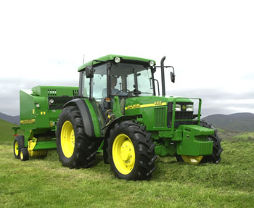
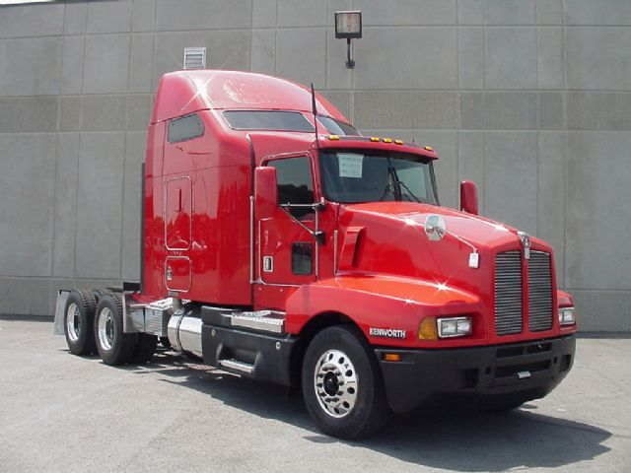

Slide 9
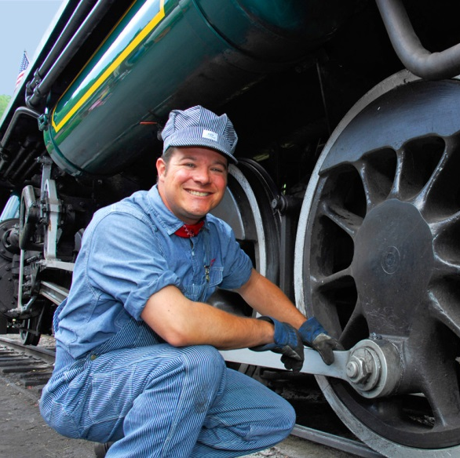

Slide 10
Ekklesia is found in the Greek N.T. 114 times
Three (3) times in the Gospels
Twenty-three (23) times in Acts
Sixty-eight (68) times in the Letters
Twenty (20) times in Revelation
N.T. use ekklesia 110 time to signify a body of disciples called Christians—the exceptions are Acts 7:38; Acts 19:32,39,41
First time is by Jesus in Matt 16:18.
“out of”
“a calling”
Church, therefore, means an assembly, a congregation, a community, or a gathering of “called ones.”

Slide 11
The church is not an institution dispensing salvation, validating faith and conveying blessings (Eph 1:3-7)
The church is not denominational (1 Cor 1:10; Eph 3:1-6)
The church is not an Amalgamation of churches (Rom 16:16)
Church is a collective noun referring to those men and women who answer the call of the gospel; are called out of darkness and SAVED by the blood of Christ—established upon the immovable foundation of Jesus Christ, “For no other foundation can anyone lay than that which is laid, which is Jesus Christ” (1 Cor 3:11).

Slide 12
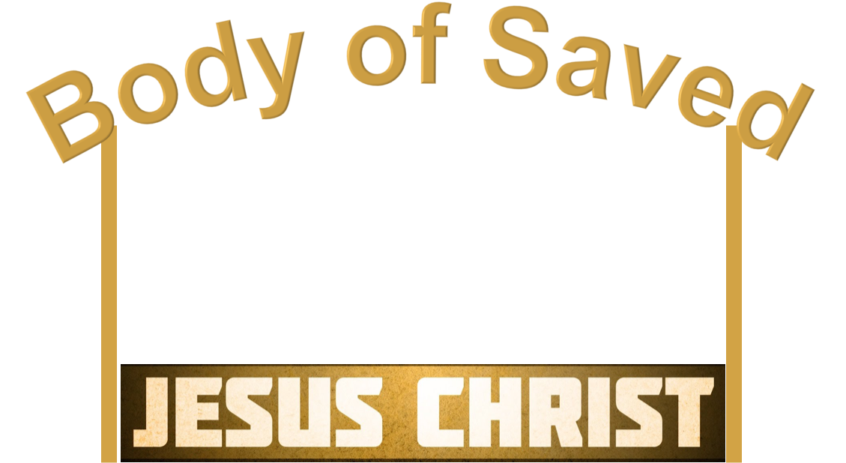
“. . . shepherd the church of God which He purchased with His own blood.”
(Acts 20:28)
“. . . knowing that you were not redeemed with corruptible things, like silver or gold, from your aimless conduct received by tradition from your fathers, but with the precious blood of Christ, as of a lamb without blemish and without spot.”
(1 Pet 1:18-19)

Slide 13
Church (ekklesia) refers to a called out body of people (an assembly, a congregation, a meeting, a community).
Church (ekklesia) ALWAYS refers to a body or to an assembly of people (Matt 16:18; 1 Cor 1:2; Acts 8:3).
The church (ekklesia) Jesus established refers to those called out of sin into fellowship with God by the gospel (2 Thess 2:13-14).
The church (ekklesia) therefore is the body / assembly of saved people (Acts 2:47; Eph 5:23).

Slide 14
The church established in Acts 2 on the Day of Pentecost
Brought into existence!
Salvation / church was always anticipated but not realized while Jesus was on earth.
(Matt 16:18; Lk 24:47)
Pentecost is actually the Greek name for a festival known in the O.T. as the Feast of Weeks (Lev 23:15; Deut 16:9).
The Greek word means “fifty” and refers to the fifty days that had elapsed since Passover. The Feast of Weeks celebrated the end of the grain harvest; it always fell upon the first day of the week.

Slide 15
Days of these kings (Dan 2:44)
Caesar Augustus (Lk 2:1)
Kingdom at ascension (Dan 7:13-14)
Jesus ascended to God (Ac 1:9-11)
Word . . . from Jerusalem (Isa 2:3)
Men . . . in Jerusalem (Ac 2:14)
All nations flow into it (Isa 2:2)
Men of every nation (Ac 2:5)
Sit on David's Throne (Isa 9:7)
Jesus on David’s Throne (Ac 2:30)

Slide 16
God’s Spirit poured out (Joel 2:28)
This is what Joel said (Ac 2:15)
David foresaw Resurrection (Psa 16)
Jesus raised from dead (Ac 2:30-36)
Ascend to God’s right hand (Psa 110)
Jesus at God’s right hand (Ac 2:34)
Ascended on high (Psa 68:18)
Ascended on high (Ac 1:9)
Led captivity captive (Psa 68:18)
Led captivity captive (Eph 4:8)

Slide 17
Fulfilled O.T. prophets (Lk 24:44)
Fulfilled prophecies of O.T. (Ac 3:18)
Thus it is written, and thus it was necessary for the Christ to suffer and to rise from the dead the third day, and that repentance and remission of sins should be preached in His name to all nations,
beginning at Jerusalem.
(Lk 24:46-47)
And as I began to
speak, the Holy Spirit fell upon them, as upon us at the beginning. Then I remembered the word of the Lord, how He said, John indeed baptized with water, but you shall be baptized with the Holy Spirit.
(Acts 11:15-16)
Kingdom . . . at hand (Matt 3:2)
Kingdom in existence (Col 1:13)
Your kingdom come . . . (Matt 6:10)
The kingdom came (Ac 14:22)
Kingdom of God at hand (Mk 1:15)
Christians are in kingdom (Rev 1:9)
Kingdom came w/power (Mk 9:1)
Power came w/Holy Spirit (Ac 2:1-4)

Slide 18
The church established in Acts 2 on the Day of Pentecost
Added to it by the Lord: “And the Lord added to the church daily those who were being saved.” (Ac 2:47)
Name recorded in Heaven: “the general assembly and church of the firstborn who are registered in heaven” (Heb 12:23)
Name can be removed by the Lord: “He who overcomes shall be clothed in white garments, and I will not blot out his name from the Book of Life” (Rev 3:5)
But in order to be added: “Then those who gladly received his word were baptized; and that day about three thousand souls were added to them” (Ac 2:41)

