Slide 2
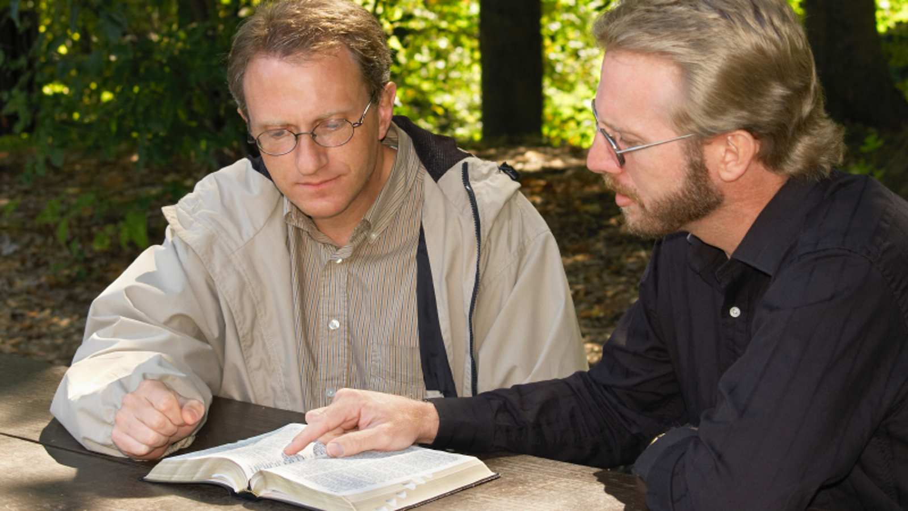
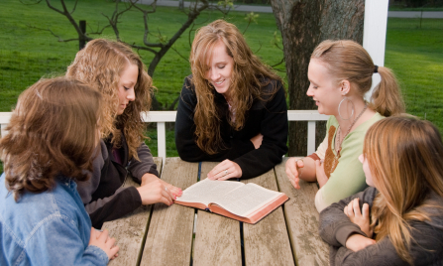
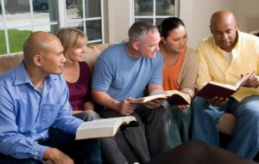
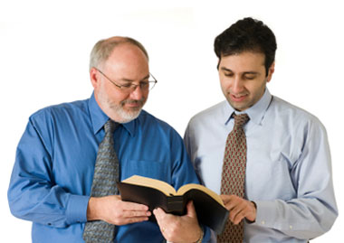
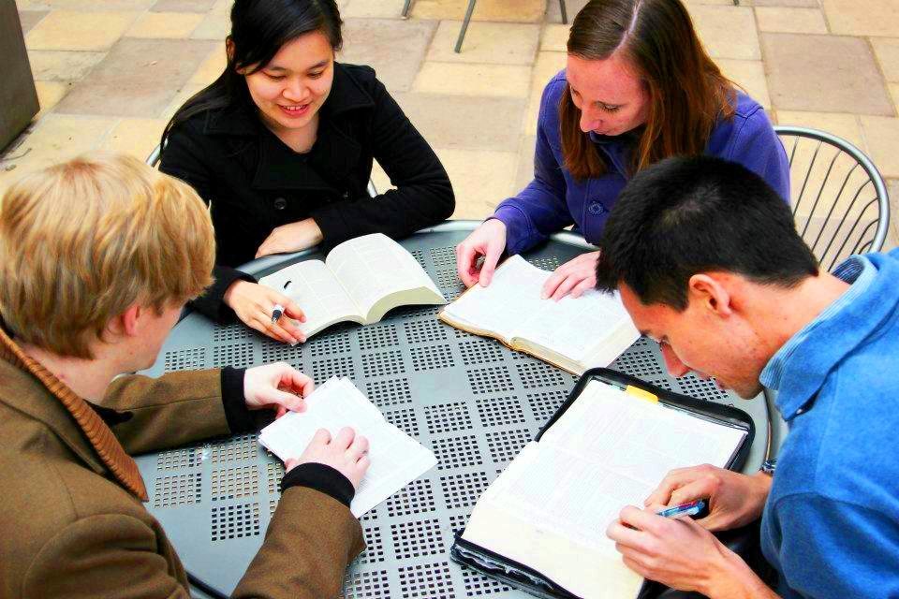

Slide 5
Making Disciples of ALL Men
I say to you, lift up your eyes and look at the fields, for they are already white for harvest! (John 4:35)

Slide 6
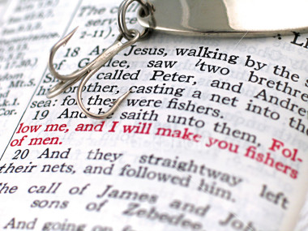
2017

Slide 7
Committed (2 Timothy 1:12)
Patient (Galatians 6:9)
Courageous (Acts 4:19-20)
GO (Matthew 28:19)

