Slide 2
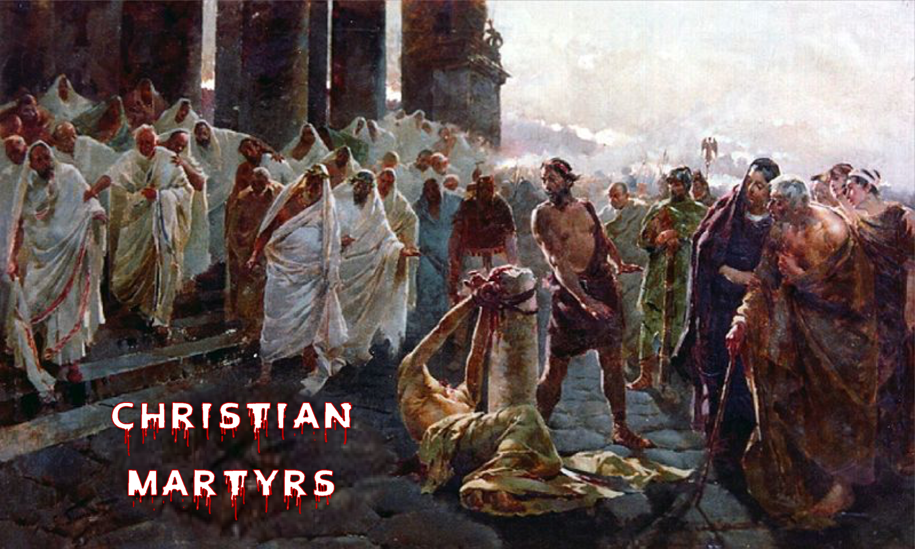
2 Tim 3:12
Acts 12:1-2
Rev 2:13
Rev 6:9
Acts 7:54-60

Slide 3
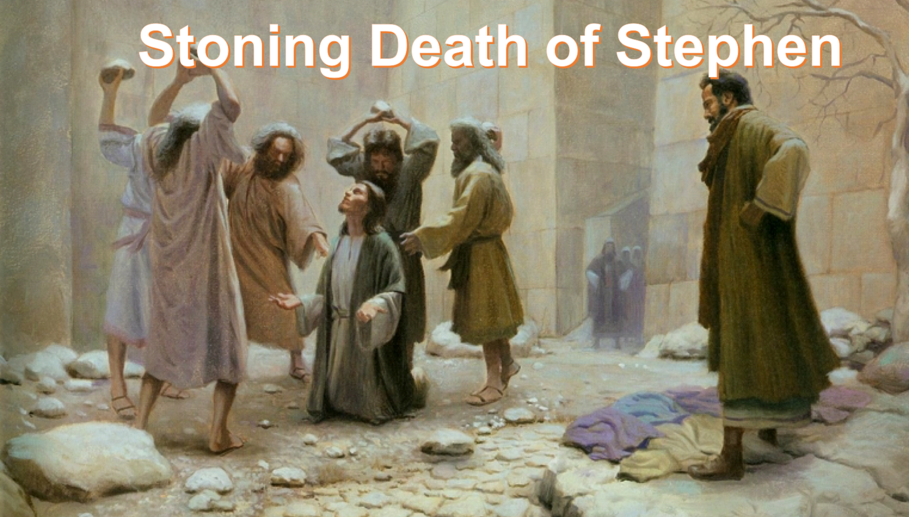
They cast him out of the city and stoned him. And the witnesses laid down their clothes at the feet of a young man named Saul.

Slide 4


Slide 5
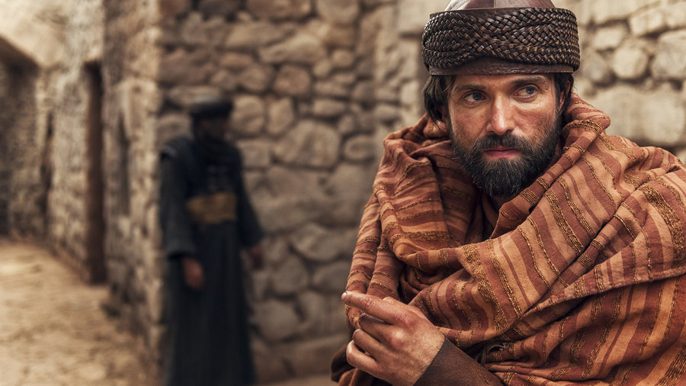

“I am a Jew from Tarsus, in Cilicia, a citizen of no mean city . . .” (Ac 21:39).
From the tiny tribe of Benjamin (Phil 3:5).
Sent to Jerusalem as a youth to study at feet of Gamaliel (Ac 22:3).
Belonged to the strict sect of the Pharisees (Phil 3:5).
Rapid Progress, “And I advanced in Judaism beyond many of my contemporaries in my own nation, being more exceedingly zealous for the traditions of my fathers” (Gal 1:14).
Very Zealous for the Law / Judaism, “. . . taught according to the strictness of our fathers’ law, and was zealous toward God . . .” (Ac 22:3).
Sincerely believed Christianity was heresy, (Deut 21:22-23; Ac 23:1; Ac 26:9).

Slide 6
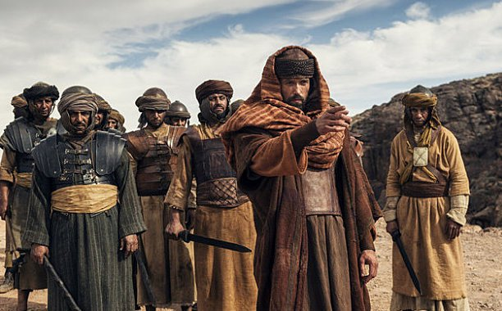

Then Saul, still breathing threats and murder against the disciples of the Lord, (Ac 9:1).
As for Saul, he made havoc of the church, entering every house, and dragging off men and women, committing them to prison, (Ac 8:3).
I persecuted this Way to the death, binding and delivering into prisons both men and women, (Ac 22:4).
And when the blood of Your martyr Stephen was shed, I also was standing by consenting to his death, and guarding the clothes of those who were killing him, (Ac 22:20).
. . . and when they were put to death, I cast my vote against them. And I punished them often in every synagogue and compelled them to blaspheme; and being exceedingly enraged against them, I persecuted them even to foreign cities, (Ac 26:10-11)
I persecuted the church of God beyond measure and tried to destroy it, (Gal 1:13).

Slide 7
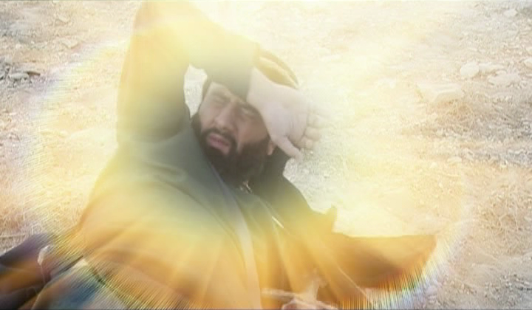
So he, trembling and astonished, said, Lord, what do You want me to do? Then the Lord said to him, arise and go into the city, and you will be told what you must do. (Ac 9:6)
As he journeyed he came near Damascus, and suddenly a light shone around him from heaven. Then he fell to the ground, and heard a voice saying to him, Saul, Saul, why are you persecuting Me? (Ac 9:3-4)
And he said, who are You, Lord? Then the Lord said, I am Jesus, whom you are persecuting. It is hard for you to kick against the goads. (Ac 9:5)

Slide 8
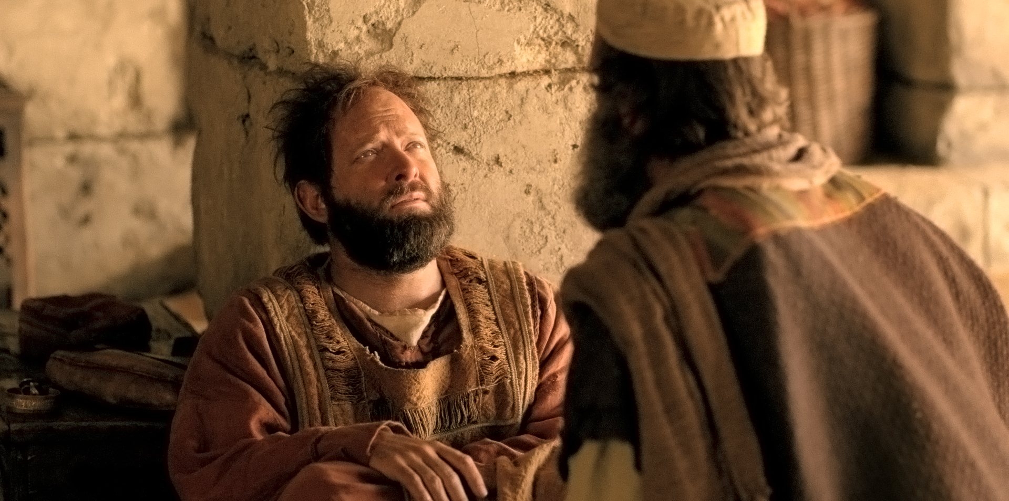
Then a certain Ananias, a devout man according to the law, having a good testimony with all the Jews who dwelt there, came to me; and he stood and said to me, brother Saul, receive your sight. And at that same hour I looked up at him. Then he said, the God of our fathers has chosen you that you should know His will, and see the Just One, and hear the voice of His mouth. For you will be His witness to all men of what you have seen and heard. And now why are you waiting? Arise and be baptized, and wash away your sins, calling on the name of the Lord. (Ac 22:13-16)

Slide 9
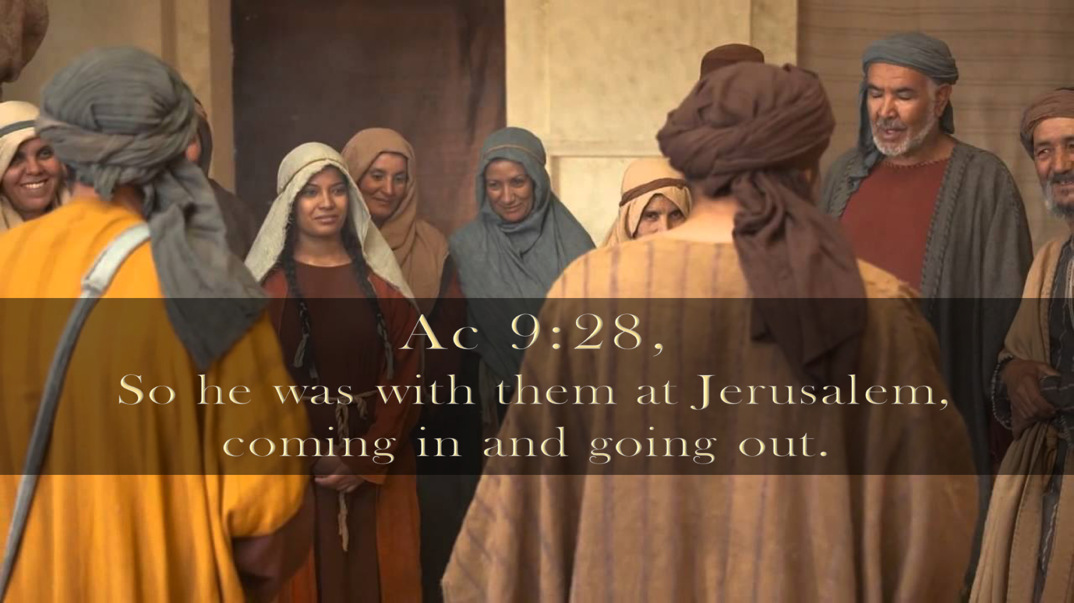

Slide 10

Anyone can be Saved (1 Tim 1:15-16)
Sincerity does not equal Truth (Ac 23:1)
Must genuinely experience Godly Sorrow (2 Cor 7:10)
God can/will use certain “nobodies” (Ac 9:10)
See the art of Christian forgiveness (Matt 6:14-15)

