Slide 1
Alienated from God in Darkness
Ephesians 4:17-19

Slide 2
Ephesians 4:17-19
¹⁷ This I say, therefore, and testify in the Lord, that you should no longer walk as the rest of the Gentiles walk, in the futility of their mind, ¹⁸ having their understanding darkened, being alienated from the life of God, because of the ignorance that is in them, because of the blindness of their heart; ¹⁹ who, being past feeling, have given themselves over to lewdness, to work all uncleanness with greediness.

Slide 3
Nature of Alienating Darkness
Darkness Associated with Ignorance
Psalm 82:5 No knowledge or understanding = darkness
John 1:4-9 Light not comprehended by darkened world
Romans 1:18-23 Darkness causes irrational rejection of God
Darkness Imposed by Self-Deception
Romans 10:1-3 Focus on man’s will leads to ignoring God’s
John 9:30-33 Blind man understood what others missed
Matthew 13:10-15 Hidden in open sight due to own prejudice
Darkness Manifested in Actions
John 3:19-20 Darkness loved when acts of evil present
Romans 1:26-32 Perversion & ungodliness manifest darkness
Ephesians 5:3-14 Vast difference in light & darkness in life
However, Darkness Is Not Inevitable or Unavoidable

Slide 4
Darkness Can Be Corrected
Eph. 4:20-24 - But you have not so learned Christ, if indeed you have heard Him and have been taught by Him, as the truth is in Jesus: that you put off, concerning your former conduct, the old man which grows corrupt according to the deceitful lusts, and be renewed in the spirit of your mind, and that you put on the new man which was created according to God, in true righteousness and holiness.
Rom. 13:11-14 - And do this, knowing the time, that now it is high time to awake out of sleep; for now our salvation is nearer than when we first believed. The night is far spent, the day is at hand. Therefore let us cast off the works of darkness, and let us put on the armor of light. Let us walk properly, as in the day, not in revelry and drunkenness, not in lewdness and lust, not in strife and envy. But put on the Lord Jesus Christ, and make no provision for the flesh, to fulfill its lusts.

Slide 5
271 - Near To The Heart Of God - Title

Slide 6
271 - Near To The Heart Of God - 1.1

Slide 7
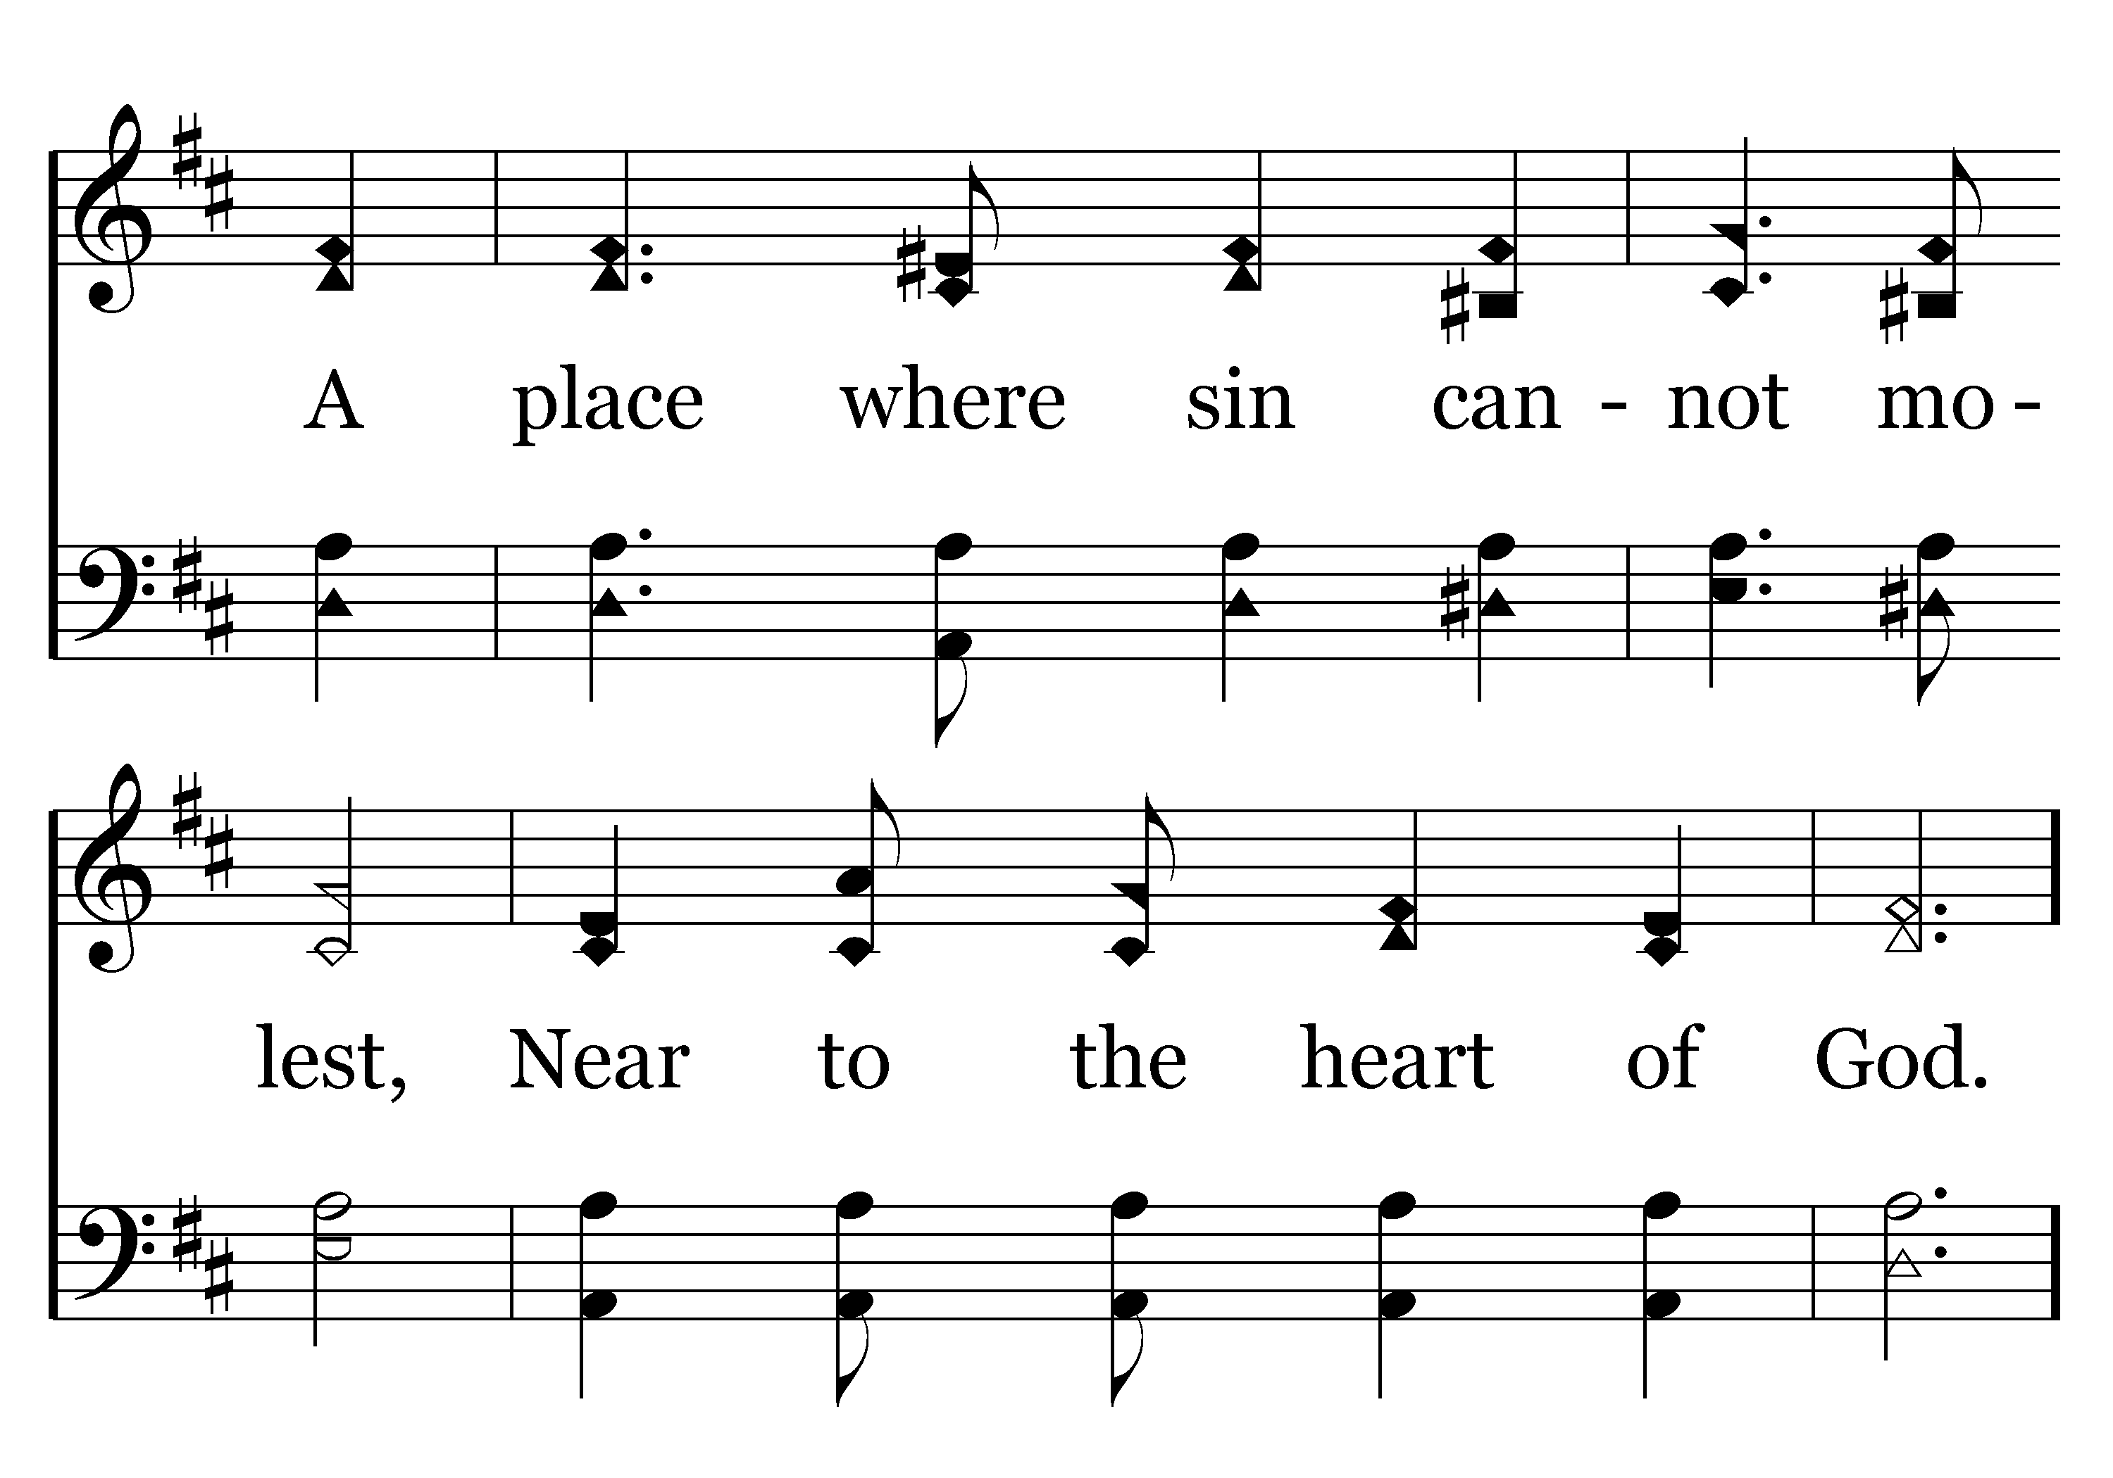
271 - Near To The Heart Of God - 1.2

Slide 8
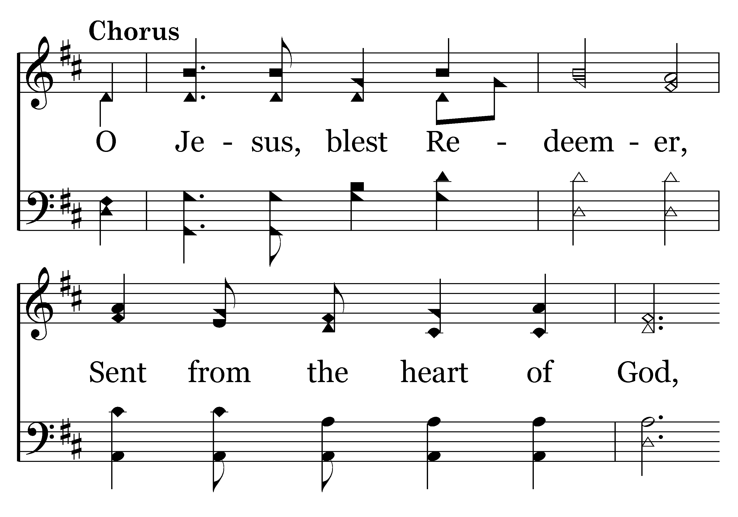
271 - Near To The Heart Of God - C.1

Slide 9
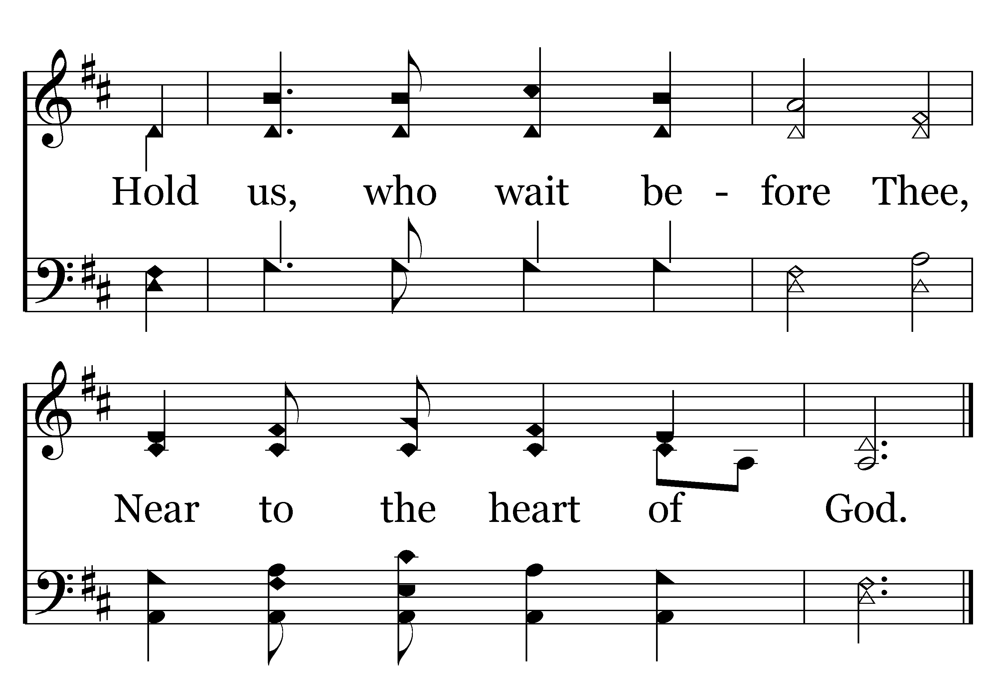
271 - Near To The Heart Of God - C.2
End of Verse 1

Slide 10
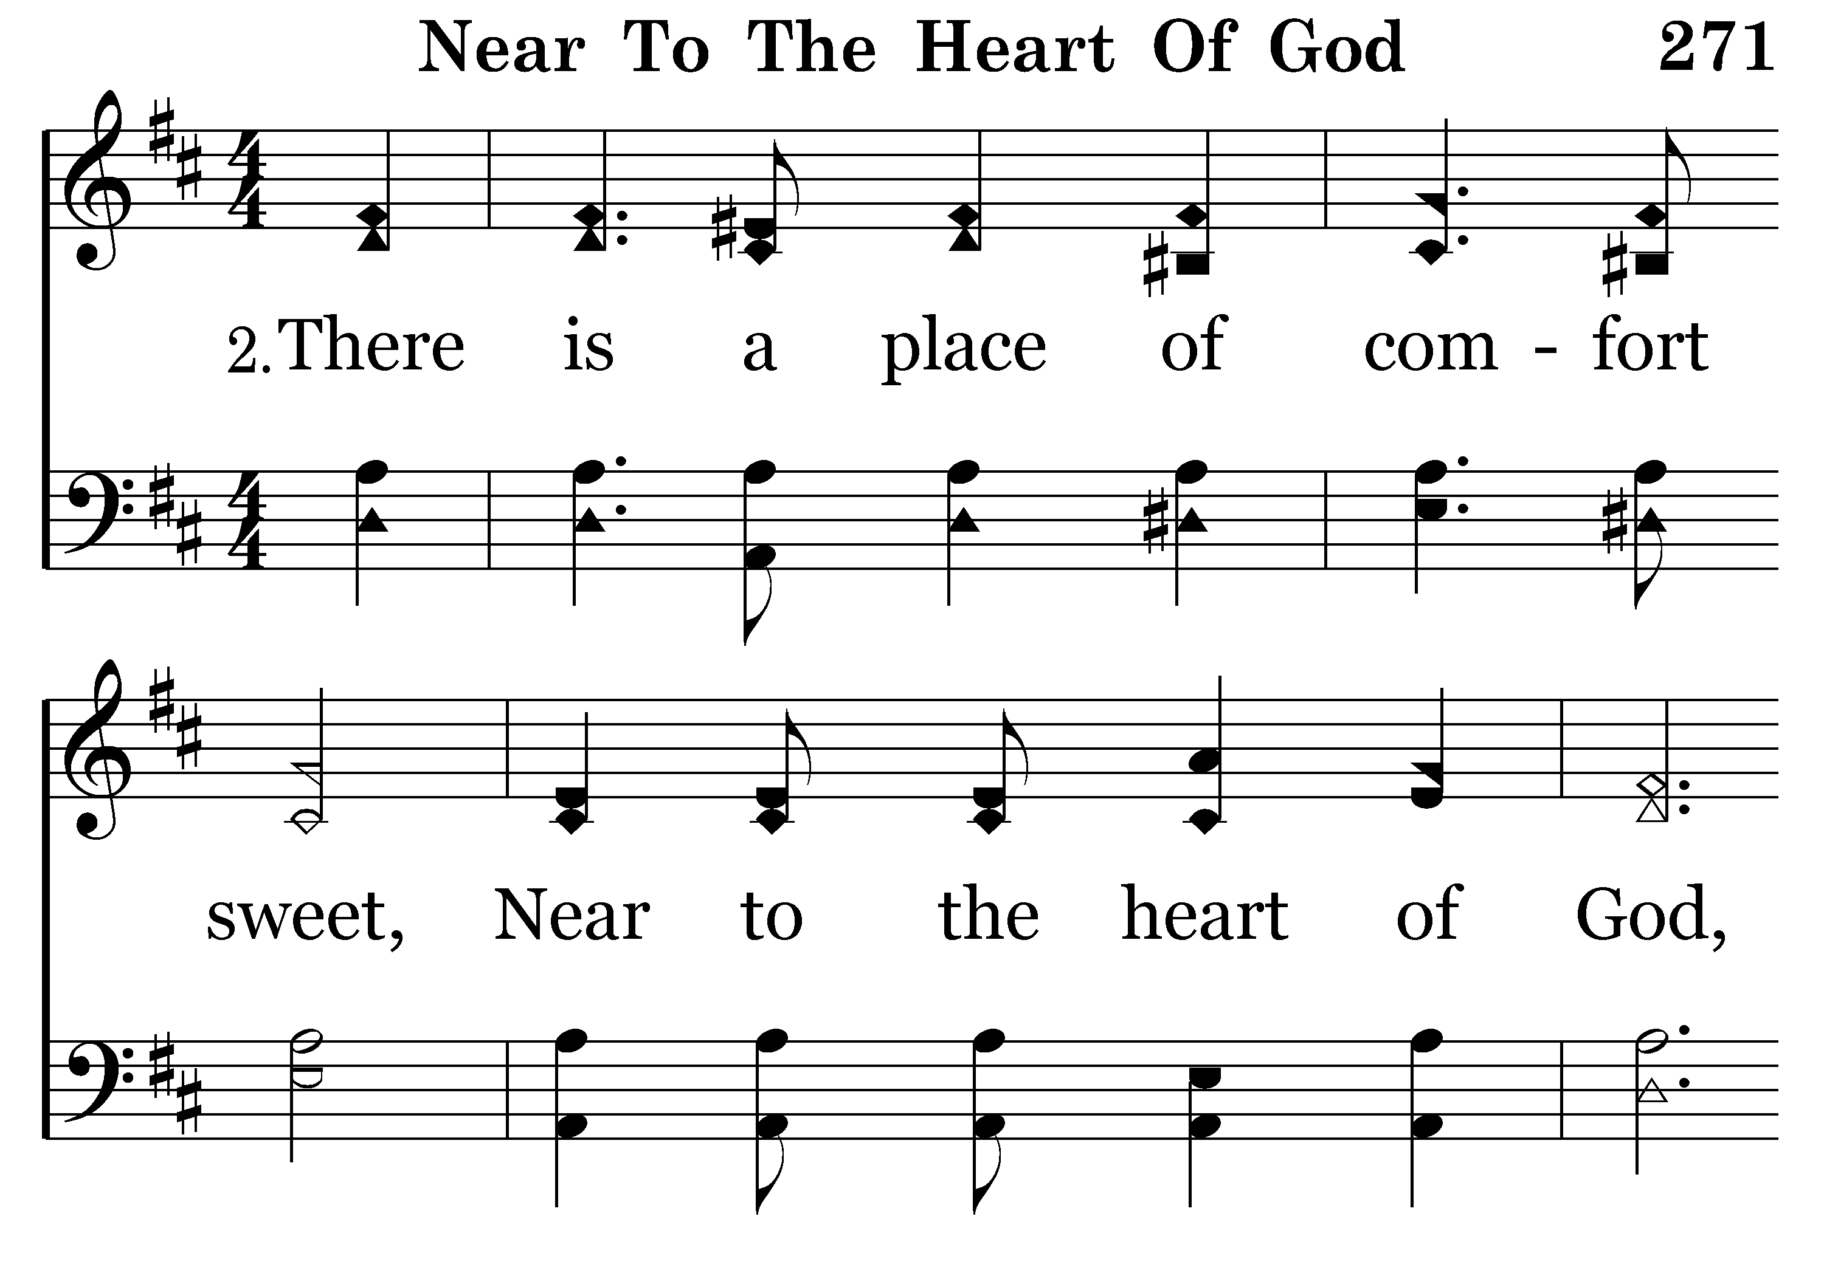
271 - Near To The Heart Of God - 2.1

Slide 11
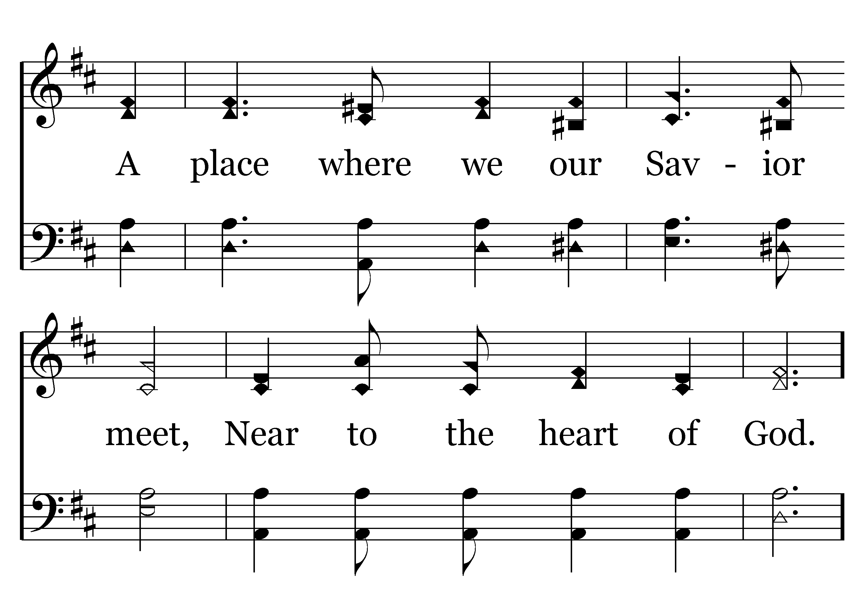
271 - Near To The Heart Of God - 2.2

Slide 12
271 - Near To The Heart Of God - C.1

Slide 13
271 - Near To The Heart Of God - C.2
End of Verse 2

Slide 14
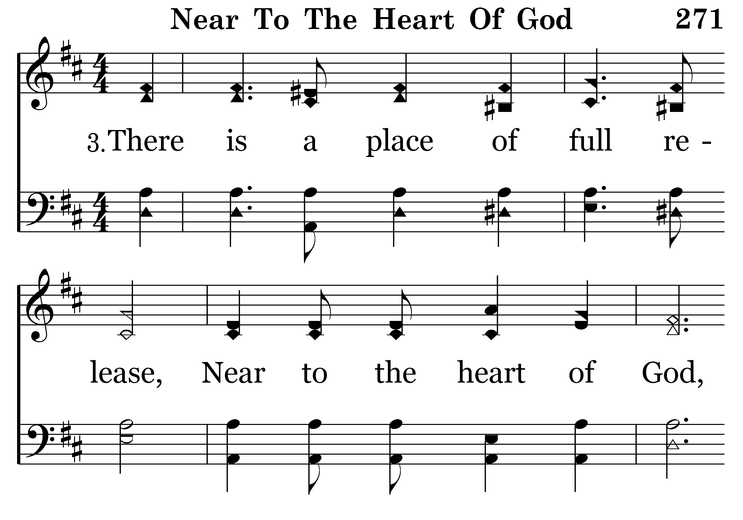
271 - Near To The Heart Of God - 3.1

Slide 15
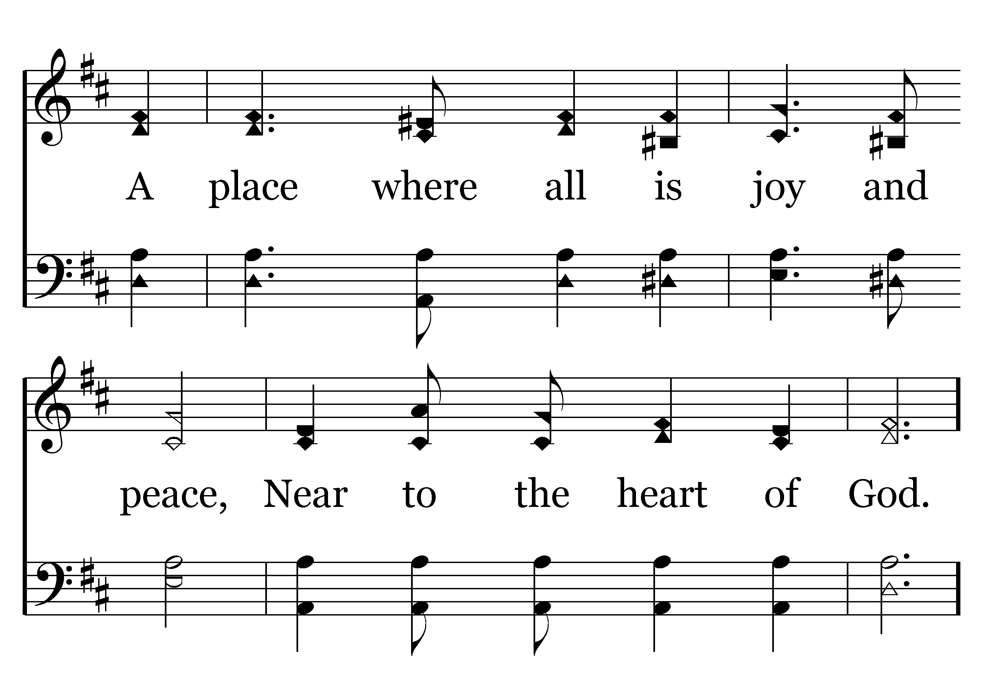
271 - Near To The Heart Of God - 3.2

Slide 16
271 - Near To The Heart Of God - C.1

Slide 17
271 - Near To The Heart Of God - C.2
End of Song

