Slide 1
Following Family Religion?
2nd Timothy 3:14-15
1st Kings 22:51-53

Slide 2
2nd Timothy 3:14-15
¹⁴ But you must continue in the things which you have learned and been assured of, knowing from whom you have learned them, ¹⁵ and that from childhood you have known the Holy Scriptures, which are able to make you wise for salvation through faith which is in Christ Jesus.
1st Kings 22:51-53
⁵¹ Ahaziah the son of Ahab became king over Israel in Samaria in the seventeenth year of Jehoshaphat king of Judah, and reigned two years over Israel. ⁵² He did evil in the sight of the Lord, and walked in the way of his father and in the way of his mother and in the way of Jeroboam the son of Nebat, who had made Israel sin; ⁵³ for he served Baal and worshiped him, and provoked the Lord God of Israel to anger, according to all that his father had done.

Slide 3
What Makes the Difference?
Family Religious Practice We Must Not Follow
Josh. 24:14-15 Must choose, but choice must be for truth
1 Pet. 1:17-19 Vain tradition from fathers vs. Christ
Matt. 10:34-37 May be divided from family by truth
Family Religious Practice We Should Follow
Timothy had learned, been assured & knew the source
2 Tim. 3:16-17 Scripture is only inspired pattern for truth
2 Tim. 1:3-5 Faith must be true & one’s own – genuine
Acts 10:24, 33
What should one do if taught “faith only,” catechism…?
Which Will We Choose to Follow?
11:13-14
10:34-37
Mk. 16:15-16

Slide 4
322 - Bring Christ Your Broken Life - Title

Slide 5
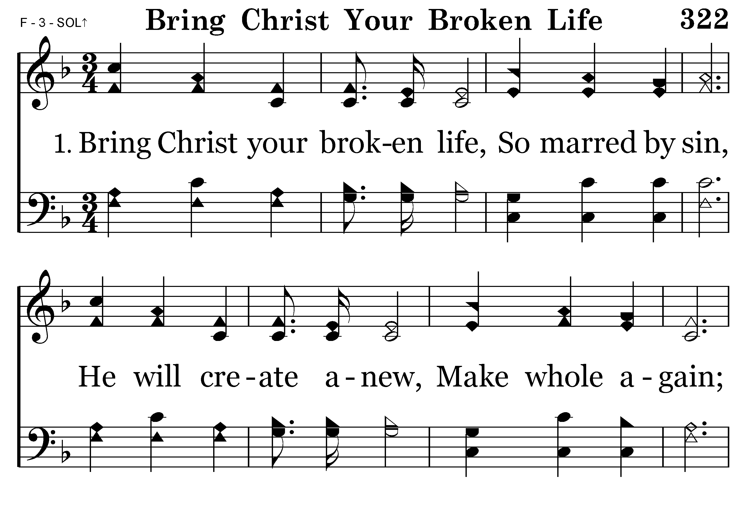
322 - Bring Christ Your Broken Life - 1.1

Slide 6
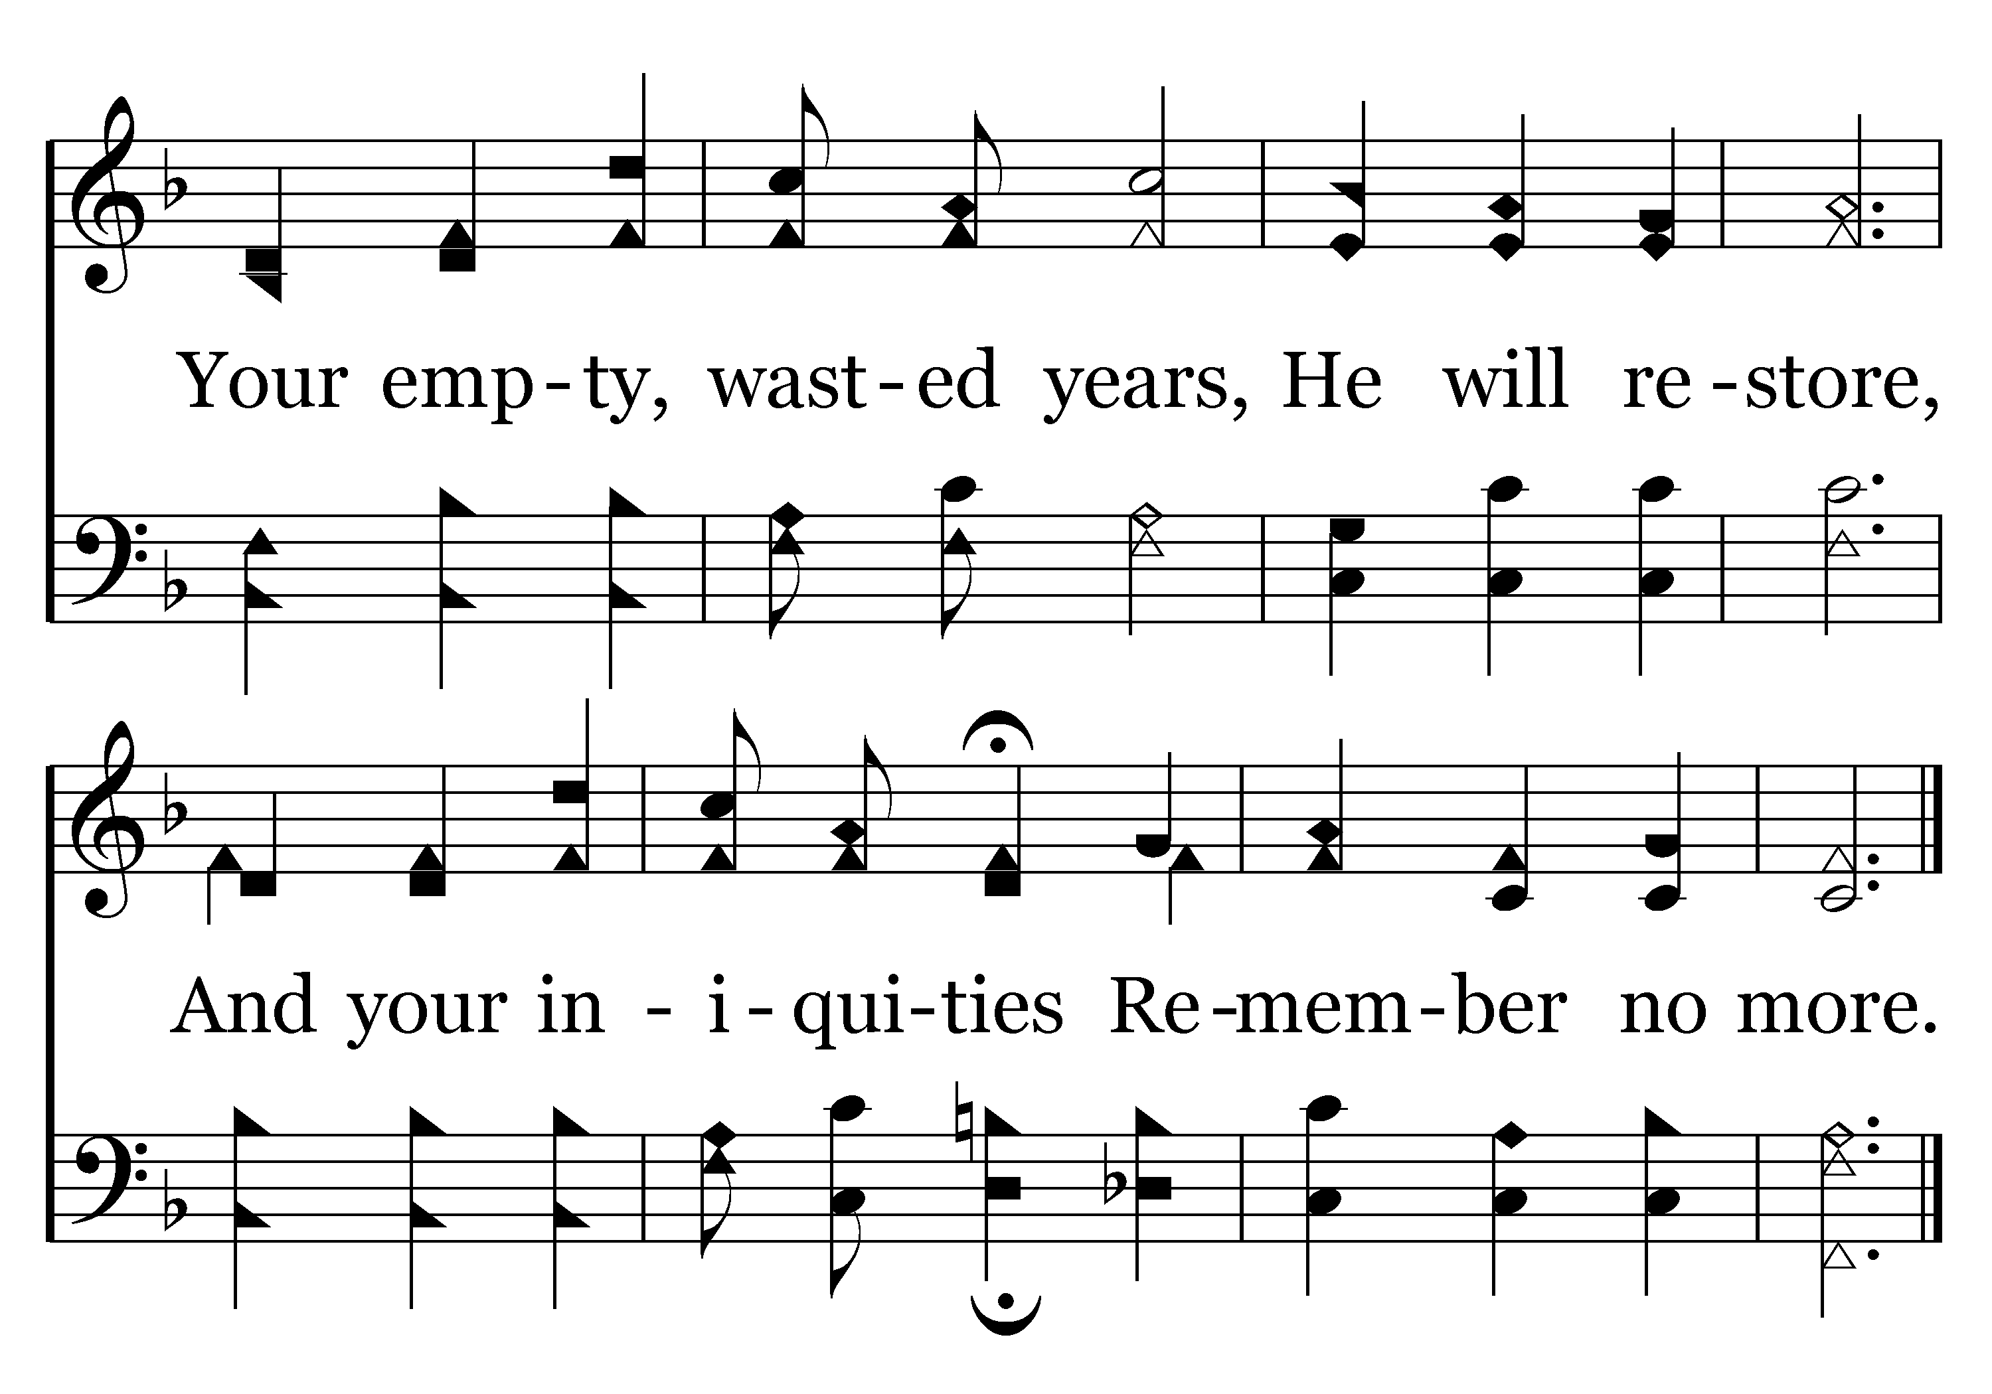
322 - Bring Christ Your Broken Life - 1.2
End of Verse 1

Slide 7
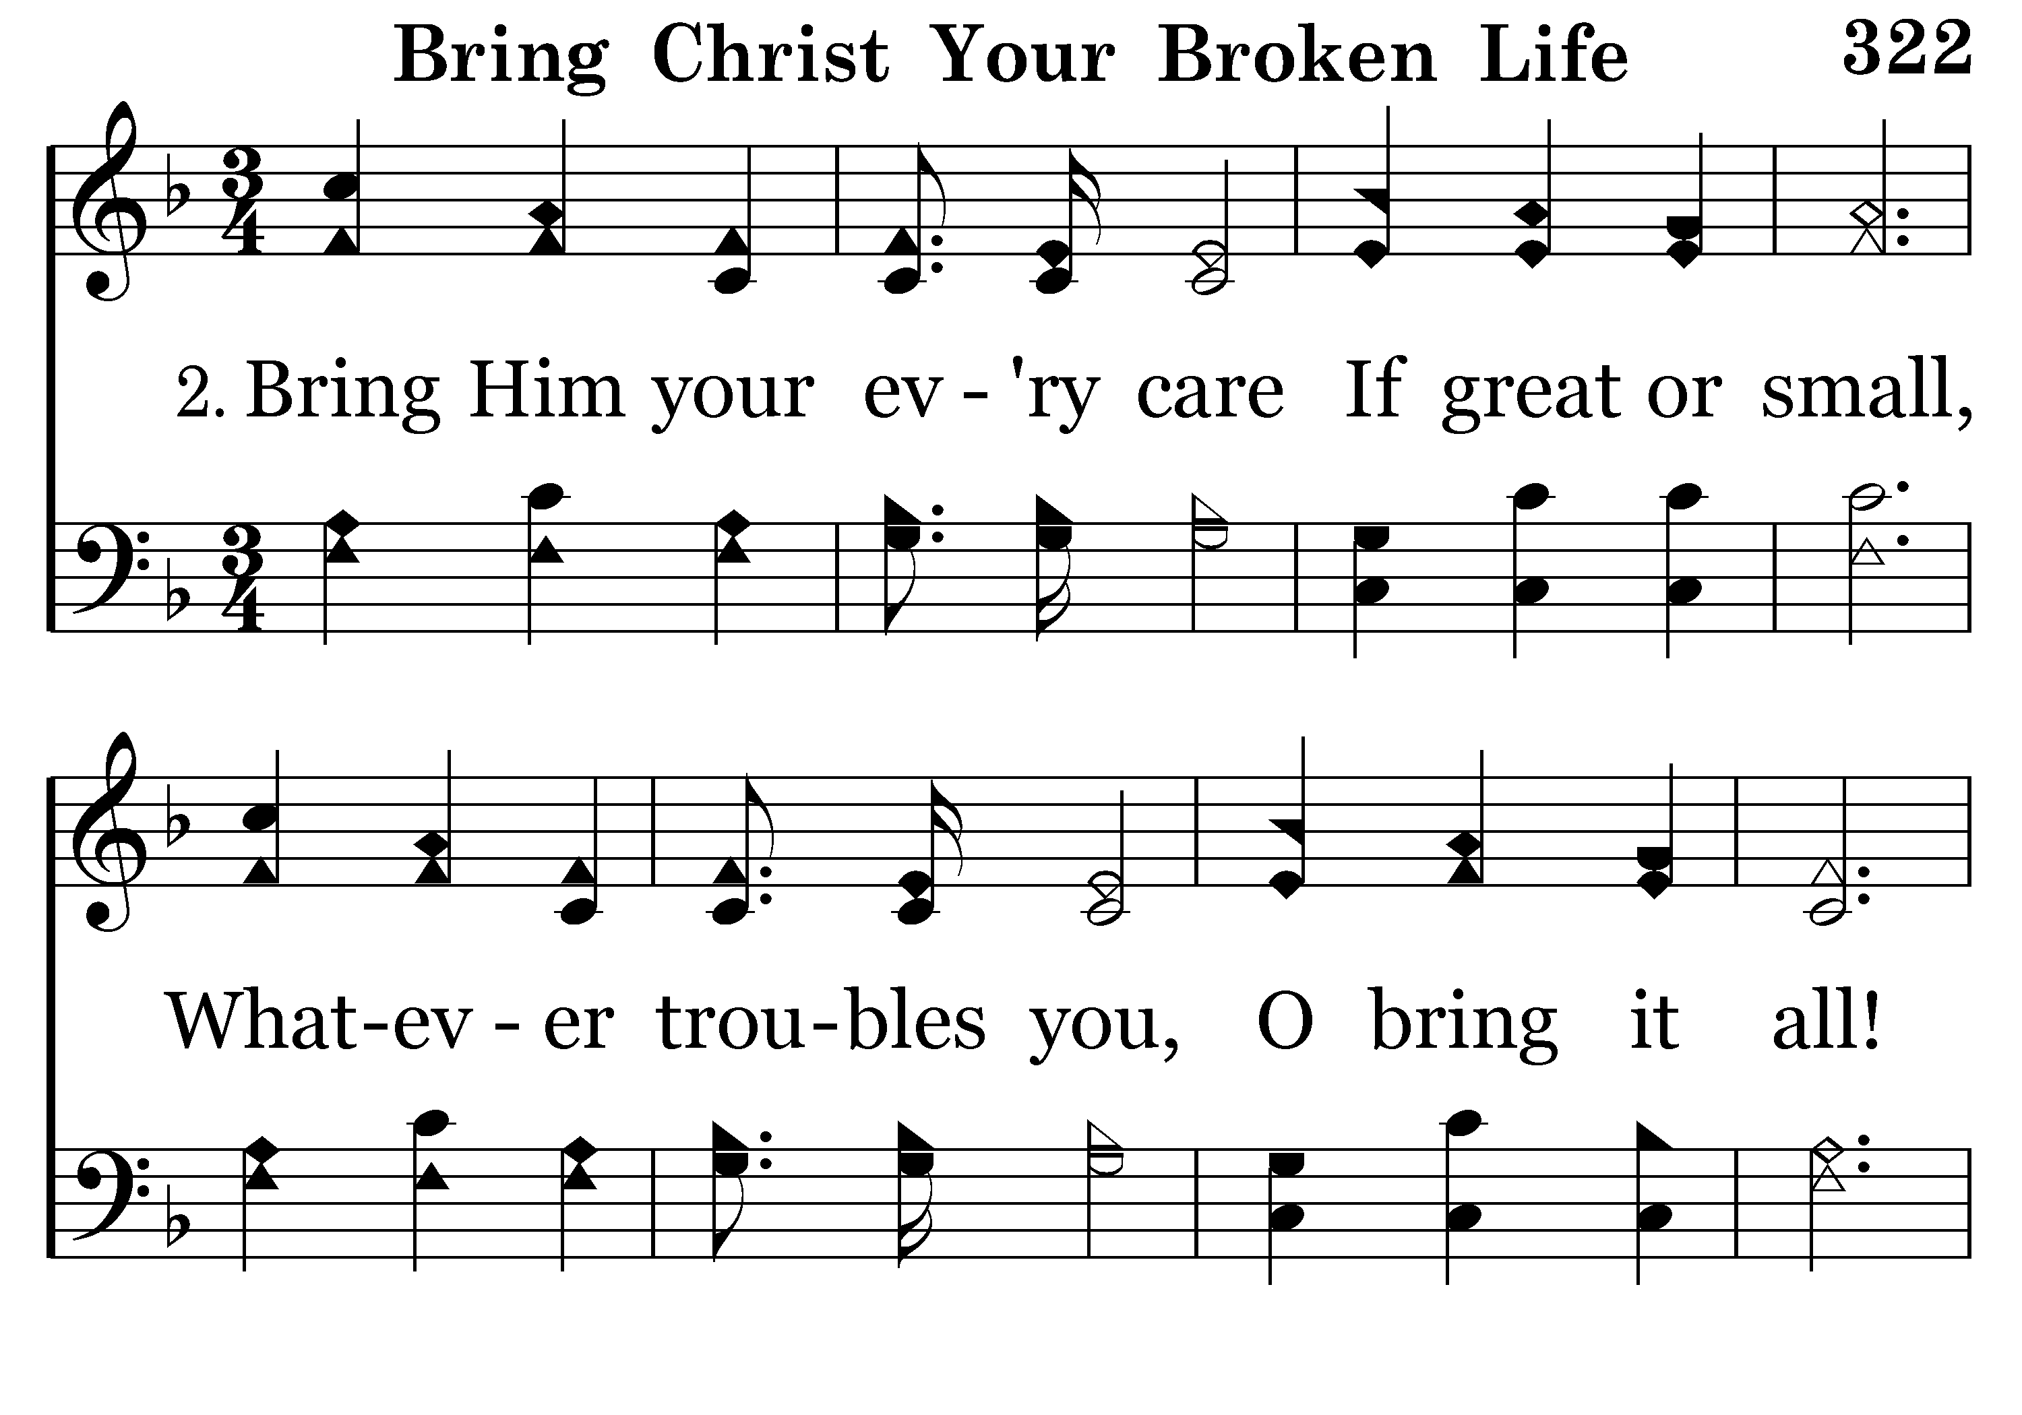
322 - Bring Christ Your Broken Life - 2.1

Slide 8
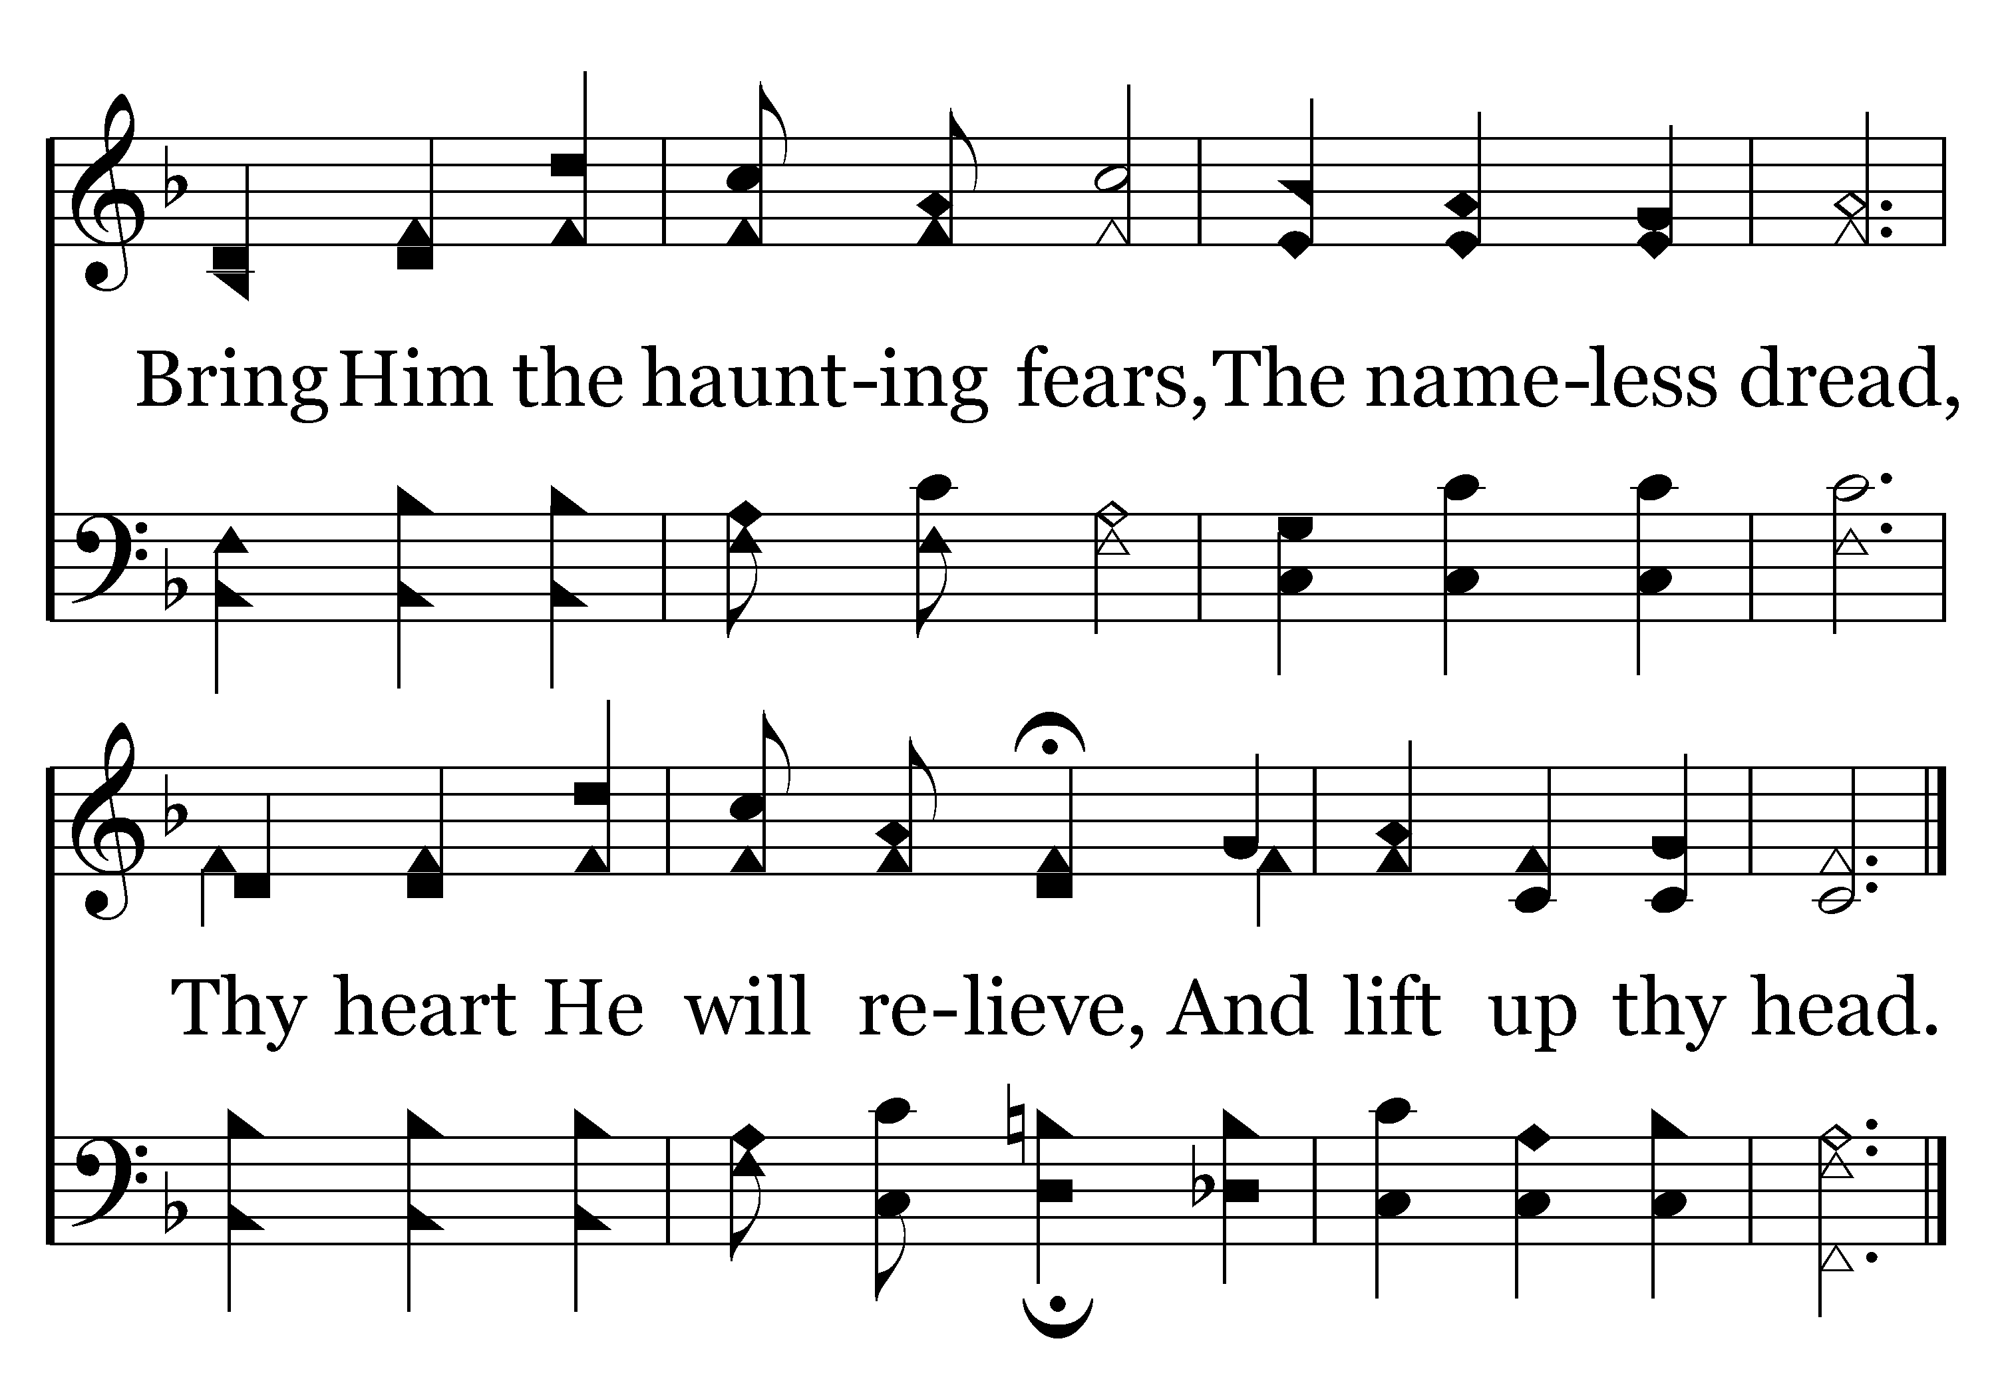
322 - Bring Christ Your Broken Life - 2.2
End of Verse 2

Slide 9
322 - Bring Christ Your Broken Life - 3.1

Slide 10
322 - Bring Christ Your Broken Life - 3.2
End of Song

