Slide 1
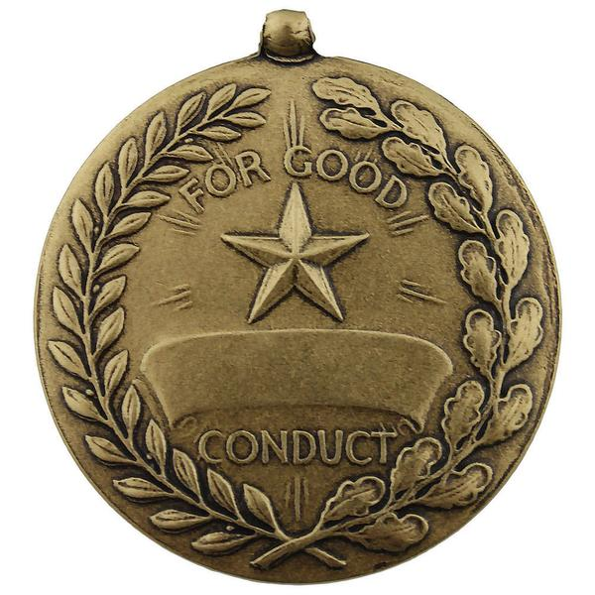
Good Conduct & Its Effect
1st Peter 2:11-12
1st Peter 3:13-16

Slide 2
1st Peter 2:11-12
¹¹ Beloved, I beg you as sojourners and pilgrims, abstain from fleshly lusts which war against the soul, ¹² having your conduct honorable among the Gentiles, that when they speak against you as evildoers, they may, by your good works which they observe, glorify God in the day of visitation.
1st Peter 3:13-16
¹³ And who is he who will harm you if you become followers of what is good? ¹⁴ But even if you should suffer for righteousness’ sake, you are blessed. And do not be afraid of their threats, nor be troubled. ¹⁵ But sanctify the Lord God in your hearts, and always be ready to give a defense to everyone who asks you a reason for the hope that is in you, with meekness and fear; ¹⁶ having a good conscience, that when they defame you as evildoers, those who revile your good conduct in Christ may be ashamed.

Slide 3
Good Conduct & Its Effect on World
Demands Mindset of a Pilgrim in Foreign Land
1 Pet. 1:17 Calling God “Father” changes view of home
Heb. 11:13-16 Characters of faith have this mindset
Demands Purity of Life
1 Jn. 3:1-3 Being children of God calls for purification
1 Jn. 5:18-19 Being born of God seen by different life
Titus 2:7-8 “Having nothing evil to say of you”
Demands Stand for Truth in Presence of Ungodly
Phil. 2:15 “In midst of a crooked & perverse generation”
2 Tim. 4:17-18 Example of Paul (cf. 2 Tim. 4:1-5)
Dan. 1-3 Daniel, Shadrach, Meshach & Abednego
Effect of Bringing Others to Lord (Matt. 5:13-16)

