Slide 1
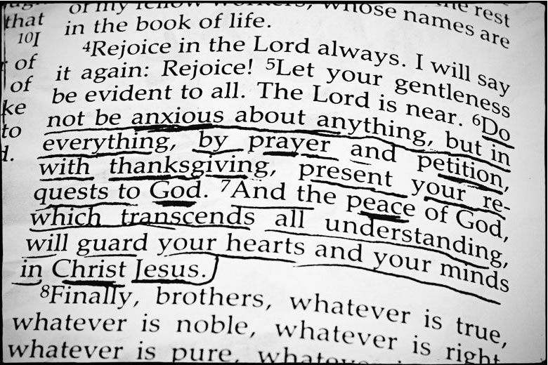
Letting God’s Peace Guard Our Hearts
Philippians 4:6-9

Slide 2
Philippians 4:6-9
⁶ Be anxious for nothing, but in everything by prayer and supplication, with thanksgiving, let your requests be made known to God; ⁷ and the peace of God, which surpasses all understanding, will guard your hearts and minds through Christ Jesus. ⁸ Finally, brethren, whatever things are true, whatever things are noble, whatever things are just, whatever things are pure, whatever things are lovely, whatever things are of good report, if there is any virtue and if there is anything praiseworthy — meditate on these things. ⁹ The things which you learned and received and heard and saw in me, these do, and the God of peace will be with you.

Slide 3
In Order to Let God’s Peace Guard…
Let Prayer Replace Anxiety (v. 6)
1 Pet. 5:7 Cast all cares on God
Luke 12:22-30 “Nor have an anxious mind” – Trust God
1 Thess. 5:16-18 Prayer is tied to life of rejoicing
Let Christ Replace Self (v. 7)
Gal. 2:20 “It is no longer I who live, but Christ lives in me”
John 14:27 Jesus promised, “My peace I give to you”
Acts 10:36 “Preaching peace through Jesus Christ”
Rom. 5:1-2 Peace obtained as justified in Christ (Col. 1:19-20)
Let Scripture Replace Worldly Thought (vs. 8-9)
Psa. 25:4-5 Mind of faithful one is on His word
Psa. 119:162-165 Love of God’s word brings joy & peace
Col. 3:15-17 Peace of God is tied to word indwelling us

