Slide 1

Welcome
Times of Worship
Sunday 9 AM Worship
Sunday 10 AM Bible Class
Sunday 11 AM Worship
Wednesday 7 PM Bible Class
Elders
Gerald Gudgel
Ronny Hightower
Tim Hogland

Slide 2

Seek Ye First…
Order of Worship
Tim Hogland – Scripture - Matthew 6:19-33
Foster Craig – Songs - 249, 694 & 128
Terry Yontz – Prayer
Colby Lovelady – Songs – 111, 130 & 484
Jason Gudgel – Scripture – Philippians 3:4-14
Nevin Cox – Songs – 502, 105 & 332
Dan Hicks – Scripture – Romans 12:1-2
Jim Rowbottom – Songs – 65, 415 & 7
Richard McIntyre – Closing Prayer

Slide 3
Matthew 6:19-33
¹⁹ “Do not lay up for yourselves treasures on earth, where moth and rust destroy and where thieves break in and steal, ²⁰ but lay up for yourselves treasures in heaven, where neither moth nor rust destroys and where thieves do not break in and steal. ²¹ For where your treasure is, there your heart will be also. ²² “The eye is the lamp of the body. So, if your eye is healthy, your whole body will be full of light, ²³ but if your eye is bad, your whole body will be full of darkness. If then the light in you is darkness, how great is the darkness! ²⁴ “No one can serve two masters, for either he will hate the one and love the other, or he will be devoted to the one and despise the other. You cannot serve God and money. ²⁵ “Therefore I tell you, do not be anxious about your life, what you will eat or what you will drink, nor about your body, what you will put on. Is not life more than food, and the body more than clothing? ²⁶ Look at the birds of the air: they neither sow nor reap nor gather into barns, and yet your heavenly Father feeds them. Are you not of more value than they? ²⁷ And which of you by being anxious can add a single hour to his span of life? ²⁸ And why are you anxious about clothing? Consider the lilies of the field, how they grow: they neither toil nor spin, ²⁹ yet I tell you, even Solomon in all his glory was not arrayed like one of these. ³⁰ But if God so clothes the grass of the field, which today is alive and tomorrow is thrown into the oven, will he not much more clothe you, O you of little faith? ³¹ Therefore do not be anxious, saying, ‘What shall we eat?’ or ‘What shall we drink?’ or ‘What shall we wear?’ ³² For the Gentiles seek after all these things, and your heavenly Father knows that you need them all. ³³ But seek first the kingdom of God and his righteousness, and all these things will be added to you.
Scripture Reading – Tim Hogland

Slide 4
Seek Ye First…
Order of Worship
Tim Hogland – Scripture - Matthew 6:19-33
Foster Craig – Songs - 249, 694 & 128
Terry Yontz – Prayer
Colby Lovelady – Songs – 111, 130 & 484
Jason Gudgel – Scripture – Philippians 3:4-14
Nevin Cox – Songs – 502, 105 & 332
Dan Hicks – Scripture – Romans 12:1-2
Jim Rowbottom – Songs – 65, 415 & 7
Richard McIntyre – Closing Prayer

Slide 5
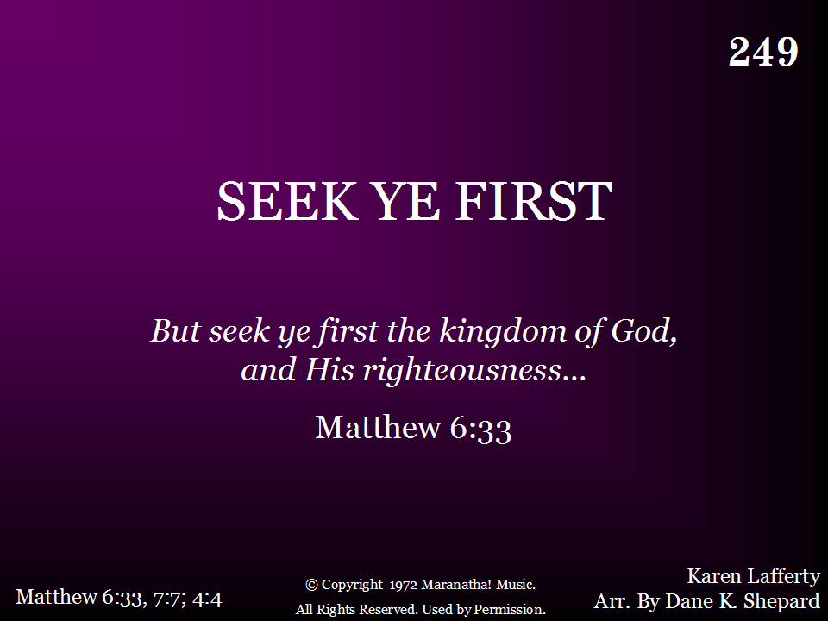
249 - Seek Ye First - Title

Slide 6
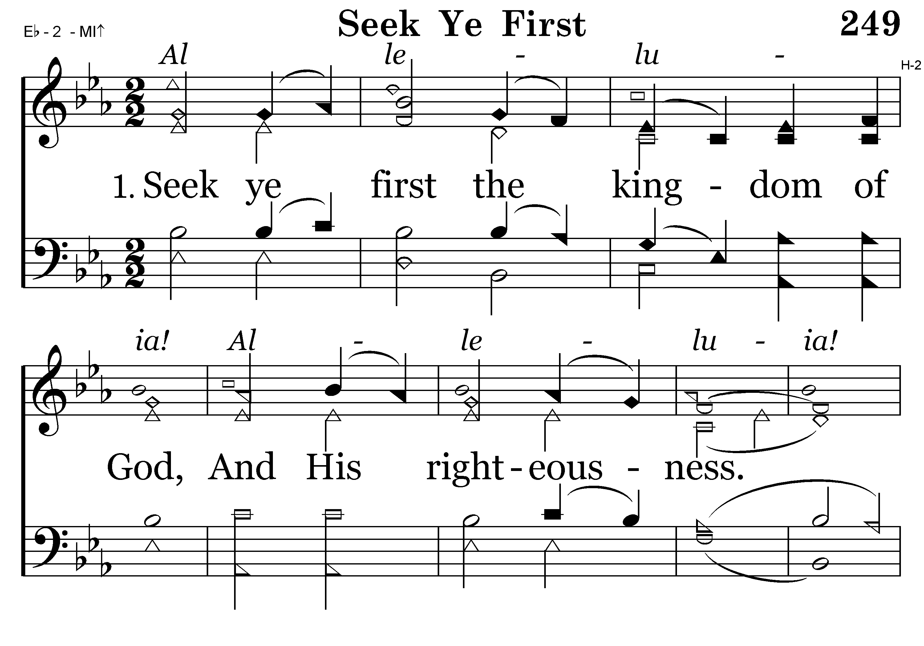
249 - Seek Ye First - 1.1

Slide 7
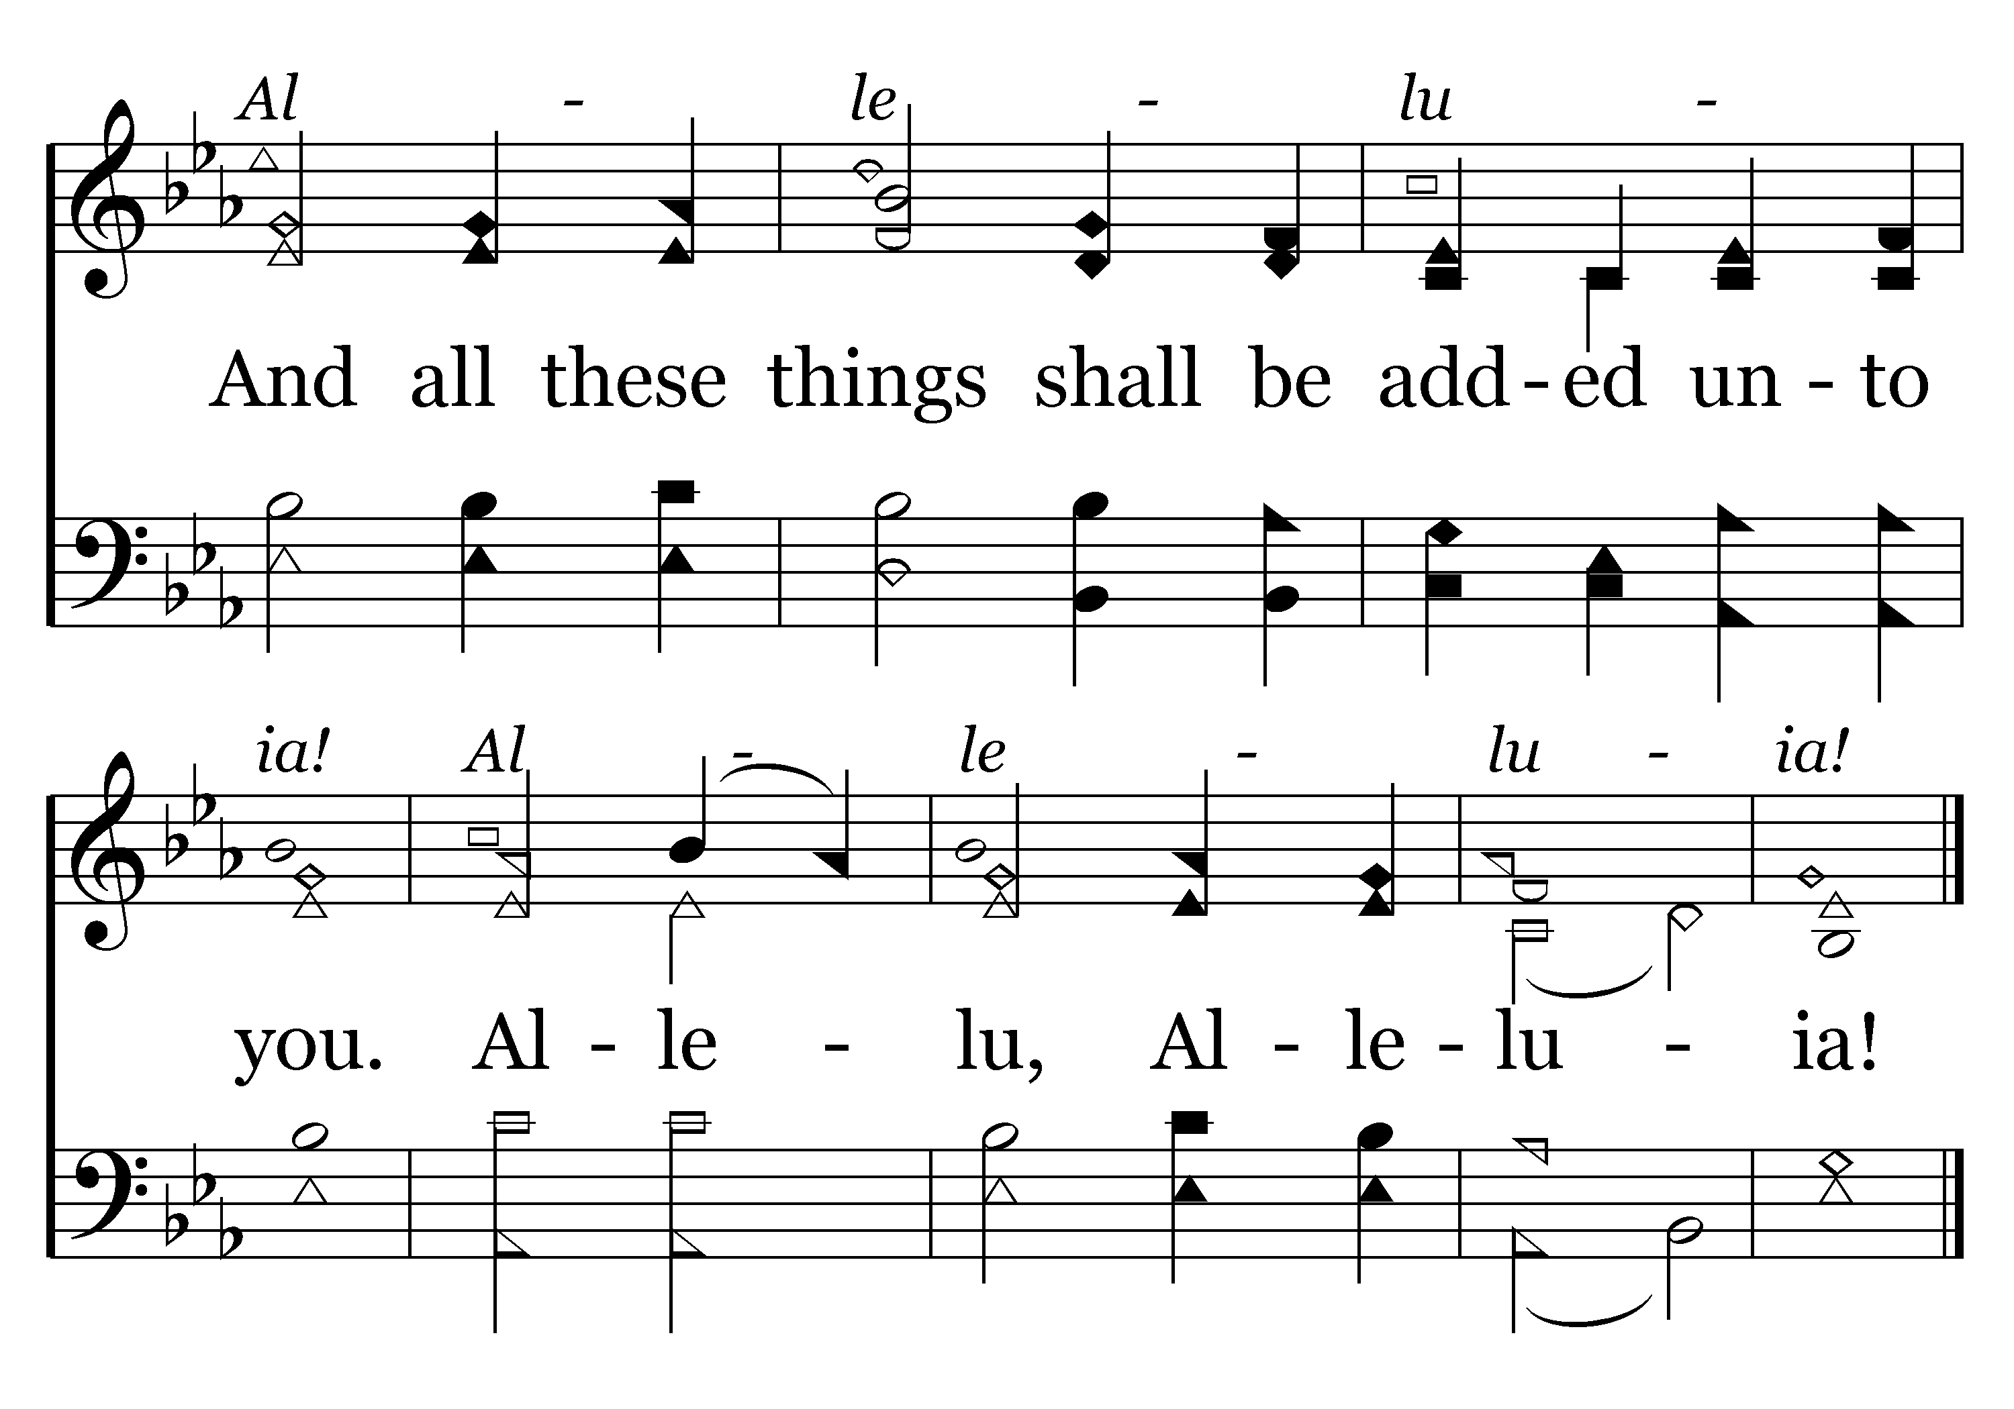
249 - Seek Ye First - 1.2
End of Verse 1

Slide 8
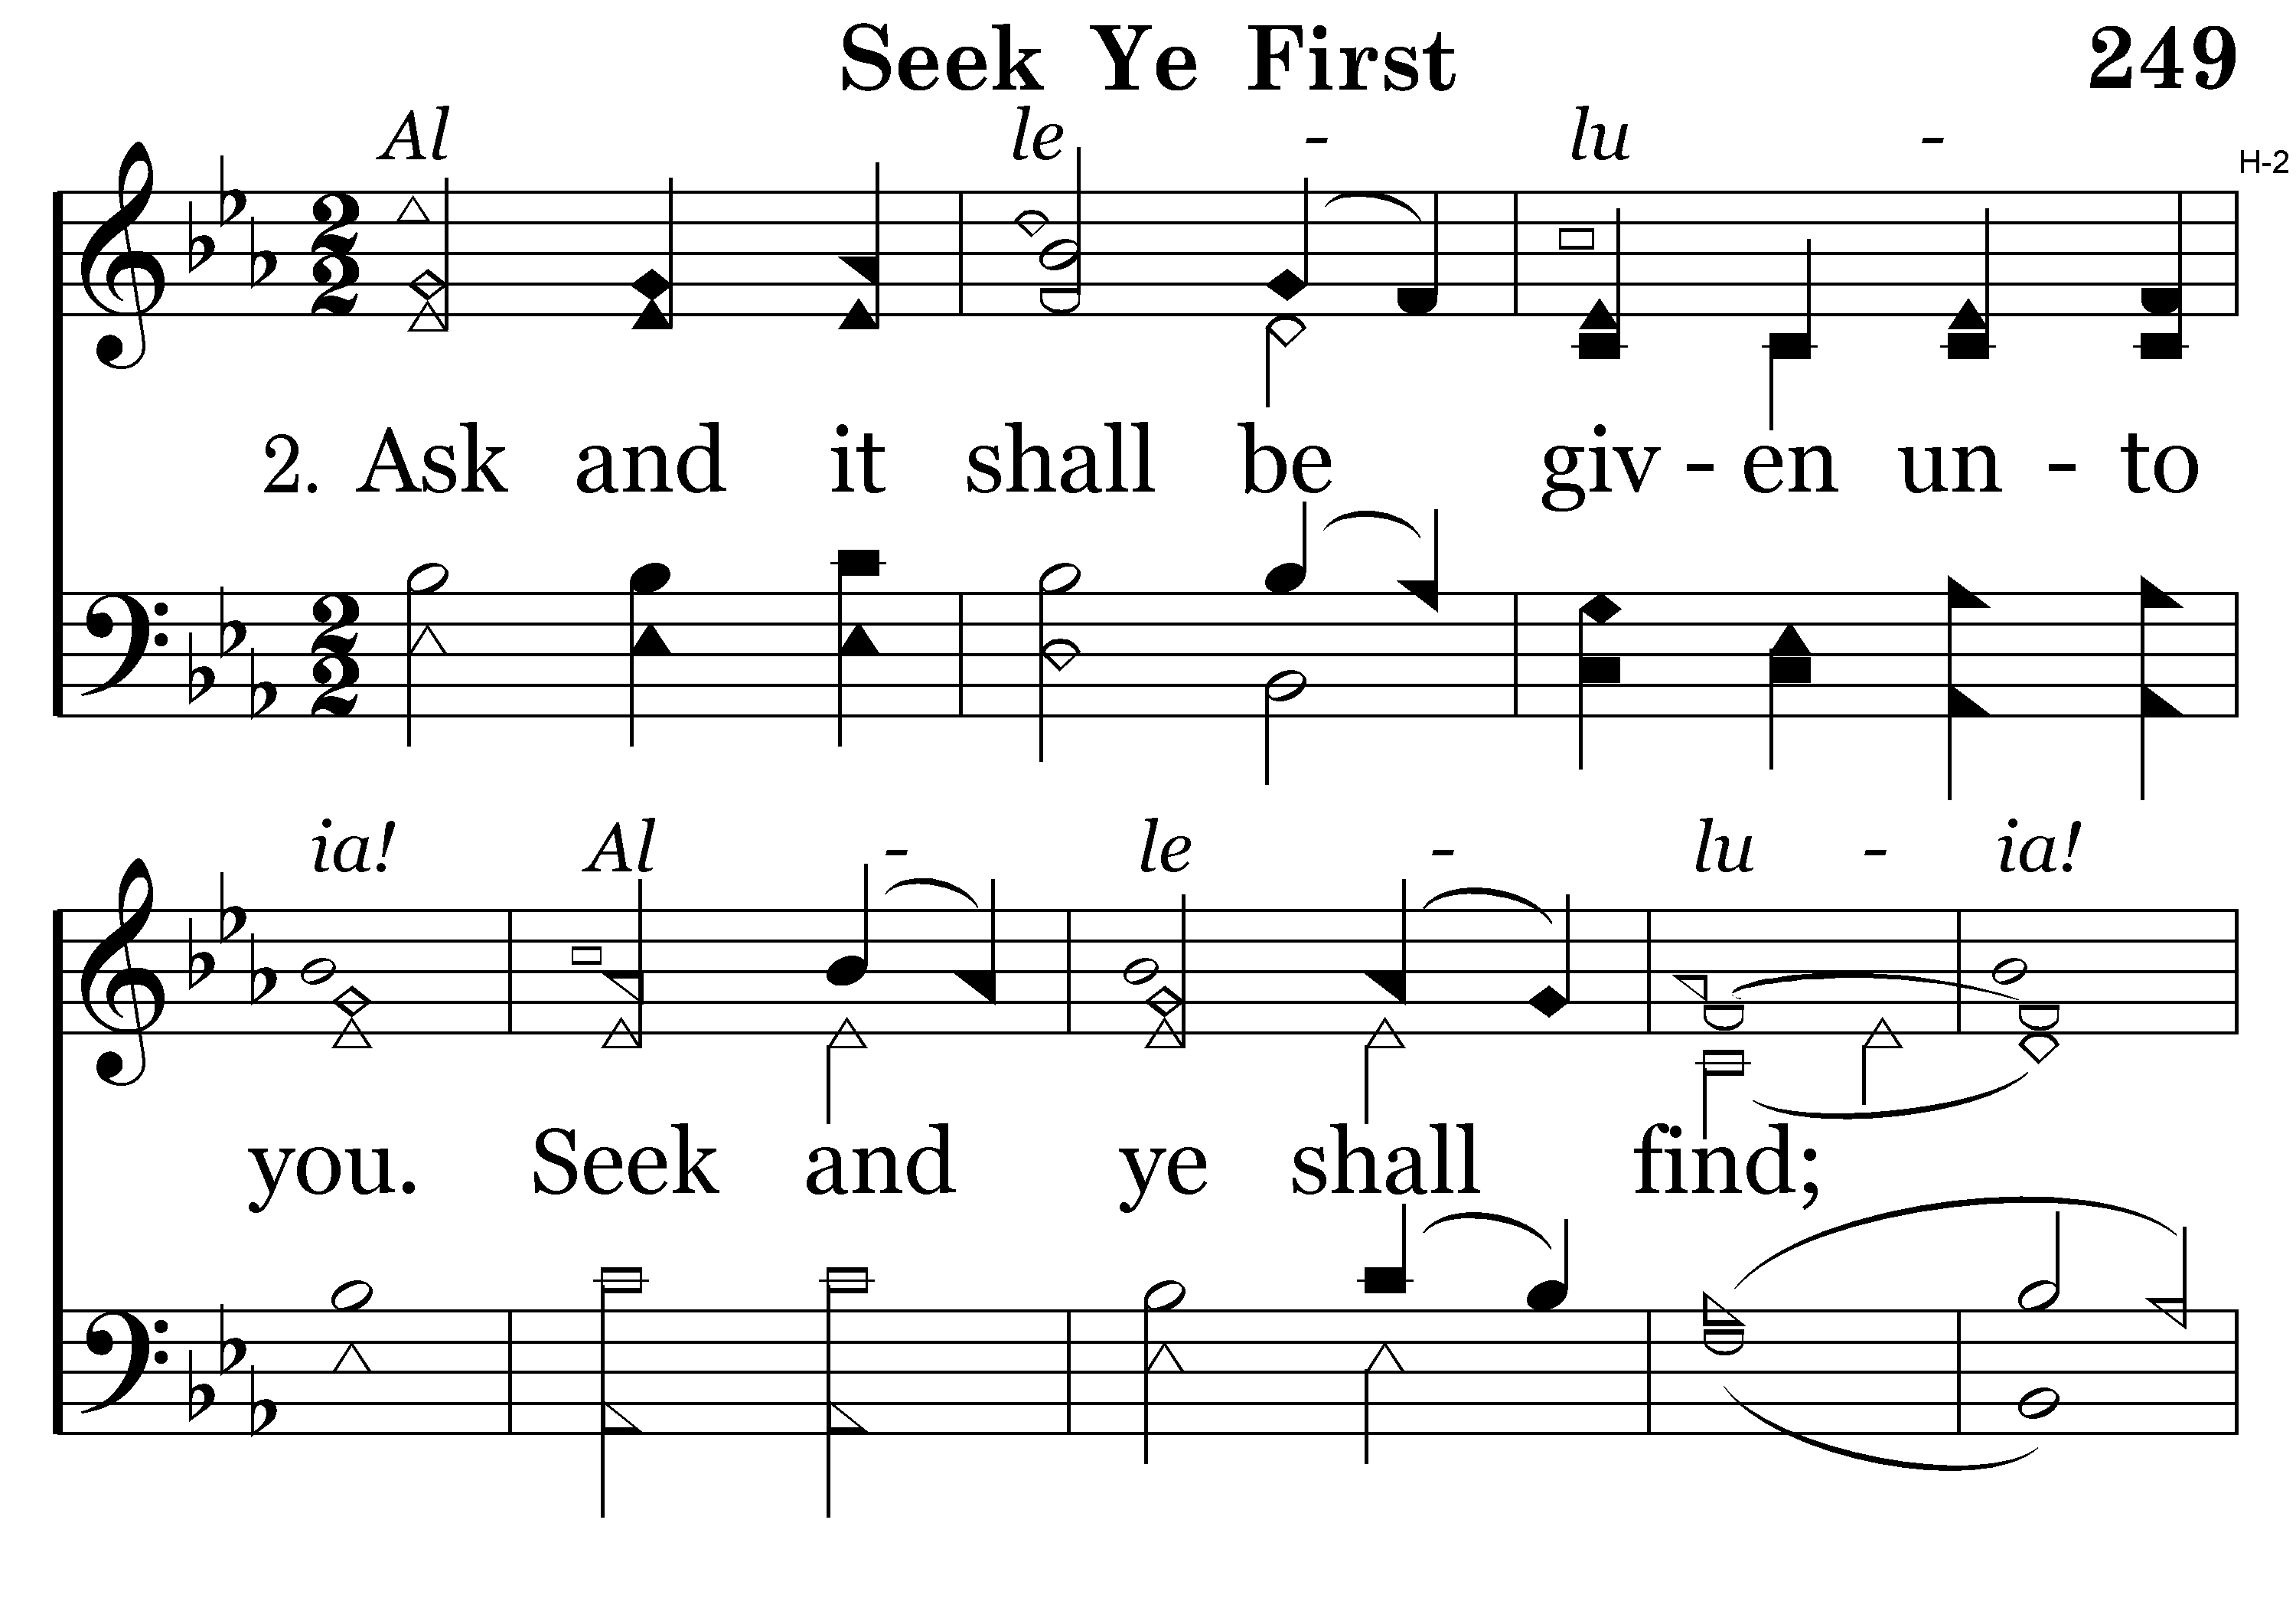
249 - Seek Ye First - 2.1

Slide 9
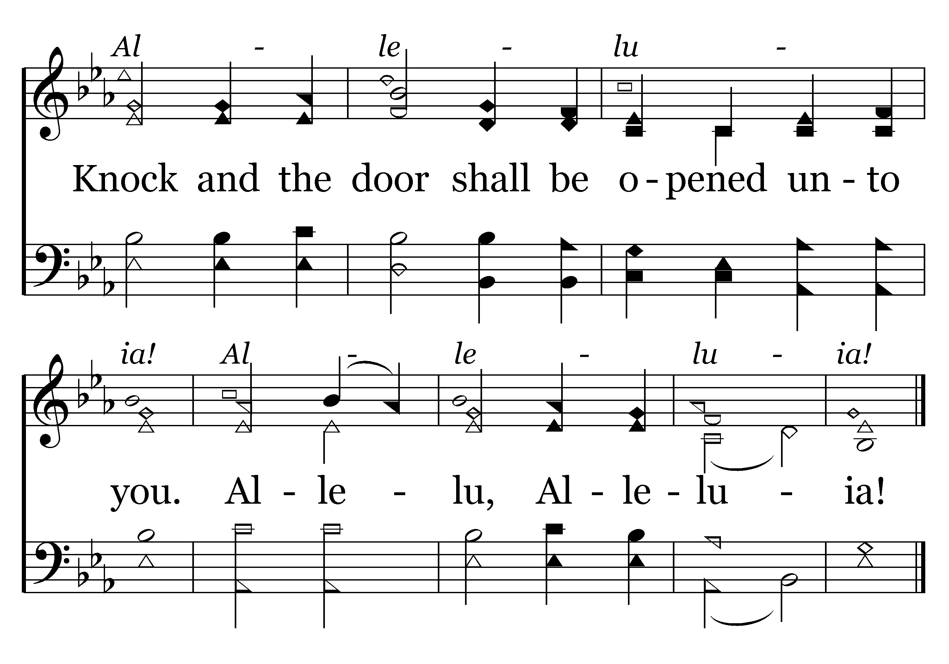
249 - Seek Ye First - 2.2
End of Verse 2

Slide 10
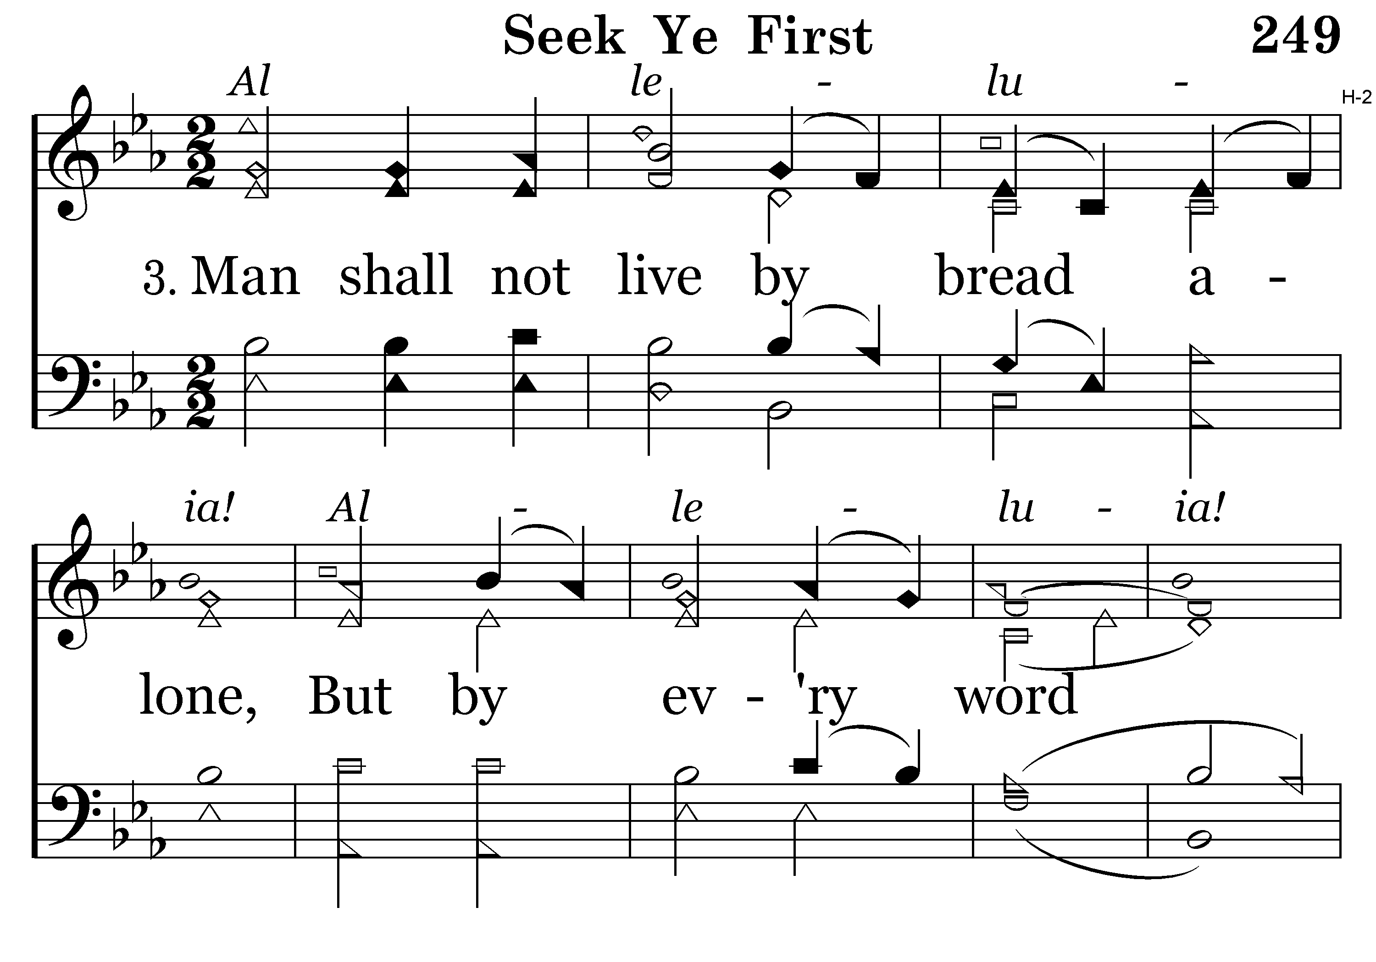
249 - Seek Ye First - 3.1

Slide 11
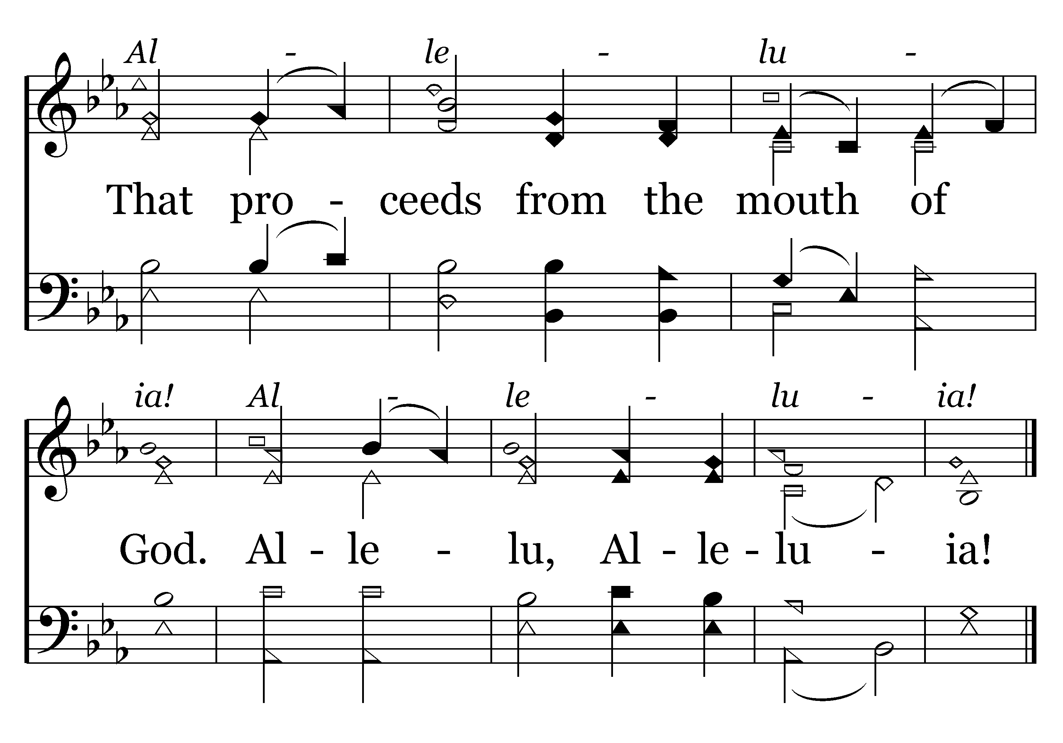
249 - Seek Ye First - 3.2
End of Song

Slide 12
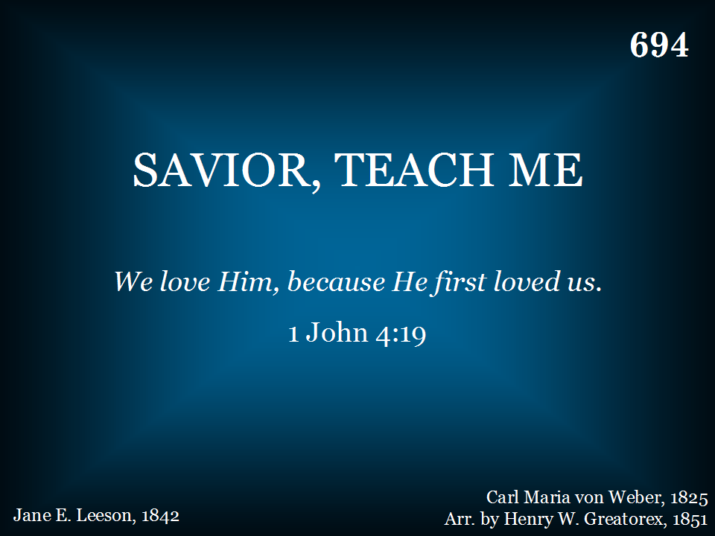
694 - Savior, Teach Me - Title

Slide 13
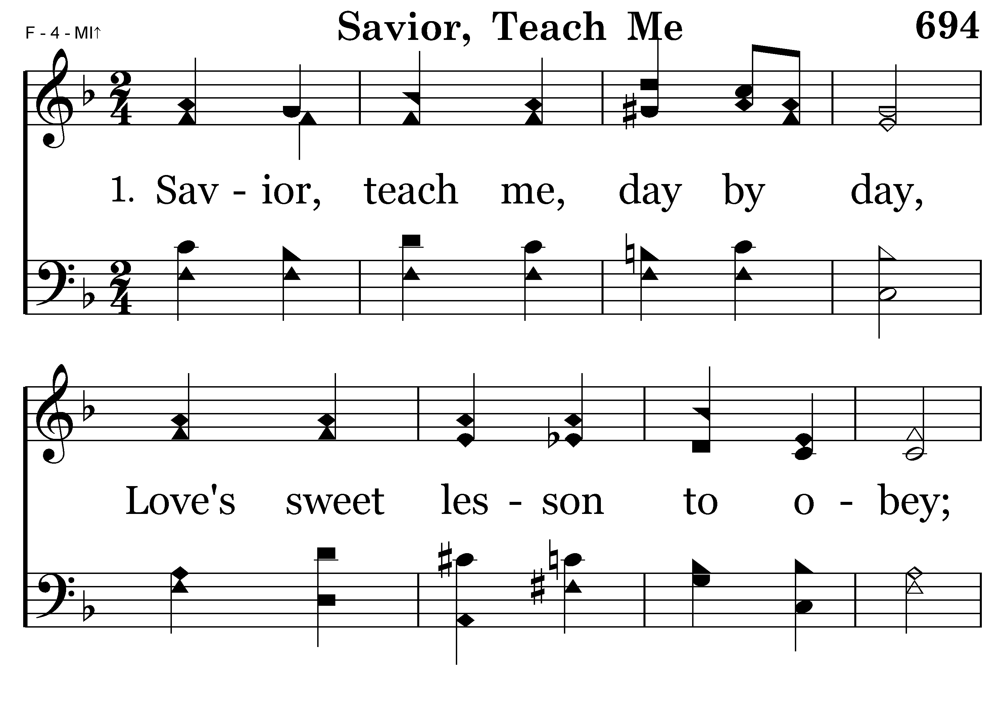
694 - Savior, Teach Me - 1.1

Slide 14
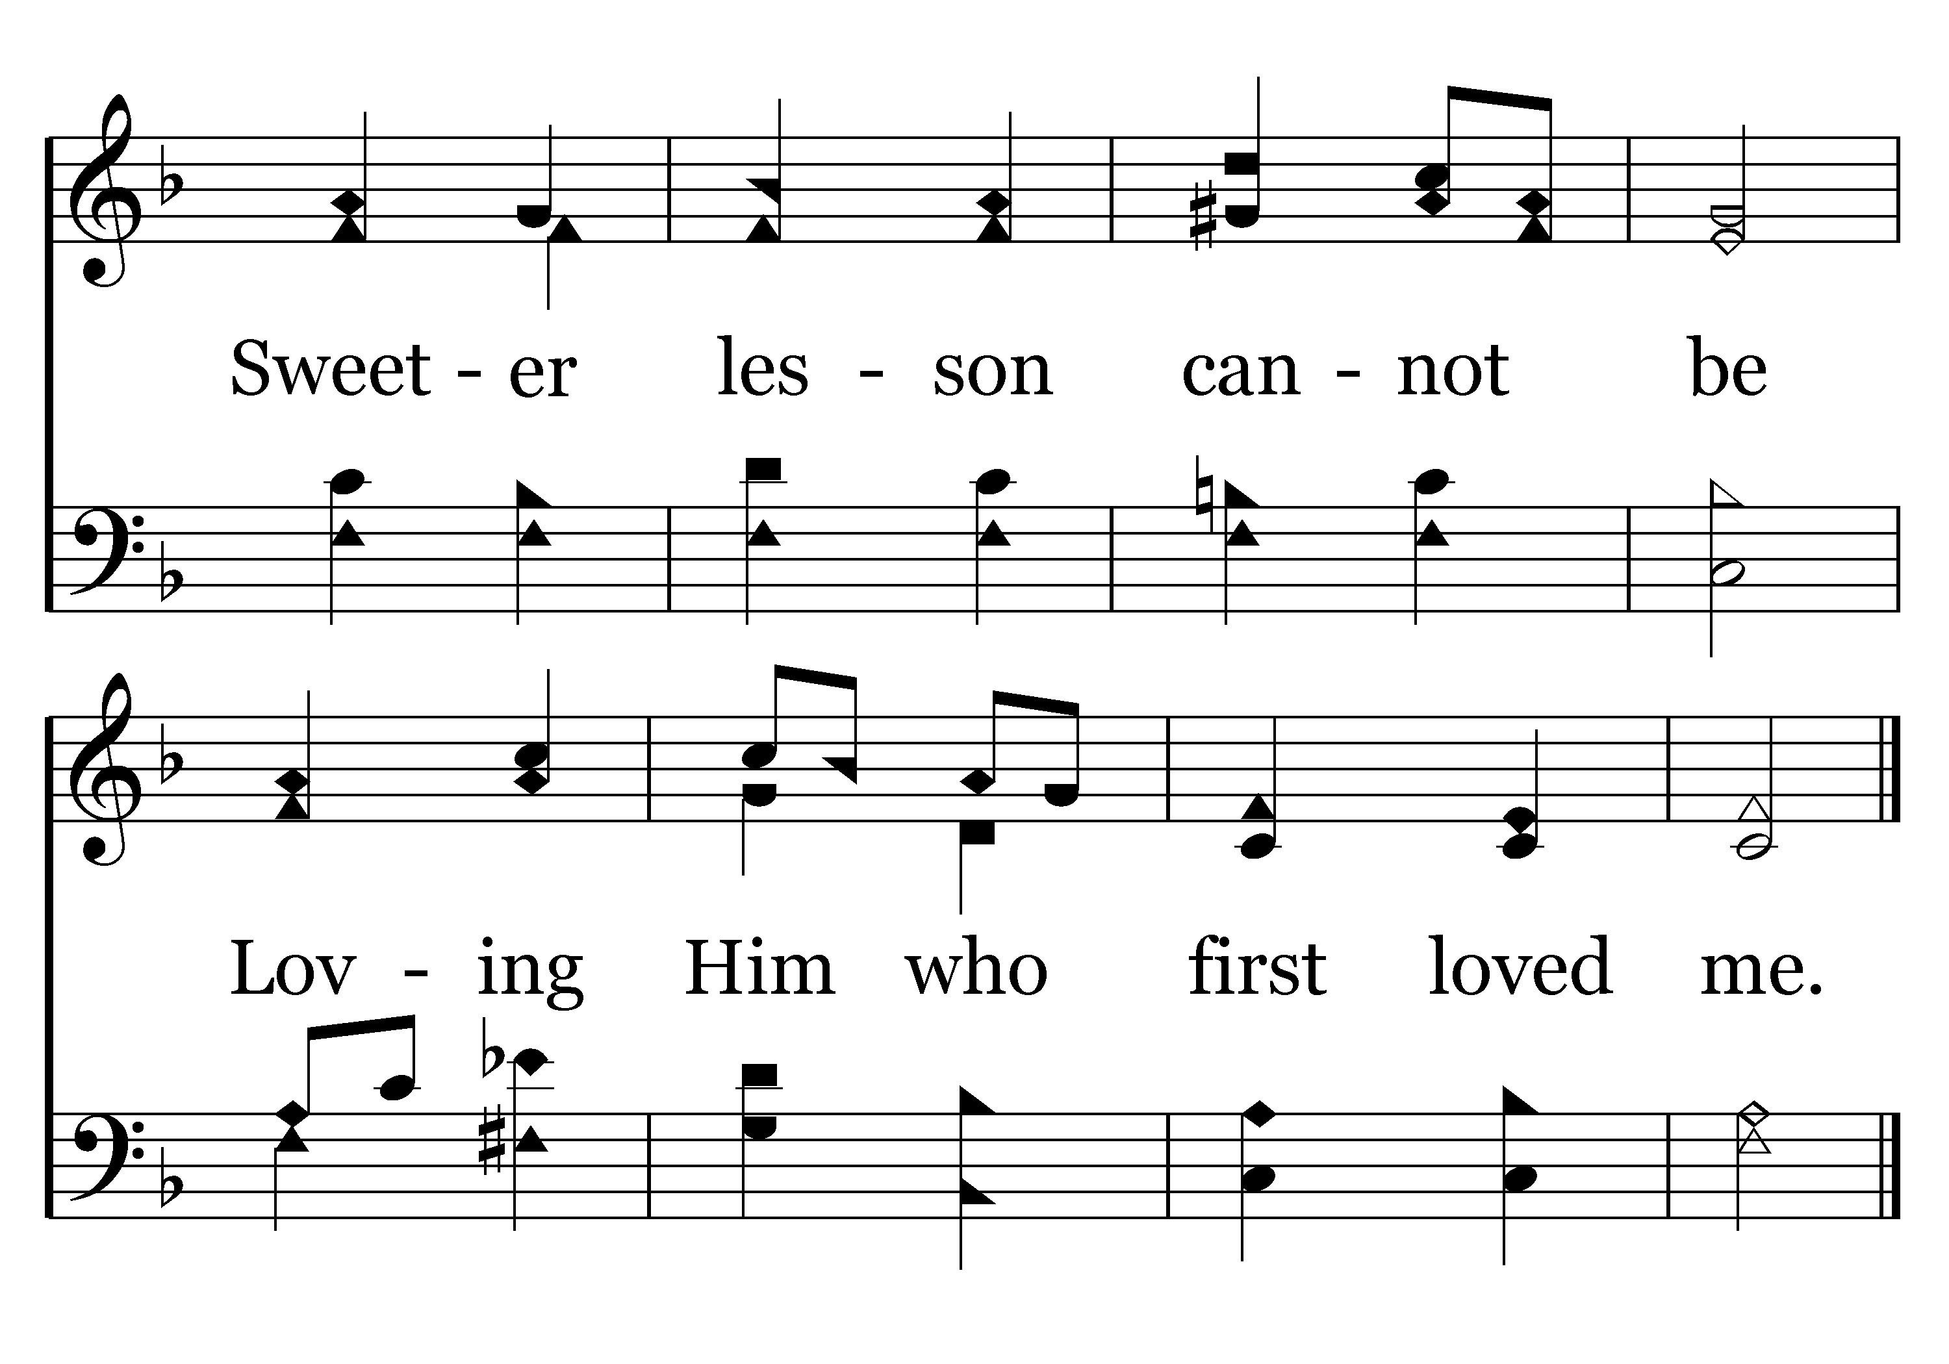
694 - Savior, Teach Me - 1.2
End of Verse 1

Slide 15
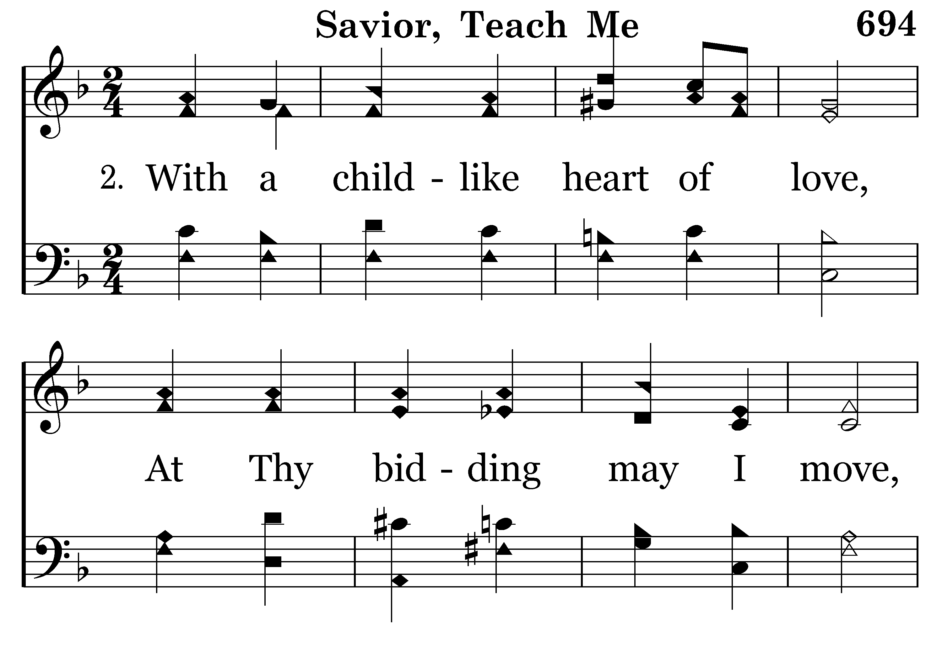
694 - Savior, Teach Me - 2.1

Slide 16
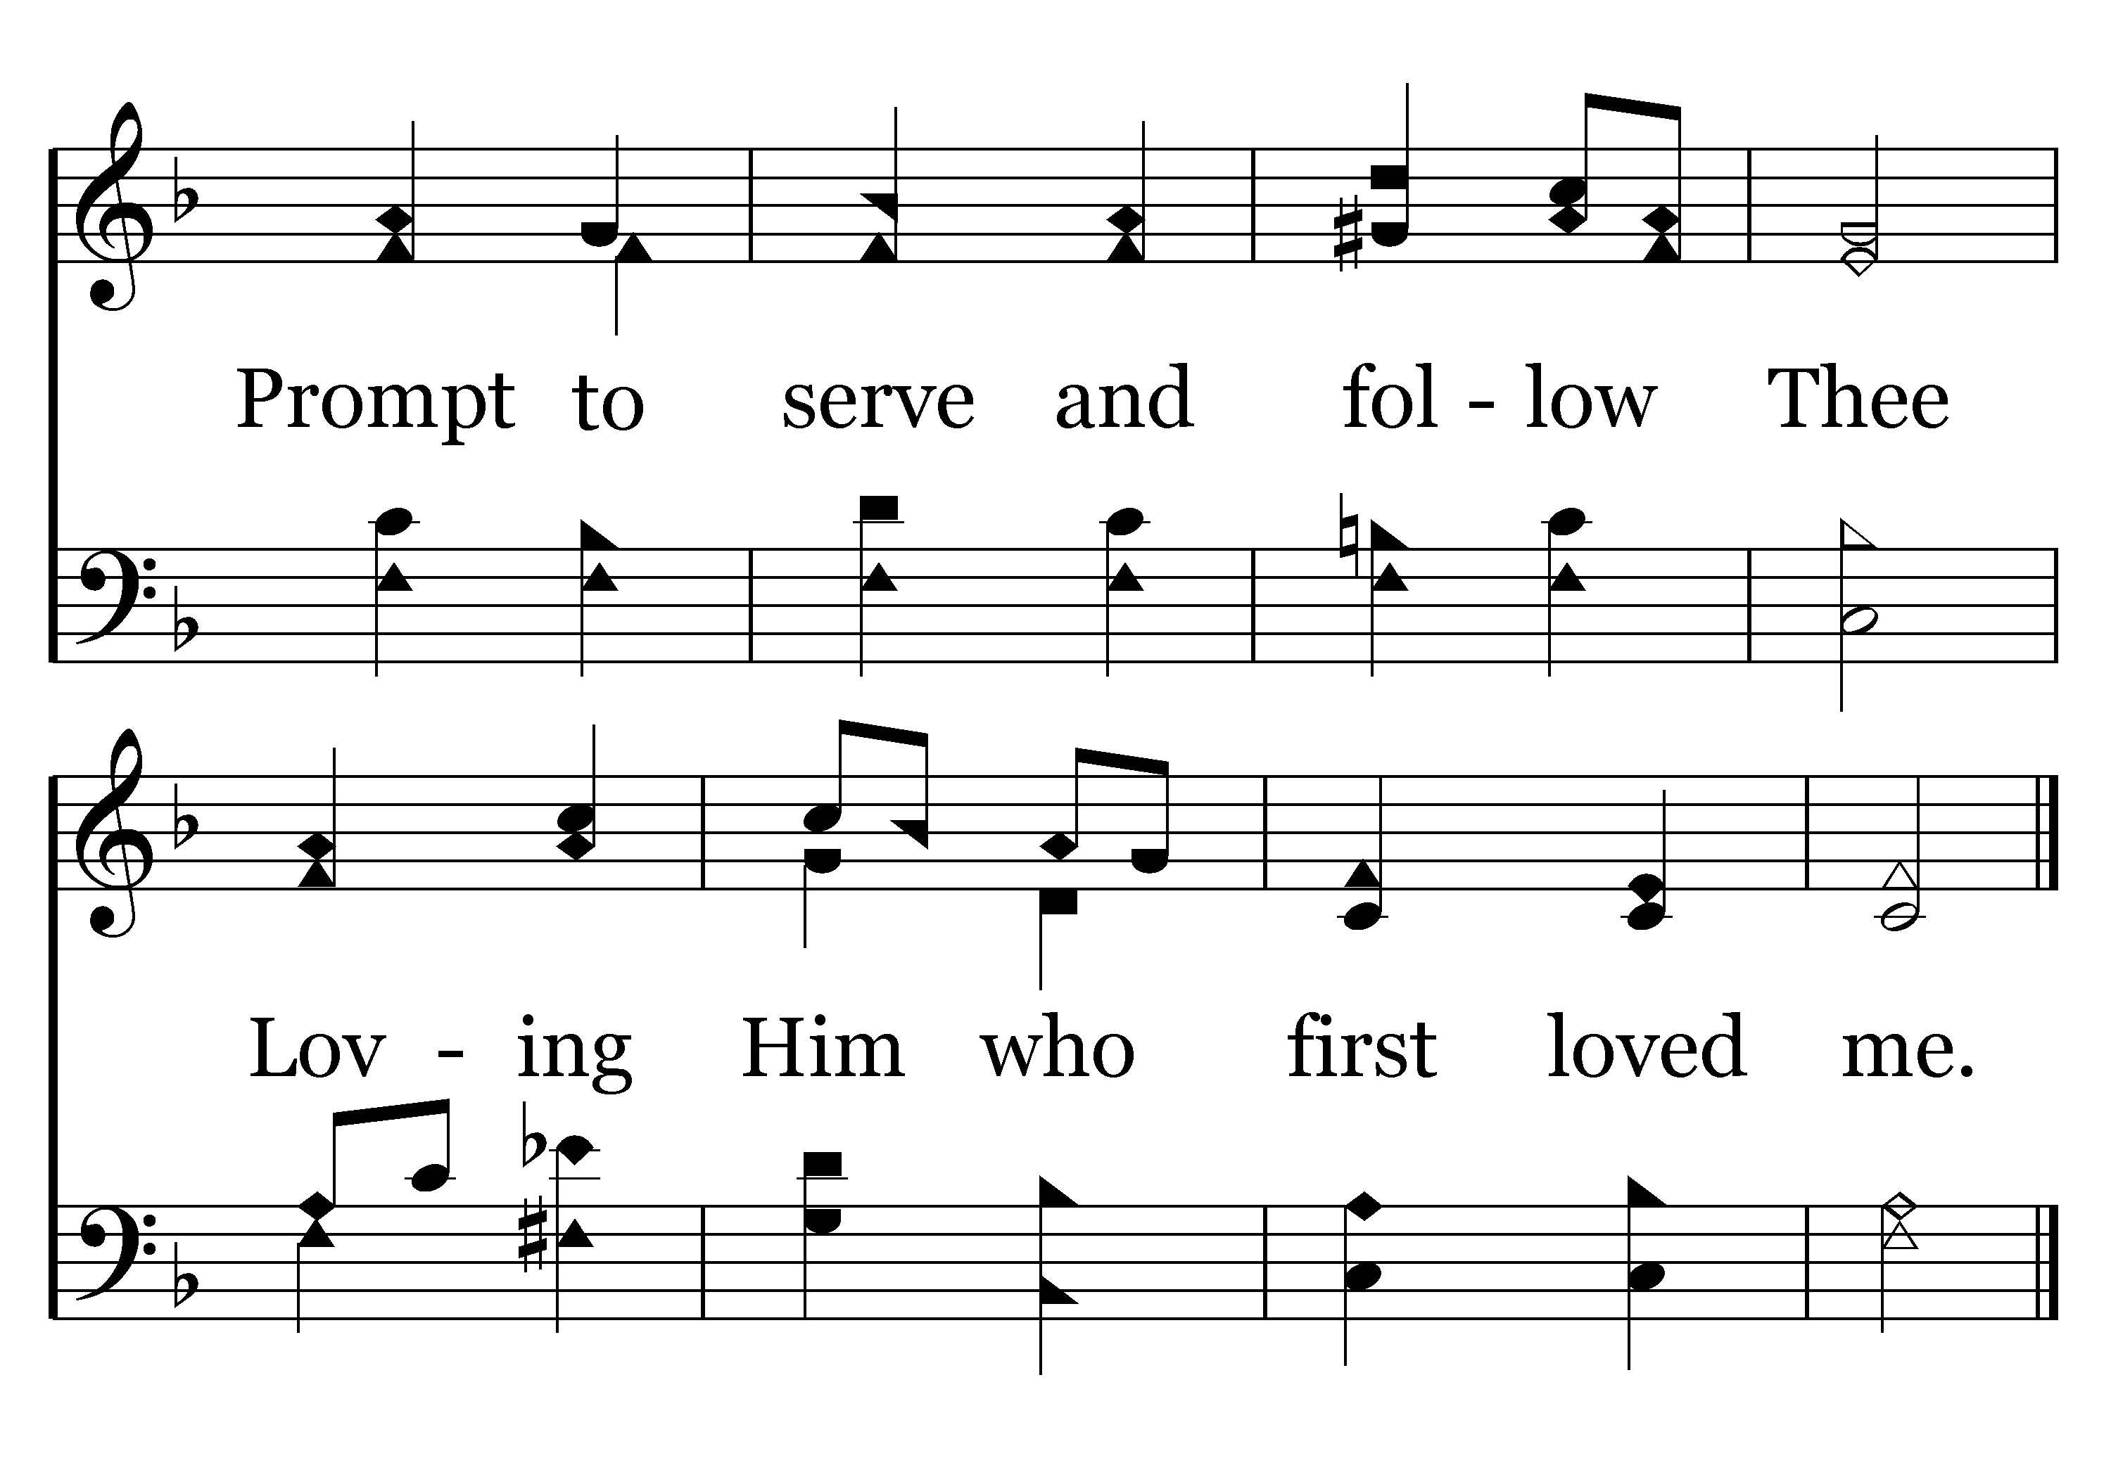
694 - Savior, Teach Me - 2.2
End of Verse 2

Slide 17
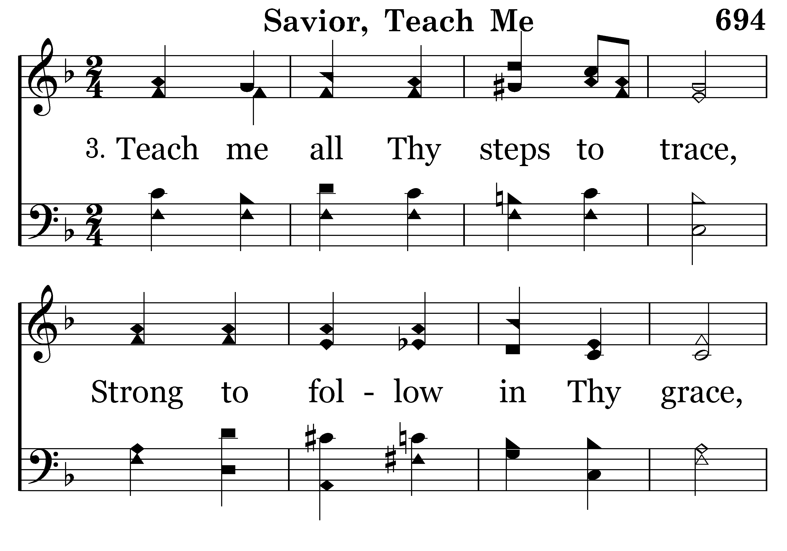
694 - Savior, Teach Me - 3.1

Slide 18
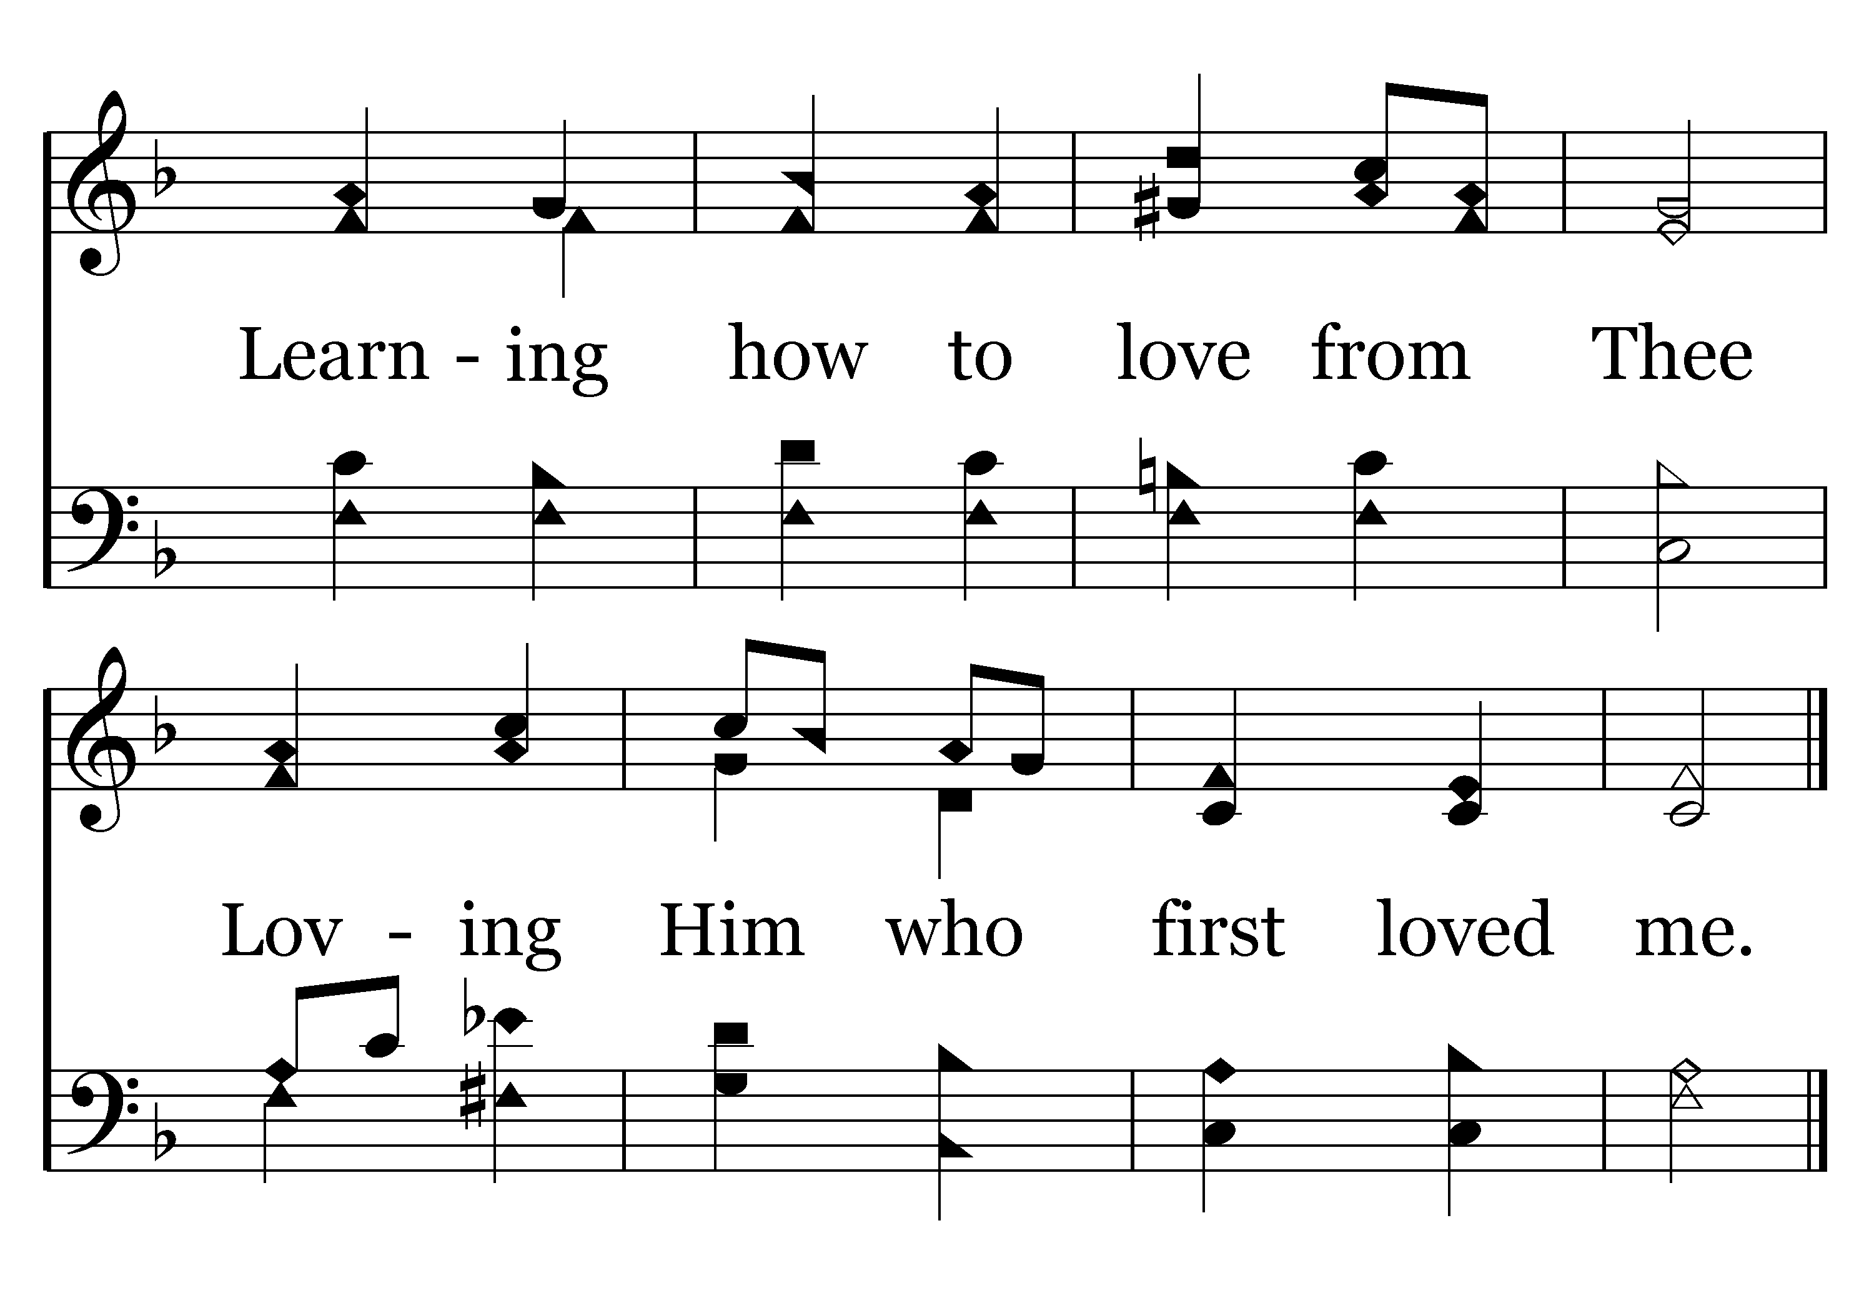
694 - Savior, Teach Me - 3.2
End of Song

Slide 19
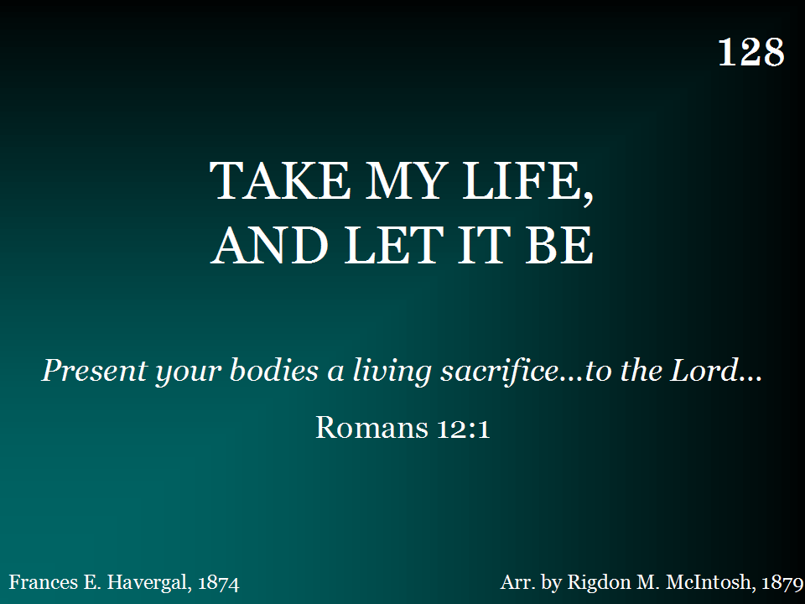
128 - Take My Life And Let It Be - Title

Slide 20
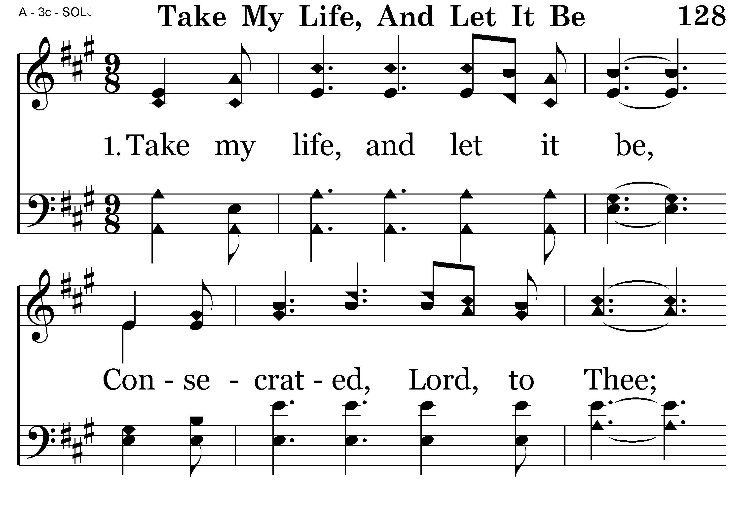
128 - Take My Life And Let It Be - 1.1

Slide 21
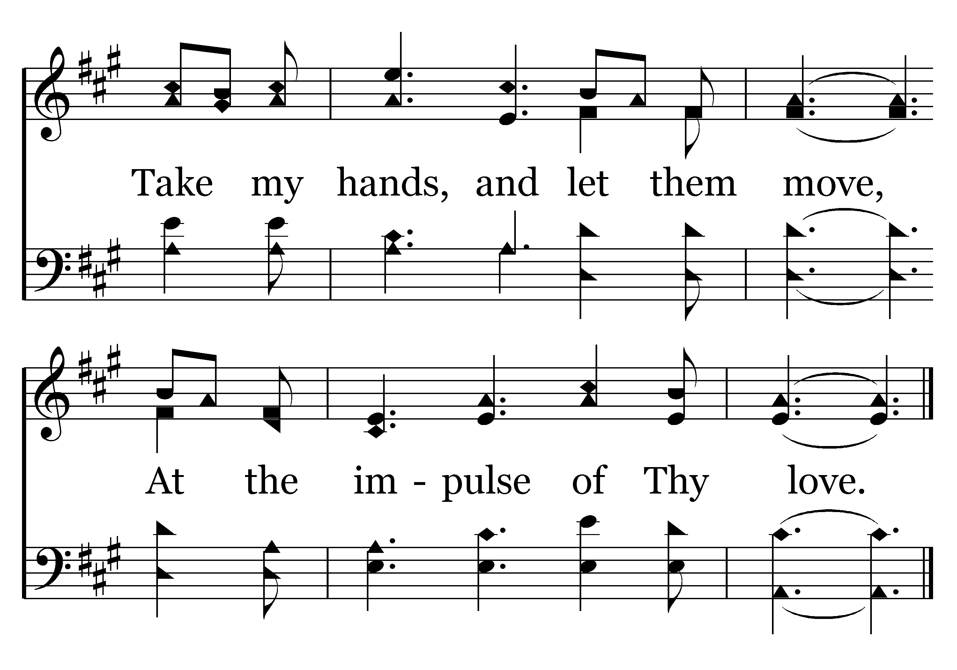
128 - Take My Life And Let It Be - 1.2
End of Verse 1

Slide 22
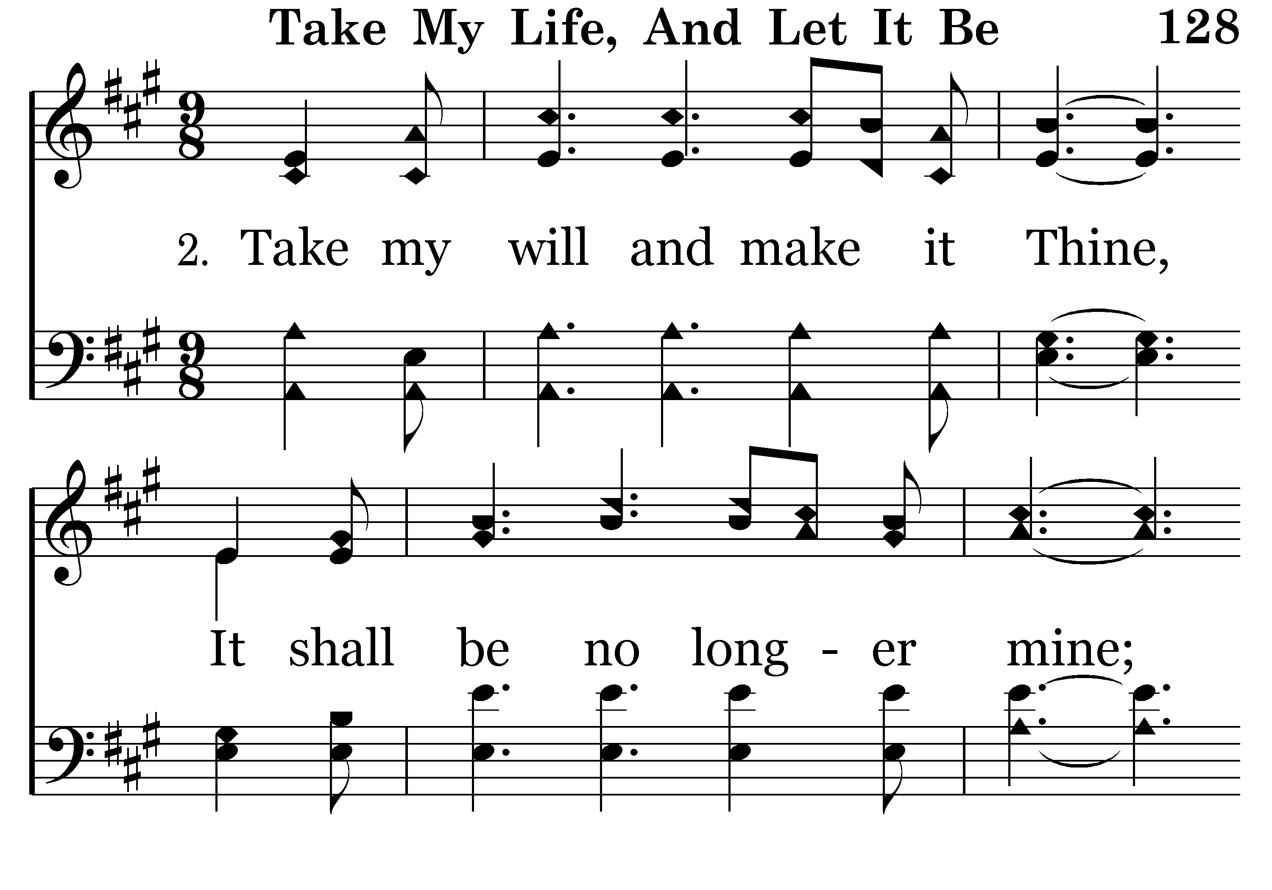
128 - Take My Life And Let It Be - 2.1

Slide 23
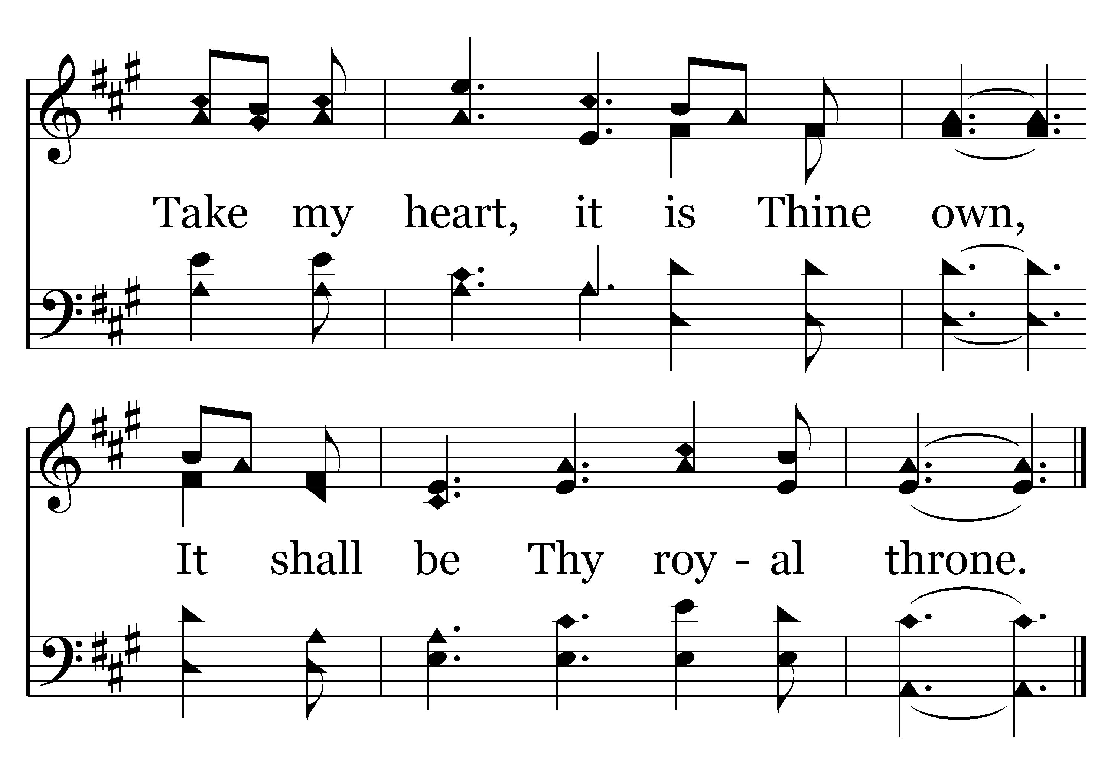
128 - Take My Life And Let It Be - 2.2
End of Verse 2

Slide 24
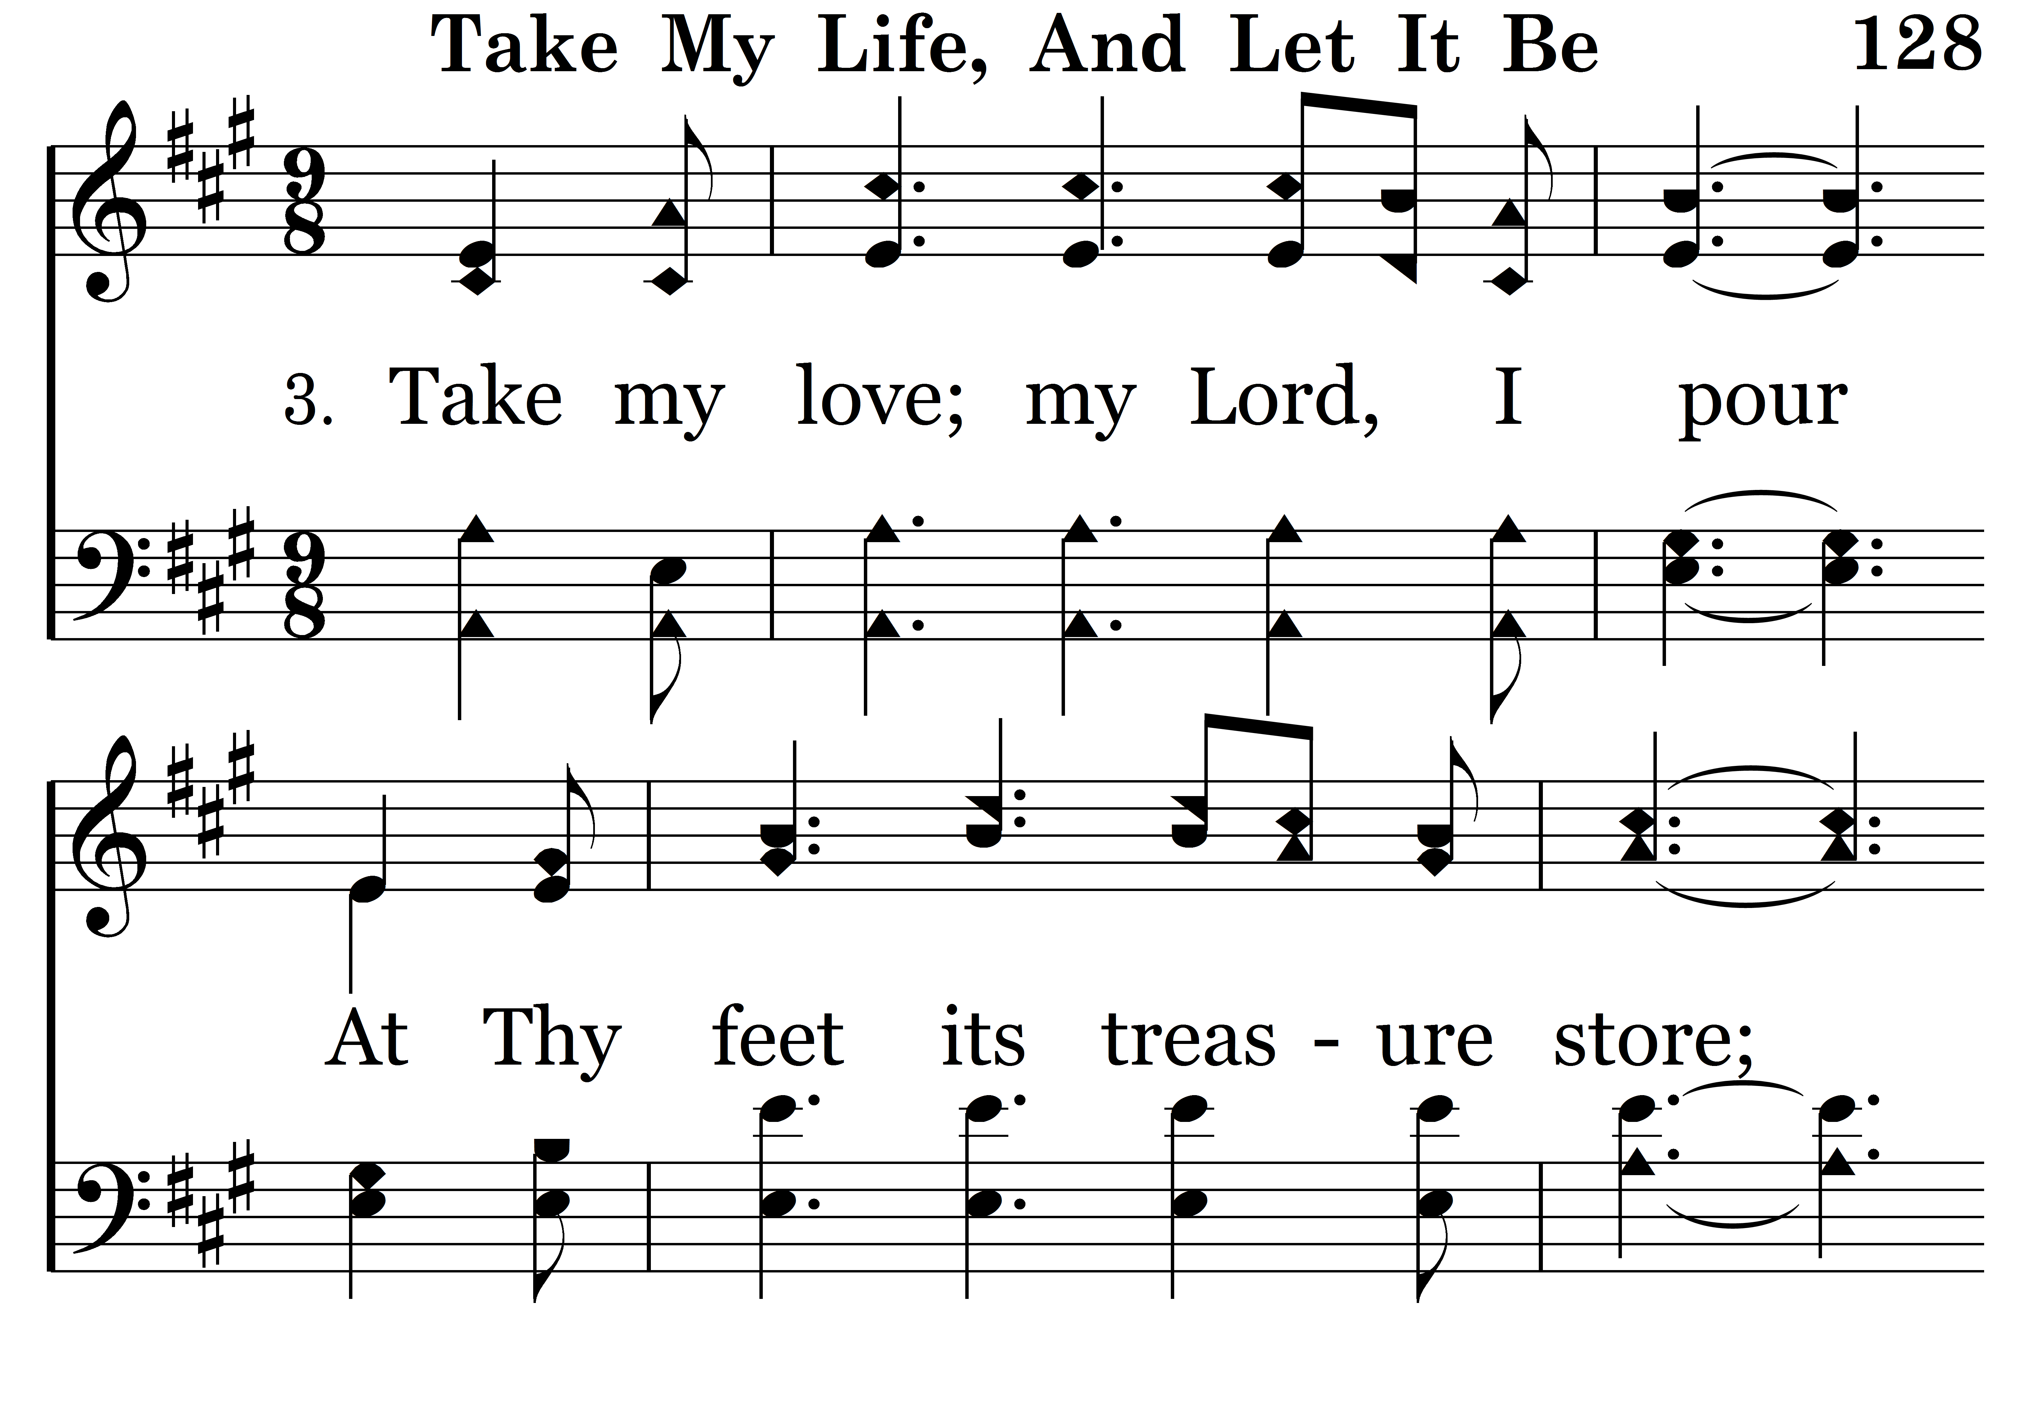
128 - Take My Life And Let It Be - 3.1

Slide 25
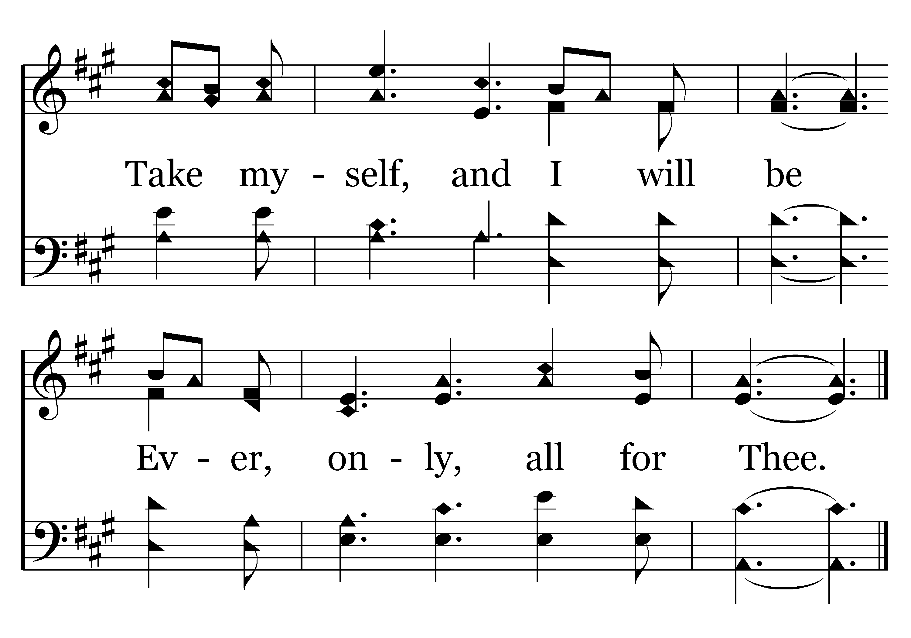
128 - Take My Life And Let It Be - 3.2
End of Song

Slide 26
Seek Ye First…
Order of Worship
Tim Hogland – Scripture - Matthew 6:19-33
Foster Craig – Songs - 249, 694 & 128
Terry Yontz – Prayer
Colby Lovelady – Songs – 111, 130 & 484
Jason Gudgel – Scripture – Philippians 3:4-14
Nevin Cox – Songs – 502, 105 & 332
Dan Hicks – Scripture – Romans 12:1-2
Jim Rowbottom – Songs – 65, 415 & 7
Richard McIntyre – Closing Prayer

Slide 27
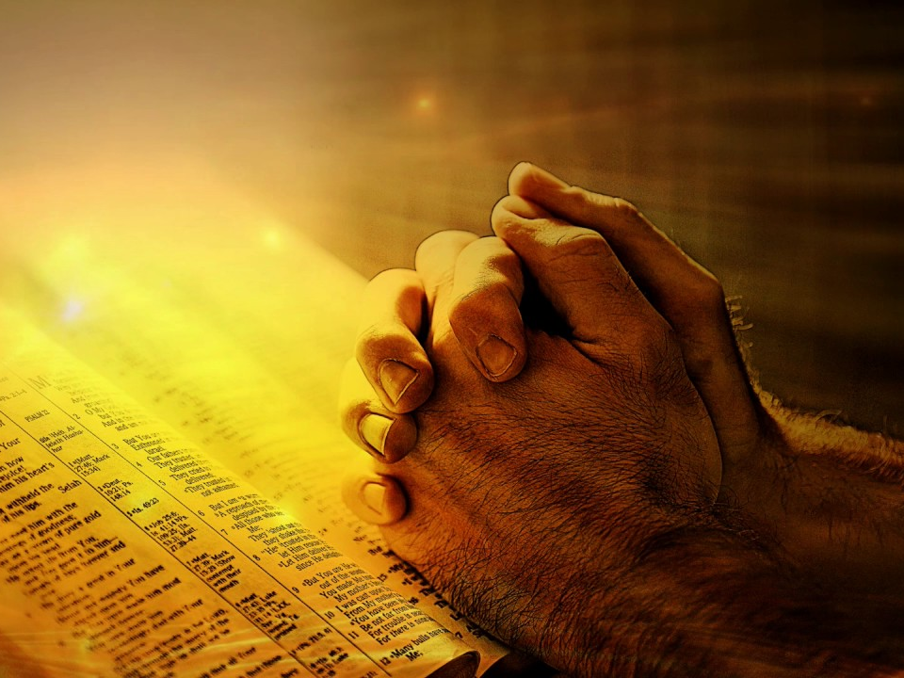
PRAYER
Terry Yontz

Slide 28
Seek Ye First…
Order of Worship
Tim Hogland – Scripture - Matthew 6:19-33
Foster Craig – Songs - 249, 694 & 128
Terry Yontz – Prayer
Colby Lovelady – Songs – 111, 130 & 484
Jason Gudgel – Scripture – Philippians 3:4-14
Nevin Cox – Songs – 502, 105 & 332
Dan Hicks – Scripture – Romans 12:1-2
Jim Rowbottom – Songs – 65, 415 & 7
Richard McIntyre – Closing Prayer

Slide 29
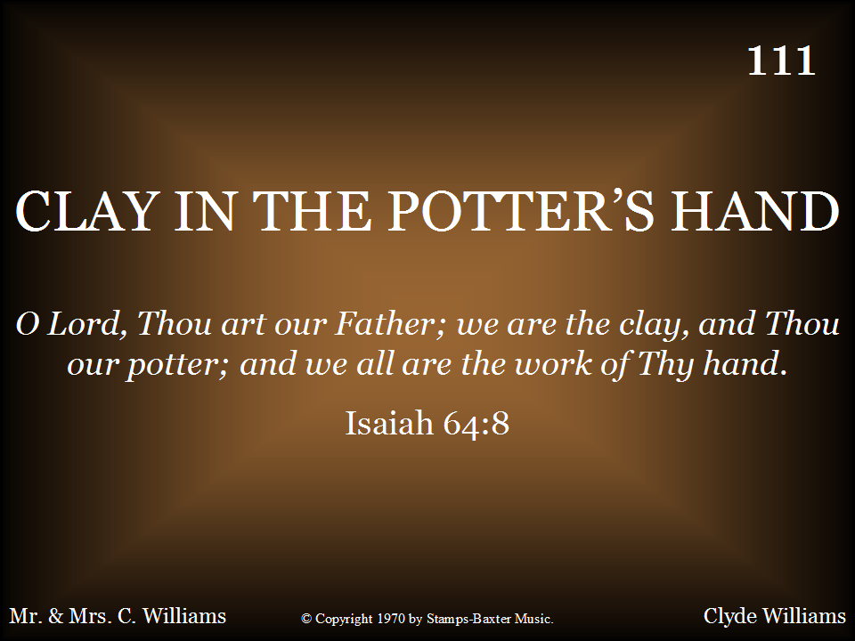
111 - Clay In The Potter's Hand - Title

Slide 30
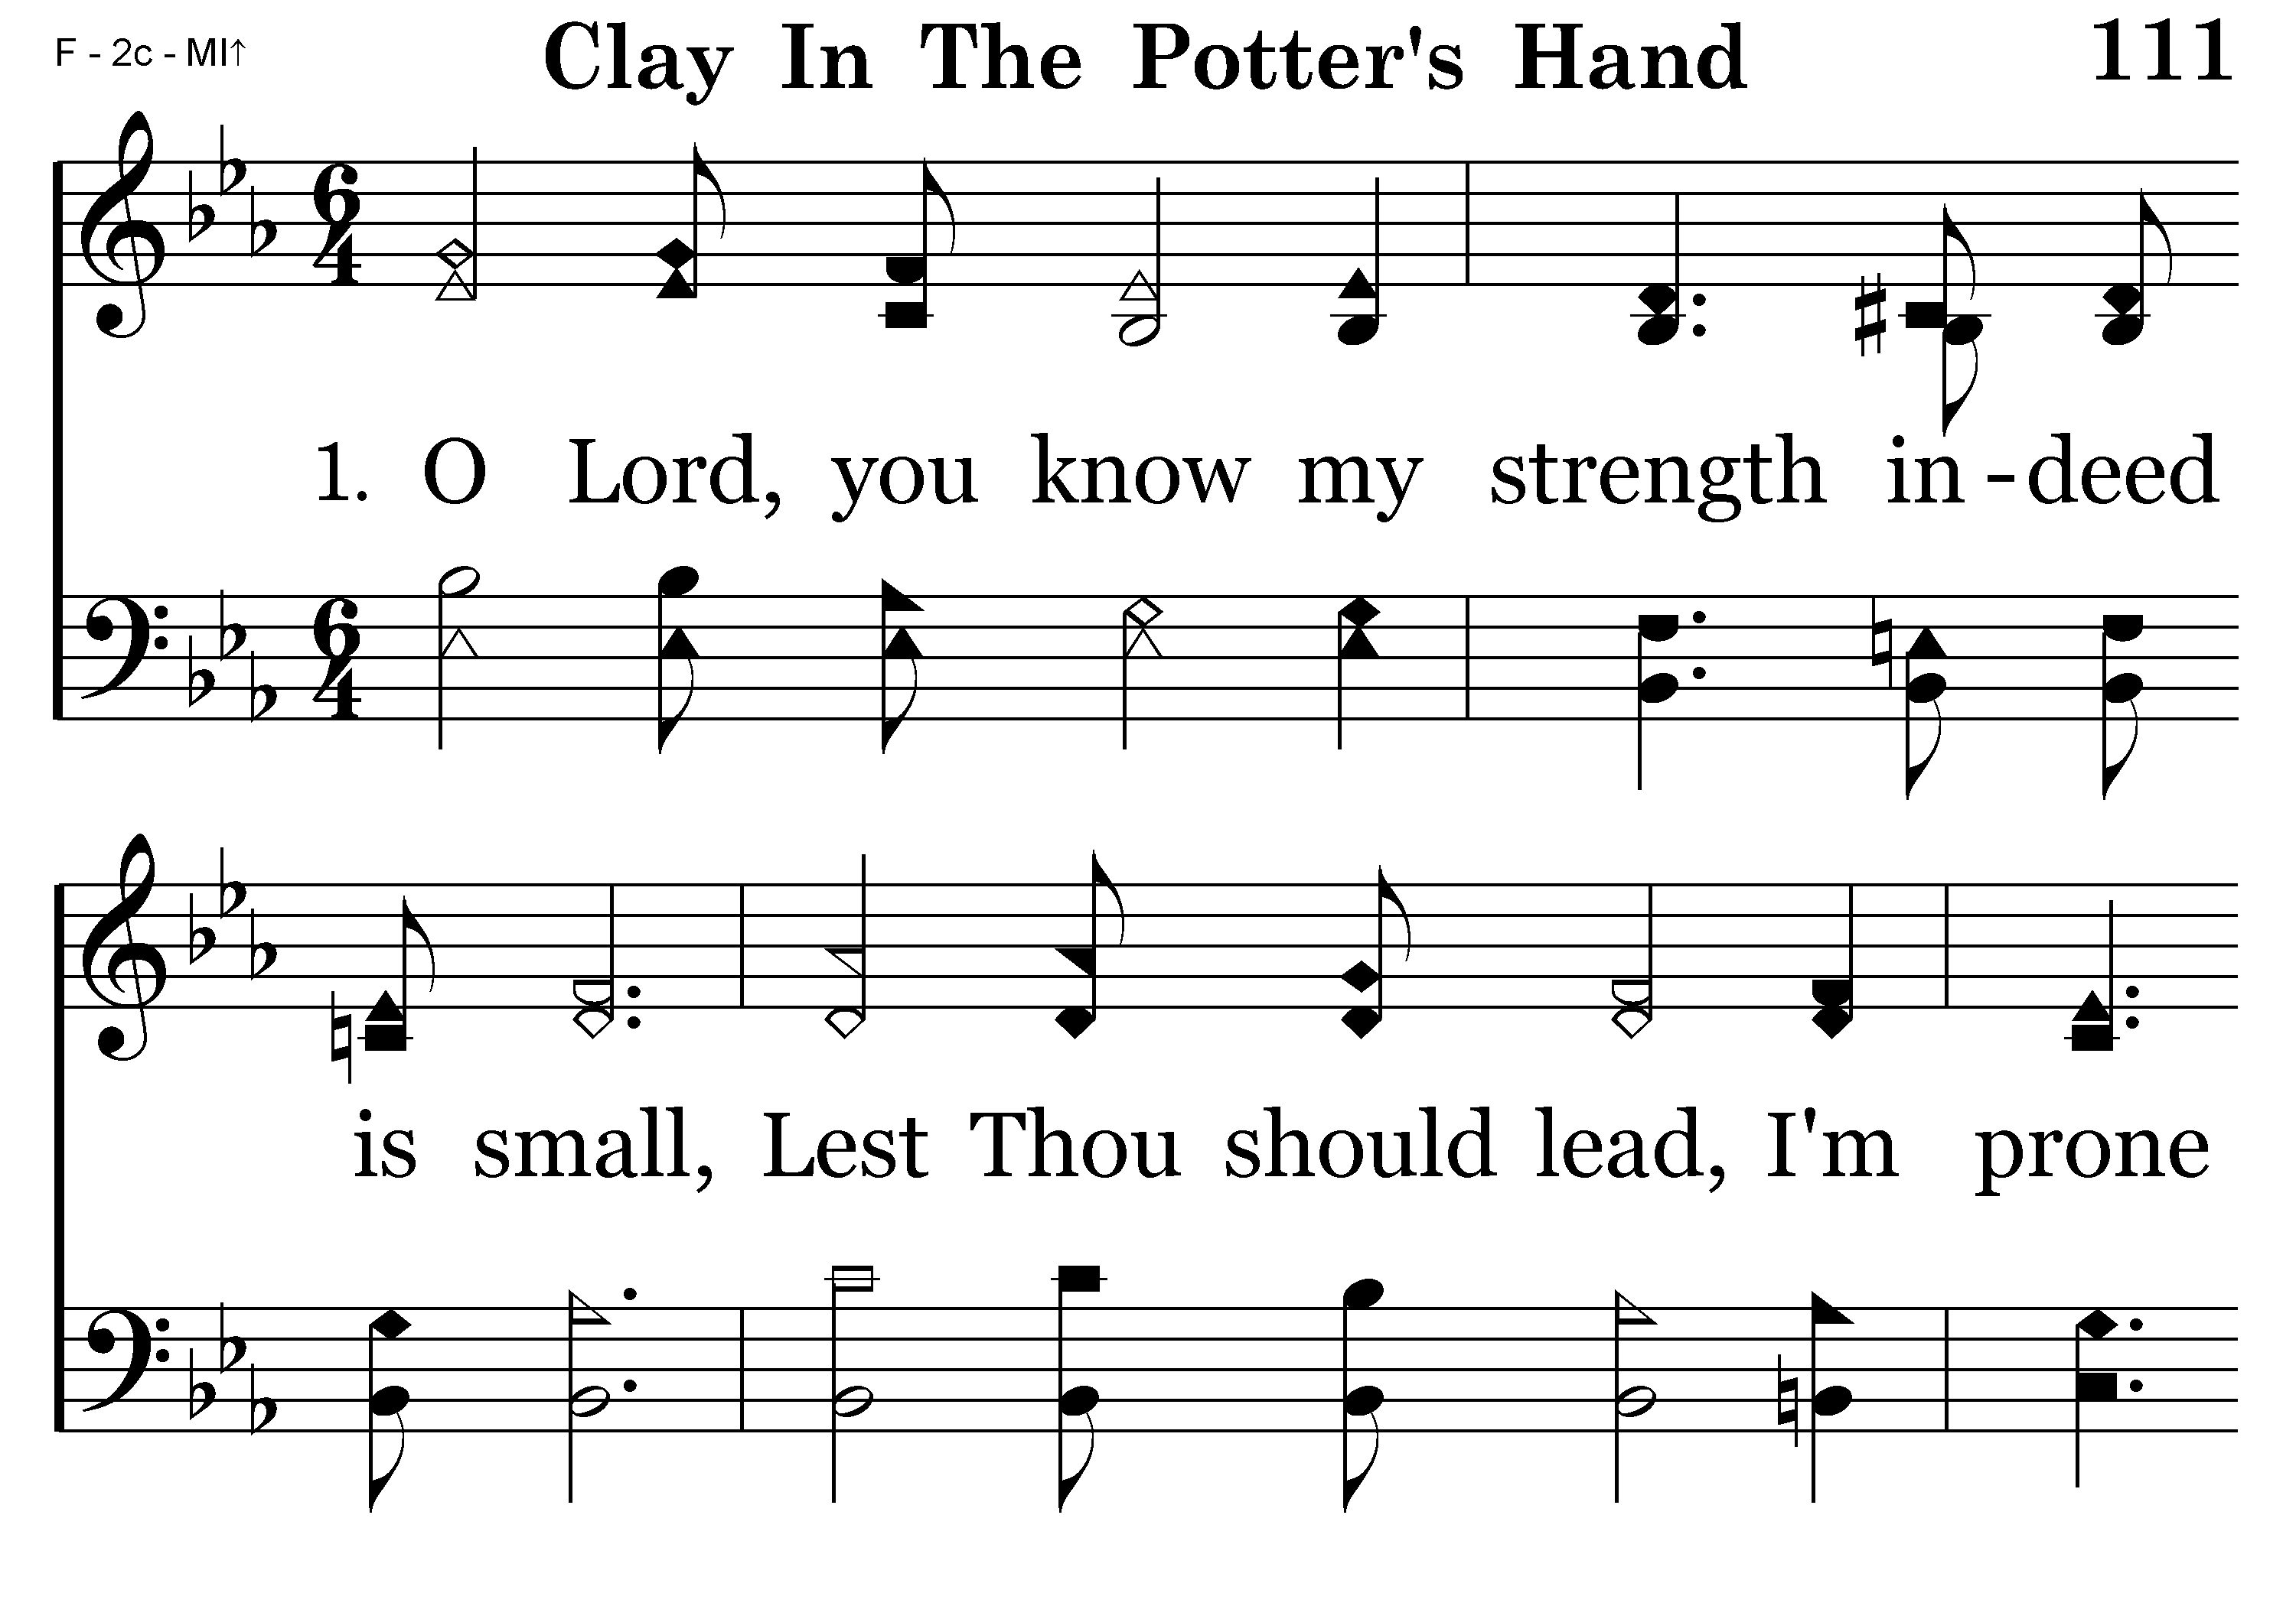
111 - Clay In The Potter's Hand - 1.1

Slide 31
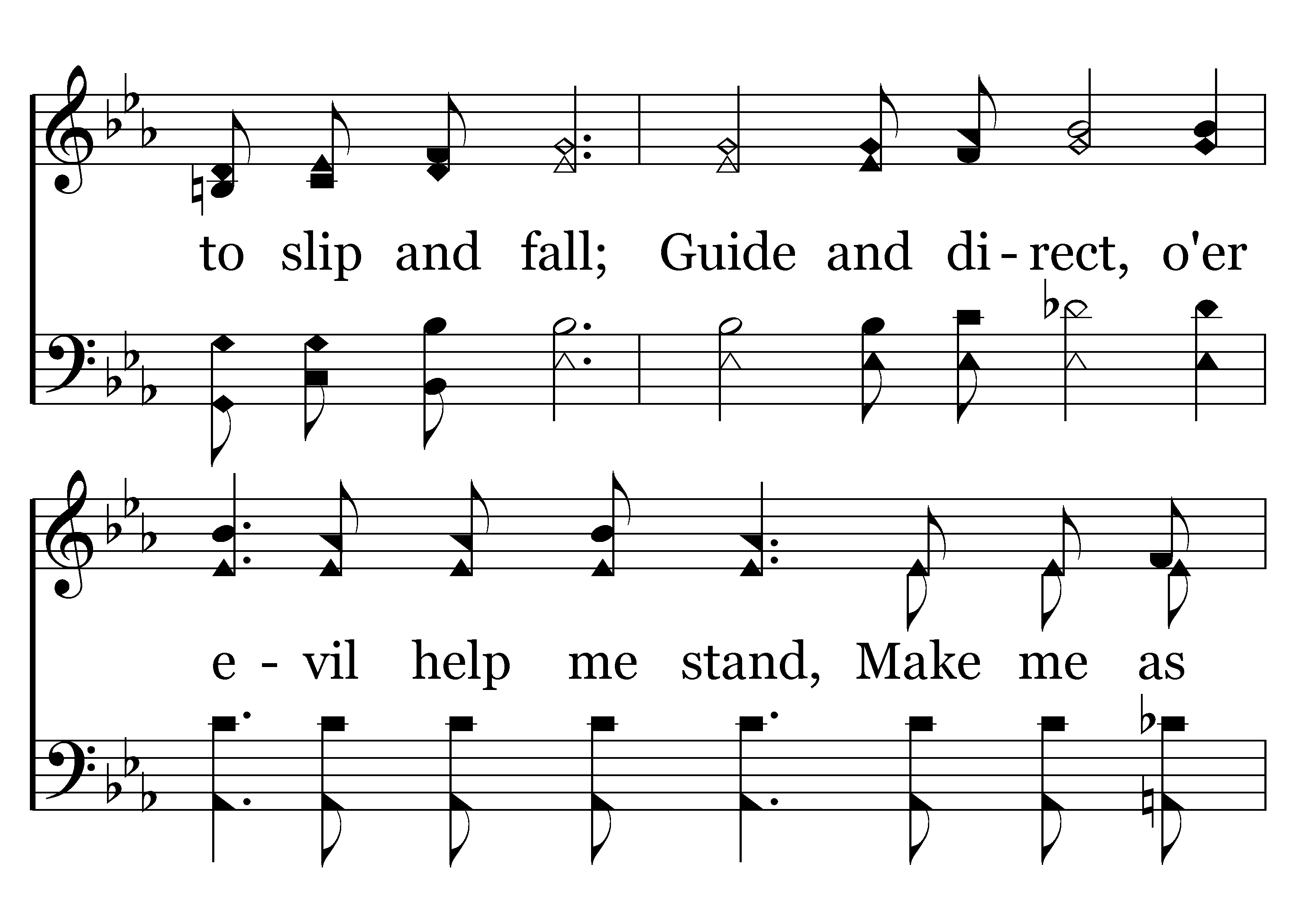
111 - Clay In The Potter's Hand - 1.2

Slide 32
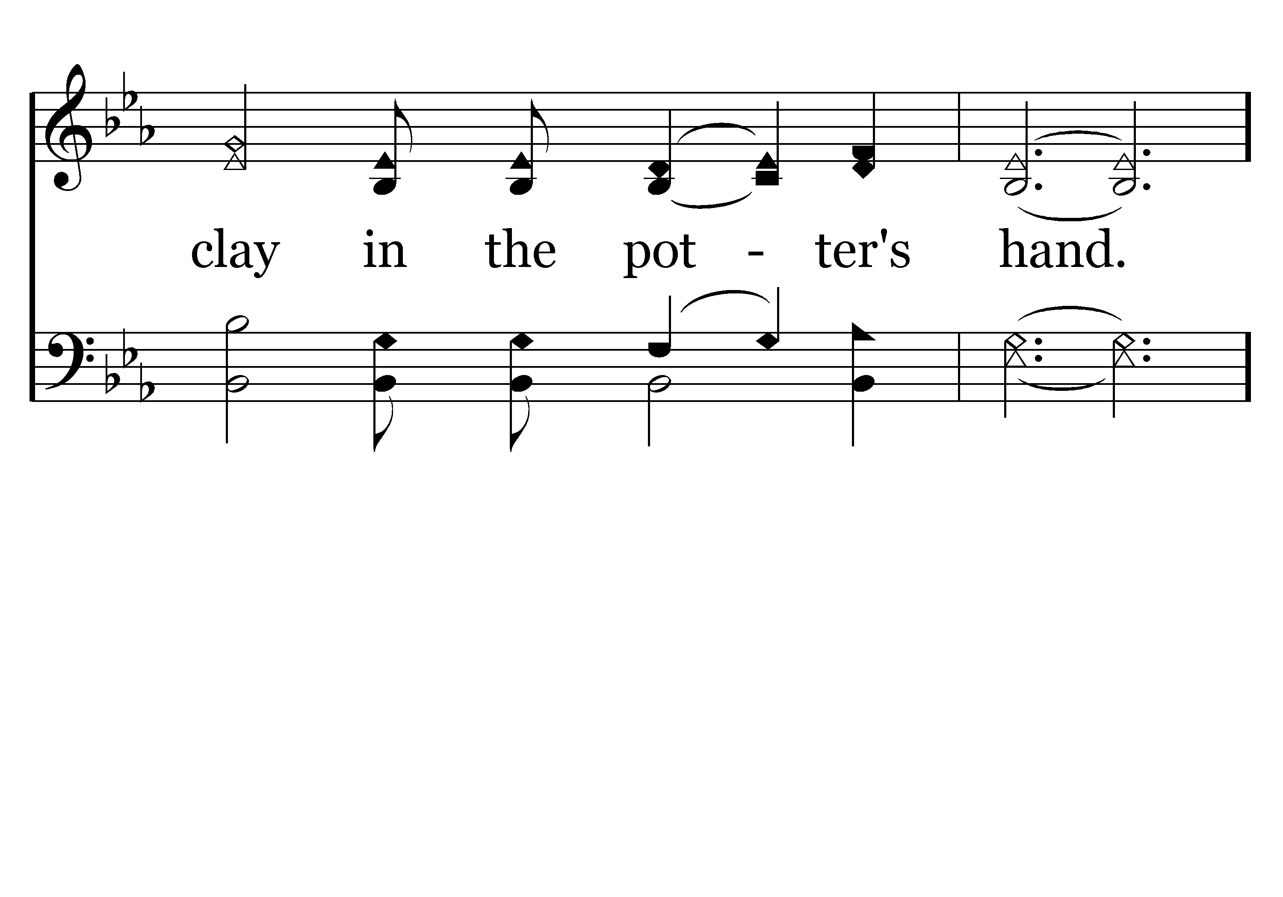
111 - Clay In The Potter's Hand - 1.3

Slide 33
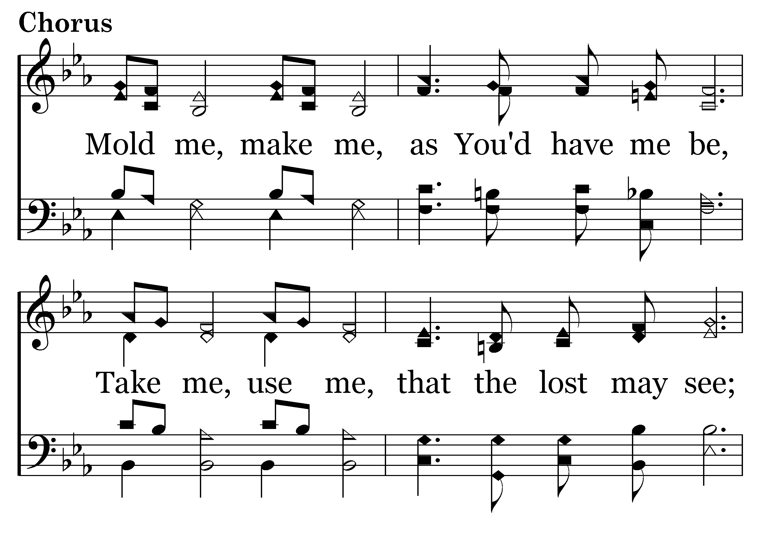
111 - Clay In The Potter's Hand - C.1

Slide 34
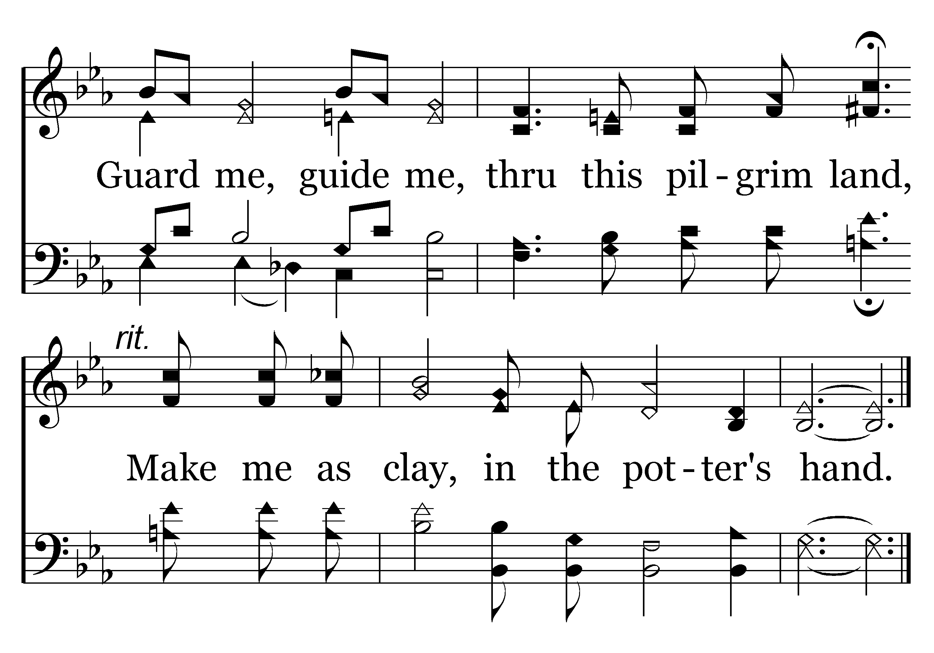
111 - Clay In The Potter's Hand - C.2
End of Verse 1

Slide 35
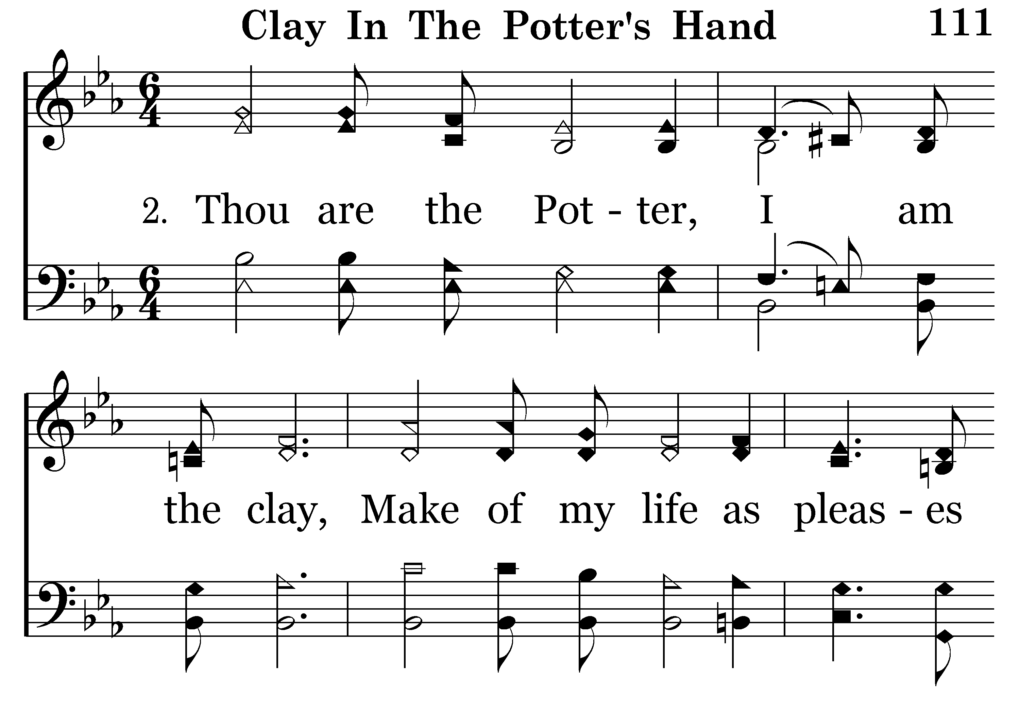
111 - Clay In The Potter's Hand - 2.1

Slide 36
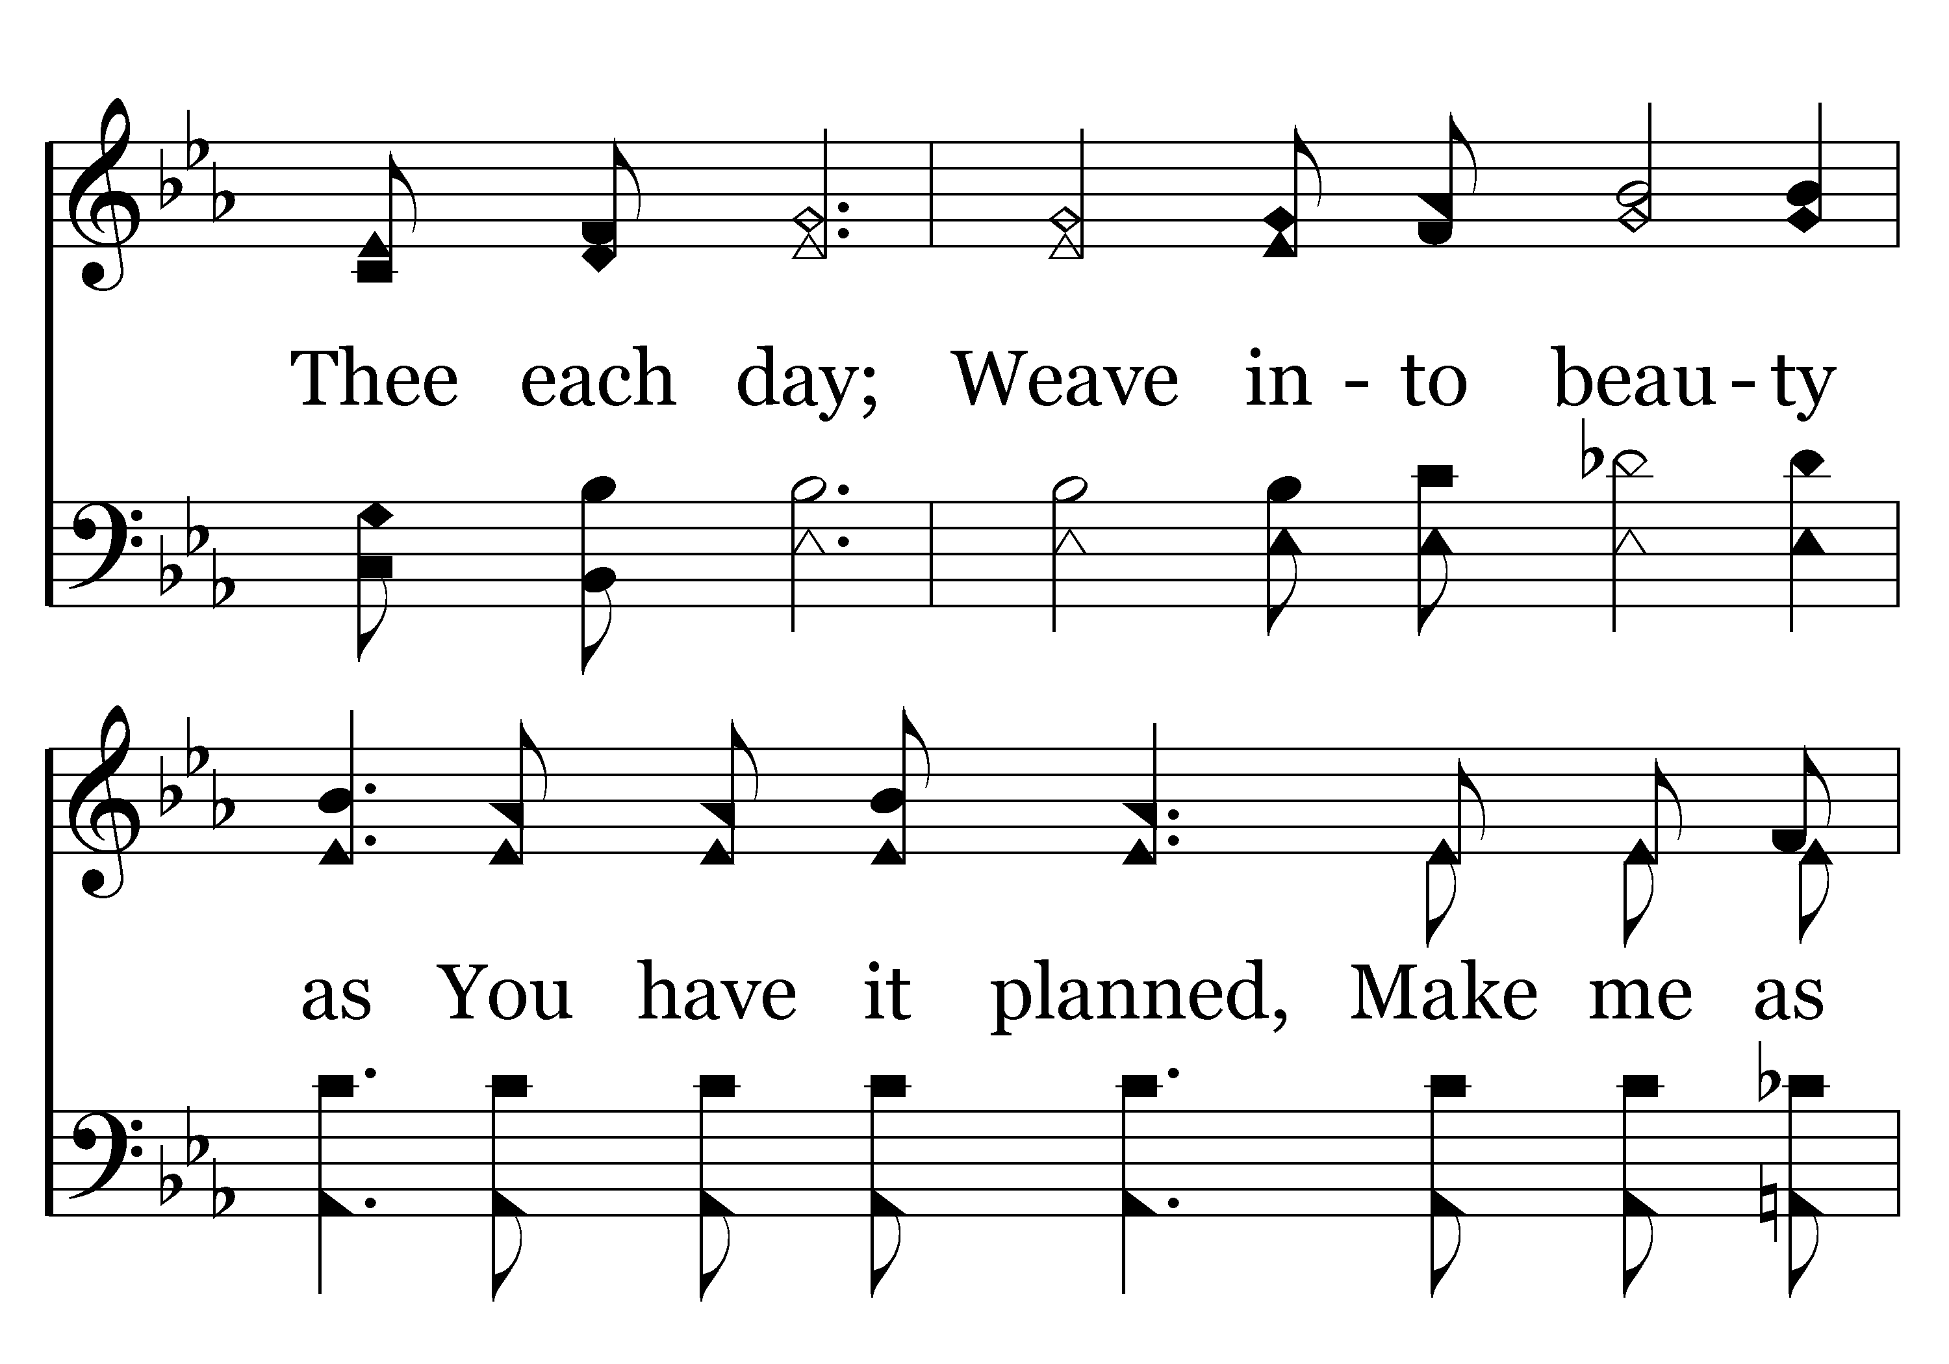
111 - Clay In The Potter's Hand - 2.2

Slide 37
111 - Clay In The Potter's Hand - 2.3

Slide 38
111 - Clay In The Potter's Hand - C.1

Slide 39
111 - Clay In The Potter's Hand - C.2
End of Verse 2

Slide 40
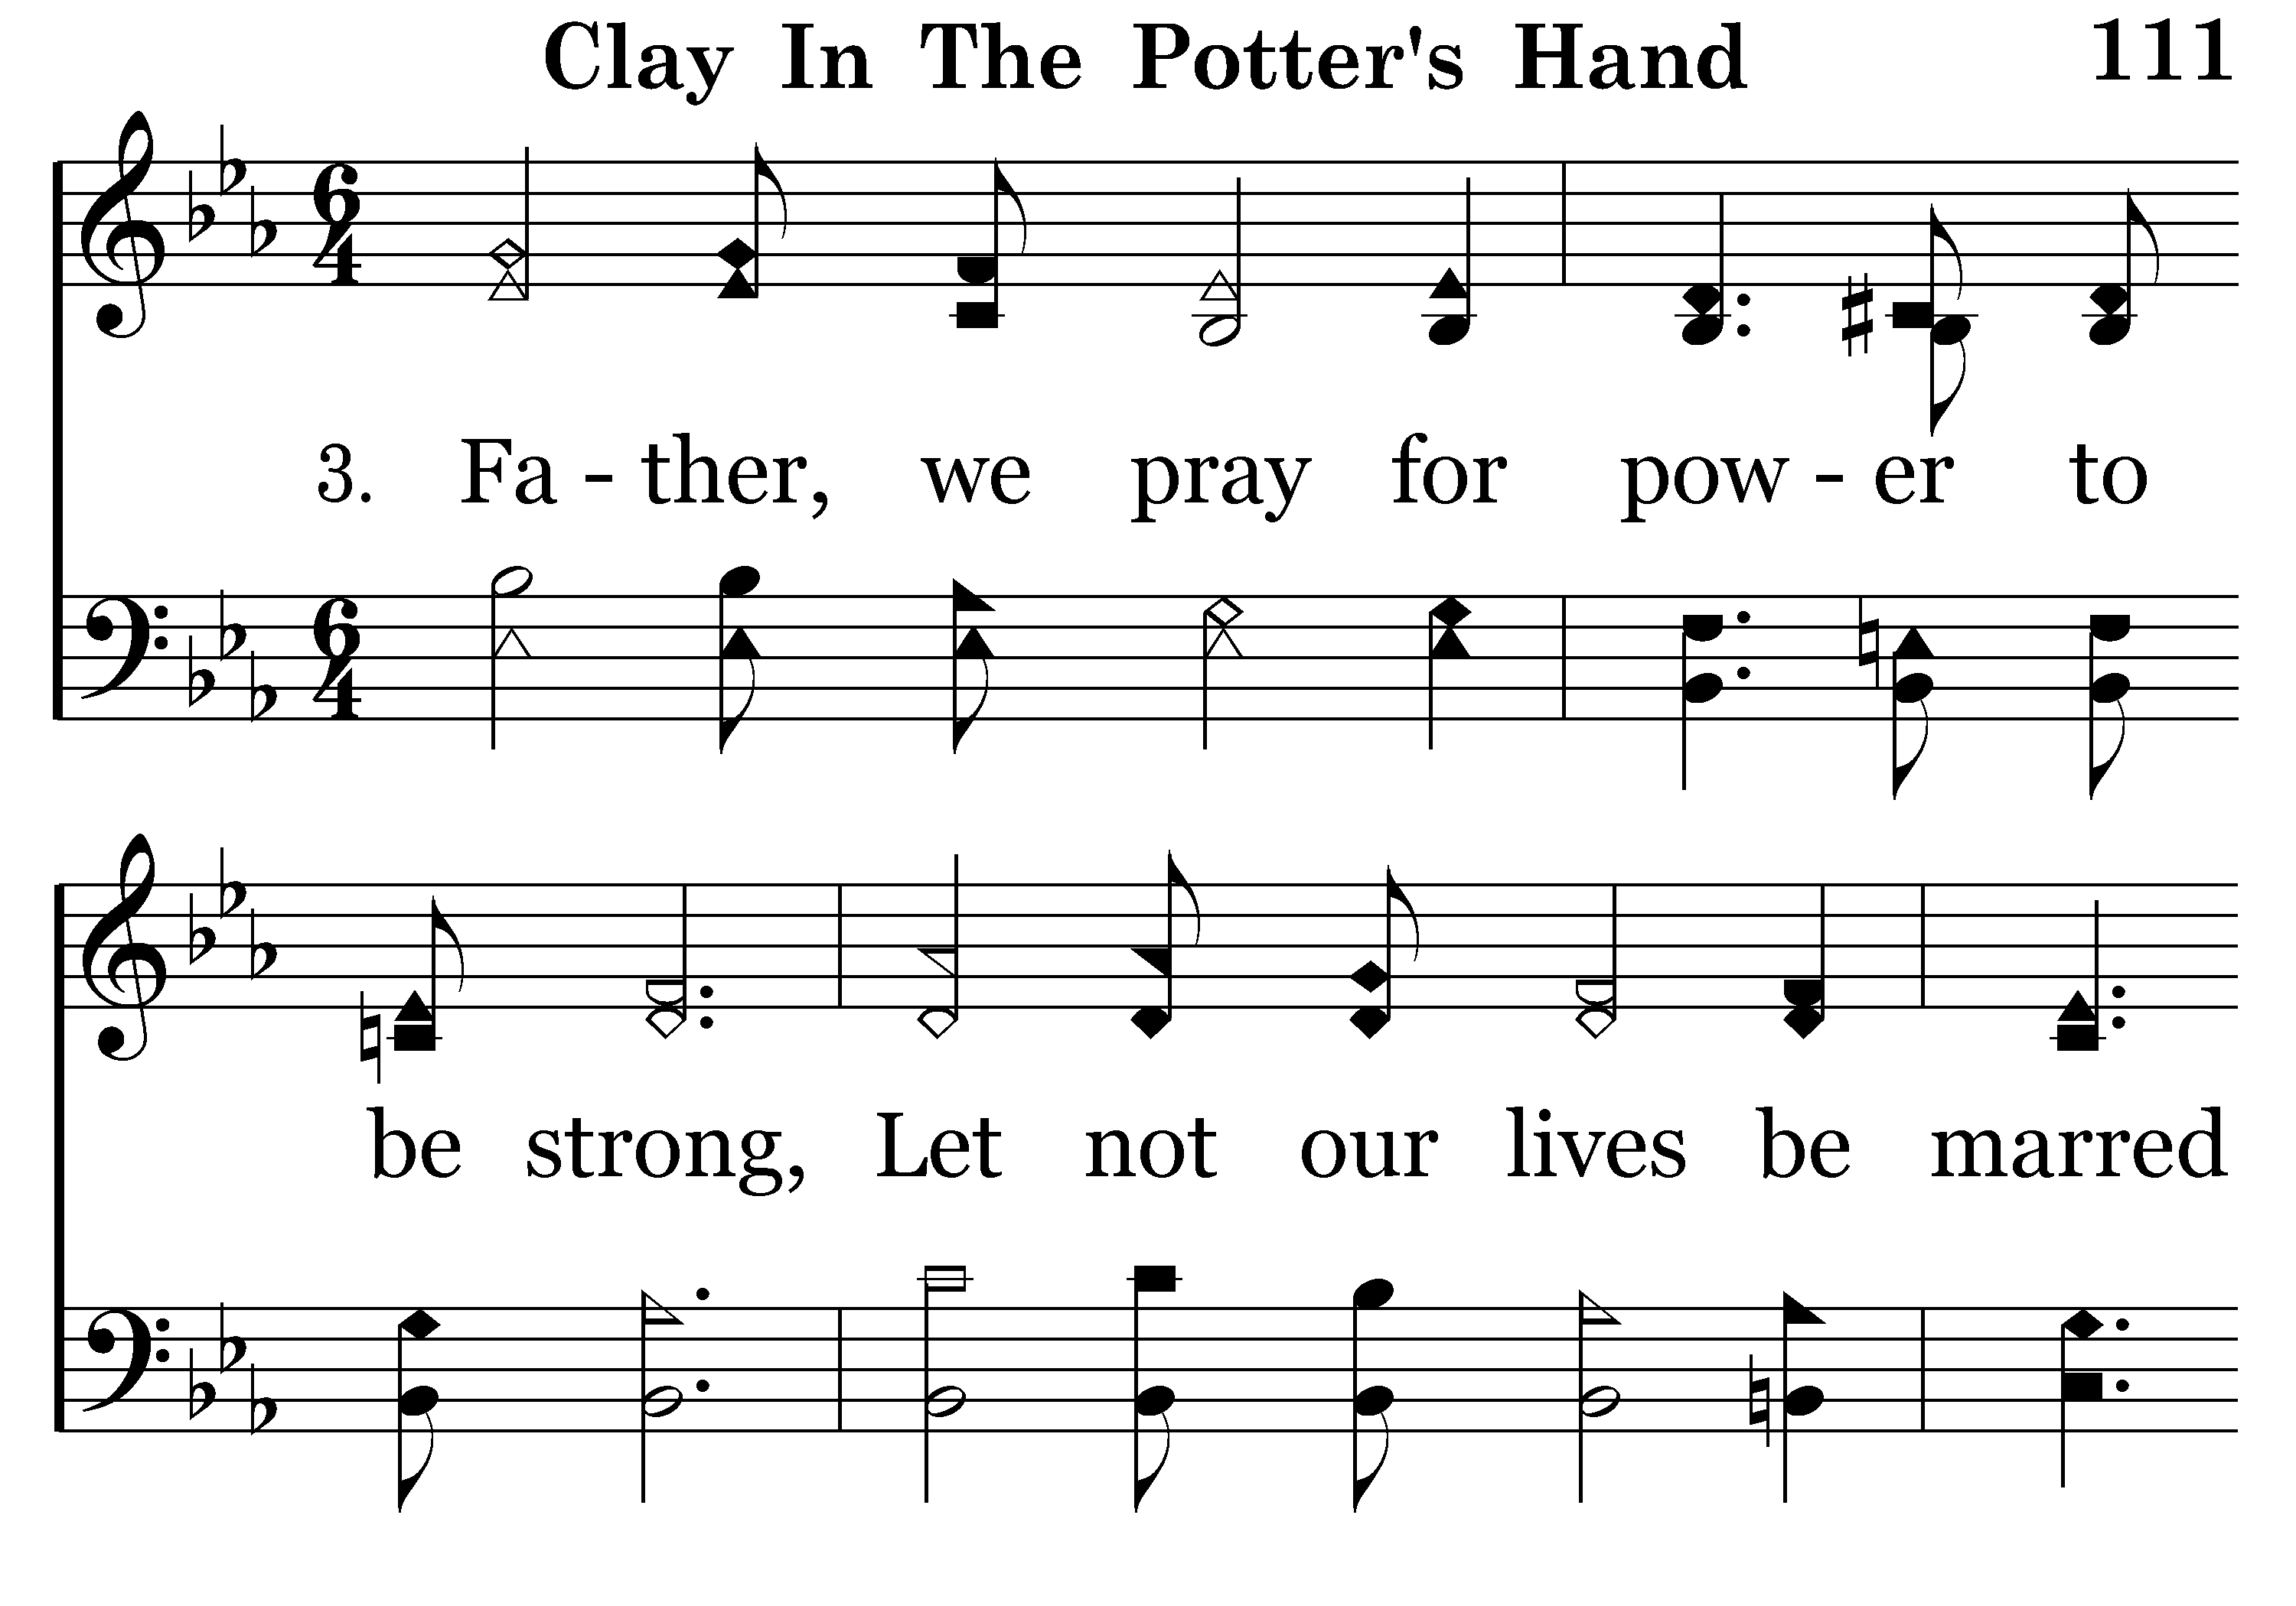
111 - Clay In The Potter's Hand - 3.1

Slide 41
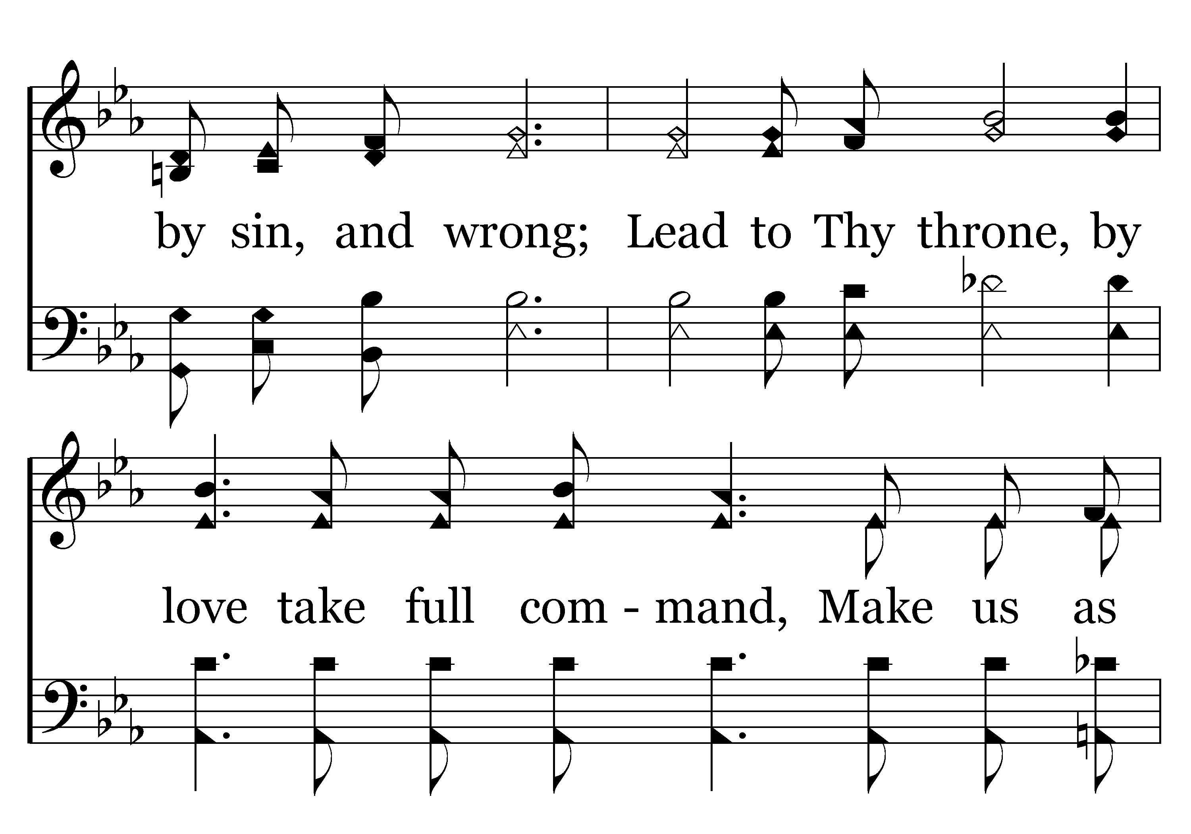
111 - Clay In The Potter's Hand - 3.2

Slide 42
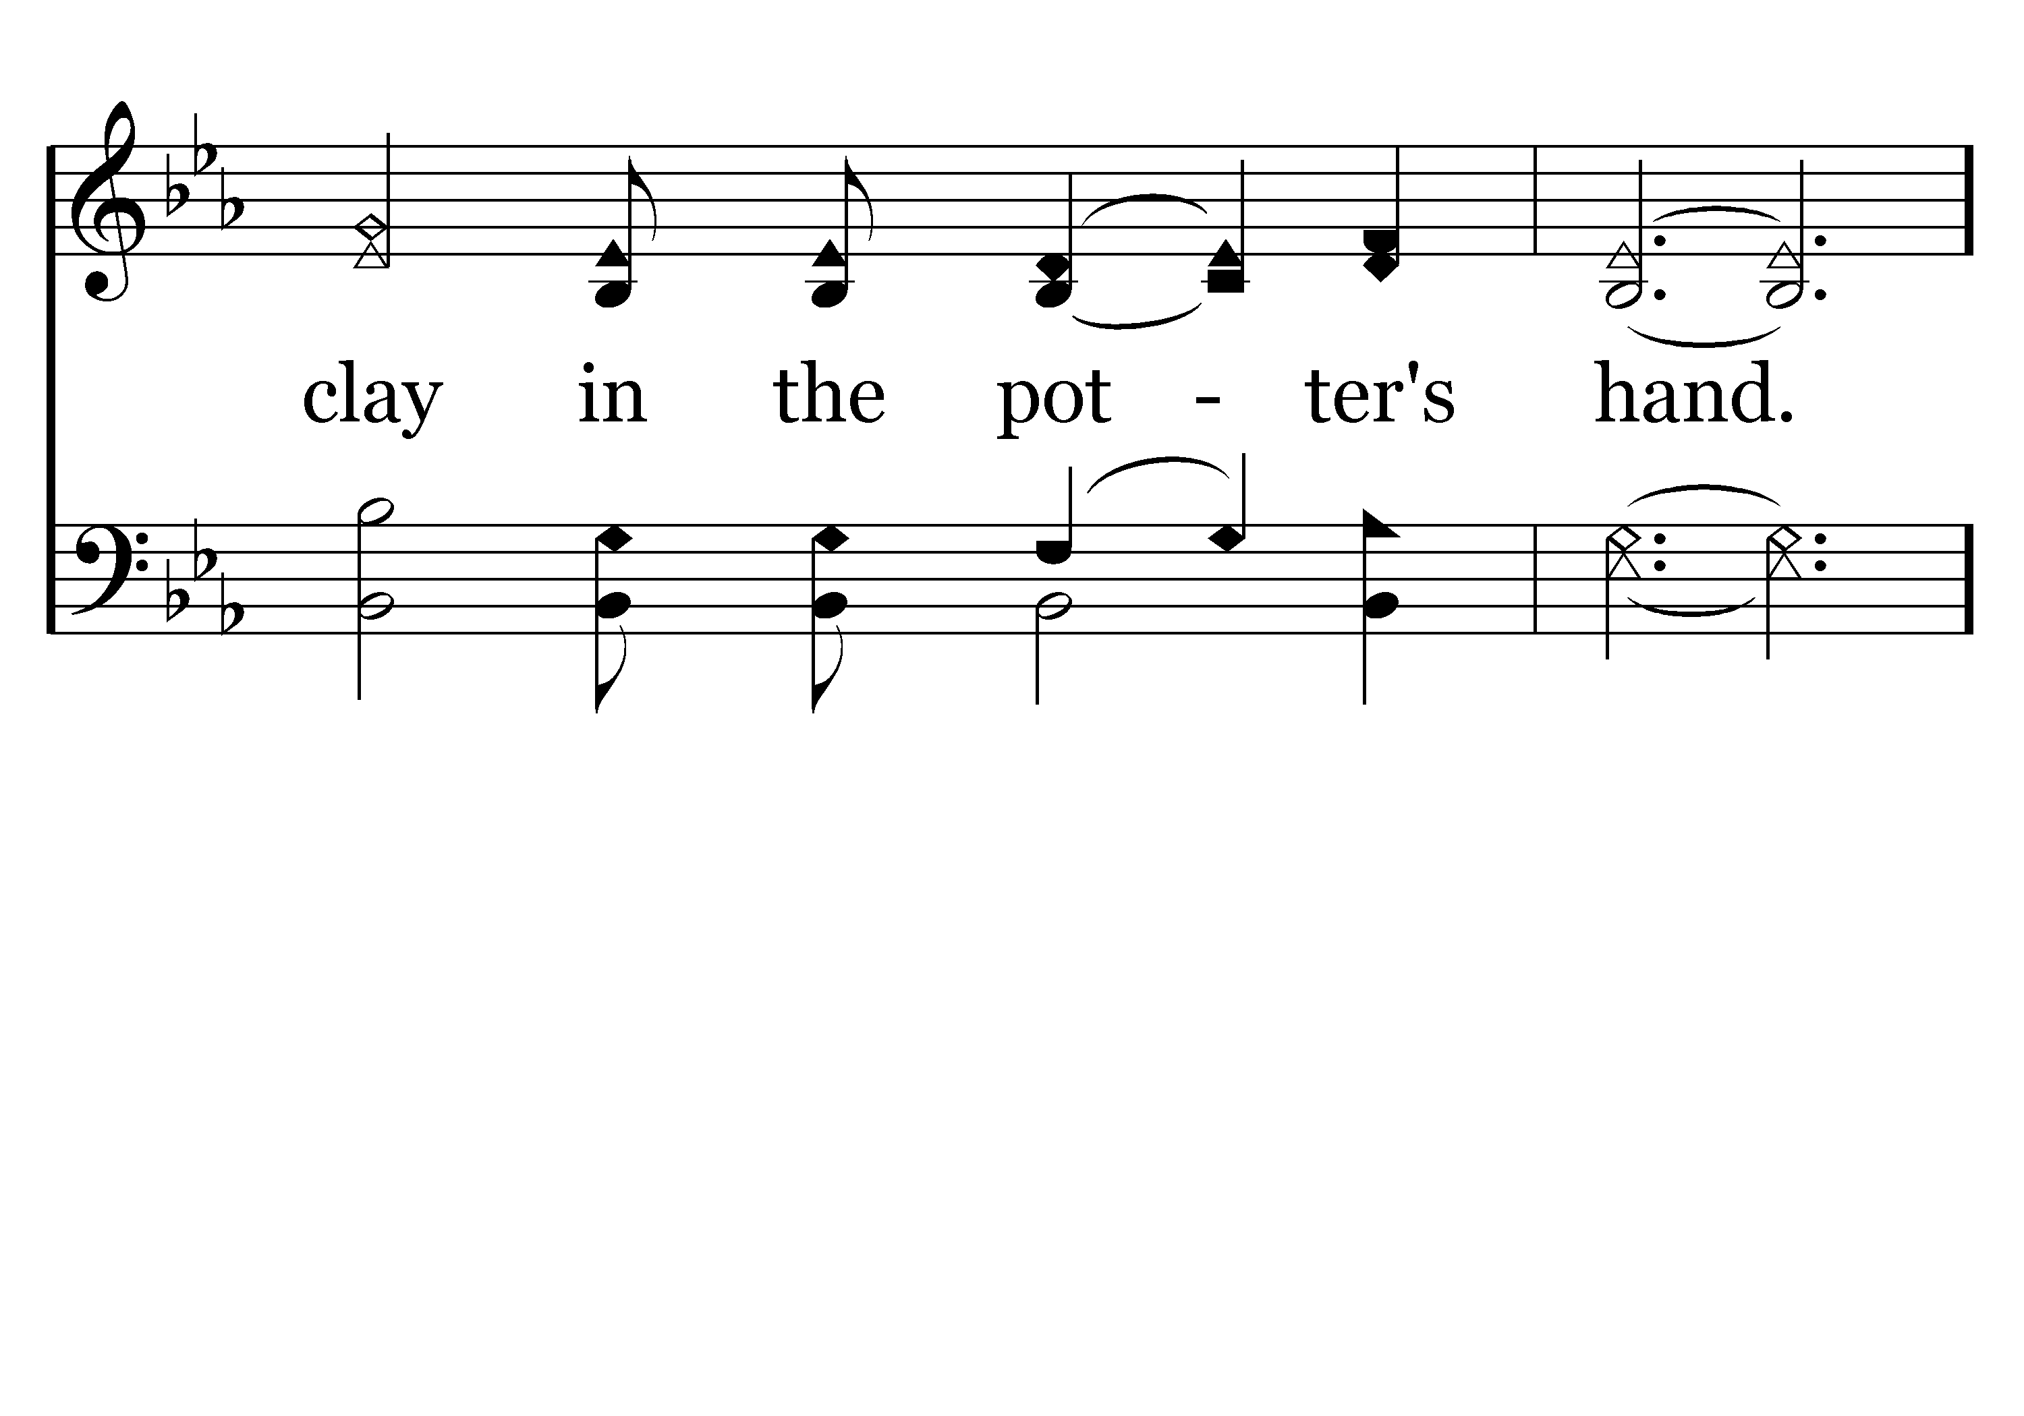
111 - Clay In The Potter's Hand - 3.3

Slide 43
111 - Clay In The Potter's Hand - C.1

Slide 44
111 - Clay In The Potter's Hand - C.2
End of Song

Slide 45
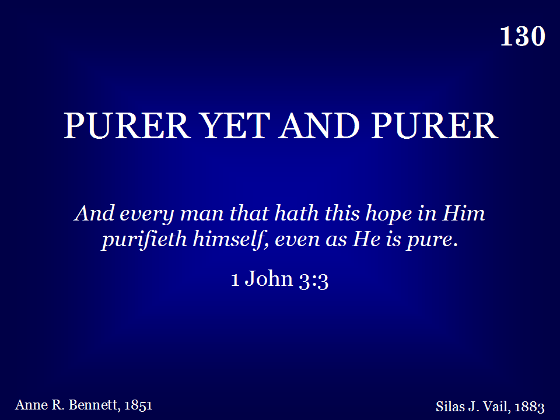
130 - Purer Yet And Purer - Title

Slide 46
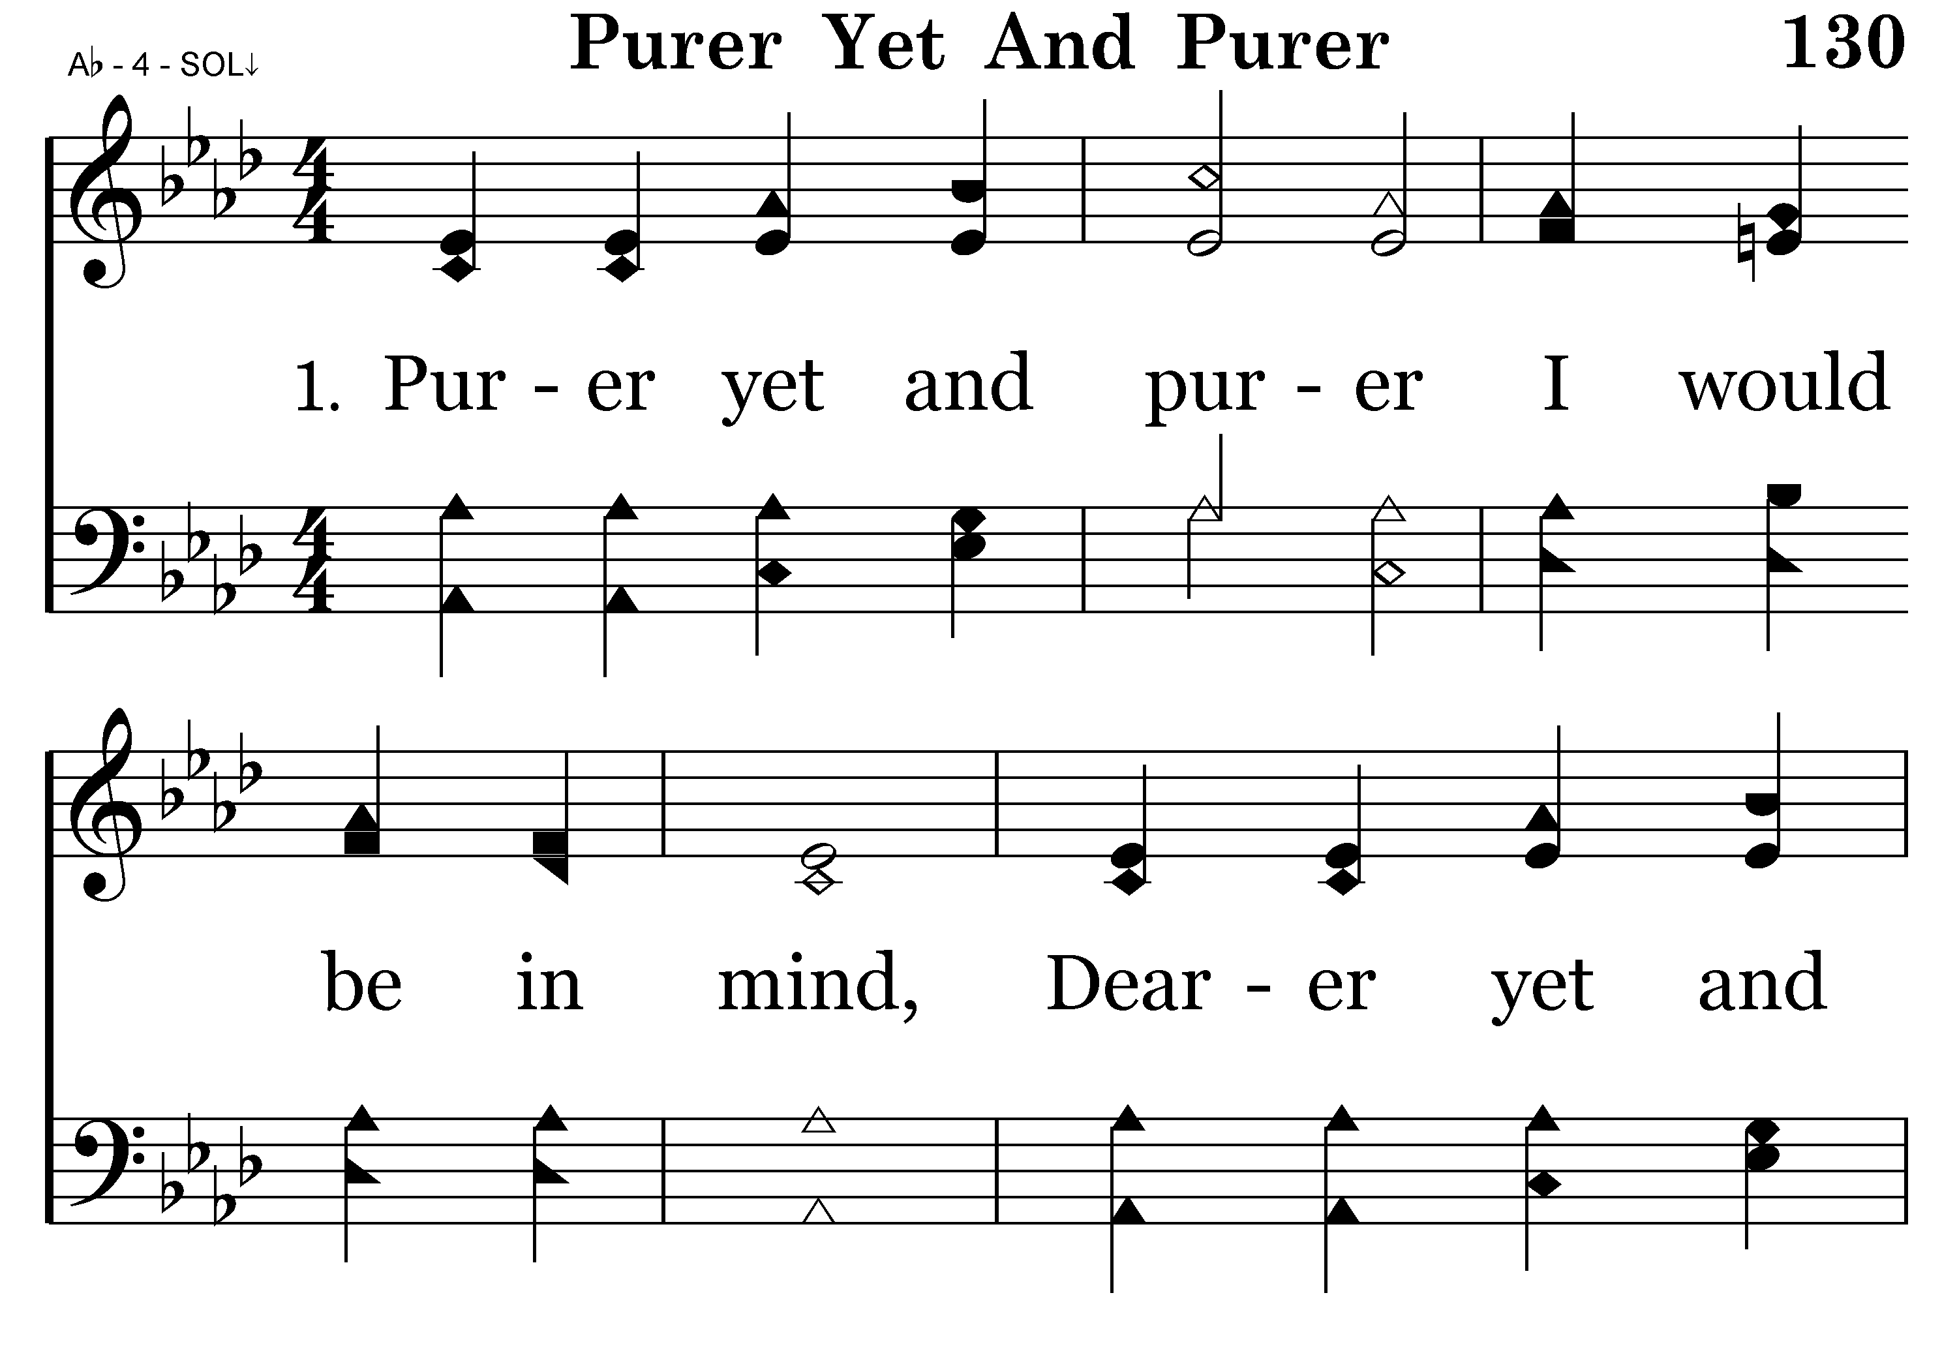
130 - Purer Yet And Purer - 1.1

Slide 47
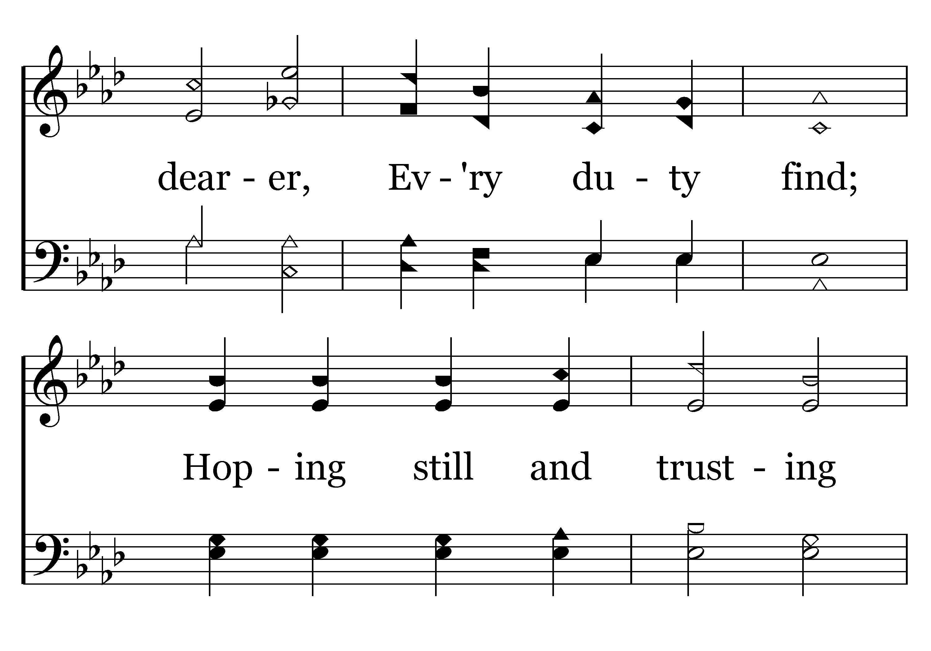
130 - Purer Yet And Purer - 1.2

Slide 48
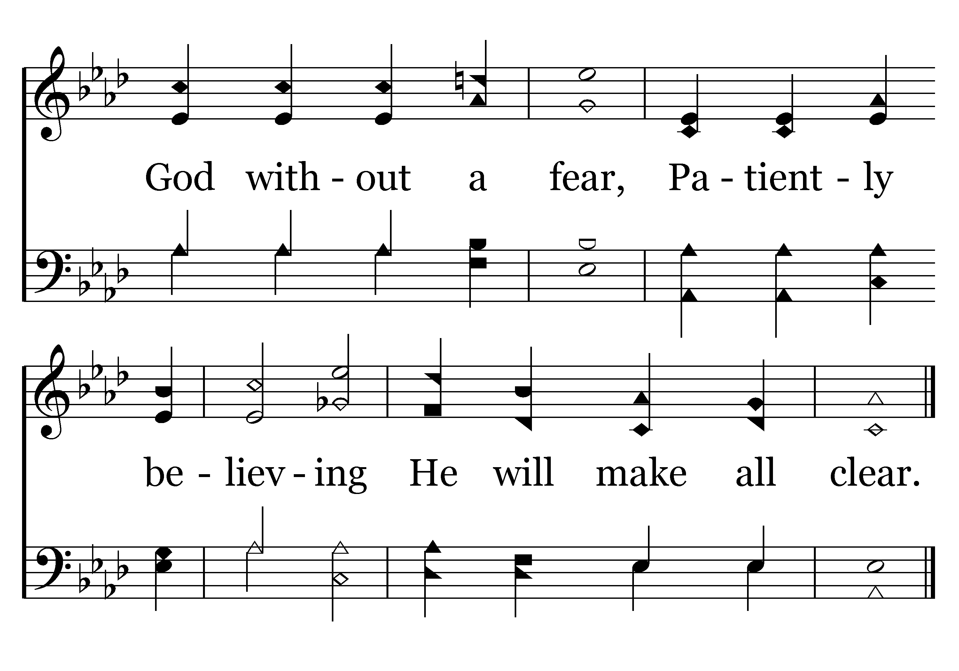
130 - Purer Yet And Purer - 1.3
End of Verse 1

Slide 49
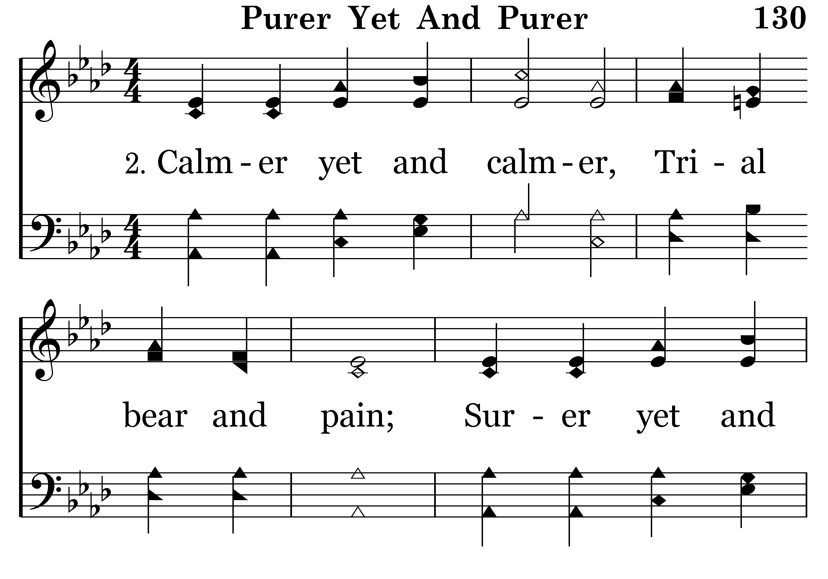
130 - Purer Yet And Purer - 2.1

Slide 50
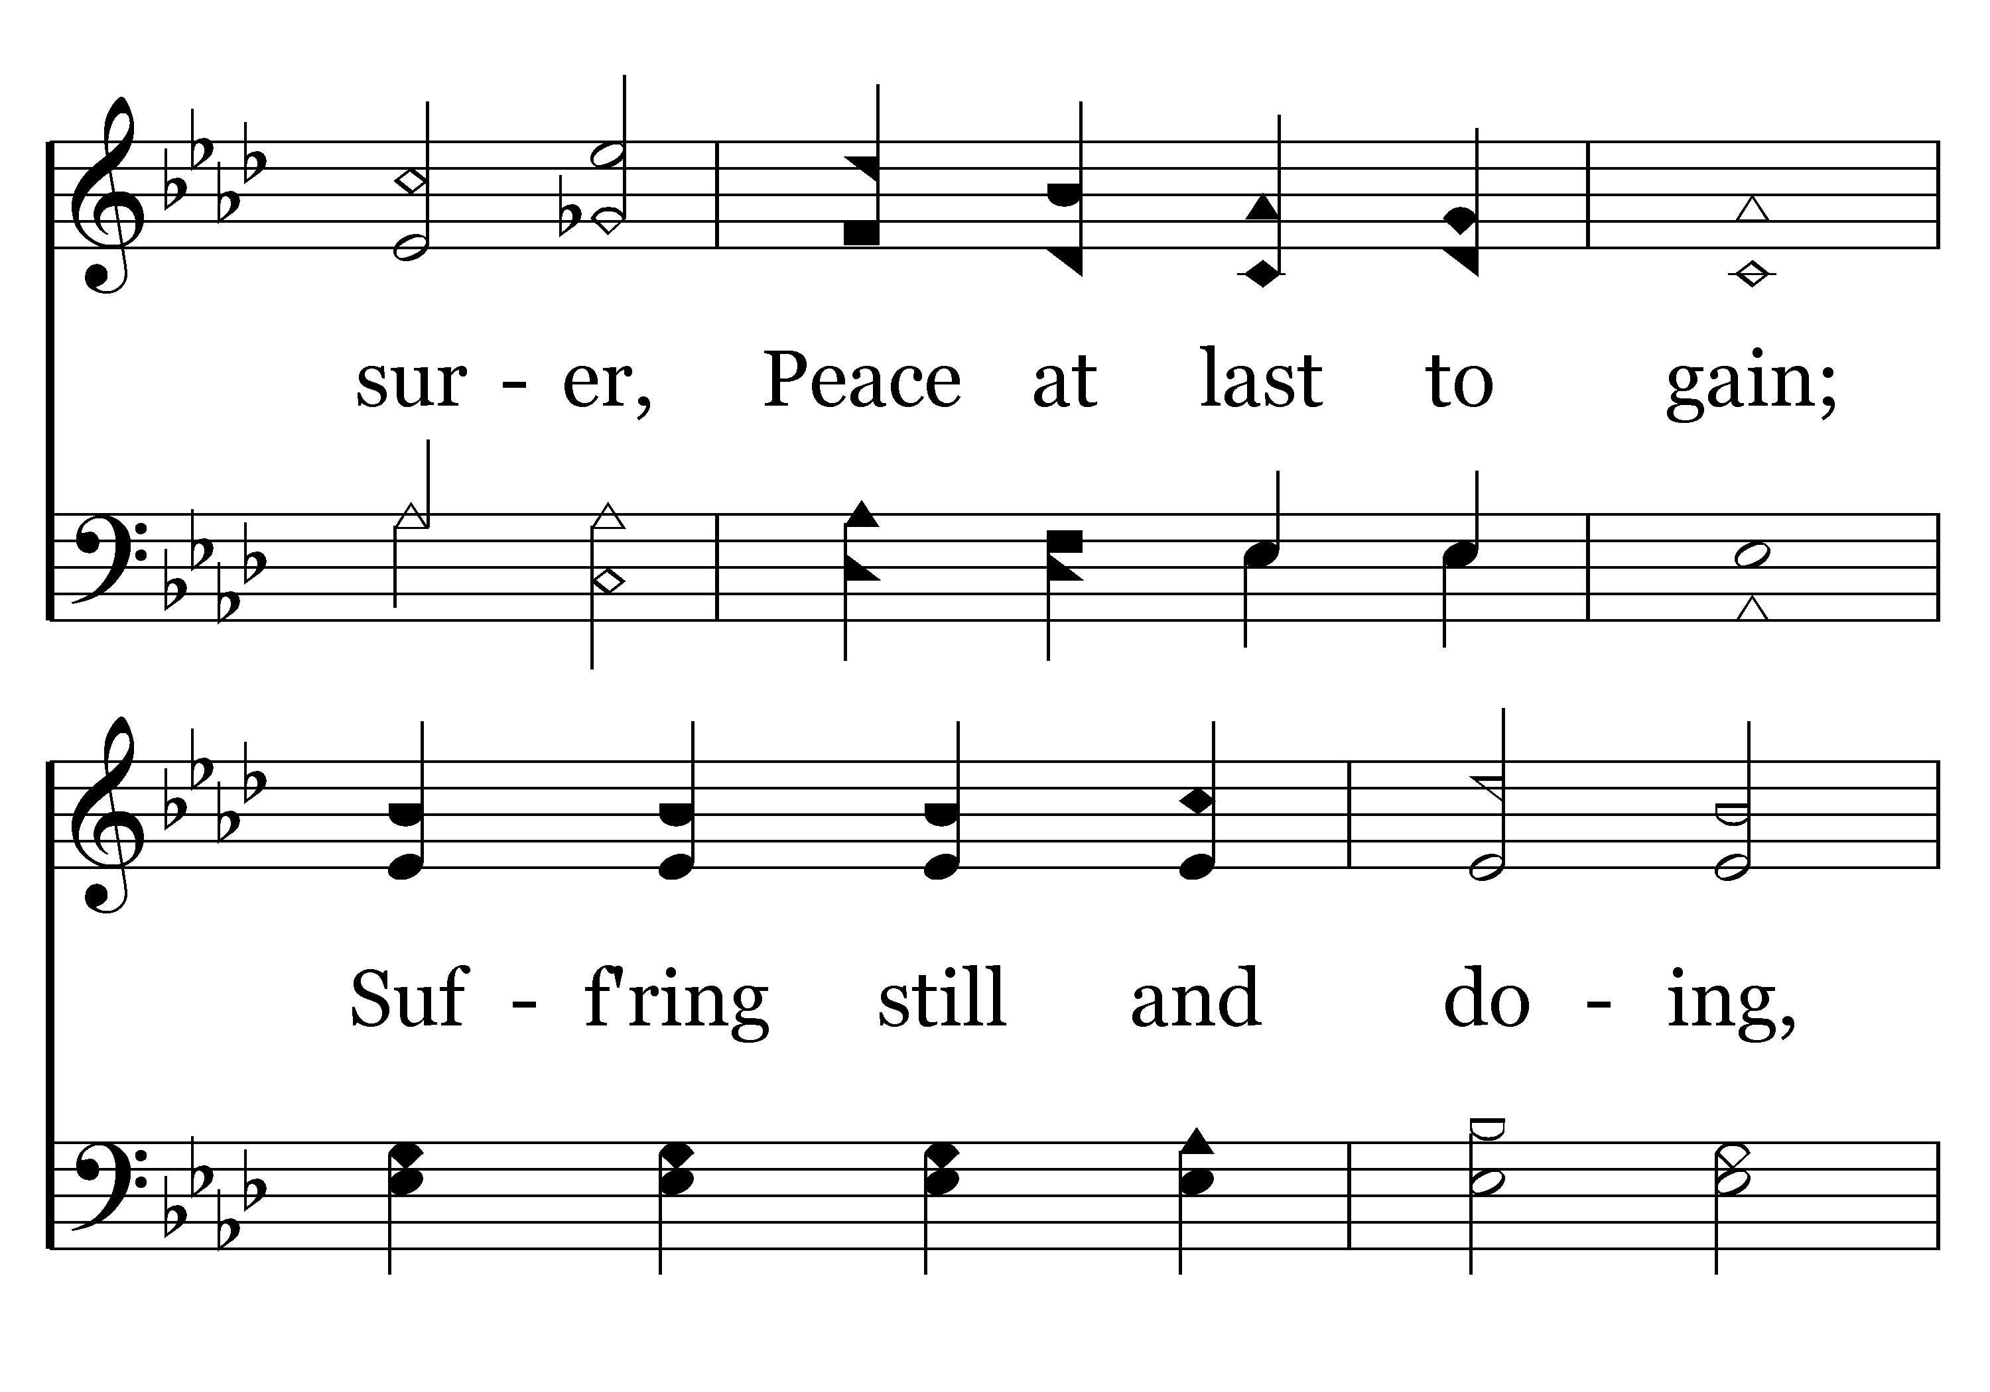
130 - Purer Yet And Purer - 2.2

Slide 51
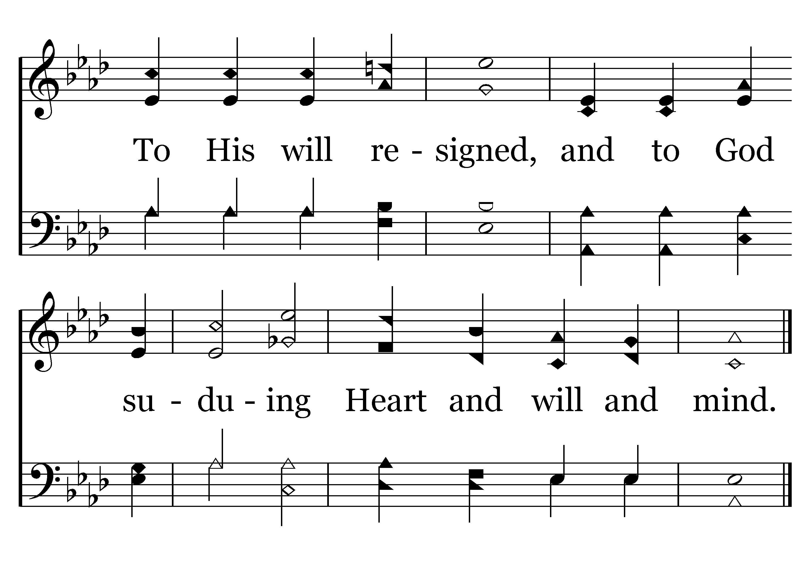
130 - Purer Yet And Purer - 2.3
End of Verse 2

Slide 52
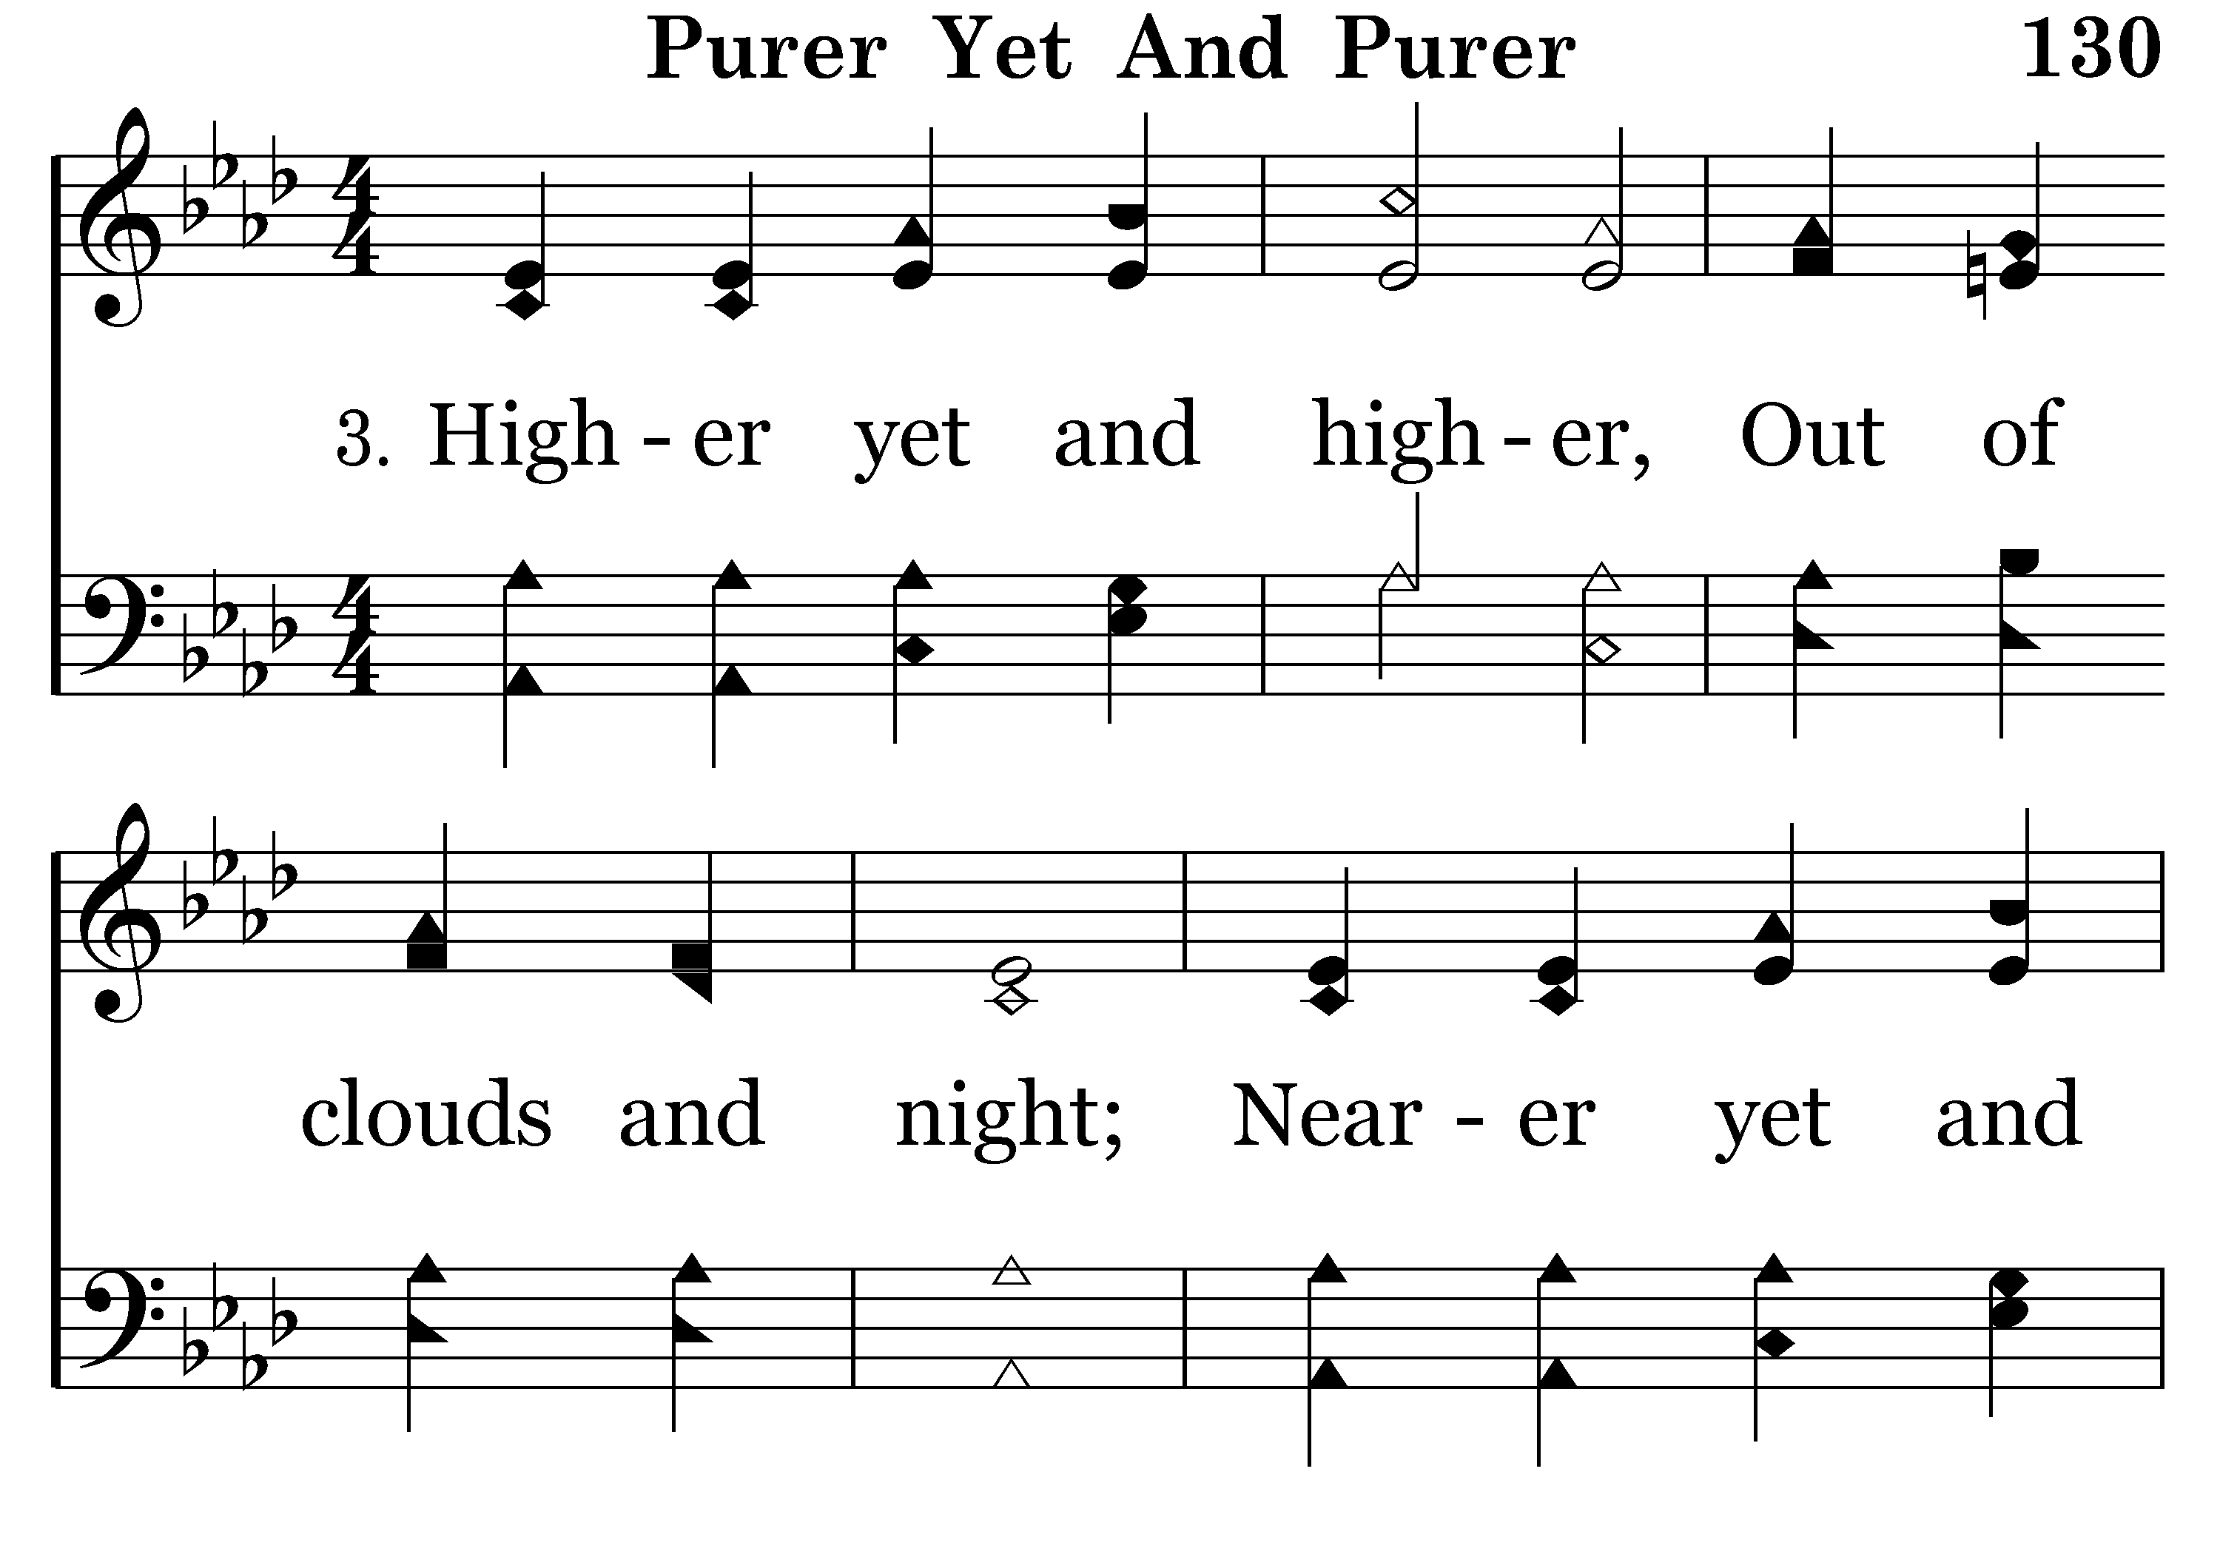
130 - Purer Yet And Purer - 3.1

Slide 53
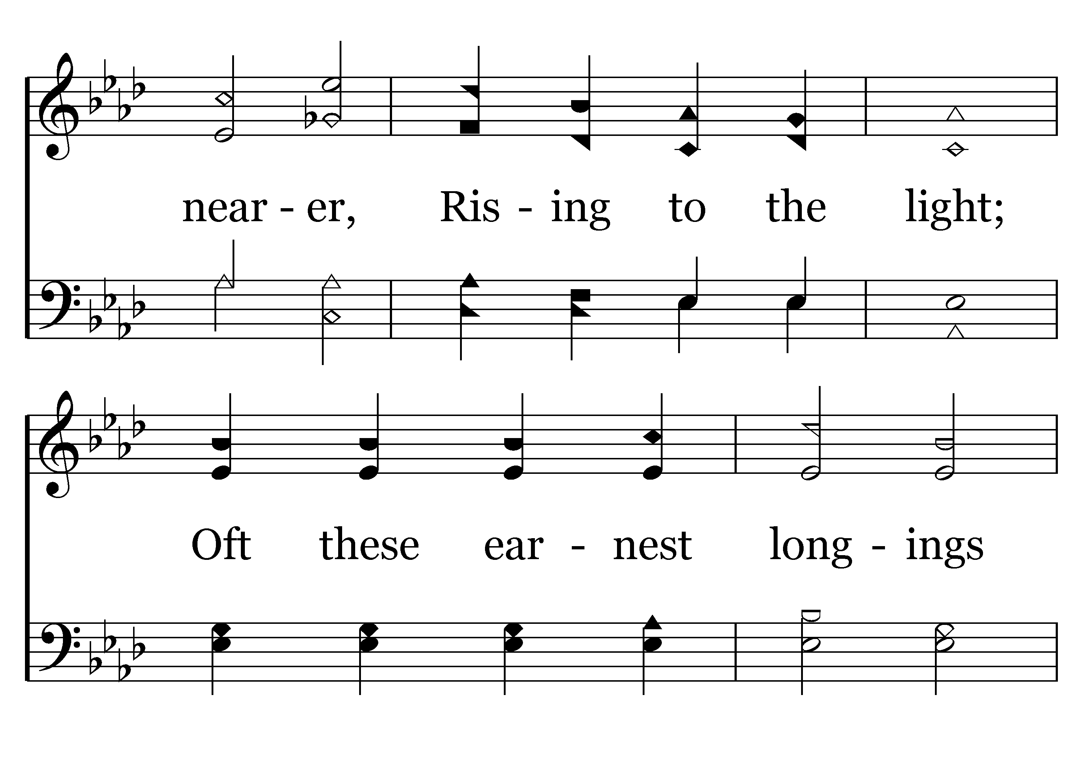
130 - Purer Yet And Purer - 3.2

Slide 54
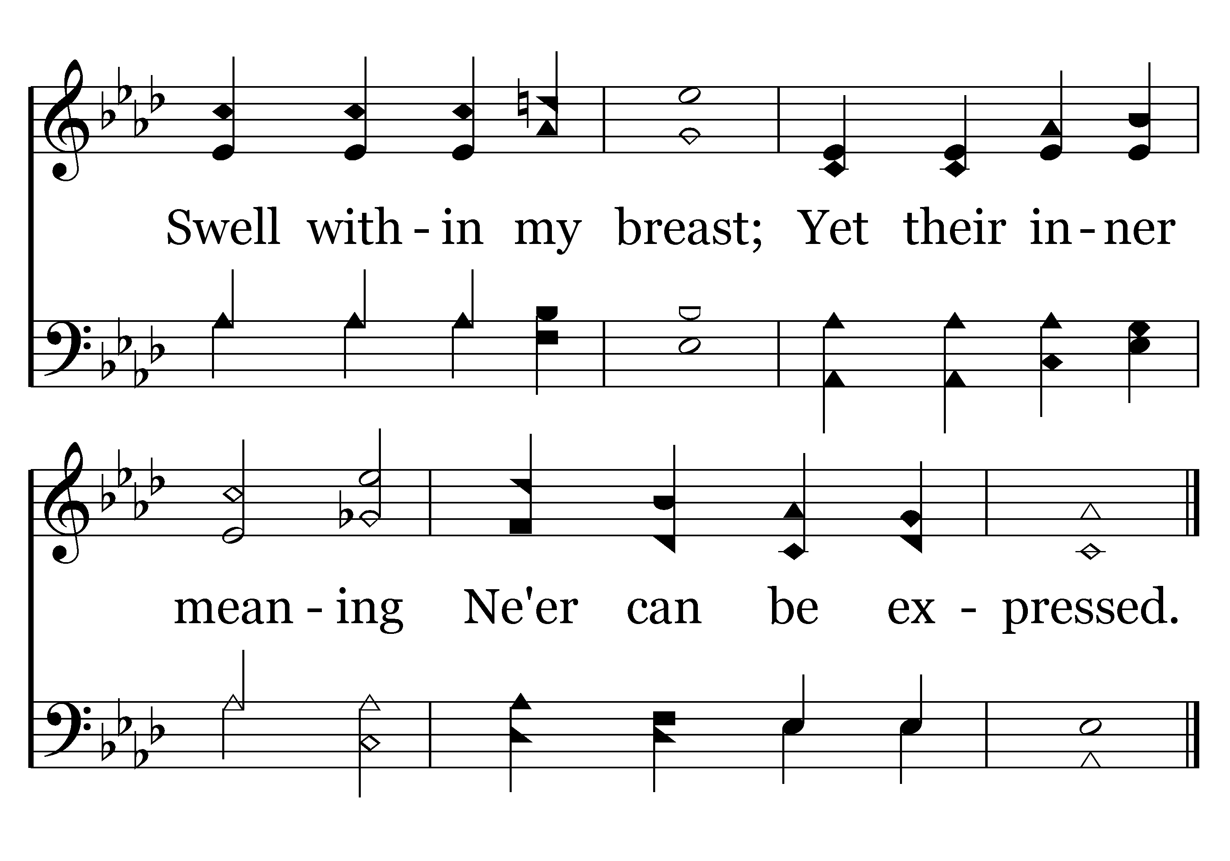
130 - Purer Yet And Purer - 3.3
End of Song

Slide 55
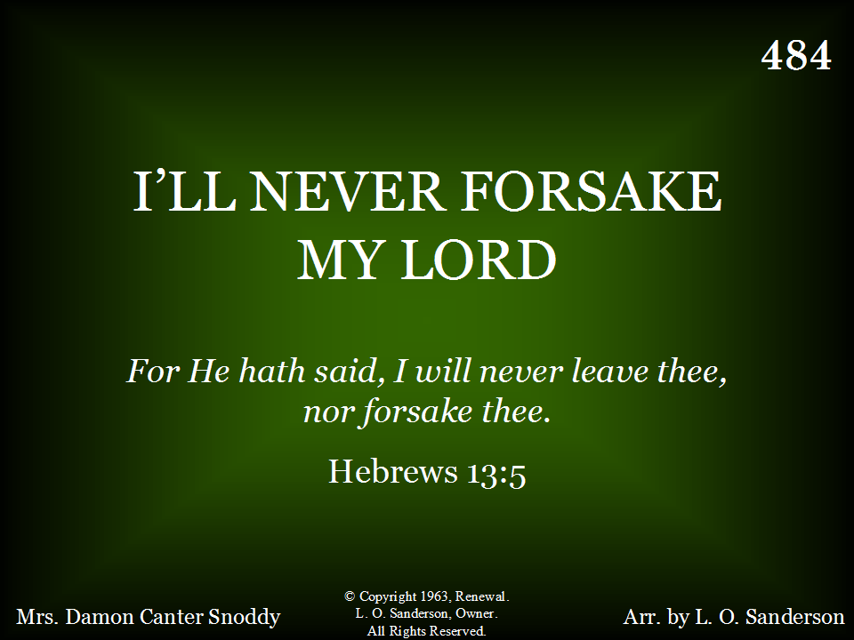
484 - I'll Never Forsake My Lord - Title

Slide 56
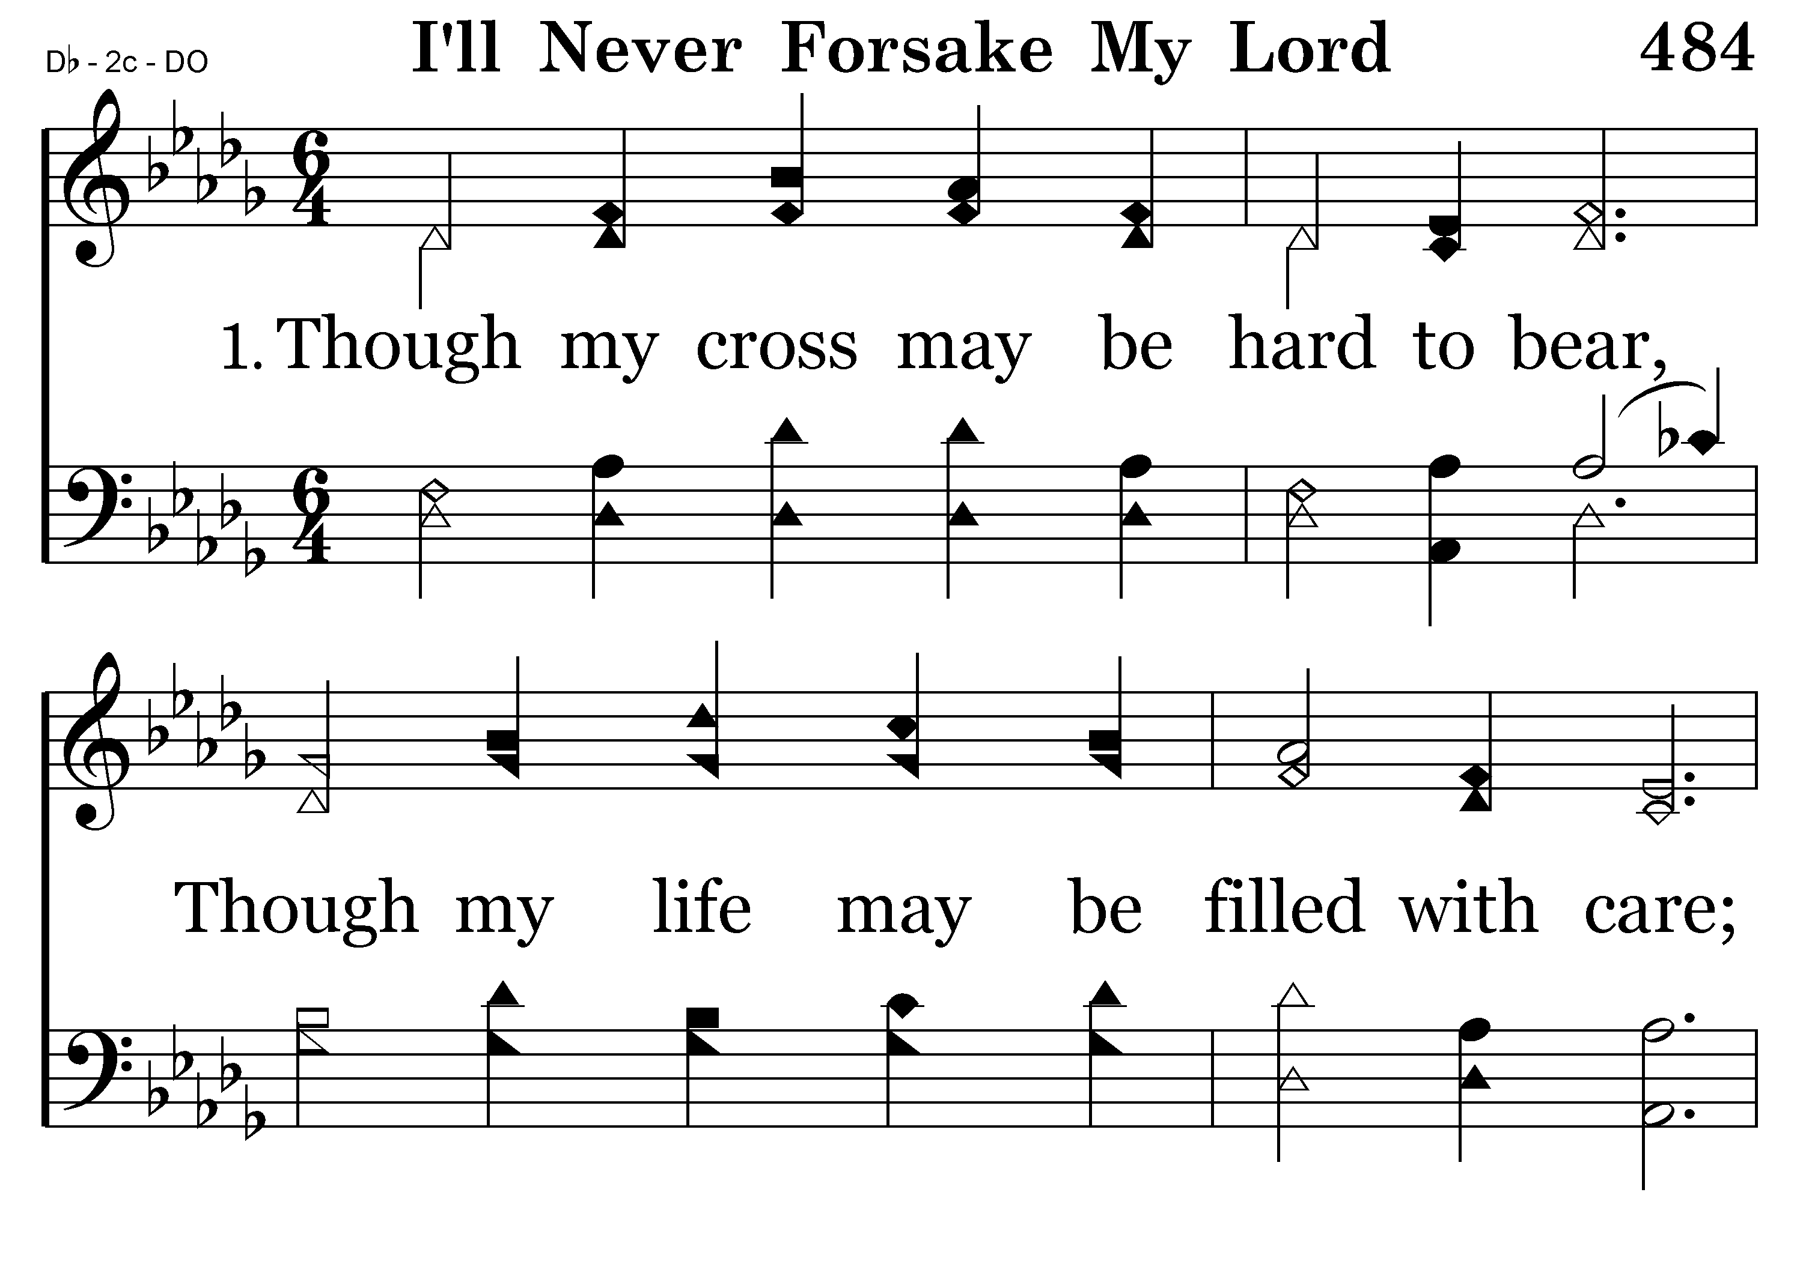
484 - I'll Never Forsake My Lord - 1.1

Slide 57
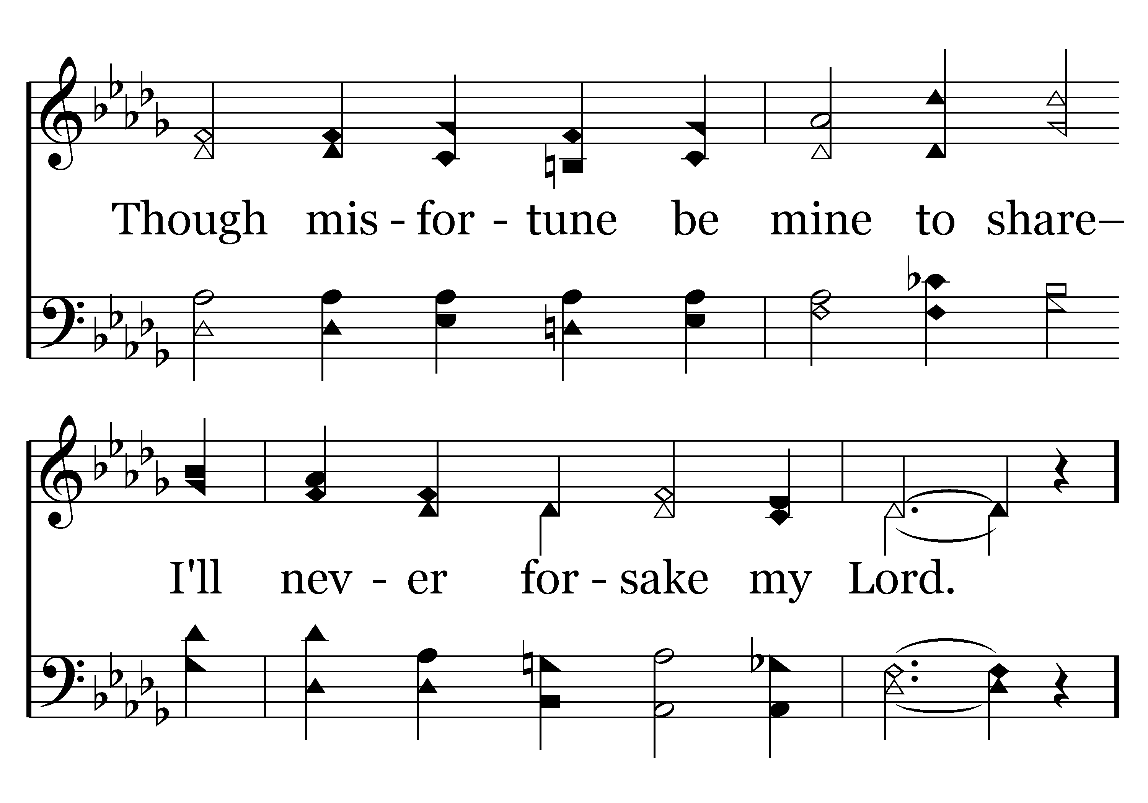
484 - I'll Never Forsake My Lord - 1.2

Slide 58
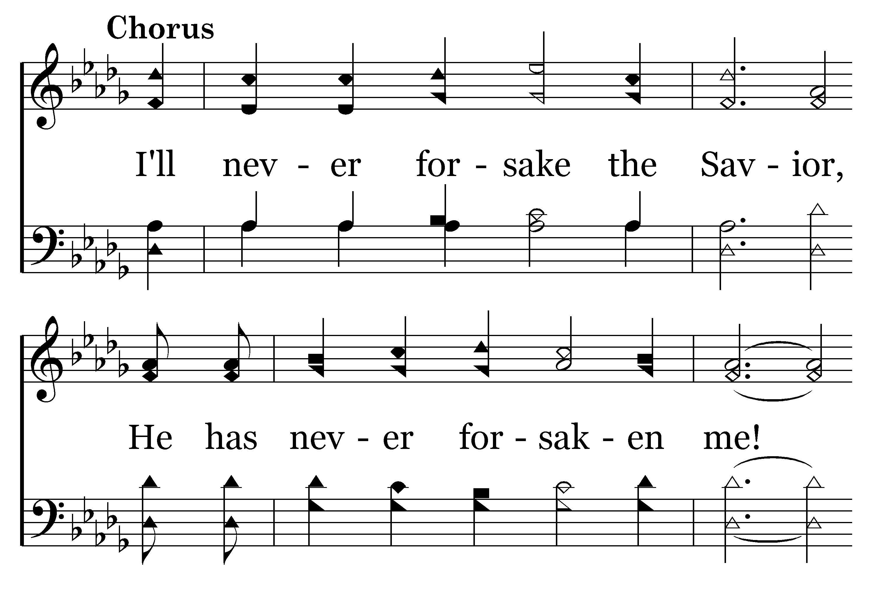
484 - I'll Never Forsake My Lord - C.1

Slide 59
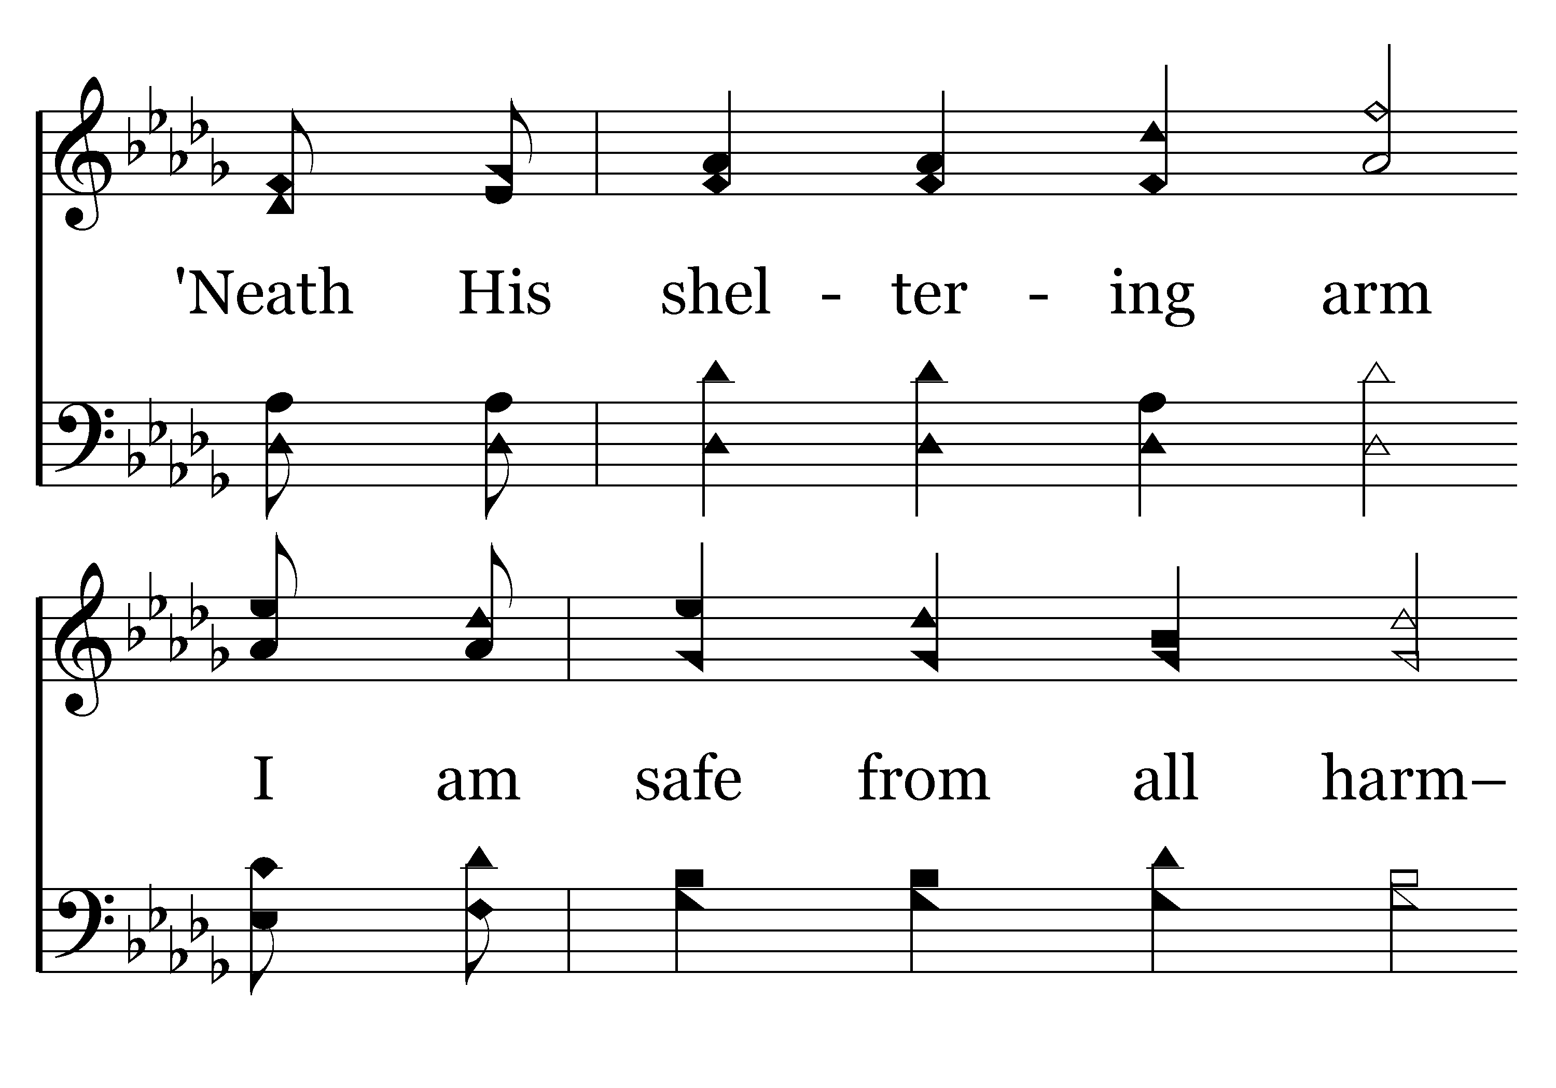
484 - I'll Never Forsake My Lord - C.2

Slide 60
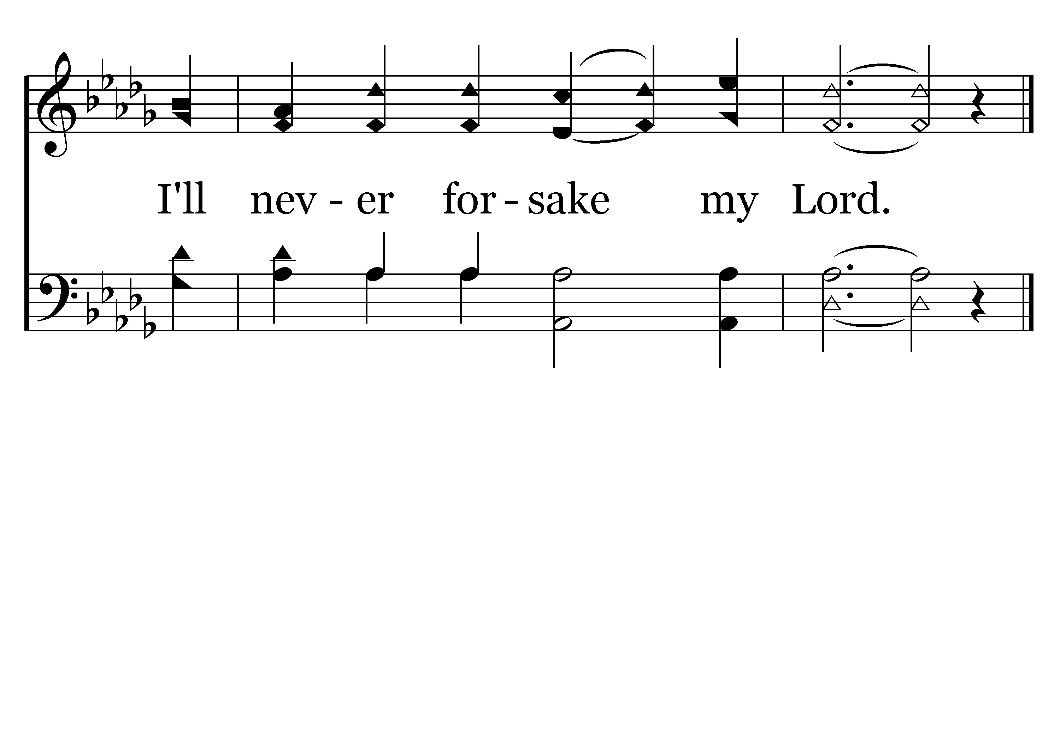
484 - I'll Never Forsake My Lord - C.3
End of Verse 1

Slide 61
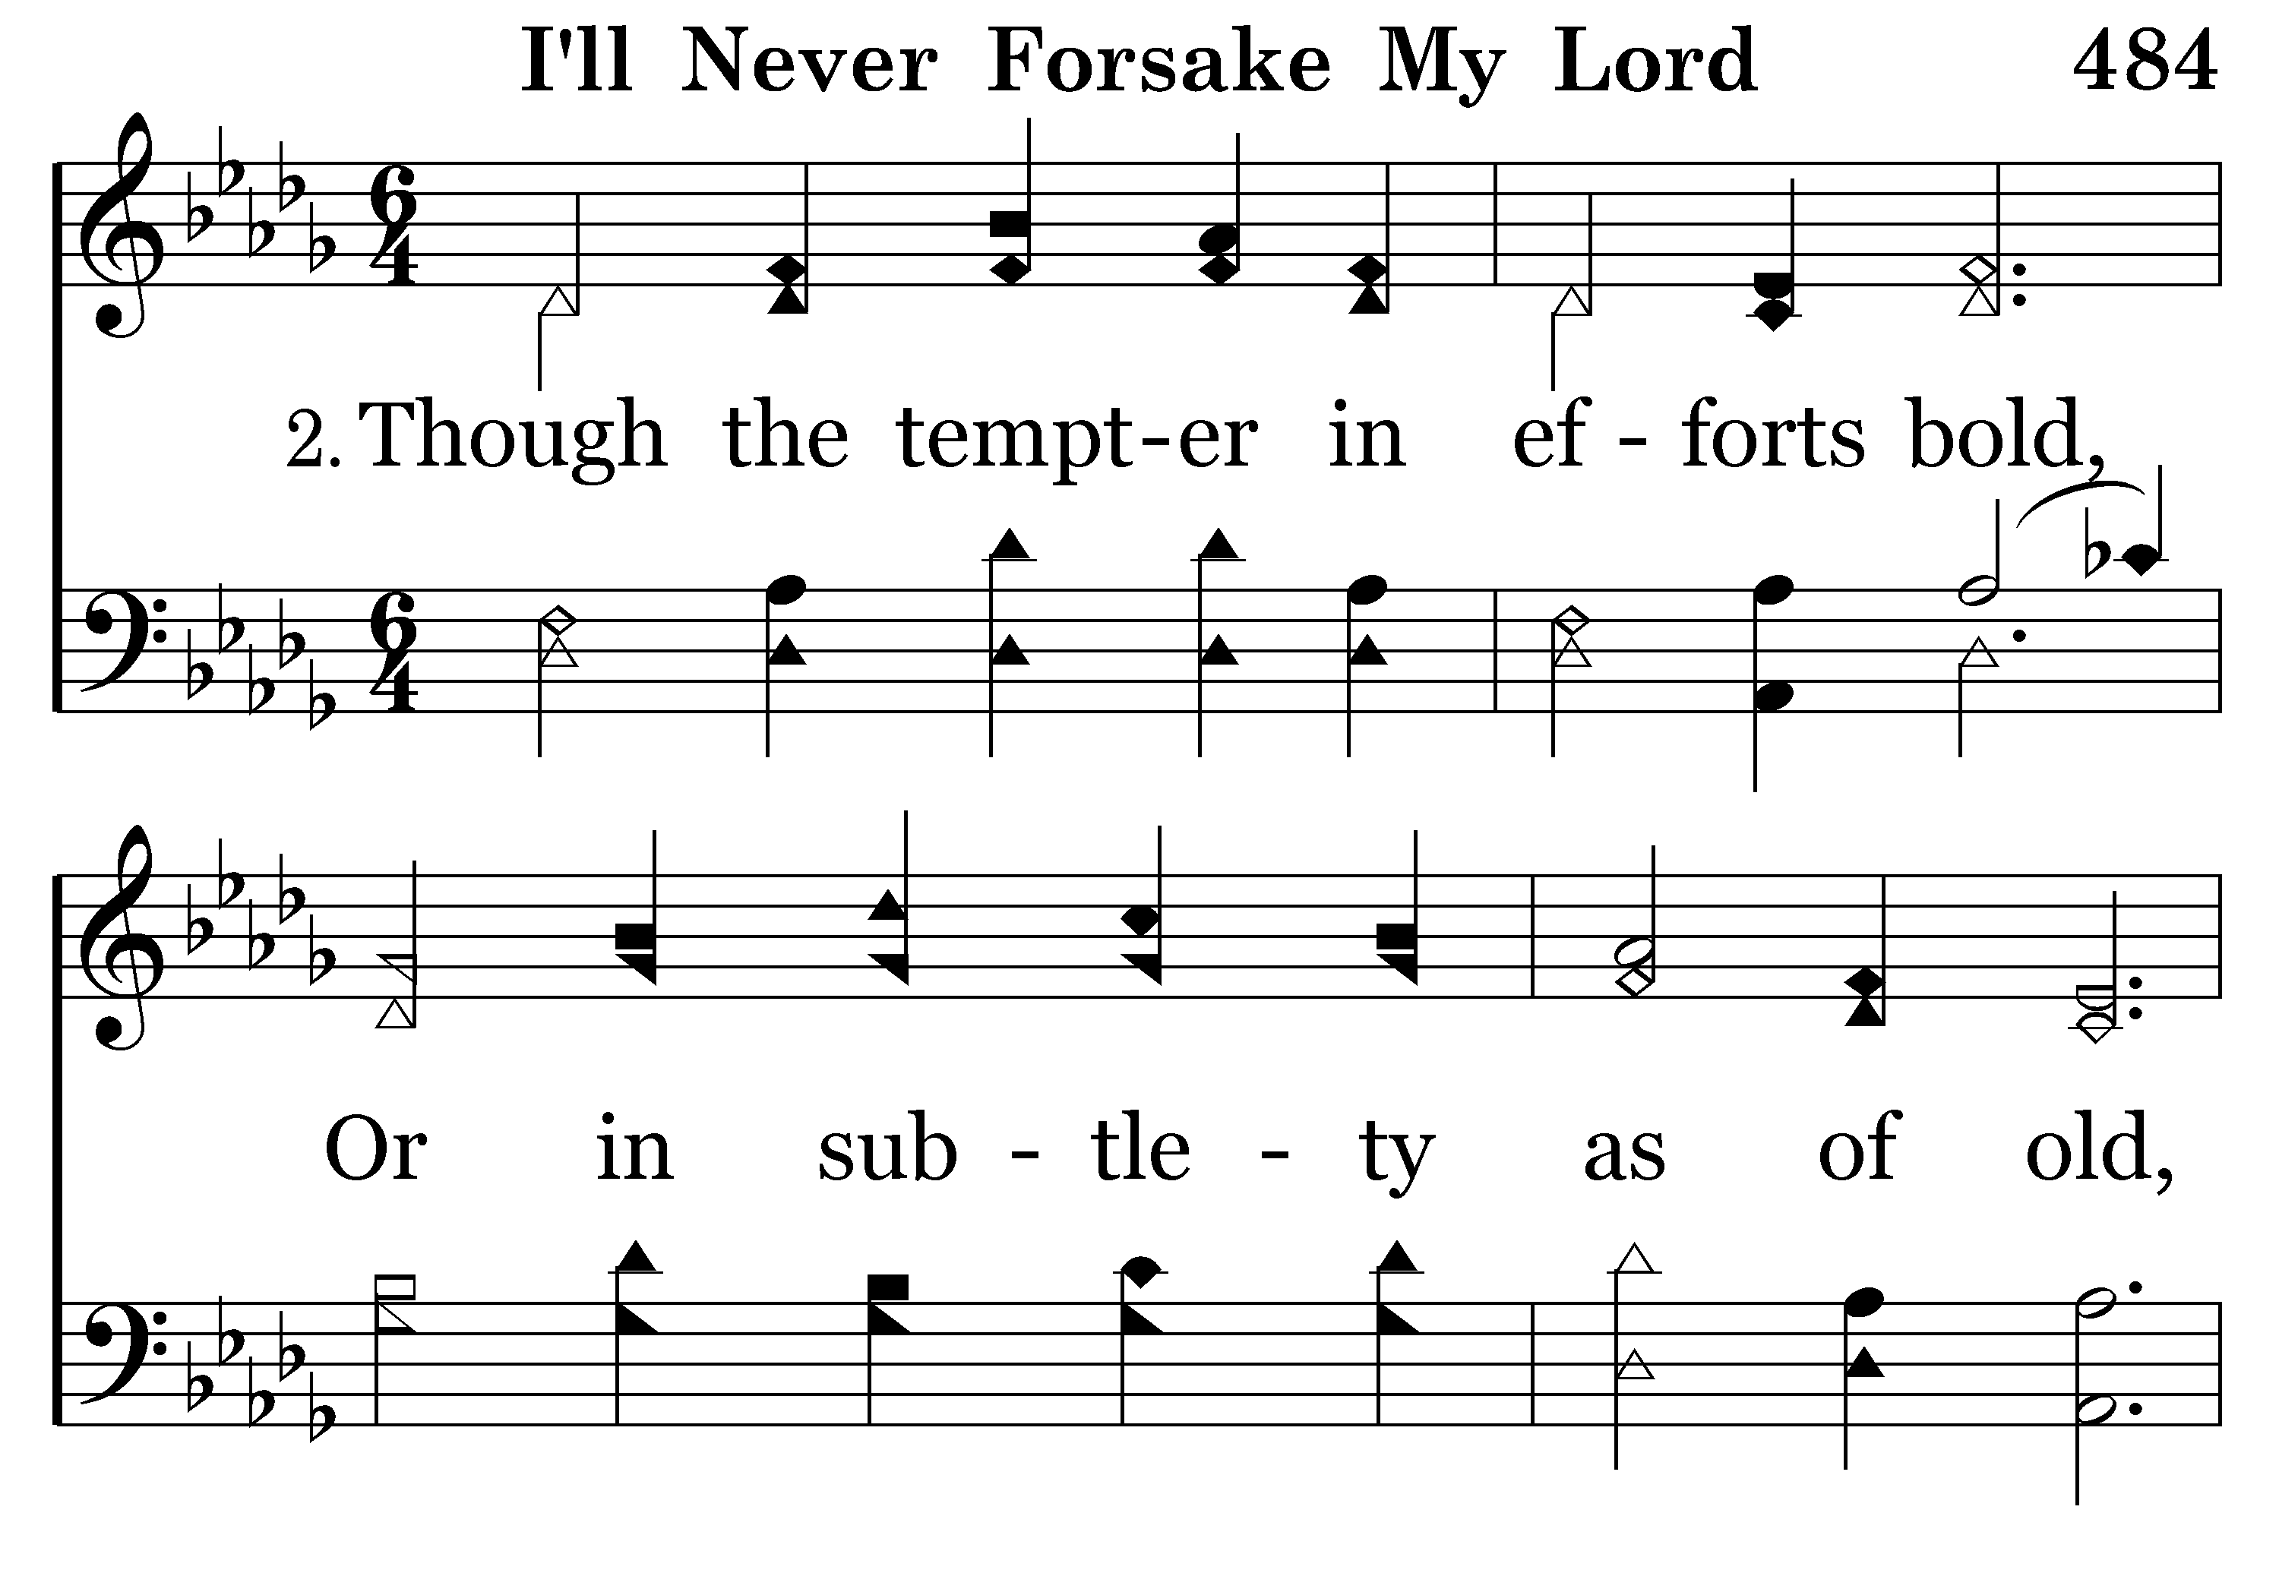
484 - I'll Never Forsake My Lord - 2.1

Slide 62

484 - I'll Never Forsake My Lord - 2.2

Slide 63
484 - I'll Never Forsake My Lord - C.1

Slide 64
484 - I'll Never Forsake My Lord - C.2

Slide 65
484 - I'll Never Forsake My Lord - C.3
End of Verse 2

Slide 66

484 - I'll Never Forsake My Lord - 3.1

Slide 67

484 - I'll Never Forsake My Lord - 3.2

Slide 68
484 - I'll Never Forsake My Lord - C.1

Slide 69
484 - I'll Never Forsake My Lord - C.2

Slide 70
484 - I'll Never Forsake My Lord - C.3
End of Song

Slide 71
Seek Ye First…
Order of Worship
Tim Hogland – Scripture - Matthew 6:19-33
Foster Craig – Songs - 249, 694 & 128
Terry Yontz – Prayer
Colby Lovelady – Songs – 111, 130 & 484
Jason Gudgel – Scripture – Philippians 3:4-14
Nevin Cox – Songs – 502, 105 & 332
Dan Hicks – Scripture – Romans 12:1-2
Jim Rowbottom – Songs – 65, 415 & 7
Richard McIntyre – Closing Prayer

Slide 72
Philippians 3:4-14
⁴ though I myself have reason for confidence in the flesh also. If anyone else thinks he has reason for confidence in the flesh, I have more: ⁵ circumcised on the eighth day, of the people of Israel, of the tribe of Benjamin, a Hebrew of Hebrews; as to the law, a Pharisee; ⁶ as to zeal, a persecutor of the church; as to righteousness under the law, blameless. ⁷ But whatever gain I had, I counted as loss for the sake of Christ. ⁸ Indeed, I count everything as loss because of the surpassing worth of knowing Christ Jesus my Lord. For his sake I have suffered the loss of all things and count them as rubbish, in order that I may gain Christ ⁹ and be found in him, not having a righteousness of my own that comes from the law, but that which comes through faith in Christ, the righteousness from God that depends on faith— ¹⁰ that I may know him and the power of his resurrection, and may share his sufferings, becoming like him in his death, ¹¹ that by any means possible I may attain the resurrection from the dead. ¹² Not that I have already obtained this or am already perfect, but I press on to make it my own, because Christ Jesus has made me his own. ¹³ Brothers, I do not consider that I have made it my own. But one thing I do: forgetting what lies behind and straining forward to what lies ahead, ¹⁴ I press on toward the goal for the prize of the upward call of God in Christ Jesus.
Scripture Reading – Jason Gudgel

Slide 73
Seek Ye First…
Order of Worship
Tim Hogland – Scripture - Matthew 6:19-33
Foster Craig – Songs - 249, 694 & 128
Terry Yontz – Prayer
Colby Lovelady – Songs – 111, 130 & 484
Jason Gudgel – Scripture – Philippians 3:4-14
Nevin Cox – Songs – 502, 105 & 332
Dan Hicks – Scripture – Romans 12:1-2
Jim Rowbottom – Songs – 65, 415 & 7
Richard McIntyre – Closing Prayer

Slide 74

502 - True-Hearted, Whole-Hearted - Title

Slide 75

502 - True-Hearted, Whole-Hearted - 1.1

Slide 76

502 - True-Hearted, Whole-Hearted - 1.2

Slide 77

502 - True-Hearted, Whole-Hearted - 1.3

Slide 78

502 - True-Hearted, Whole-Hearted - C.1

Slide 79

502 - True-Hearted, Whole-Hearted - C.2

Slide 80

502 - True-Hearted, Whole-Hearted - C.3
End of Verse 1

Slide 81

502 - True-Hearted, Whole-Hearted - 2.1

Slide 82

502 - True-Hearted, Whole-Hearted - 2.2

Slide 83

502 - True-Hearted, Whole-Hearted - 2.3

Slide 84
502 - True-Hearted, Whole-Hearted - C.1

Slide 85
502 - True-Hearted, Whole-Hearted - C.2

Slide 86
502 - True-Hearted, Whole-Hearted - C.3
End of Verse 2

Slide 87

502 - True-Hearted, Whole-Hearted - 3.1

Slide 88

502 - True-Hearted, Whole-Hearted - 3.2

Slide 89

502 - True-Hearted, Whole-Hearted - 3.3

Slide 90
502 - True-Hearted, Whole-Hearted - C.1

Slide 91
502 - True-Hearted, Whole-Hearted - C.2

Slide 92
502 - True-Hearted, Whole-Hearted - C.3
End of Song

Slide 93

105 - I Am Thine O Lord - Title

Slide 94

105 - I Am Thine O Lord - 1.1

Slide 95

105 - I Am Thine O Lord - 1.2

Slide 96

105 - I Am Thine O Lord - C.1

Slide 97

105 - I Am Thine O Lord - C.2
End of Verse 1

Slide 98

105 - I Am Thine O Lord - 2.1

Slide 99

105 - I Am Thine O Lord - 2.2

Slide 100
105 - I Am Thine O Lord - C.1

Slide 101
105 - I Am Thine O Lord - C.2
End of Verse 2

Slide 102

105 - I Am Thine O Lord - 3.1

Slide 103

105 - I Am Thine O Lord - 3.2

Slide 104
105 - I Am Thine O Lord - C.1

Slide 105
105 - I Am Thine O Lord - C.2
End of Verse 3

Slide 106

105 - I Am Thine O Lord - 4.1

Slide 107

105 - I Am Thine O Lord - 4.2

Slide 108
105 - I Am Thine O Lord - C.1

Slide 109
105 - I Am Thine O Lord - C.2
End of Song

Slide 110

332 - I Surrender All - Title

Slide 111

332 - I Surrender All - 1.1

Slide 112

332 - I Surrender All - 1.2

Slide 113

332 - I Surrender All - C.1

Slide 114

332 - I Surrender All - C.2
End of Verse 1

Slide 115

332 - I Surrender All - 2.1

Slide 116

332 - I Surrender All - 2.2

Slide 117
332 - I Surrender All - C.1

Slide 118
332 - I Surrender All - C.2
End of Verse 2

Slide 119

332 - I Surrender All - 3.1

Slide 120

332 - I Surrender All - 3.2

Slide 121
332 - I Surrender All - C.1

Slide 122
332 - I Surrender All - C.2
End of Song

Slide 123
Seek Ye First…
Order of Worship
Tim Hogland – Scripture - Matthew 6:19-33
Foster Craig – Songs - 249, 694 & 128
Terry Yontz – Prayer
Colby Lovelady – Songs – 111, 130 & 484
Jason Gudgel – Scripture – Philippians 3:4-14
Nevin Cox – Songs – 502, 105 & 332
Dan Hicks – Scripture – Romans 12:1-2
Jim Rowbottom – Songs – 65, 415 & 7
Richard McIntyre – Closing Prayer

Slide 124
Romans 12:1-2
¹ I appeal to you therefore, brothers, by the mercies of God, to present your bodies as a living sacrifice, holy and acceptable to God, which is your spiritual worship. ² Do not be conformed to this world, but be transformed by the renewal of your mind, that by testing you may discern what is the will of God, what is good and acceptable and perfect
Scripture Reading - Daniel Hicks

Slide 125
Seek Ye First…
Order of Worship
Tim Hogland – Scripture - Matthew 6:19-33
Foster Craig – Songs - 249, 694 & 128
Terry Yontz – Prayer
Colby Lovelady – Songs – 111, 130 & 484
Jason Gudgel – Scripture – Philippians 3:4-14
Nevin Cox – Songs – 502, 105 & 332
Dan Hicks – Scripture – Romans 12:1-2
Jim Rowbottom – Songs – 65, 415 & 7
Richard McIntyre – Closing Prayer

Slide 126

065 - O Master, Let Me Walk With Thee - Title

Slide 127

065 - O Master, Let Me Walk With Thee - 1.1

Slide 128

065 - O Master, Let Me Walk With Thee - 1.2
End of Verse 1

Slide 129

065 - O Master, Let Me Walk With Thee - 2.1

Slide 130

065 - O Master, Let Me Walk With Thee - 2.2
End of Verse 2

Slide 131

065 - O Master, Let Me Walk With Thee - 3.1

Slide 132

065 - O Master, Let Me Walk With Thee - 3.2
End of Verse 3

Slide 133

065 - O Master, Let Me Walk With Thee - 4.1

Slide 134

065 - O Master, Let Me Walk With Thee - 4.2
End of Song

Slide 135

415 - To Christ Be True - Title

Slide 136

415 - To Christ Be True - 1.1

Slide 137

415 - To Christ Be True - 1.2

Slide 138

415 - To Christ Be True - C.1

Slide 139

415 - To Christ Be True - C.2
End of Verse 1

Slide 140

415 - To Christ Be True - 2.1

Slide 141

415 - To Christ Be True - 2.2

Slide 142
415 - To Christ Be True - C.1

Slide 143
415 - To Christ Be True - C.2
End of Verse 2

Slide 144

415 - To Christ Be True - 3.1

Slide 145

415 - To Christ Be True - 3.2

Slide 146
415 - To Christ Be True - C.1

Slide 147
415 - To Christ Be True - C.2
End of Verse 3

Slide 148

415 - To Christ Be True - 4.1

Slide 149

415 - To Christ Be True - 4.2

Slide 150
415 - To Christ Be True - C.1

Slide 151
415 - To Christ Be True - C.2
End of Song

Slide 152

007 - Saints Lift Your Voices - Title

Slide 153

007 - Saints Lift Your Voices - 1.1

Slide 154

007 - Saints Lift Your Voices - 1.2

Slide 155

007 - Saints Lift Your Voices - C.1

Slide 156

007 - Saints Lift Your Voices - C.2
End of Verse 1

Slide 157

007 - Saints Lift Your Voices - 2.1

Slide 158

007 - Saints Lift Your Voices - 2.2

Slide 159
007 - Saints Lift Your Voices - C.1

Slide 160
007 - Saints Lift Your Voices - C.2
End of Verse 2

Slide 161

007 - Saints Lift Your Voices - 3.1

Slide 162

007 - Saints Lift Your Voices - 3.2

Slide 163
007 - Saints Lift Your Voices - C.1

Slide 164
007 - Saints Lift Your Voices - C.2
End of Song

Slide 165
CLOSING PRAYER
Richard McIntyre

Slide 166
Welcome
Times of Worship
Sunday 9 AM Worship
Sunday 10 AM Bible Class
Sunday 11 AM Worship
Wednesday 7 PM Bible Class
Elders
Gerald Gudgel
Ronny Hightower
Tim Hogland

