Slide 2
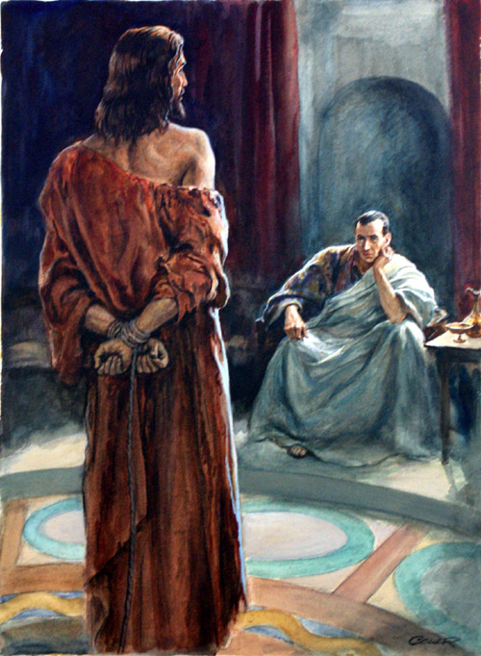
What
Is
Truth?

Slide 3
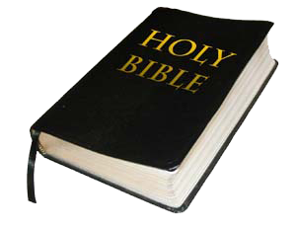
That’s Your Interpretation! – The Quest for Truth
John 1:3-5

Slide 4
The Quest for Truth
Psa 119:151
151 You are near, O Lord, And all Your commandments are truth. (NKJV)
John 17:17
17 Sanctify them by Your truth. Your word is truth. (NKJV)

Slide 5
The Quest for Truth
2 Tim 3:16-17
16 All Scripture is given by inspiration of God, and is profitable for doctrine, for reproof, for correction, for instruction in righteousness, 17 that the man of God may be complete, thoroughly equipped for every good work.
(NKJV)
2 Tim 2:14
15 Be diligent to present yourself approved to God, a worker who does not need to be ashamed, rightly dividing the word of truth.
(NKJV)

Slide 6
Exegesis
Get meaning out of passage
Eisegesis
Put meaning into passage

Slide 7
Exegesis vs Eisegesis Analysis
Mark 16:15-16
15 And He said to them, "Go into all the world and preach the gospel to every creature. 16 He who believes and is baptized will be saved; but he who does not believe will be condemned.
(NKJV)
“Jesus does not say or even imply that the one who isn’t baptized won’t be saved.” - bible.org

Slide 8
Exegesis vs Eisegesis Analysis
Ex 20:13
13 "You shall not murder.
NKJV
“God does not say or even imply that the one who murders won’t be saved.”

Slide 9
Exegesis vs Eisegesis Analysis
Mark 16:15-16
15 And He said to them, "Go into all the world and preach the gospel to every creature. 16 He who believes and is baptized will be saved; but he who does not believe will be condemned.
(NKJV)
“Jesus does not say or even imply that the one who isn’t baptized won’t be saved.” - bible.org

Slide 10
Truth and the Bible
Absolute Truth is from God, not within Man
PSA 119:151; John 17:17; Jer 10:23; Num 16
Absolute Truth is Understandable through Reading
Eph 3:3-6; Luke 10:25-28
Absolute Truth is not Contradictory
Psa 119:126-128; Gen 2:17; 3:3-5; Rom 11:5-6
James 2:14-26; Rom 9:30-33; 2 Tim 2:15

Slide 11
Believe
(John 8:24)
(Heb 11:6)
Hear
(Rom 10:17)
Repent
(Acts 2:38)
God’s Plan
of
Salvation
(Rom 16:25-26)
Be Faithful
(Phil 1:27)
(Rev 2:10)
Confess
(Rom 10:10)
Be Baptized
(Mark 16:16)
(Acts 8:36-38)

Slide 12
Acts 8:22-24
22 Repent therefore of this thy wickedness, and pray the Lord, if perhaps the thought of thy heart shall be forgiven thee.
23 For I see that thou art in the gall of bitterness and in the bond of iniquity.
24 And Simon answered and said, Pray ye for me to the Lord, that none of the things which ye have spoken come upon me.
(ASV)

