Slide 1
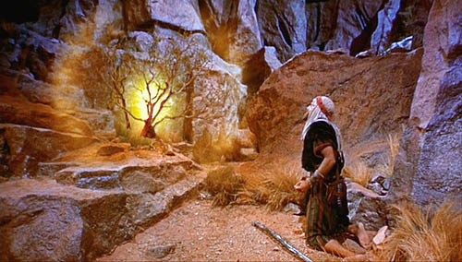
Lessons from the Burning Bush
Exodus 3:1-10

Slide 2
Exodus 3:1-10
¹ Now Moses was tending the flock of Jethro his father-in-law, the priest of Midian. And he led the flock to the back of the desert, and came to Horeb, the mountain of God. ² And the Angel of the Lord appeared to him in a flame of fire from the midst of a bush. So he looked, and behold, the bush was burning with fire, but the bush was not consumed. ³ Then Moses said, “I will now turn aside and see this great sight, why the bush does not burn.” ⁴ So when the Lord saw that he turned aside to look, God called to him from the midst of the bush and said, “Moses, Moses!” And he said, “Here I am.” ⁵ Then He said, “Do not draw near this place. Take your sandals off your feet, for the place where you stand is holy ground.” ⁶ Moreover He said, “I am the God of your father — the God of Abraham, the God of Isaac, and the God of Jacob.” And Moses hid his face, for he was afraid to look upon God.

Slide 3
Exodus 3:1-10 (cont.)
⁷ And the Lord said: “I have surely seen the oppression of My people who are in Egypt, and have heard their cry because of their taskmasters, for I know their sorrows. ⁸ So I have come down to deliver them out of the hand of the Egyptians, and to bring them up from that land to a good and large land, to a land flowing with milk and honey, to the place of the Canaanites and the Hittites and the Amorites and the Perizzites and the Hivites and the Jebusites. ⁹ Now therefore, behold, the cry of the children of Israel has come to Me, and I have also seen the oppression with which the Egyptians oppress them. ¹⁰ Come now, therefore, and I will send you to Pharaoh that you may bring My people, the children of Israel, out of Egypt.”

Slide 4
Lessons Learned at the Burning Bush
God has always given evidence of His power (v. 2-3)
Rom. 1:18-21 God has manifested His power & divinity
Mk. 16:19-20 Miracles evidenced divine origin of Gospel
God has always been characterized by holiness (5)
Lev. 19:2 → 1 Pet. 1:15-16 God described: “I Am Holy”
Rev. 15:3-4 “For You alone are holy”
God has always revealed Himself to Man (6)
Acts 14:14-17 “He did not leave Himself without witness”
1 Cor. 2:9-12 God revealed to man His will in His words
God has always offered delivery from oppression (7f)
Dan. 9:1-2, 20-24 God was ready to answer Daniel’s prayer
Heb. 2:14-15 Jesus offers deliverance from spiritual bondage

