Slide 1
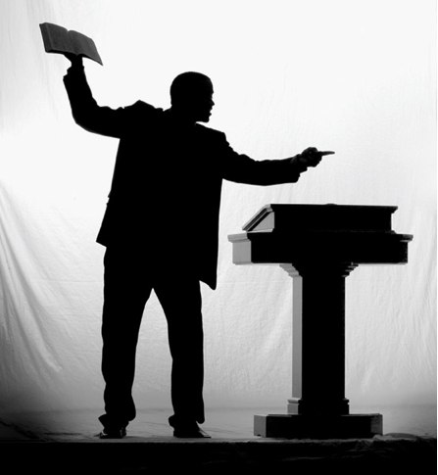
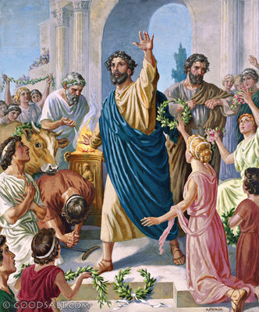
Are We Preaching Like Paul?
1st Thessalonians 2:1-9

Slide 2
1st Thessalonians 2:1-9
¹ For you yourselves know, brethren, that our coming to you was not in vain. ² But even after we had suffered before and were spitefully treated at Philippi, as you know, we were bold in our God to speak to you the gospel of God in much conflict. ³ For our exhortation did not come from error or uncleanness, nor was it in deceit. ⁴ But as we have been approved by God to be entrusted with the gospel, even so we speak, not as pleasing men, but God who tests our hearts. ⁵ For neither at any time did we use flattering words, as you know, nor a cloak for covetousness - God is witness. ⁶ Nor did we seek glory from men, either from you or from others, when we might have made demands as apostles of Christ. ⁷ But we were gentle among you, just as a nursing mother cherishes her own children. ⁸ So, affectionately longing for you, we were well pleased to impart to you not only the gospel of God, but also our own lives, because you had become dear to us. ⁹ For you remember, brethren, our labor and toil; for laboring night and day, that we might not be a burden to any of you, we preached to you the gospel of God.

Slide 3
1st Thessalonians 2:1-9
¹ For you yourselves know, brethren, that our coming to you was not in vain. ² But even after we had suffered before and were spitefully treated at Philippi, as you know, we were bold in our God to speak to you the gospel of God in much conflict. ³ For our exhortation did not come from error or uncleanness, nor was it in deceit. ⁴ But as we have been approved by God to be entrusted with the gospel, even so we speak, not as pleasing men, but God who tests our hearts. ⁵ For neither at any time did we use flattering words, as you know, nor a cloak for covetousness - God is witness. ⁶ Nor did we seek glory from men, either from you or from others, when we might have made demands as apostles of Christ. ⁷ But we were gentle among you, just as a nursing mother cherishes her own children. ⁸ So, affectionately longing for you, we were well pleased to impart to you not only the gospel of God, but also our own lives, because you had become dear to us. ⁹ For you remember, brethren, our labor and toil; for laboring night and day, that we might not be a burden to any of you, we preached to you the gospel of God.

Slide 4
1st Thessalonians 2:1-9
¹ For you yourselves know, brethren, that our coming to you was not in vain. ² But even after we had suffered before and were spitefully treated at Philippi, as you know, we were bold in our God to speak to you the gospel of God in much conflict. ³ For our exhortation did not come from error or uncleanness, nor was it in deceit. ⁴ But as we have been approved by God to be entrusted with the gospel, even so we speak, not as pleasing men, but God who tests our hearts. ⁵ For neither at any time did we use flattering words, as you know, nor a cloak for covetousness - God is witness. ⁶ Nor did we seek glory from men, either from you or from others, when we might have made demands as apostles of Christ. ⁷ But we were gentle among you, just as a nursing mother cherishes her own children. ⁸ So, affectionately longing for you, we were well pleased to impart to you not only the gospel of God, but also our own lives, because you had become dear to us. ⁹ For you remember, brethren, our labor and toil; for laboring night and day, that we might not be a burden to any of you, we preached to you the gospel of God.

Slide 5
1st Thessalonians 2:1-9
¹ For you yourselves know, brethren, that our coming to you was not in vain. ² But even after we had suffered before and were spitefully treated at Philippi, as you know, we were bold in our God to speak to you the gospel of God in much conflict. ³ For our exhortation did not come from error or uncleanness, nor was it in deceit. ⁴ But as we have been approved by God to be entrusted with the gospel, even so we speak, not as pleasing men, but God who tests our hearts. ⁵ For neither at any time did we use flattering words, as you know, nor a cloak for covetousness - God is witness. ⁶ Nor did we seek glory from men, either from you or from others, when we might have made demands as apostles of Christ. ⁷ But we were gentle among you, just as a nursing mother cherishes her own children. ⁸ So, affectionately longing for you, we were well pleased to impart to you not only the gospel of God, but also our own lives, because you had become dear to us. ⁹ For you remember, brethren, our labor and toil; for laboring night and day, that we might not be a burden to any of you, we preached to you the gospel of God.

Slide 6
“Approved by God” or “In Vain”?
Characteristics of Paul’s Preaching
Romans 1:16-17 Boldness due to power from God in gospel
2 Timothy 4:1-2 Preached word in season & out of season
2 Timothy 2:24-26 Gentleness in teaching to save souls
1 Timothy 4:6-16 Nourished in doctrine of Christ, not fables
Characteristics of Vain Preaching
Content of Error (Eph. 4:14-15)
Uncleanness of Life (Eph. 5:3; 2 Pet. 2:12-14)
Deceitful (2 Cor. 4:1-2; 2 Pet. 2:3)
Purpose of pleasing men (2 Tim. 4:3-5; Jer. 5:30-31)
Words of Flattery (Psa. 12:1-3; Rom. 16:17-18; Jude 16)
Cloak of Covetousness (Jer. 6:13; 1 Tim. 6:10; 2 Pet. 2:3)
Seeking glory of men (John 12:42-43; 5:44)

