Slide 1
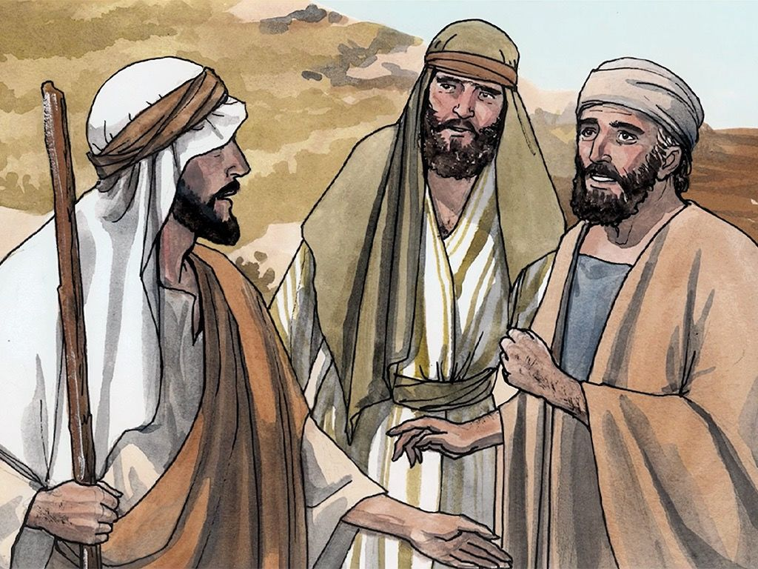
“What Do You Seek?”
John 1:35-42

Slide 2
John 1:35-42
³⁵ Again, the next day, John stood with two of his disciples. ³⁶ And looking at Jesus as He walked, he said, “Behold the Lamb of God!” ³⁷ The two disciples heard him speak, and they followed Jesus. ³⁸ Then Jesus turned, and seeing them following, said to them, “What do you seek?” They said to Him, “Rabbi”
(which is to say, when translated, Teacher), “where are You staying?” ³⁹ He said to them, “Come and see.” They came and saw where He was staying, and remained with Him that day (now it was about the tenth hour). ⁴⁰ One of the two who heard John speak, and followed Him, was Andrew, Simon Peter’s brother. ⁴¹ He first found his own brother Simon, and said to him, “We have found the Messiah” (which is translated, the Christ). ⁴² And he brought him to Jesus. Now when Jesus looked at him, He said, “You are Simon the son of Jonah. You shall be called Cephas” (which is translated, A Stone).

Slide 3
John 1:35-42
³⁵ Again, the next day, John stood with two of his disciples. ³⁶ And looking at Jesus as He walked, he said, “Behold the Lamb of God!” ³⁷ The two disciples heard him speak, and they followed Jesus. ³⁸ Then Jesus turned, and seeing them following, said to them, “What do you seek?” They said to Him, “Rabbi”
(which is to say, when translated, Teacher), “where are You staying?” ³⁹ He said to them, “Come and see.” They came and saw where He was staying, and remained with Him that day (now it was about the tenth hour). ⁴⁰ One of the two who heard John speak, and followed Him, was Andrew, Simon Peter’s brother. ⁴¹ He first found his own brother Simon, and said to him, “We have found the Messiah” (which is translated, the Christ). ⁴² And he brought him to Jesus. Now when Jesus looked at him, He said, “You are Simon the son of Jonah. You shall be called Cephas” (which is translated, A Stone).

Slide 4
Characteristics of Those Seeking Jesus
Seek to understand O.T. prophecy about the Messiah
Isaiah 53:3-7 → John 1:29, 35
Luke 24:25-27 → Luke 24:44-47
John 5:38-39, 45-47
Acts 2 → Acts 3 → Acts 7 – Appealed to prophecy
Continue to follow Jesus (“abide” or “remain” – meno)
John 6:60-69
Luke 9:57-62
Matthew 28:18-20 → 2 John 9 → Heb. 3:12-14
Seek to bring others to Christ
John 1:43-45
Acts 8:4 → 1 Peter 3:15
1 Corinthians 9:19-22

