Slide 1
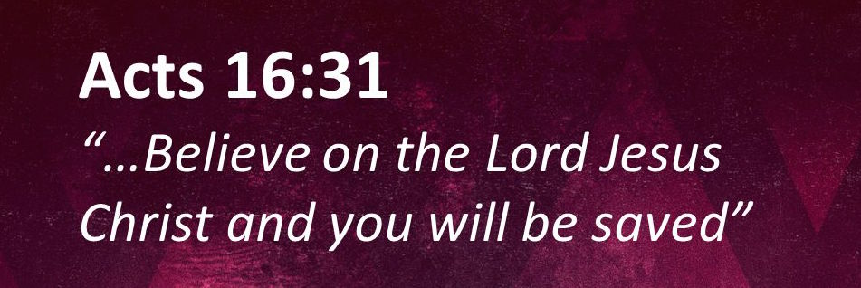
The Faith That Saves
Acts 16:25-34

Slide 2
Acts 16:25-34
²⁵ But at midnight Paul and Silas were praying and singing hymns to God, and the prisoners were listening to them. ²⁶ Suddenly there was a great earthquake, so that the foundations of the prison were shaken; and immediately all the doors were opened and everyone’s chains were loosed. ²⁷ And the keeper of the prison, awaking from sleep and seeing the prison doors open, supposing the prisoners had fled, drew his sword and was about to kill himself. ²⁸ But Paul called with a loud voice, saying, “Do yourself no harm, for we are all here.” ²⁹ Then he called for a light, ran in, and fell down trembling before Paul and Silas. ³⁰ And he brought them out and said, “Sirs, what must I do to be saved?” ³¹ So they said, “Believe on the Lord Jesus Christ, and you will be saved, you and your household.” ³² Then they spoke the word of the Lord to him and to all who were in his house. ³³ And he took them the same hour of the night and washed their stripes. And immediately he and all his family were baptized. ³⁴ Now when he had brought them into his house, he set food before them; and he rejoiced, having believed in God with all his household.

Slide 3
Acts 16:25-34
²⁵ But at midnight Paul and Silas were praying and singing hymns to God, and the prisoners were listening to them. ²⁶ Suddenly there was a great earthquake, so that the foundations of the prison were shaken; and immediately all the doors were opened and everyone’s chains were loosed. ²⁷ And the keeper of the prison, awaking from sleep and seeing the prison doors open, supposing the prisoners had fled, drew his sword and was about to kill himself. ²⁸ But Paul called with a loud voice, saying, “Do yourself no harm, for we are all here.” ²⁹ Then he called for a light, ran in, and fell down trembling before Paul and Silas. ³⁰ And he brought them out and said, “Sirs, what must I do to be saved?” ³¹ So they said, “Believe on the Lord Jesus Christ, and you will be saved, you and your household.” ³² Then they spoke the word of the Lord to him and to all who were in his house. ³³ And he took them the same hour of the night and washed their stripes. And immediately he and all his family were baptized. ³⁴ Now when he had brought them into his house, he set food before them; and he rejoiced, having believed in God with all his household.

Slide 4
What Kind of Faith Saves?
Faith that comes from teaching
Faith is not result of God’s direct action in “irresistible grace”
Acts 17:11-12 Believed as result of searching Scripture
Rom. 10:17 Faith comes by hearing the word of God
Faith in the Lord Jesus Christ
Acts 2:36 Peter preached that Jesus was both Lord & Christ
John 8:23-24 Must believe in deity of Christ
John 20:30-31 Must believe He is the Christ, Son of God
Faith that acts to obey the teaching of the Lord
John 6:28-29 Faith is a work – man’s action directed by God
Heb. 10:36-39 Saving faith involves doing will of God
Mk. 16:15-16 → Acts 2:37-38, 41; 8:12-13; 22:6-10, 16
Faith that sees the immediate need for salvation

