Slide 1
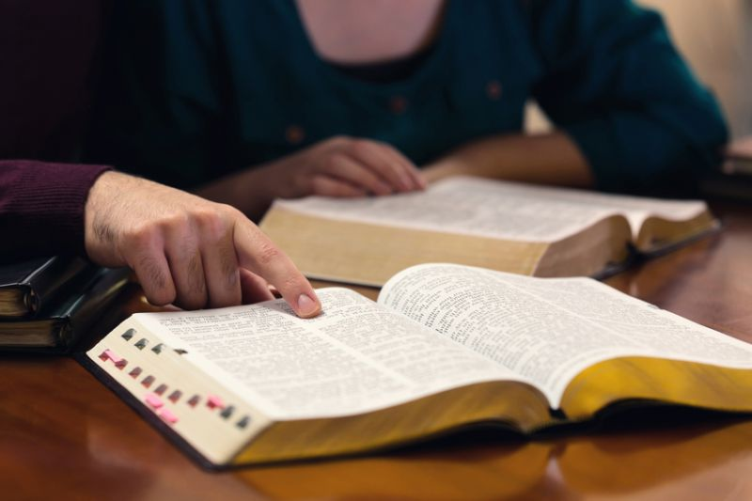
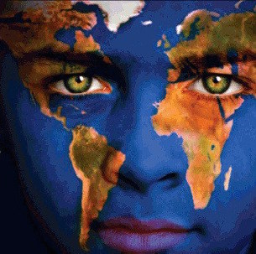
Are We Shaped by Word or World?
1 John 2:12-17

Slide 2
1st John 2:12-17
¹² I write to you, little children, because your sins are forgiven you for His name’s sake. ¹³ I write to you, fathers, because you have known Him who is from the beginning. I write to you, young men, because you have overcome the wicked one. I have written to you, little children, because you have known the Father. ¹⁴ I have written to you, fathers, because you have known Him who is from the beginning. I have written to you, young men, because you are strong, and the word of God abides in you, and you have overcome the wicked one. ¹⁵ Do not love the world or the things in the world. If anyone loves the world, the love of the Father is not in him. ¹⁶ For all that is in the world — the lust of the flesh, the lust of the eyes, and the pride of life — is not of the Father but is of the world. ¹⁷ And the world is passing away, and the lust of it; but he who does the will of God abides forever.

Slide 3
Shaping Inward Person by The Word

Slide 4
Purpose of the Word
Note use of present & past tense as well as pronoun
“I write to you…” (“you” is 2nd person singular)
Little children - because your sins are forgiven you
Fathers - because you have known Him who is from…
Young men - because you have overcome the wicked one
“I have written to you…” (“you” - 2nd person sing.)
Little children - because you have known the Father
Fathers - because you have known Him who is from…
Young men - because you are strong, word of God abides in you & you have overcome the wicked one
Purpose: Word must abide in & shape our own lives

Slide 5
Word Within Affects Our Lives
O.T. mandated that the law must be within follower
Deuteronomy 6:6; 11:18; 30:14
N.T. says gospel has unique nature of being within
Jeremiah 31:31-34 Prophecy of coming gospel of Christ
Hebrews 8:7-13 New covenant prophesied now in effect
Hebrews 10:8-18 New covenant within & forgiveness
Word of gospel within has effect upon us
James 1:21 Implanted word is able to save the soul
1 Peter 1:22-25 New birth from seed planted within
Colossians 3:16-17 Act in the name of the Lord
Impact not had if left on paper within closed cover
Must have an abiding presence within us

Slide 6
When Word Shapes from Within...
We recognize forgiveness found in Christ
We have tools to overcome the evil one
We learn to truly know the eternal Father
We find the source of true strength
We have abiding instruction to direct us
We can see the past effect it has on us
We are confident that effect will continue
These points made by writer throughout 1st John

Slide 7
Contrast with Shaping by The World

Slide 8
Instruction: “Love Not The World…”
Emphasis demands total rejection of world
“Do not love the world or the things in the world”
Love of world inconsistent with love of God
“If anyone loves the world, the love of the Father is not in him”
Gospel demands separation from world
James 4:4 If friend of the world, enemy of God
Titus 2:11-14 Deny worldly lusts, live righteously

Slide 9
Description: Nature of the World
“The lust of the flesh” – Sensual desires
Rom. 13:12-14 Intoxicants & sexual sins are named
1 Pet. 2:11-12 Fleshly lusts war against soul
“The lust of the eyes” – Materialism
Matt. 6:19-24 Treasures on earth – transitory & vain
1 Tim. 6:9-10 Love of money is a root of many evils
“The vainglory of life” – Seek power & glory
Prov. 16:18 Pride goes before destruction
Jas. 4:6-10 God resists proud, gives grace to humble
Ultimate end of world & worldliness is clear…

Slide 10
2 Peter 3:10-12
¹⁰ But the day of the Lord will come as a thief in the night, in which the heavens will pass away with a great noise, and the elements will melt with fervent heat; both the earth and the works that are in it will be burned up. ¹¹ Therefore, since all these things will be dissolved, what manner of persons ought you to be in holy conduct and godliness, ¹² looking for and hastening the coming of the day of God, because of which the heavens will be dissolved, being on fire, and the elements will melt with fervent heat? ¹³ Nevertheless we, according to His promise, look for new heavens and a new earth in which righteousness dwells.

Slide 11
Is My Life Directed By The World or The Word?
Where do I look for heroes to emulate?
Who sets my standard for dress & speech?
What is my goal in life?
How much time do I spend with each?
Which one occupies most of my thoughts?
Which will I let direct my actions now?
Five minutes after I die, how would I want to have answered each of the above?

