Slide 2
WE OFTEN COMPARTIMENTLIZE OUR LIFE
OUR LIFE
FAMILY
WORK/ JOB
LEISURE/RECREATION
SERVICE TO GOD/ CHRISTIAN

Slide 3
BETTER VIEW
BEING A CHRISTIAN
WORK/ JOB
LEISURE/RECREATION
MARRIAGE
PARENT

Slide 4
A FOUR HOUR “CHRISTIAN”
PHILIPPIANS 1:21-26

Slide 5
A FOUR HOUR CHRISTIAN
WHAT DO WE MEAN BY “FOUR HOUR CHRISTIAN”?

Slide 6
DEFINING A FOUR HOUR CHRISTIAN
“CHRISTIAN” WHO ATTENDS EVERY SERVICE
They take seriously the responsibility to attend – Heb. 10:25
They Have a “Form” of Godliness
2 Timothy 3:5
“form” – “appearance”, “the mere form”
Matthew 23:25-28

Slide 7
DEFINING A FOUR HOUR CHRISTIAN
IT IS AN INDIVIDUAL WHO DOES NOT ALLOW THEIR “CHRISTIANITY” TO EFFECT THEIR DAILY LIVING
Phil.1:27
2 Corinthians 12:20-21

Slide 8
A FOUR HOUR CHRISTIAN
WHAT DO WE MEAN BY “FOUR HOUR CHRISTIAN”?
WHAT ARE THE IDENTFYING MARKS OF A “FOUR HOUR CHRISTIAN”?

Slide 9
Signs of A “Four Hour” Christian
They Spend Little Time in Studying of the Scriptures and in Prayer
It is impossible to be a strong Christian who does not study and prayer
1 Peter 2:2 – “Like newborn infants, long for the pure spiritual milk, that by it you may grow up into salvation”
Both study and prayer should be part of our daily lives
Acts 17:11
1 Thess.5:17

Slide 10
Signs of A “Four Hour” Christian
Their Time is Dominated by "Worldly" Things Instead of the Spiritual/Too Many Irons in the Fire
Schedules are too full – little time for spiritual things
Always Been Danger for God’s People
Deut.6:12; 2 Tim.4:10
Mark 4:19

Slide 11
Signs of A “Four Hour” Christian
They More Closely Identify With the World Than Those Practice Their Christianity
James 4:4
Their dress, speech, priorities make them blend in with the world
2 Cor.6:17
Others May Not Identify Them As “Christians”

Slide 12
Signs of A “Four Hour” Christian
Worship is Probably Considered a Burden – Not A Privilege
Malachi 1:13
It is not looked forward to with joy and anticipation – Psa.122:1

Slide 13
A FOUR HOUR CHRISTIAN
WHAT DO WE MEAN BY “FOUR HOUR CHRISTIAN”?
WHAT ARE THE IDENTIFYING MARKS OF A “FOUR HOUR CHRISTIAN”
IS IT POSSIBLE TO BE A“FOUR”HOUR CHRISTIAN”?

Slide 14
A CHRISTIAN IS A “DISCIPLE”
26 And when he had found him, he brought him to Antioch. So it was that for a whole year they assembled with the church and taught a great many people. And the disciples were first called Christians in Antioch.

Slide 15
A DISCIPLE
A DISCIPLE SEEKS TO BE LIKE HIS MASTER
MATTHEW 10:25
EPHESIANS 4:24
A DISCIPLE TAKES UP HIS CROSS “DAILY”
Luke 9:23
A DISCIPLE MUST PUT THE LORD BEFORE ALL OTHER RELATIONSHIPS
Luke 14:25-33

Slide 16
Being a Christian Affects Every Area of Life
It Is Our Calling – Ephesians 4:1
¹ I, therefore, the prisoner of the Lord, beseech you to walk worthy of the calling with which you were called

Slide 17
“Our Calling” or “Vocation”
“The vocation or ‘calling” of the Christian is the job of being a Christian. It is the spiritual, heavenly calling of God to salvation. It includes the benefits and responsibilities pertaining to salvation. It involves what we do in our lives and what we teach others to do. This ‘vocation’ is the full-time occupation of the child of God. It is our work in life. It is what we do” – Colly Caldwell

Slide 18
“Our Calling” Means:
Possessing the Right Attitude (Eph.4:2)
Being Committed to the “Unity of the Spirit” (Eph.4:4-6)
Providing Our Part for Edifying the Body (Eph.4:7-16)
Being Different Than the World (Eph.4:17-32)
Seeking to Imitate God in Love, Light, and Wisdom (Eph.5:1-21)
Being a Good Family Man/Woman (Eph.5:22-6:4)
Being a Good Employee/Employer (Eph.6:5-9)

Slide 19
Being a Christian Affects Every Area of Life
We Must Be Holy in All Our Conduct – 1 Peter 1:15
but as He who called you is holy, you also be holy in all your conduct,

Slide 20
“Holy In All Our Conduct”
Holy in Relationship to the World – 1 Peter 2:9-12
Holy in Relationship to the Government – 1 Peter 2:13-25
Holy In Marriage – 1 Peter 3:1-7
Holy in Suffering – 1 Peter 3:8-22; 4:12ff
Holy in Living for “The End of All Things” – 1 Peter 4:1-11
Holy in Humbly Filling Our Place – 1 Peter 5:1-11

Slide 21
Being a Christian Affects Every Area of Life
Our Righteousness Must Exceed That of the Scribes and Pharisees – Mt.5:20
For I say to you, that unless your righteousness exceeds the righteousness of the scribes and Pharisees, you will by no means enter the kingdom of heaven.

Slide 22
“Exceeds the Righteousness of Scribes and Pharisees
Righteousness of Heart – Not Just Abstain from Overt Acts – Matt.5:21-30
Righteous View of Marriage – Matt.5:27-30
Righteous View of Our Word – Matt.5:31-37
Righteous Treatment of Enemies – Matt.5:38-48

Slide 23
“Exceeds the Righteousness of Scribes and Pharisees
Righteous Motive in Our Deeds (Matt.6:1-18
Righteous View of Material Things (Matt.6:19-24
Righteous View of What is Important (Matt.6:25-34)
Righteous Treatment of Fellowman (Matt.7:1-12)

Slide 24
Being a Christian Affects Every Area of Life
Our Godliness Should Be Seen in Our Daily Living
Matthew 5:13-16
1 Peter 2:11-12
John 13:35

Slide 26
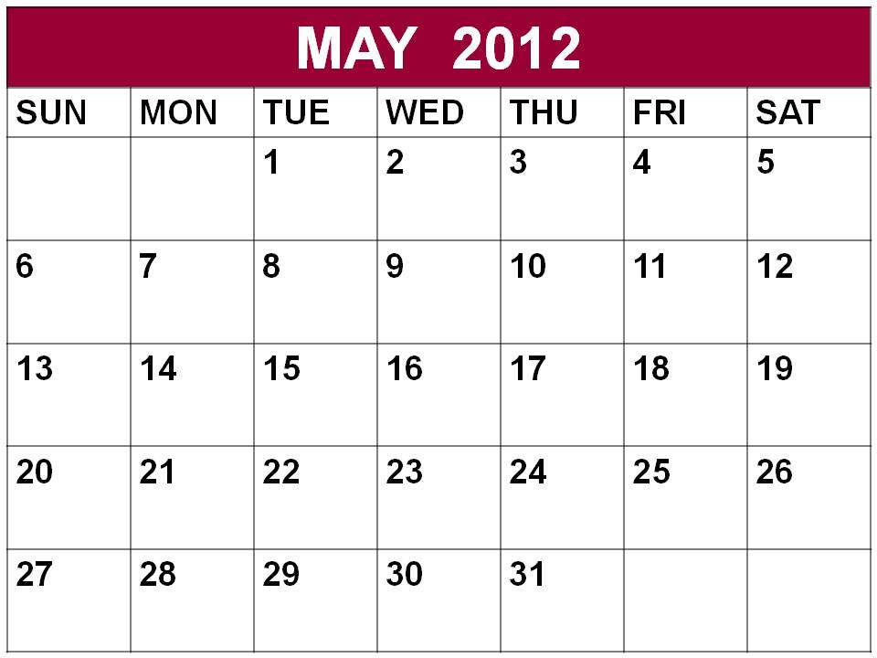
The Lord’s Time
Service to God

Slide 27
Deut.6:6-9
6 "And these words which I command you today shall be in your heart. 7 You shall teach them diligently to your children, and shall talk of them when you sit in your house, when you walk by the way, when you lie down, and when you rise up. 8 You shall bind them as a sign on your hand, and they shall be as frontlets between your eyes. 9 You shall write them on the doorposts of your house and on your gates.

Slide 28
A FOUR HOUR “CHRISTIAN”
PHILIPPIANS 1:21-26

