Slide 1
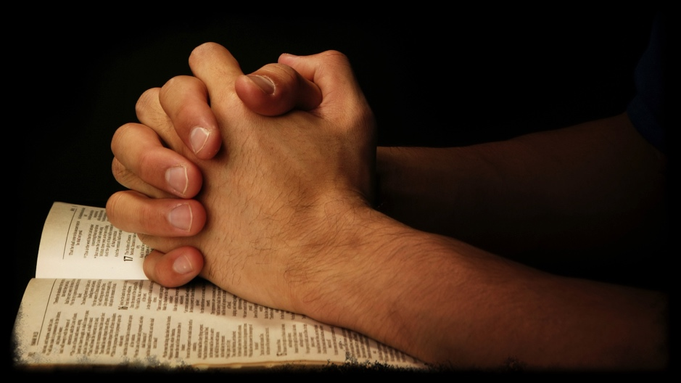
Give Thanks: It Is the Will of God
1st Thessalonians 5:16-18

Slide 2
1 Thessalonians 5:16-18
¹⁶ Rejoice always, ¹⁷ pray without ceasing, ¹⁸ in everything give thanks; for this is the will of God in Christ Jesus for you.

Slide 3
“Count Your Many Blessings”
Bible is filled with admonitions to see that we are richly blessed by God
Thank God for His goodness with joy, service & praise (Psa. 100)
Prophesied that thanksgiving would be found in Zion (Isa. 51:1-3)
Citizens of the kingdom of heaven thank the Lord (Col. 3:15)

Slide 4
1 Thessalonians 5:16-18
¹⁶ Rejoice always, ¹⁷ pray without ceasing, ¹⁸ in everything give thanks; for this is the will of God in Christ Jesus for you.
Failure to Give Thanks Shows Ingratitude
¹ But know this, that in the last days perilous times will come: ² For men will be lovers of themselves, lovers of money, boasters, proud, blasphemers, disobedient to parents, unthankful, unholy, ³ unloving, unforgiving, slanderers, without self-control, brutal, despisers of good, ⁴ traitors, headstrong, haughty, lovers of pleasure rather than lovers of God, ⁵ having a form of godliness but denying its power. And from such people turn away! (2 Tim. 3:1-5)

Slide 5
1 Thessalonians 5:16-18
¹⁶ Rejoice always, ¹⁷ pray without ceasing, ¹⁸ in everything give thanks; for this is the will of God in Christ Jesus for you.
Learning Proper Gratitude to God…
…giving thanks always for all things to God the Father in the name of our Lord Jesus Christ (Eph. 5:20)

Slide 6
Learning Proper Gratitude (Eph. 5:20)
“Giving Thanks Always…”
1 Thess. 5:17-18 Pray without ceasing – giving thanks
Phil. 4:6 “In everything by prayer & supplication...”
Col. 3:15-17 Abundance of thankfulness comes from focus
“… For All Things…”
1 Tim. 4:1-4 Thankful for food
Psa. 119:61-62 Thankful for God’s word
Col. 1:3 Thankful for brethren (Rom. 1:8)
Phil. 1:3 Thankful for memories of faithful (1 Thess.1:2-3)
“… To God the Father”
James 1:17 Must remember that He is source of all good
2 Chron. 20:21 Praised God His mercy that endures forever
Luke 17:12-16 Only one of the ten lepers thanked God
Are We Being Properly Thankful to God?

