Slide 1
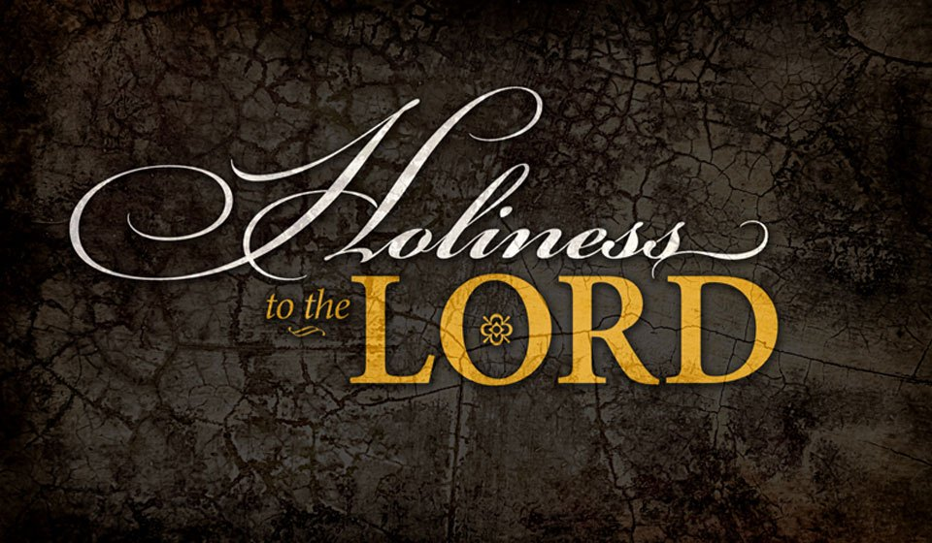
Holiness: Introduced in O.T.
Psalm 99

Slide 2
Psalm 99
¹ The Lord reigns; let the peoples tremble! He dwells between the cherubim; let the earth be moved! ² The Lord is great in Zion, and He is high above all the peoples. ³ Let them praise Your great and awesome name — He is holy. ⁴ The King’s strength also loves justice; You have established equity; You have executed justice and righteousness in Jacob. ⁵ Exalt the Lord our God, and worship at His footstool — He is holy. ⁶ Moses and Aaron were among His priests, and Samuel was among those who called upon His name; they called upon the Lord, and He answered them. ⁷ He spoke to them in the cloudy pillar; they kept His testimonies and the ordinance He gave them. ⁸ You answered them, O Lord our God; You were to them God-Who-Forgives, though You took vengeance on their deeds. ⁹ Exalt the Lord our God, and worship at His holy hill; for the Lord our God is holy.

Slide 3
Why Look at Holiness in O.T.?
Romans 15:4
Scriptures written "before" (O.T.) are for “our learning” (Christians)
1 Corinthians 10:11
Examples for “our admonition”
2 Timothy 3:14-17
Scripture considered is O.T.
Has bearing on our life in Christ
Principle: O.T. is our tutor (Gal. 3:24)

Slide 4
God Is Holiness Personified
Isaiah 5:16 God Who Is Holy
Psalm 89:18 Holy One of Israel
Same title is used repeated through the Psalms and Isaiah
Ezekiel 39:7 "My Holy Name"
To be made known & not profaned
Hab. 1:13 "Of purer eyes than to behold evil"
Isaiah 6:3 "Holy, Holy, Holy is the Lord..."
Triune statement denotes absolute holiness

Slide 5
Principles of Holiness to God Applied
Some things were to be kept holy to God
Exod. 20:8 Sabbath to be kept holy to God
Exod. 28:2 Garments of priest kept holy (Exod. 39:30)
Exod. 40:9 Tabernacle to be anointed & seen as holy
Leviticus stresses need to be holy to God
Lev. 19:1-2 Whole congregation must be holy as God is
Lev. 20:6-8 Turning to another prostitutes self (v. 10-21)
Lev. 20:22-26 Keeping all the law = Being holy to God
Ezekiel commanded a return to be holy to God
Ezek. 39:7 His judgments show holiness & need to return
Ezek. 36:16-31 Disobedience defiled Israel - need to change
God to be hallowed before their eyes
Purification to cleanse from filthiness
New heart & new spirit made within them
Walk in God's statutes & keep His judgments & do them
Ezek. 39:25-29 Spiritual Israel to show forth God's holiness

