Slide 1
Why Are People Lost?
Matthew 9:35-38

Slide 2
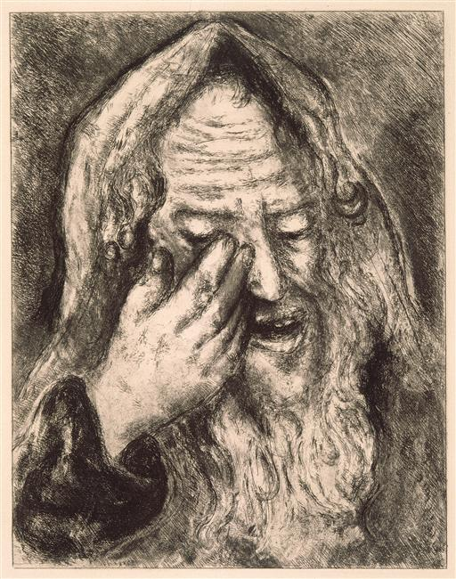
Lamentations 1:12-16
¹² “Is it nothing to you, all you who pass by? Behold and see if there is any sorrow like my sorrow, which has been brought on me, which the Lord has inflicted in the day of His fierce anger. ¹³ From above He has sent fire into my bones, and it overpowered them; He has spread a net for my feet and turned me back; He has made me desolate and faint all the day. ¹⁴ The yoke of my transgressions
was bound; they were woven together by His hands, and thrust upon my neck. He made my strength fail; the Lord delivered me into the hands of those whom I am not able to withstand. ¹⁵ The Lord has trampled underfoot all my mighty men in my midst; He has called an assembly against me to crush my young men; the Lord trampled as in a winepress the virgin daughter of Judah. ¹⁶ For these things I weep; my eye, my eye overflows with water; because the comforter, who should restore my life, is far from me. My children are desolate because the enemy prevailed.”

Slide 3
Matthew 9:35-38
³⁵ Then Jesus went about all the cities and villages, teaching in their synagogues, preaching the gospel of the kingdom, and healing every sickness and every disease among the people. ³⁶ But when He saw the multitudes, He was moved with compassion for them, because they were weary and scattered, like sheep having no shepherd. ³⁷ Then He said to His disciples, “The harvest truly is plentiful, but the laborers are few. ³⁸ Therefore pray the Lord of the harvest to send out laborers into His harvest.”

Slide 4
Why Are People Lost?
Not because they inherit sin from their forefathers
Ezek. 18:20 Neither father or son inherit sins of the other
Deut. 24:16 Neither father or son put to death for other’s sin
Jer. 31:29-30 False parable: “Fathers have eaten sour grapes…
Rom. 3:9-12 “… have all turned aside… become unprofitable”
Not because God wants them to be lost
2 Pet. 3:9 God does not will or desire that anyone be lost
1 Tim. 2:3-4 Desires all to be saved & come to know truth
Acts 10:34-35 God shows no partiality - no respect of persons
Not because the gospel has no power
Rom. 1:16-17 Gospel is God’s power to save all
1 Cor. 1:21-24 Gospel is wisdom & power of God to save

Slide 5
People Are Lost Because…
Behold, the Lord’s hand is not shortened, that it cannot save; nor His ear heavy, that it cannot hear. But your iniquities have separated you from your God; and your sins have hidden His face from you, so that He will not hear (Isa. 59:1-2).
… of Their Own Sins

Slide 6
People Are Lost Because…
For all have sinned and fall short of the glory of God (Rom. 3:23).
For the wages of sin is death… (Rom. 6:23).
All we like sheep have gone astray; we have turned, every one, to his own way (Isa. 53:6).
… of Their Own Sins

Slide 7
Honesty Demands That We Admit…
Our minds have been blinded by Satan
2 Cor. 4:3-4 Lost are blinded by “god of this age (world)”
We hardened our hearts towards God
Eph. 4:17-19 (ASV) “Because of hardening of their heart”
Rom. 1:20-23 God made known, but foolish heart darkened
We made a choice to sin
Eph. 2:1-3 Fulfilling the desires of the flesh & of the mind
James 1:13-15 Not tempted by God, but by our own lust
We ignored the way of escape provided by God
1 Cor. 10:12-13 Not above ability, but given way of escape
Sin is our own choice and we must blame only self

