Slide 1
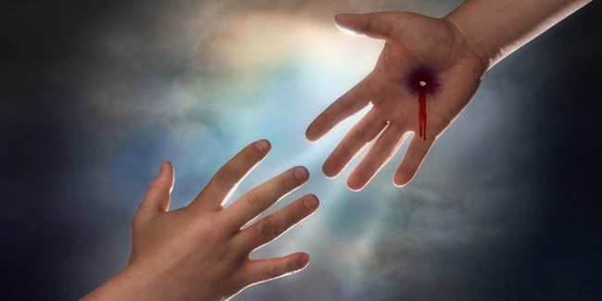
Why Are Sinners Not Yet Saved?
Jeremiah 8:18-22

Slide 2
Jeremiah 8:18-22
¹⁸ I would comfort myself in sorrow; my heart is faint in me. ¹⁹ Listen! The voice, the cry of the daughter of my people from a far country: “Is not the Lord in Zion? Is not her King in her? Why have they provoked Me to anger with their carved images — with foreign idols? ²⁰ The harvest is past, the summer is ended, and we are not saved!” ²¹ For the hurt of the daughter of my people I am hurt. I am mourning; astonishment has taken hold of me. ²² Is there no balm in Gilead, is there no physician there? Why then is there no recovery for the health of the daughter of my people?

Slide 3
Jeremiah 8:18-22
¹⁸ I would comfort myself in sorrow; my heart is faint in me. ¹⁹ Listen! The voice, the cry of the daughter of my people from a far country: “Is not the Lord in Zion? Is not her King in her? Why have they provoked Me to anger with their carved images — with foreign idols? ²⁰ The harvest is past, the summer is ended, and we are not saved!” ²¹ For the hurt of the daughter of my people I am hurt. I am mourning; astonishment has taken hold of me. ²² Is there no balm in Gilead, is there no physician there? Why then is there no recovery for the health of the daughter of my people?

Slide 4
Why Are Sinners Not Yet Saved?
Not because Jesus failed to give sacrifice for them
John 3:16-17 God’s love for world seen in giving Son
1 Jn. 2:1-2 He is propitiation for sins of “whole world”
1 Tim. 2:5-6 Christ gave Himself as “a ransom for all”
Heb. 2:9 Jesus was given to “taste death for everyone”
Not because they have been deprived of free will
Rev. 22:17 “Whoever desires, let him take the water of life”
John 7:17 “If anyone wills to do His will…”
Josh. 24:14-15 “Choose for yourselves this day who you…”
Mark 8:34 “Whoever desires to come after Me, let him…”
2 Tim. 2:22-26 Come to their senses & escape snare of devil
Not because truth is impossible to understand
Eph. 5:17 Not to be unwise, but understand will of God
Not because some things necessary were never revealed
2 Tim. 3:16-17 Scripture equips us to every good work

Slide 5
Sinners Are Not Yet Saved If They…
Have never heard the gospel
Jn. 6:44-45 Must be taught, hear & learn, then come to Him
Matt. 13:23 Good ground heart first heard the word
Have not believed that Jesus is Christ, Son of God
Rom. 10:17 Faith comes by hearing the word (Jn. 20:30-31)
Heb. 11:6 Without faith, impossible to please Him (Jn. 8:24)
Have not repented of their sins
Acts 17:30 All men everywhere commanded to repent
Have not yet confessed their faith
Rom. 10:10 “With the mouth confession is made to salvation”
Have not been baptized into Christ for remission of sins
Acts 2:37-38 Must repent & be baptized for remission of sins
Acts 22:16 Arise & be baptized & wash away sin (1 Pet. 3:21)

Slide 6
If you are still in sin, why are you not yet saved?

