Slide 1
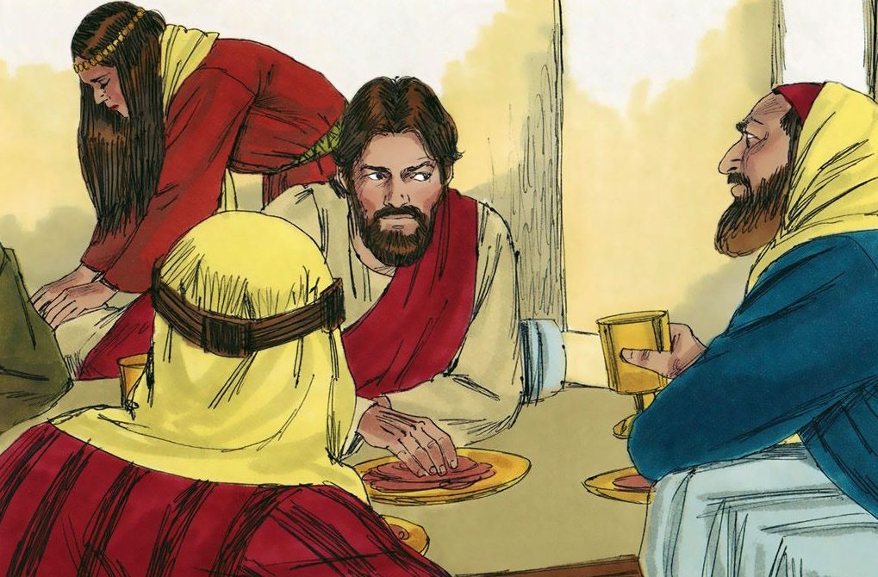
Seeing What Simon Failed to See
Luke 7:36-48

Slide 2
Luke 7:36-48
³⁶ Then one of the Pharisees asked Him to eat with him. And He went to the Pharisee’s house, and sat down to eat. ³⁷ And behold, a woman in the city who was a sinner, when she knew that Jesus sat at the table in the Pharisee’s house, brought an alabaster flask of fragrant oil, ³⁸ and stood at His feet behind Him weeping; and she began to wash His feet with her tears, and wiped them with the hair of her head; and she kissed His feet and anointed them with the fragrant oil. ³⁹ Now when the Pharisee who had invited Him saw this, he spoke to himself, saying, “This Man, if He were a prophet, would know who and what manner of woman this is who is touching Him, for she is a sinner.” ⁴⁰ And Jesus answered and said to him, “Simon, I have something to say to you.” So he said, “Teacher, say it.”

Slide 3
⁴¹ “There was a certain creditor who had two debtors. One owed five hundred denarii, and the other fifty. ⁴² And when they had nothing with which to repay, he freely forgave them both. Tell Me, therefore, which of them will love him more?” ⁴³ Simon answered and said, “I suppose the one whom he forgave more.” And He said to him, “You have rightly judged.” ⁴⁴ Then He turned to the woman and said to Simon, “Do you see this woman? I entered your house; you gave Me no water for My feet, but she has washed My feet with her tears and wiped them with the hair of her head. ⁴⁵ You gave Me no kiss, but this woman has not ceased to kiss My feet since the time I came in. ⁴⁶ You did not anoint My head with oil, but this woman has anointed My feet with fragrant oil. ⁴⁷ Therefore I say to you, her sins, which are many, are forgiven, for she loved much. But to whom little is forgiven, the same loves little.” ⁴⁸ Then He said to her, “Your sins are forgiven.”

Slide 4
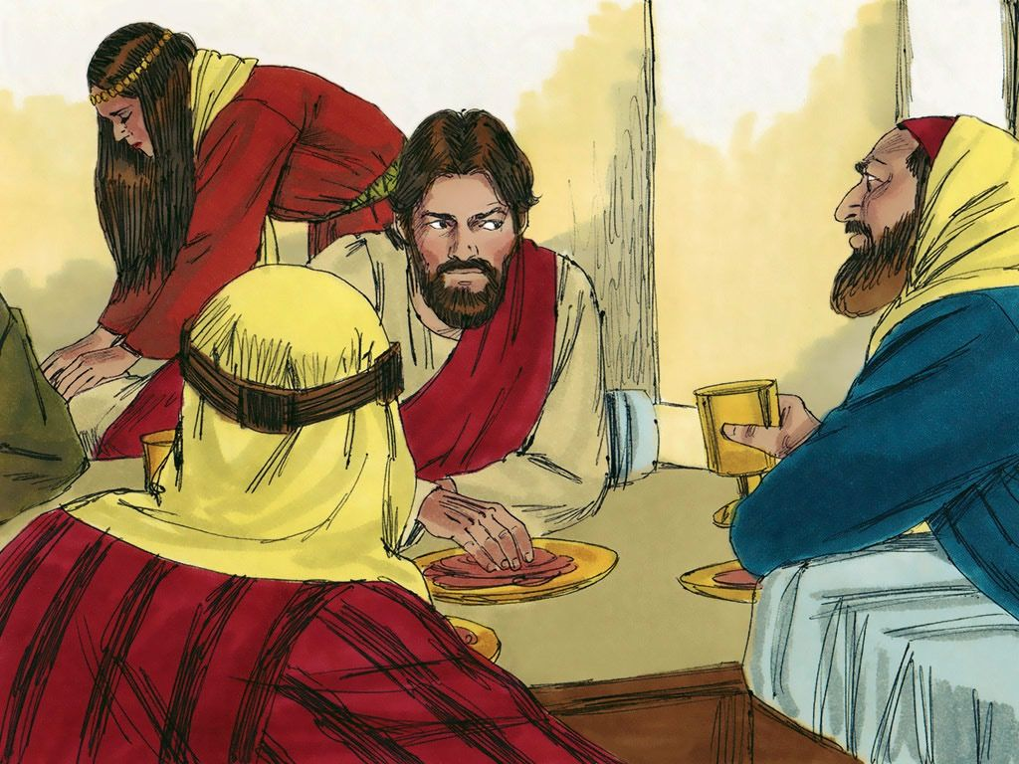

Slide 5
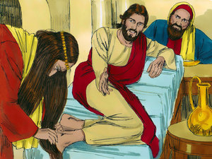

Slide 6
Do We See What Simon Failed to See?
Our Own Sinfulness?
Rom. 3:23 All have sinned and fall short of the glory of God
1 Tim. 1:15 Of his own merit, Paul saw self as chief of sinners
2 Cor. 10:12 Point of comparison must not be with self or others
The Value of Jesus?
Phil. 2:9-11 Name of Jesus is above – every knee should bow
Rev. 5:12-14 Lamb of God is worthy power, riches, wisdom…
Col. 1:18 “…that in all things He may have the preeminence”
The Saving Power of Christ?
2 Tim. 1:8-10 “Our Savior Jesus Christ” – saved us & called us
Heb. 7:25 Able to save to the uttermost because He forever…
Acts 4:12 No other name by which we can be saved – Only Jesus
The Need to Save the Lost?
Luke 19:10 Son of Man came to seek & save that which was lost
John 4:35 In a lost world, Jesus saw an abundant harvest of souls
1 Cor. 9:22 Become all things to all men in order to save some

