Slide 1
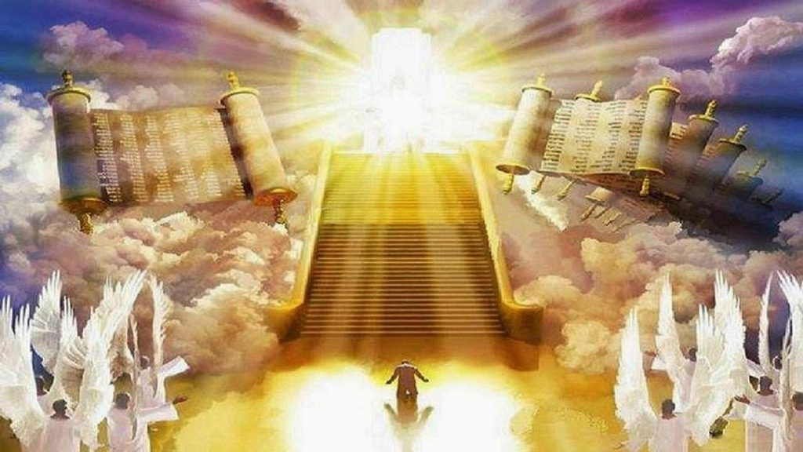
Before the Judgment Seat of Christ
2nd Corinthians 5:6-10

Slide 2
2nd Corinthians 5:6-10
⁶ So we are always confident, knowing that while we are at home in the body we are absent from the Lord. ⁷ For we walk by faith, not by sight. ⁸ We are confident, yes, well pleased rather to be absent from the body and to be present with the Lord. ⁹ Therefore we make it our aim, whether present or absent, to be well pleasing to Him. ¹⁰ For we must all appear before the judgment seat of Christ, that each one may receive the things done in the body, according to what he has done, whether good or bad.

Slide 3
Giving Answer for Our Eternity
“We must all appear before the judgment seat of Christ”
Matt. 25:31-32 All nations’ day to day actions yield separation
Acts 17:30-31 All men everywhere to answer in that day
Rev. 20:11-13 All judged by their life deeds compared to Word
Rom. 2:16 Even the secrets of all will be judged by the Gospel
“That each one may receive the things done in the body”
Matt. 25:46 Eternal life or everlasting (eternal) punishment
2 Thess. 1:3-10 Distinction made between eternal destinies
Rev. 21:1-8 Righteous with God, but wicked in second death
Rev. 20:15 Wicked cast into the lake of fire forever (Rev. 14:11)
“Therefore we make it of aim… to be well pleasing to Him”
1 Thess. 4:1-2 Living by revealed word is pleasing to God
Phil. 1:27 Strive to live in manner worthy of Christ’s gospel
Phil. 3:13-14 Press on towards goal of high calling of God
Ready to answer for all things good or bad? (Rom. 14:12)

