Slide 1
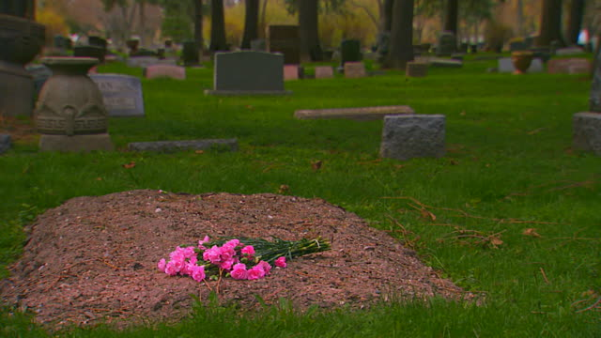
What Will Live Beyond My Grave?
Job 17:1-15

Slide 2
Job 17:1-15
¹ “My spirit is broken, my days are extinguished, the grave is ready for me….
“The grave is ready for me…
^{8 “}Upright men are astonished at this, and the innocent stirs himself up against the hypocrite. ⁹ Yet the righteous will hold to his way, and he who has clean hands will be stronger and stronger. ¹⁰ “But please, come back again, all of you, for I shall not find one wise man among you. ¹¹ My days are past, my purposes are broken off, even the thoughts of my heart. ¹² They change the night into day; ‘The light is near,’ they say, in the face of darkness. ¹³ If I wait for the grave as my house, if I make my bed in the darkness, ¹⁴ if I say to corruption, ‘You are my father,’ and to the worm, ‘You are my mother and my sister,’ ¹⁵ Where then is my hope? As for my hope, who can see it?”
Fear: What will be my lasting effect?
Where then is my hope?
…Who can see it”

Slide 3
What Can Last Beyond My Grave?
Lessons We Can Leave After Our Death
Our Priorities & Values (Heb. 11:4)
Gen. 4:3-5 Able still teaches by his “more excellent” gift
Heb. 11:24-26 Moses showed proper values & priorities
Matt. 6:19-21, 33 Jesus taught this principle as primary
Our Character (Matt. 26:6-13)
Mk. 14:8 Character seen by our use of what we can do
Jas. 4:10 Humility in character is foundational to service
Our Teaching of Truth (2 Pet. 1:15)
2 Pet. 1:16f Faith in truth’s certainty leaves impact on all
Psa. 78:5-7 Law taught so future generation may know it
1 Tim. 4:6-11 Teaching the truth is tied to trust in God

