Slide 1
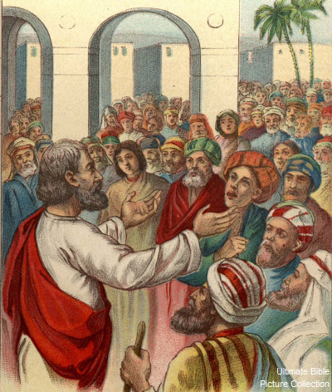
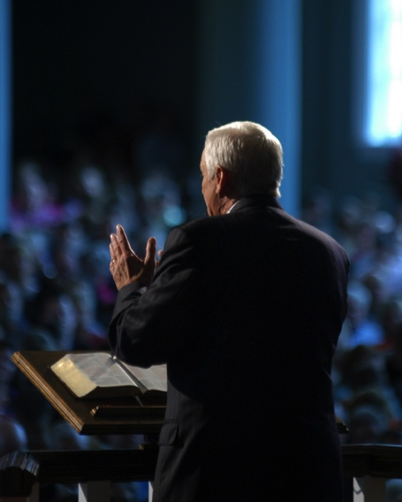
First Gospel Sermon & Today
Acts 2:22-41

Slide 2
Acts 2:22-41
²² “Men of Israel, hear these words: Jesus of Nazareth, a Man attested by God to you by miracles, wonders, and signs which God did through Him in your midst, as you yourselves also know — ²³ Him, being delivered by the determined purpose and foreknowledge of God, you have taken by lawless hands, have crucified, and put to death; ²⁴ whom God raised up, having loosed the pains of death, because it was not possible that He should be held by it. ²⁵ For David says concerning Him: ‘I foresaw the Lord always before my face, for He is at my right hand, that I may not be shaken. ²⁶ Therefore my heart rejoiced, and my tongue was glad; moreover my flesh also will rest in hope. ²⁷ For You will not leave my soul in Hades, nor will You allow Your Holy One to see corruption. ²⁸ You have made known to me the ways of life; You will make me full of joy in Your presence.’ ²⁹ Men and brethren, let me speak freely to you of the patriarch David, that he is both dead and buried, and his tomb is with us to this day. ³⁰ Therefore, being a prophet, and knowing that God had sworn with an oath to him that of the fruit of his body, according to the flesh, He would raise up the Christ to sit on his throne, ³¹ he, foreseeing this, spoke concerning the resurrection of the Christ, that His soul was not left in Hades, nor did His flesh see corruption. ³² This Jesus God has raised up,

Slide 3
of which we are all witnesses. ³³ Therefore being exalted to the right hand of God, and having received from the Father the promise of the Holy Spirit, He poured out this which you now see and hear. ³⁴ For David did not ascend into the heavens, but he says himself: ‘The Lord said to my Lord, “Sit at My right hand, ³⁵ till I make Your enemies Your footstool.” ’ ³⁶ Therefore let all the house of Israel know assuredly that God has made this Jesus, whom you crucified, both Lord and Christ.”
³⁷ Now when they heard this, they were cut to the heart, and said to Peter and the rest of the apostles, “Men and brethren, what shall we do?” ³⁸ Then Peter said to them, “Repent, and let every one of you be baptized in the name of Jesus Christ for the remission of sins; and you shall receive the gift of the Holy Spirit. ³⁹ For the promise is to you and to your children, and to all who are afar off, as many as the Lord our God will call.” ⁴⁰ And with many other words he testified and exhorted them, saying, “Be saved from this perverse generation.” ⁴¹ Then those who gladly received his word were baptized; and that day about three thousand souls were added to them.

Slide 4
1st Gospel Sermon Is Needed Today
The same basic message of Peter is relevant today
Jesus of Nazareth was approved by God
Approved by miracles (Jn. 20:30-31; 2:11; 3:1-2; 10:37-38; Matt. 11:2-6; Mark 16:15-20)
Died according to God’s plan (Luke 22:22; Eph. 1:7-11)
Resurrected from dead (Rom. 1:1-4; 1 Cor. 15:12-23)
Exalted as Lord & Christ (Phil. 2:5-11)
Man has sinned and stands condemned by God
Rom. 3:23 All have sinned & are condemned (Rom. 6:23)
God offers salvation only through Jesus Christ
Acts 4:10-12 Salvation only in Christ (1 Thess. 5:9-10)

