Slide 1
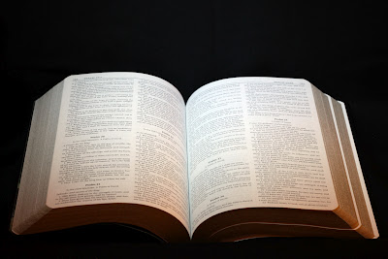
Godliness without God?
…having a form of godliness,
but denying the power thereof…
2nd Timothy 3:1-5

Slide 2
2nd Timothy 3:1-5
¹ But know this, that in the last days perilous times will come: ² For men will be lovers of themselves, lovers of money, boasters, proud, blasphemers, disobedient to parents, unthankful, unholy, ³ unloving, unforgiving, slanderers, without self-control, brutal, despisers of good, ⁴ traitors, headstrong, haughty, lovers of pleasure rather than lovers of God, ⁵ having a form of godliness but denying its power. And from such people turn away!

Slide 3
Modern Religion: Godliness without God
Much of religious world has left God out the picture
Look at words of interest in context (2 Tim. 3:1-5)
“Godliness” – eusebeia – reverence, Godward piety, loyalty towards God, fear of God
“Form” – morphosis – an appearance, semblance
“Power” – dunamis – force, ability, strength, might
Not the first time this has happened – Idolatry
Rom. 1:18-25 Made “gods” that were like man in desires
Isa. 44:9-10, 14-20 Folly of idols made by men’s hands
Jer. 19:5; 32:34-35 God: “Nor did it come into My mind”
How can one have a form of godliness without God?

Slide 4
Form of Godliness without the Power
Attraction without Authority
Some draw people to religion with what is attractive to man
Matt. 7:21-23 Jesus condemns actions of “lawlessness”
Mark 7:1-9 Teaching as doctrine the precepts of man
Col. 2:20-23 “...have a show of wisdom in will-worship” ASV
Sentiment without Scripture
Some draw people to religion by human sentiment & emotion
1 Kgs. 18:25-28 This was the appeal by worshippers of Baal
Acts 19:23-32 This was basis of plea for worship of Diana
Pleasure without the Power
Some draw people to faith that justifies their own pleasures
2 Pet. 2:14, 18-19 Having eyes full of adultery…
Jude 16-21 “Christians” who justify path of previous lusts

