Slide 1
Why All Men Everywhere Must Repent
Acts 17:24-31

Slide 2
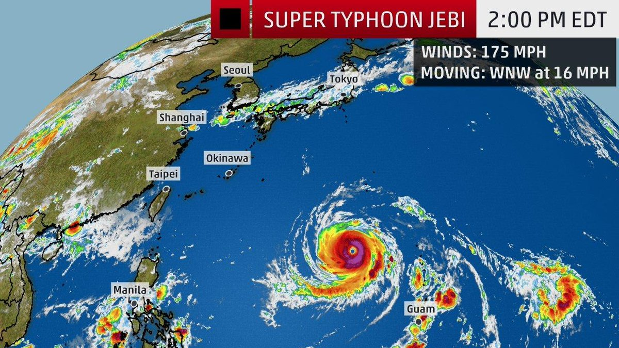
Preview of Philippine Trip - Prayers

Slide 3
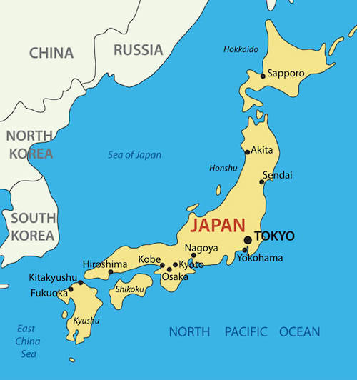
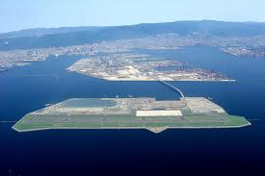
Due to Fly through Japan
Tokyo Narita Airport

Slide 4
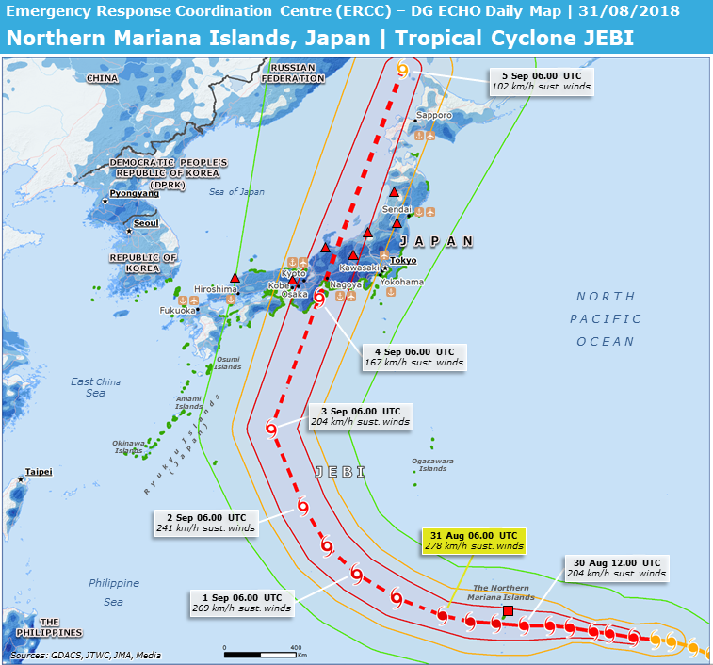

Slide 5
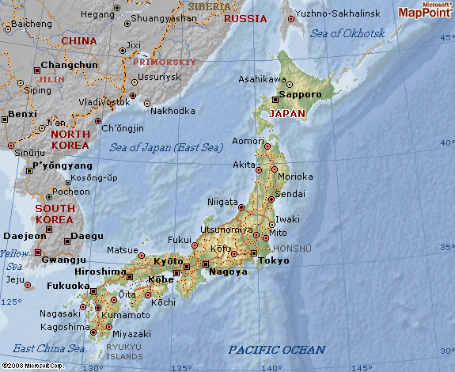
May fly through South Korea

Slide 6
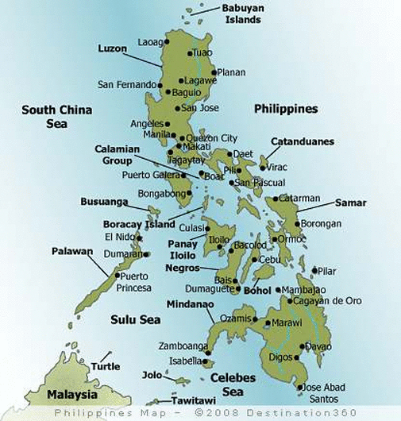
Luzon
Visayas
Mindanao
General
Santos City

Slide 7
Original Areas of Work
All over the country
General
Santos City

Slide 8
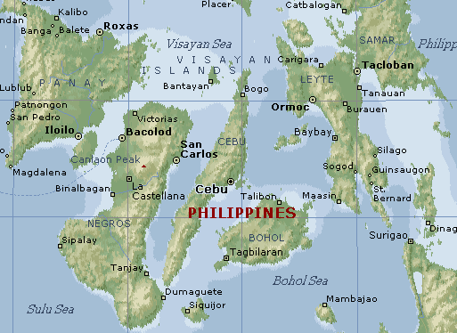
Visayas

Slide 9
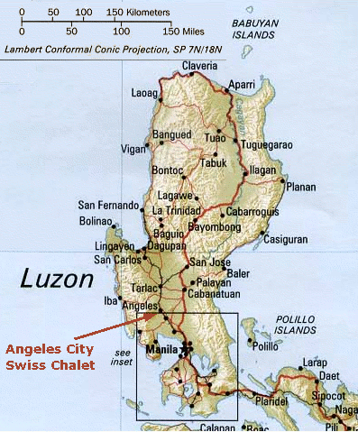
Luzon
Tuguegarao
Many new churches started in this area
Manila
Angles City

Slide 10
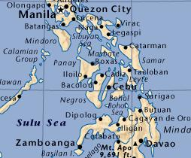
Travel in Philippine This Trip

Slide 11
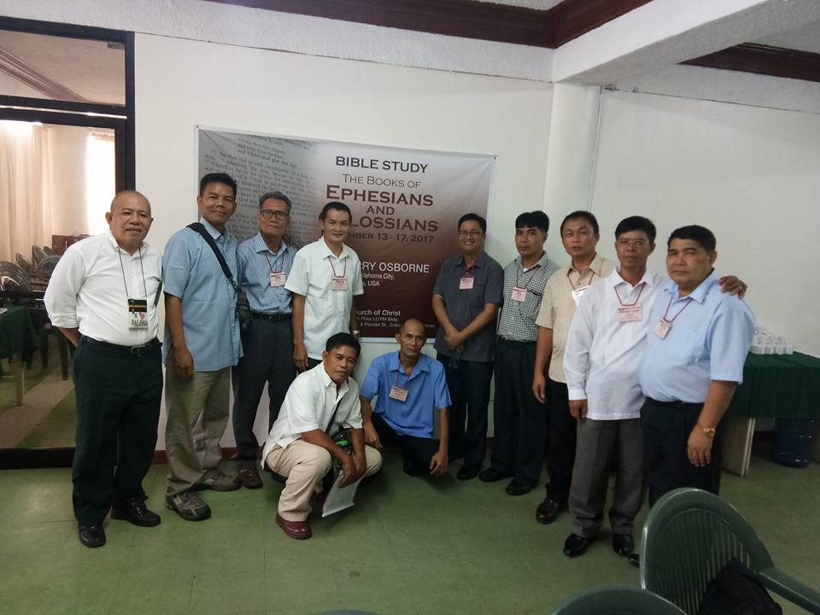
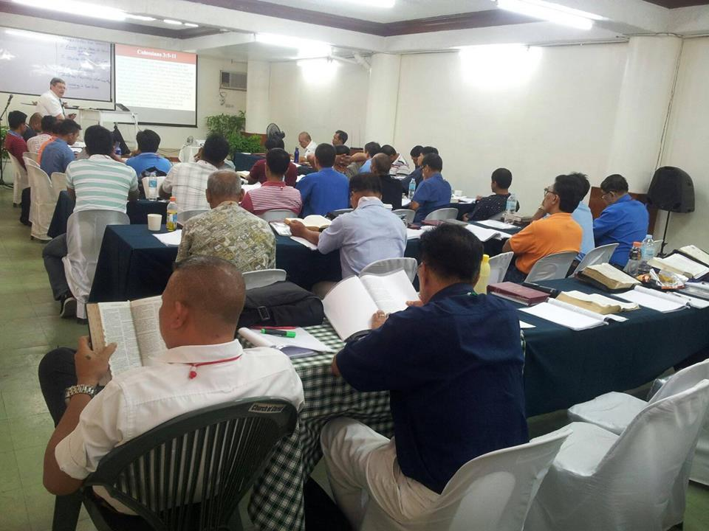
Classes in Cebu (9/10-14)
Studying the Book of Matthew

Slide 12
Travel in Philippine This Trip
Preach for Baptist Church (9/16)

Slide 13
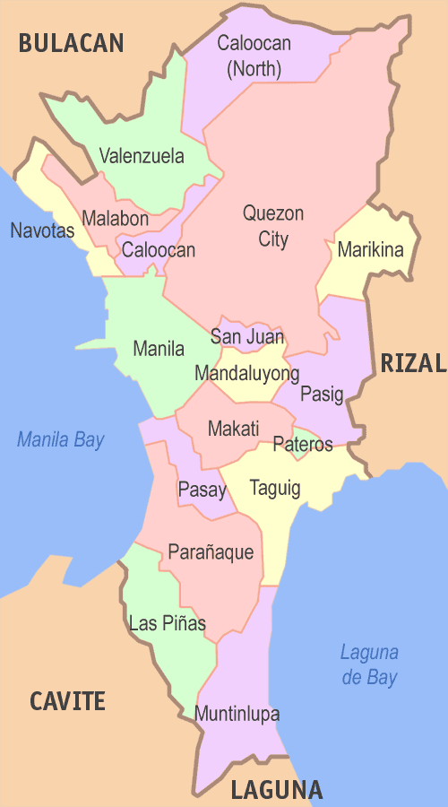
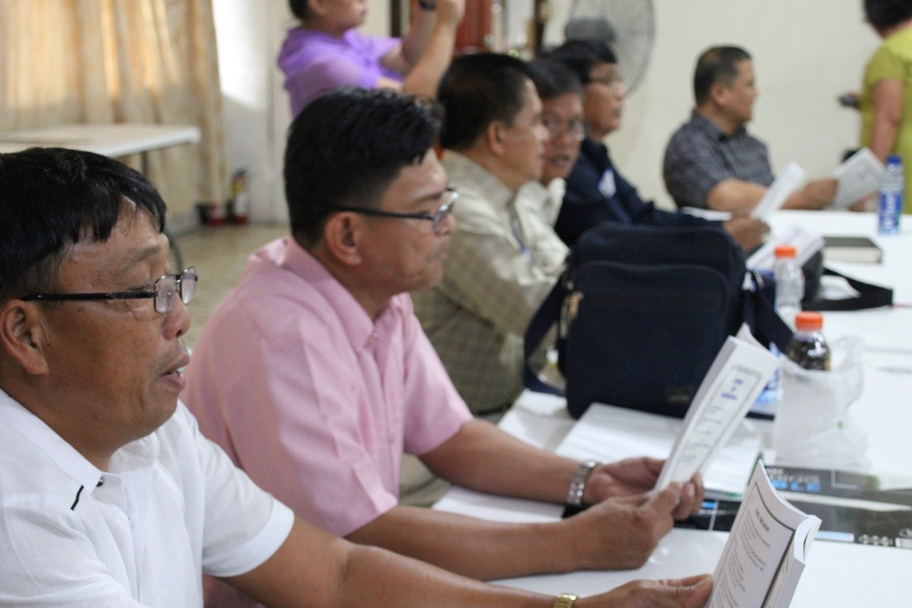
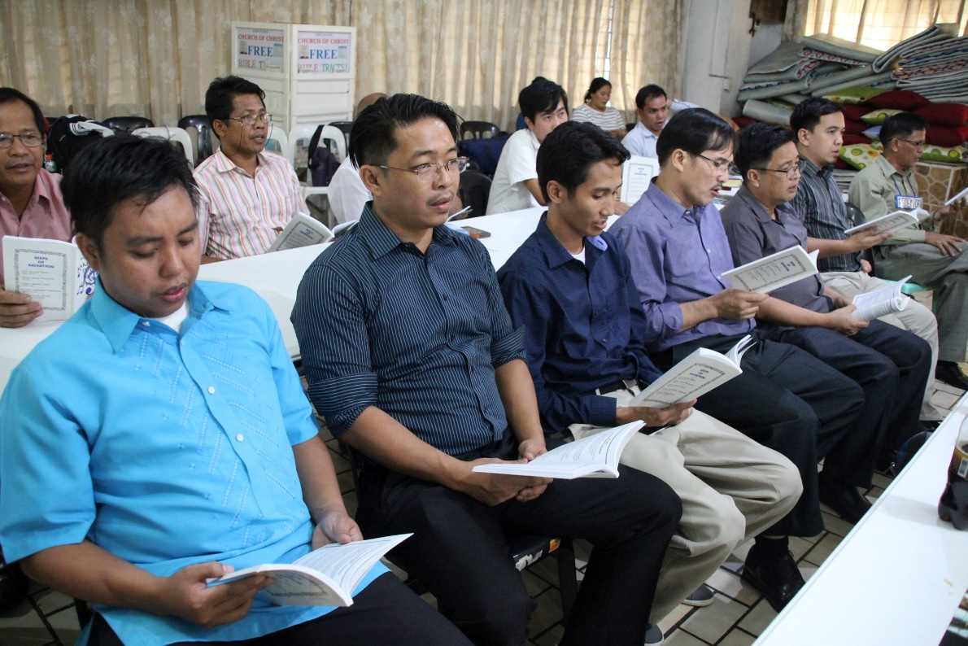
Classes in Pasay
“Leaning to Use the Bible”

Slide 14
Please Pray for This Effort!

Slide 15
Acts 17:24-29
²⁴ God, who made the world and everything in it, since He is Lord of heaven and earth, does not dwell in temples made with hands. ²⁵ Nor is He worshiped with men’s hands, as though He needed anything, since He gives to all life, breath, and all things. ²⁶ And He has made from one blood every nation of men to dwell on all the face of the earth, and has determined their preappointed times and the boundaries of their dwellings, ²⁷ so that they should seek the Lord, in the hope that they might grope for Him and find Him, though He is not far from each one of us; ²⁸ for in Him we live and move and have our being, as also some of your own poets have said, ‘For we are also His offspring.’ ²⁹ Therefore, since we are the offspring of God, we ought not to think that the Divine Nature is like gold or silver or stone, something shaped by art and man’s devising.

Slide 16
Acts 17:30-31
³⁰ Truly, these times of ignorance God overlooked, but now commands all men everywhere to repent, ³¹ because He has appointed a day on which He will judge the world in righteousness by the Man whom He has ordained. He has given assurance of this to all by raising Him from the dead.”

Slide 17
Why All Men Everywhere Must Repent
Day of Judgment is appointed
Heb. 9:27 Both death & Judgment are certain
1 Thess. 5:2-3 Will come as a thief in the night
2 Pet. 3:3-4, 10 Scoffers deny it, but it is a reality
Day of Judgment is universal
Matt. 25:32 Christ will gather all nations to separate
2 Cor. 5:10 All to appear before Christ’s judgment seat
Rev. 20:12 Both small & great must give answer
Standard of that Judgment is God’s righteousness
Rom. 2:16 Gospel is the standard for the Judgment
2 Pet. 3:11-13 Should bring sobriety in manner of life
Rev. 20:11-15 Will be eternal consequences for all

Slide 18
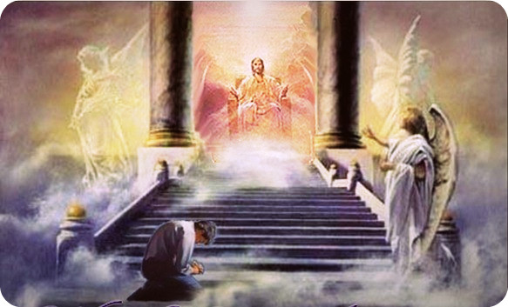
Are You Ready for the Judgment Day?

